Slide 1
Network Chat Application
Final Project Presentation
Computer Networks – June 2025

Slide 2
Objective & Scope
Develop a multi-user chat system over UDP/TCP.
Design a custom message protocol with reliability features.
Ensure secure communication using AES encryption.

Slide 3
System Architecture
Client-Server model using UDP sockets.
Server handles message routing and client discovery.
Clients send/receive messages, perform encryption/decryption.

Slide 4
Protocol Design
Message Format: HEADER | USERNAME | TIMESTAMP | CONTENT.
ACKs and retransmission mechanisms for reliability over UDP.
Timestamps used to measure message delay.

Slide 5
Implementation Details
udp_json_server.py & udp_json_client.py handle communication.
aes_utils.py manages AES encryption.
Clients identified and tracked on server side.
Log file stores chat history with timestamps.

Slide 6
Network Topology Discovery
Server maintains a list of active clients.
Each client is associated with its address and username.
Clients can view who is online.

Slide 7
Security & Encryption
AES-based symmetric encryption implemented.
Encrypts message content before sending.
Key agreed upon between sender and receiver.

Slide 8
Testing & Results
Functional tests: message sending, ACK, encryption.
Performance tests: latency and delivery success.
All features validated through screenshots and logs.

Slide 9
Performance Analysis
Low average latency in most test cases.
Near 100% success rate in message delivery.
Results confirm protocol efficiency.

Slide 10
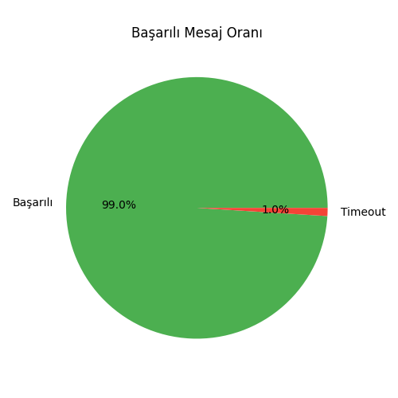

Slide 11
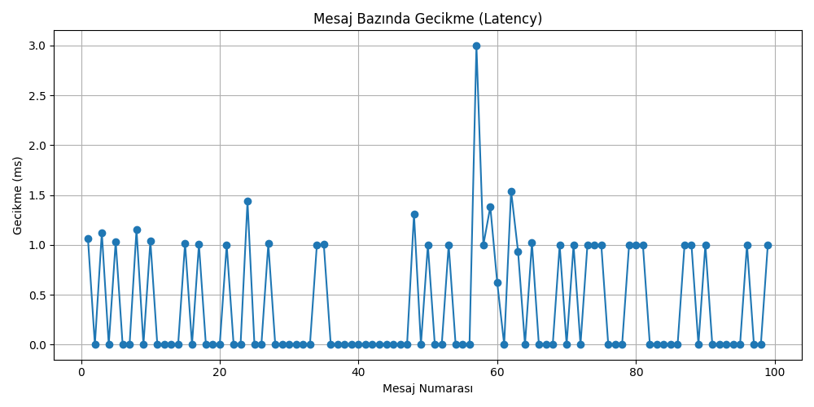

Slide 12
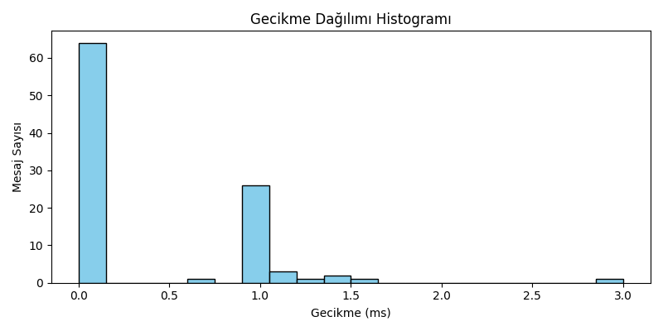

Slide 13
Conclusion
Real-time chat system built successfully.
Custom protocol, encryption, and reliability mechanisms included.
Tested and confirmed to meet project objectives.

