Slide 1
Courseware
CoursewareBros
Fürbahs, Lichtenegger, Phuong

Slide 2
Goal
Management System for Software Engineering Basics Course
Managing Data
Students
Lecturers
Grades
Assignments
Database sqlite
Report based on CSS
Error Validation

Slide 3
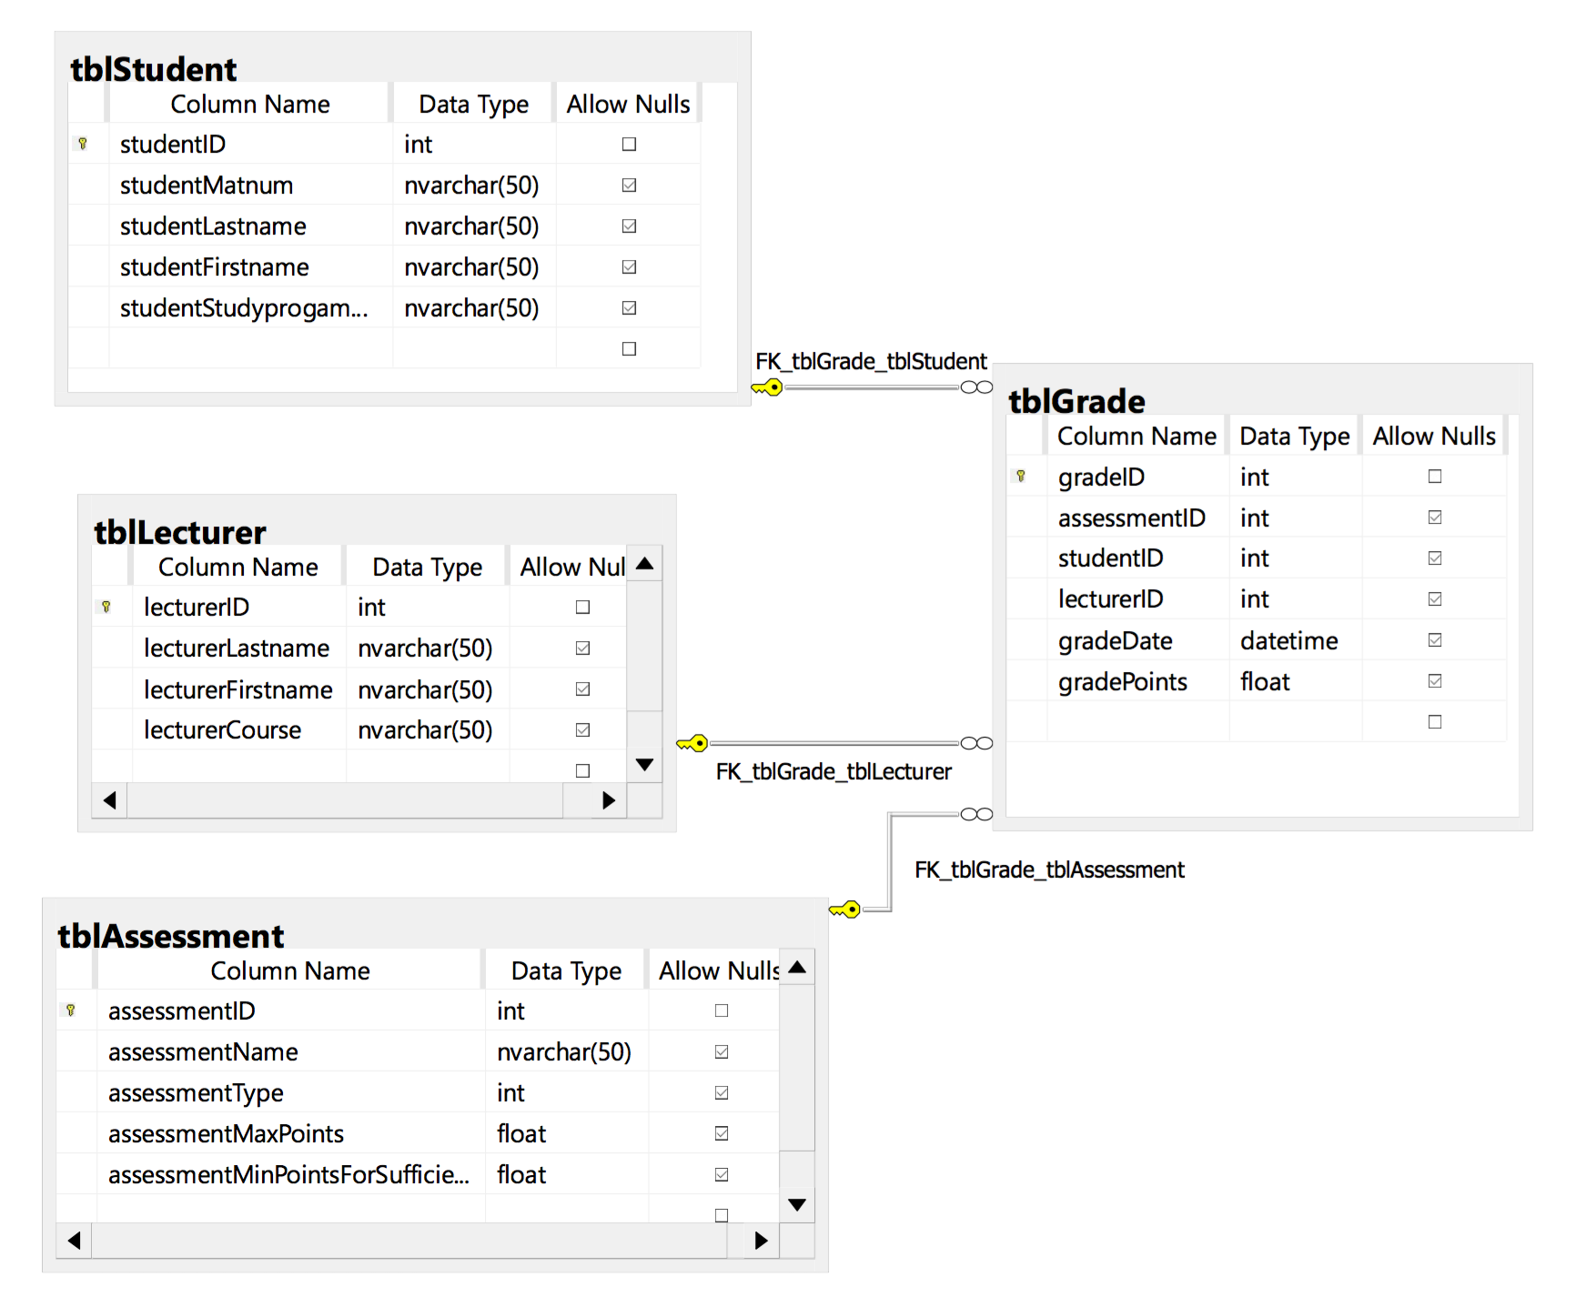
Data Model

Slide 4
Time and Price
around 60 hours for our group
500€ for our Courseware App

