Slide 1
DEBUGGING IN THE REAL WORLD
11.14.2018
Ryan Furness
Lead Software Engineer | Digital Innovation

Slide 2
DEBUGGING IN THE REAL WORLD
People [also] underestimate the time they spend debugging. They underestimate how much time they can spend chasing a long bug. With testing, I know straight away when I added a bug. That lets me fix the bug immediately, before it can crawl off and hide. There are few things more frustrating or time wasting than debugging. Wouldn't it be a hell of a lot quicker if we just didn't create the bugs in the first place?
- Martin Fowler

Slide 3
Agenda
Whoami?
What Can YOU expect?
How to start?
Where to get help?
When you are ready?
Why, why, why?

Slide 4

WHOAMI
Ryan Furness
https://github.com/furenberger
Todays code + Links:
https://github.com/furenberger/debug-in-the-real-world

Slide 5
What can YOU expect
A few days to get set up
It will not work the first time, you will get frustrated
Find people in your team who know X,Y and Z

Slide 6
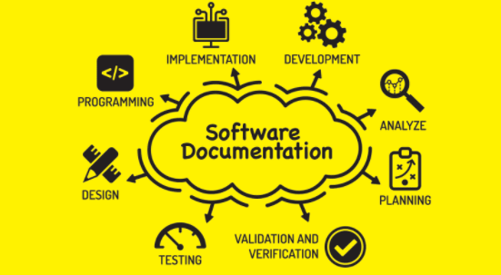
HOW TO START

Slide 7
Where to get help
Google, become a google expert.
Your X, Y, Z team (try it yourself first, 3 times)
Training:
Pluralsight, Udemy, egghead, Lydna, Hackerrank, TopCoder, CoderByte, Codewars, LeetCode, Stackoverflow, reddit…

Slide 8
WHEN ARE YOU READY
“Show that you are growing and plan to continue to do so.”

Slide 9
WHEN ARE YOU READY Continued…
Not sure if your skills are job ready? If you need to build your confidence level, get certified, join a local hackathon or jump on an open source project to keep honing your craft. Put those skills to use solving actual problems.
https://www.youtube.com/watch?v=e6g5aT2w09w
You’ll not only continue to build on them, but you’ll gain more portfolio pieces and ways to show off what you’re capable of doing.

Slide 10
WHY, WHY, WHY?
<code>lets jump into some code</code>

