Slide 1

MANTOOR INFRA
@VELIMELA
EAST & WEST VILLAS

Slide 2
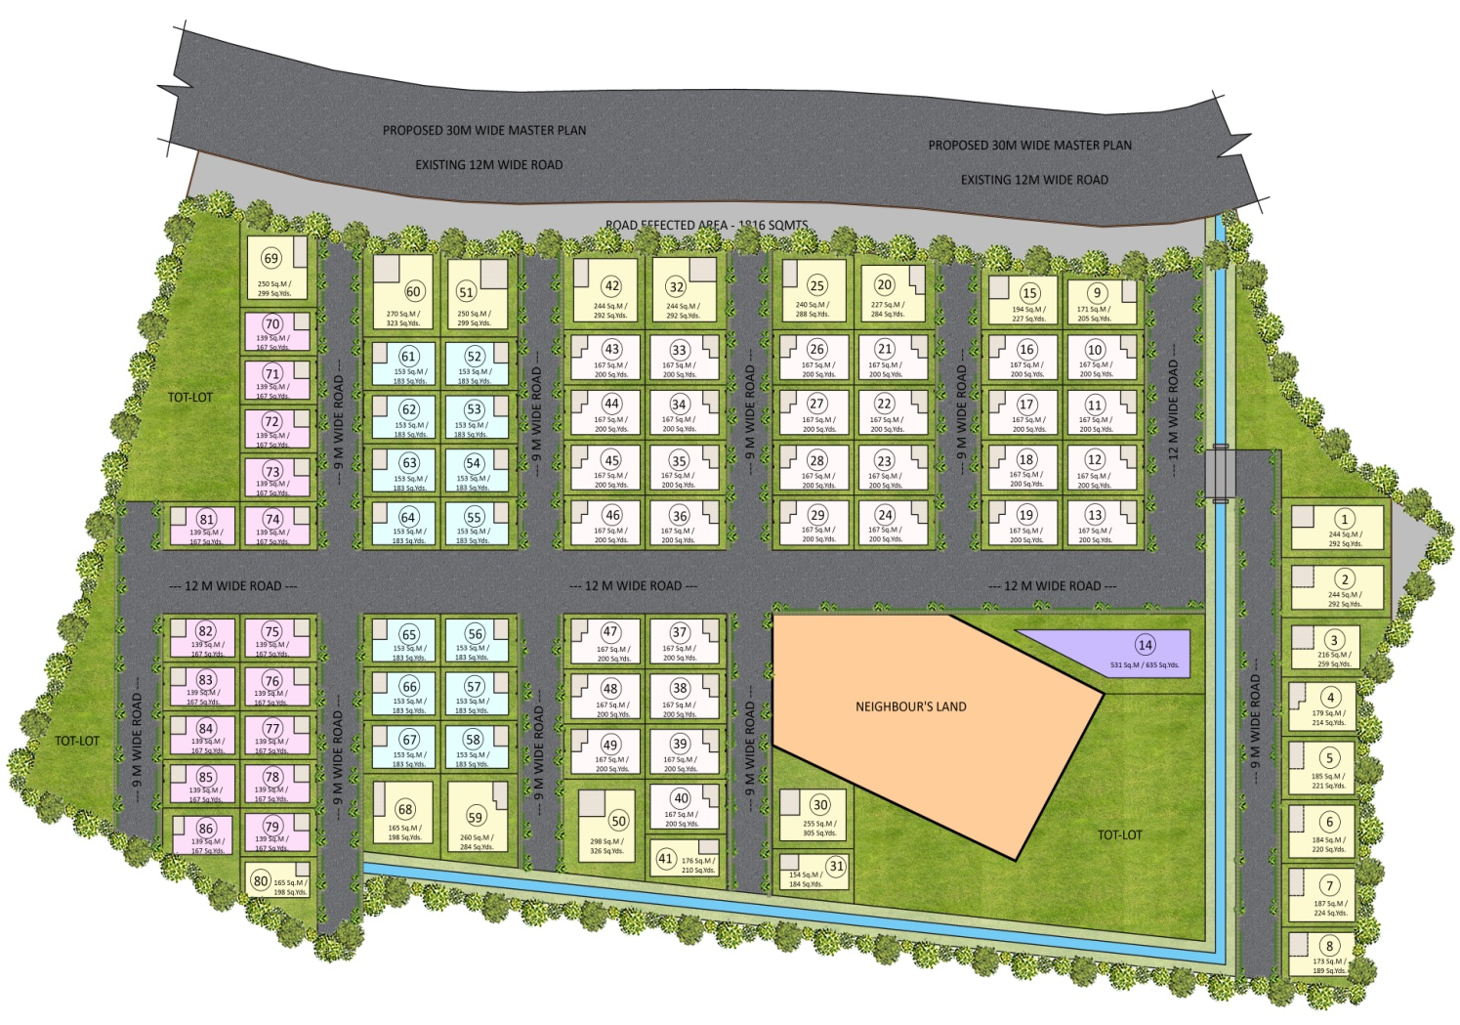

MASTER PLAN

Slide 3
EAST REGULAR VILLAS FLOOR PLANS

Slide 4
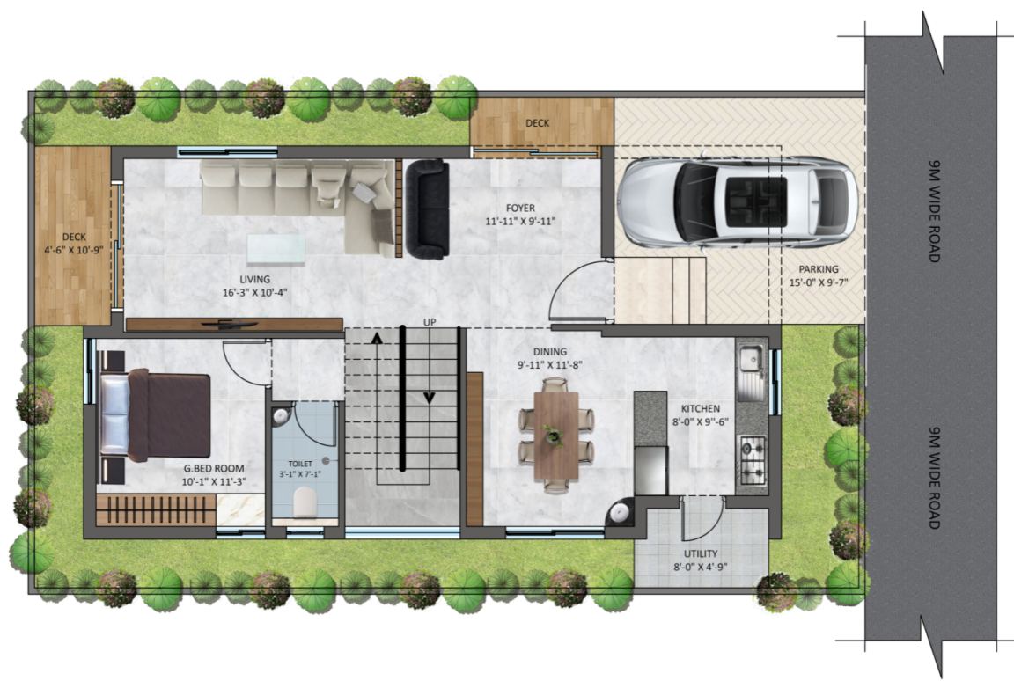
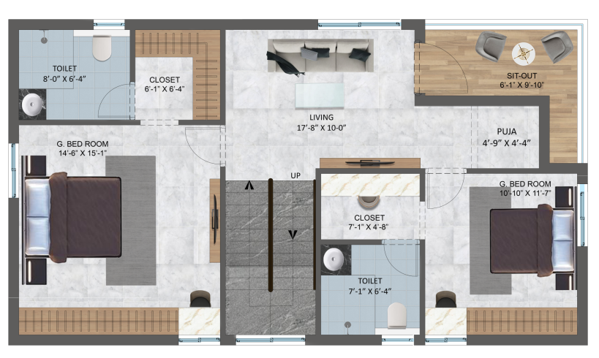
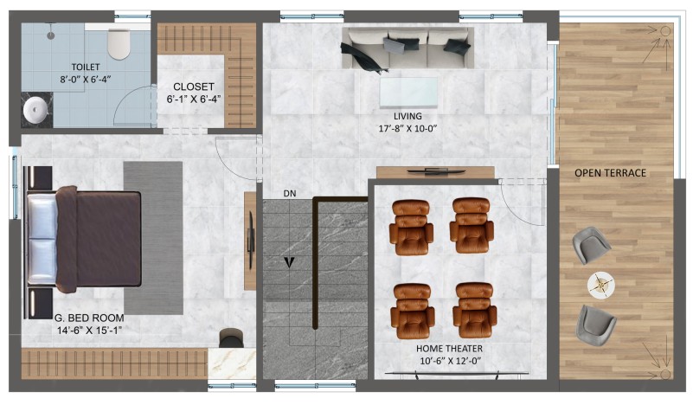
EAST REGULAR VILLA - 167 Sqyds
GROUND FLOOR PLAN
AREA STATEMENT 167 SQ.YDS (EAST VILLA)
GROUND FLOOR | 1030 SQ.FT
FIRST FLOOR | 1030 SQ.FT
SECOND FLOOR | 845 SQ.FT
TOTAL AREA | 2905 SQ.FT
FIRST FLOOR PLAN
SECOND FLOOR PLAN

Slide 5
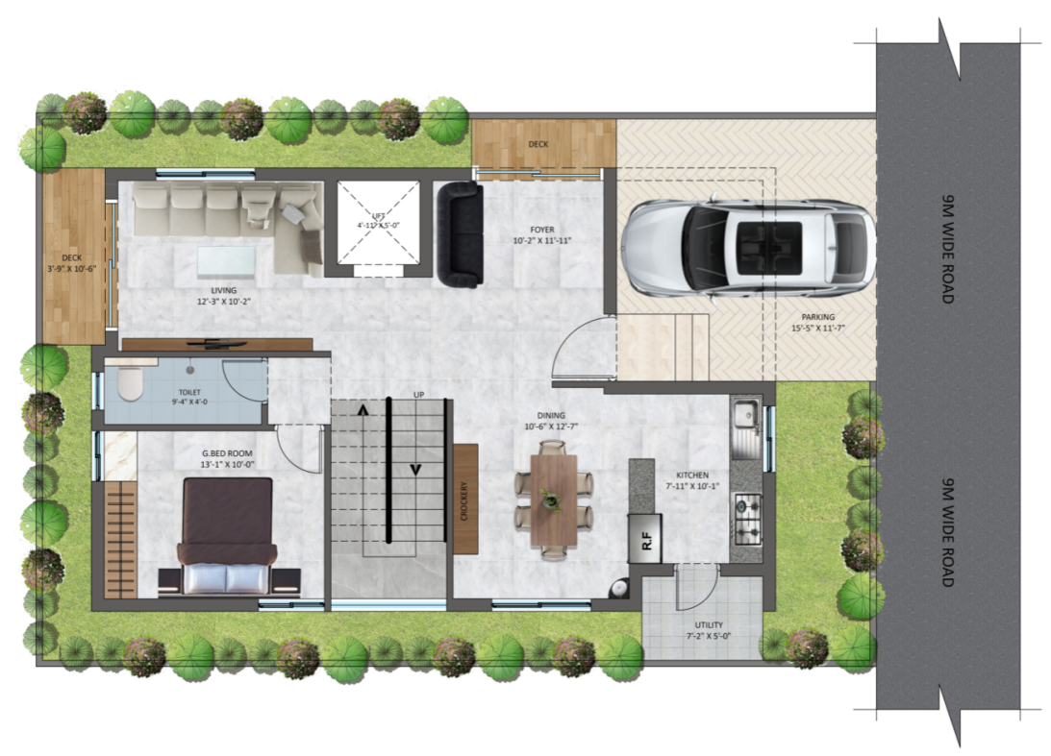
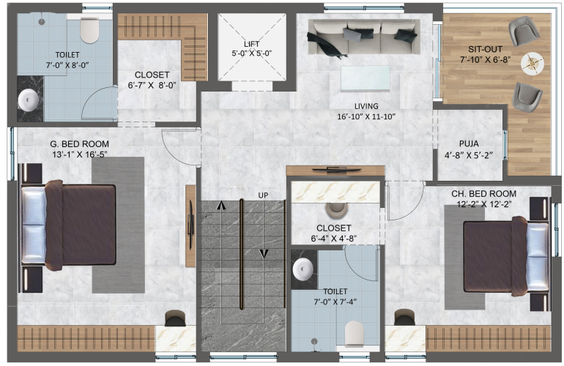
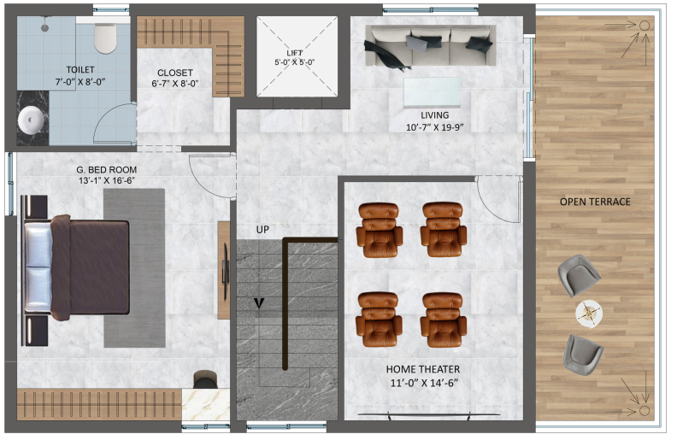
EAST REGULAR VILLA - 183 Sqyds
GROUND FLOOR PLAN
AREA STATEMENT 183 SQ.YDS (EAST VILLA)
GROUND FLOOR | 1130 SQ.FT
FIRST FLOOR | 1130 SQ.FT
SECOND FLOOR | 915 SQ.FT
TOTAL AREA | 3175 SQ.FT
FIRST FLOOR PLAN
SECOND FLOOR PLAN

Slide 6
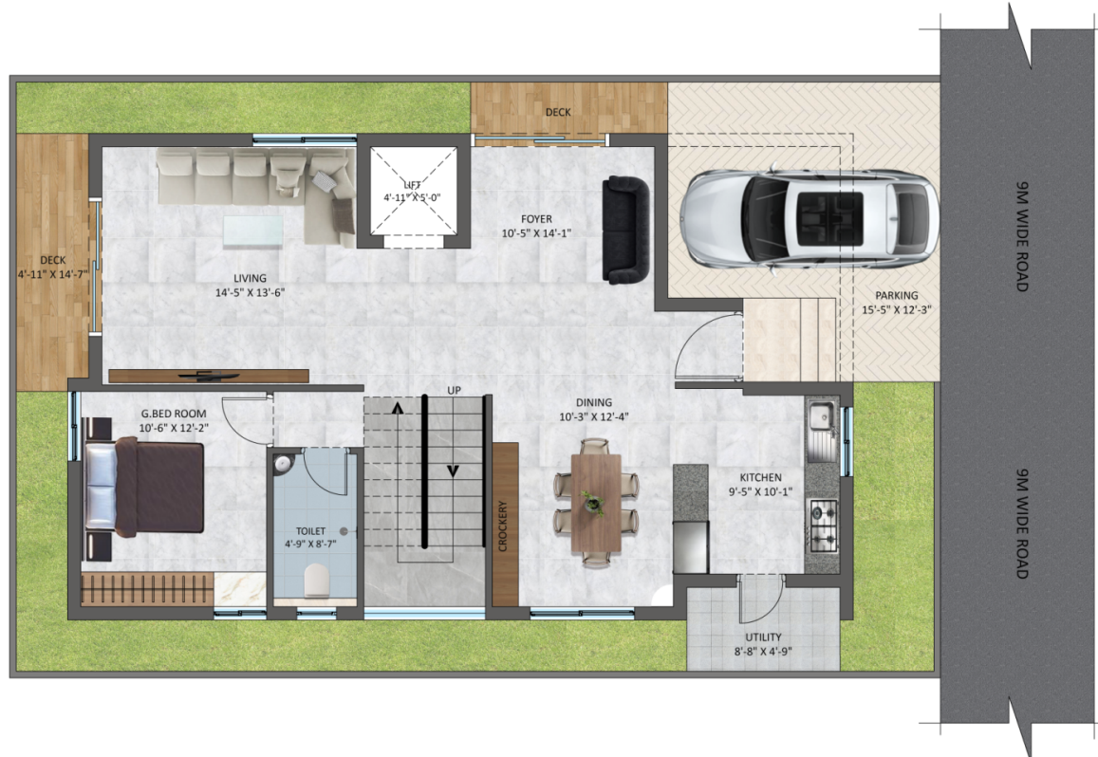
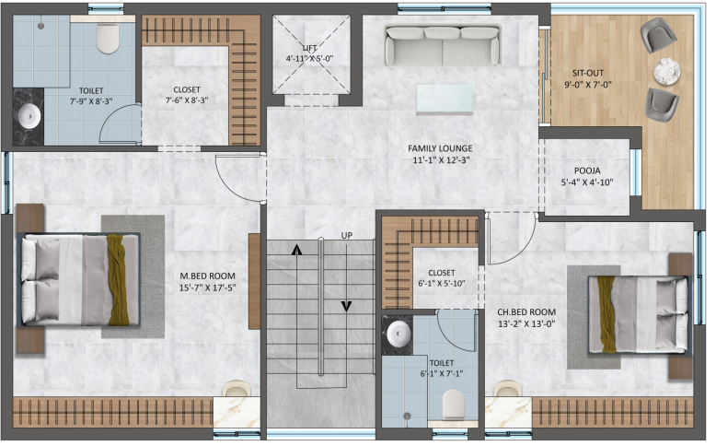
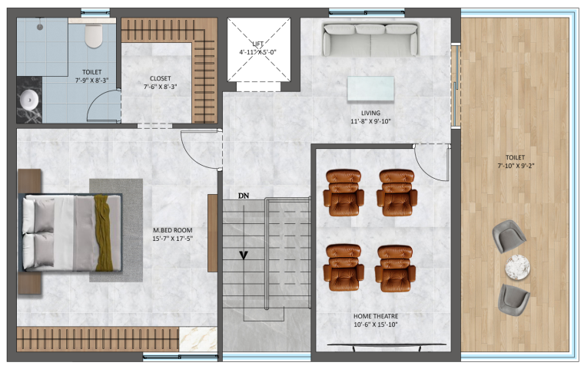
EAST REGULAR VILLA - 200 Sqyds
GROUND FLOOR PLAN
AREA STATEMENT 200 SQ.YDS (EAST VILLA)
GROUND FLOOR | 1280 SQ.FT
FIRST FLOOR | 1280 SQ.FT
SECOND FLOOR | 1030 SQ.FT
TOTAL AREA | 3590 SQ.FT
FIRST FLOOR PLAN
SECOND FLOOR PLAN

Slide 7
WEST REGULAR VILLAS FLOOR PLANS

Slide 8
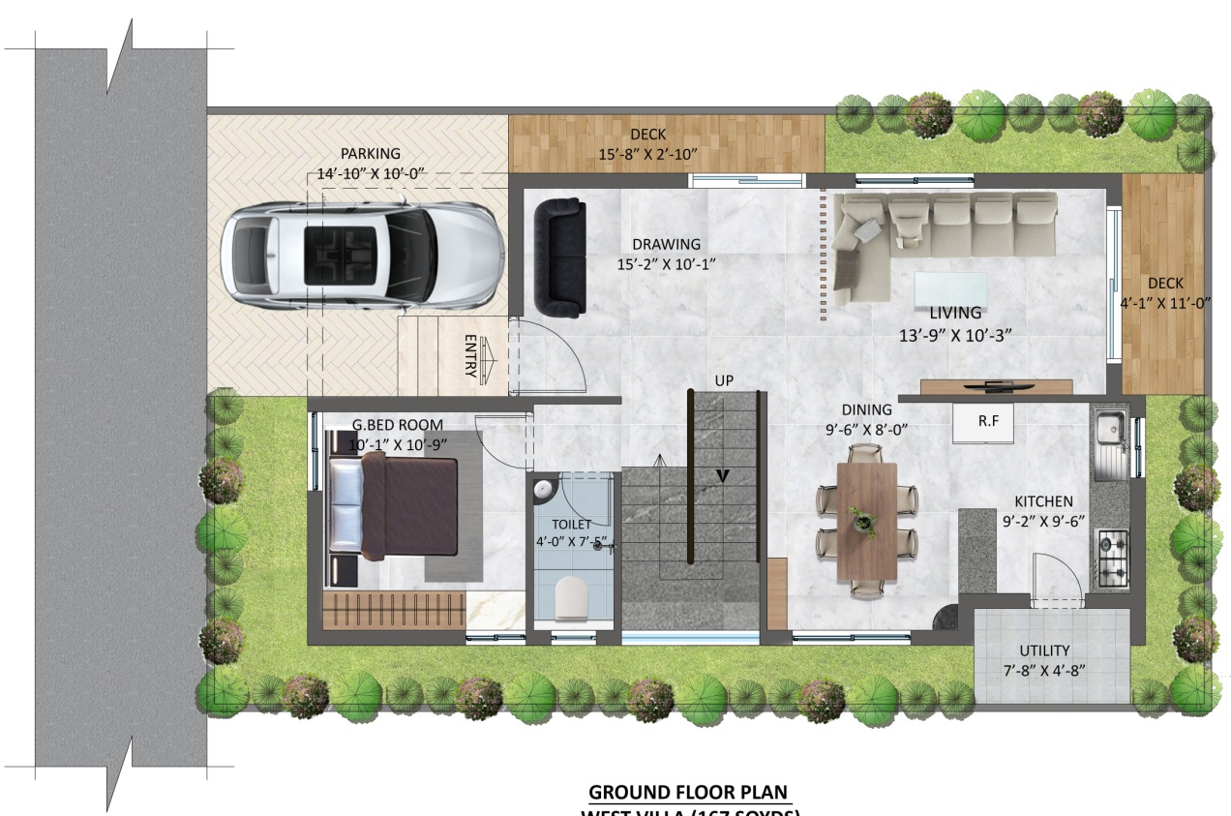
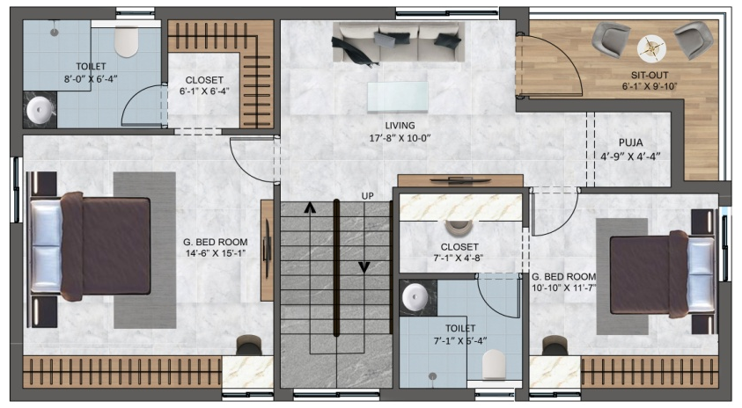
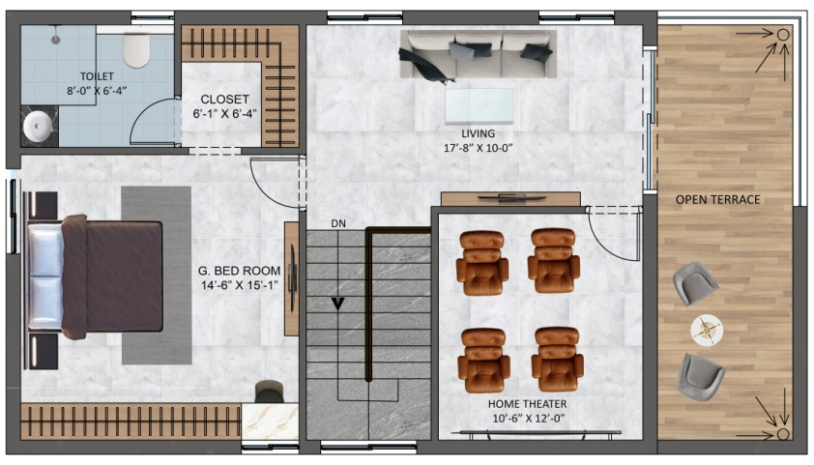
WEST REGULAR VILLA - 167 Sqyds
GROUND FLOOR PLAN
AREA STATEMENT 167 SQ.YDS (WEST VILLA)
GROUND FLOOR | 1030 SQ.FT
FIRST FLOOR | 1030 SQ.FT
SECOND FLOOR | 845 SQ.FT
TOTAL AREA | 2905 SQ.FT
FIRST FLOOR PLAN
SECOND FLOOR PLAN

Slide 9
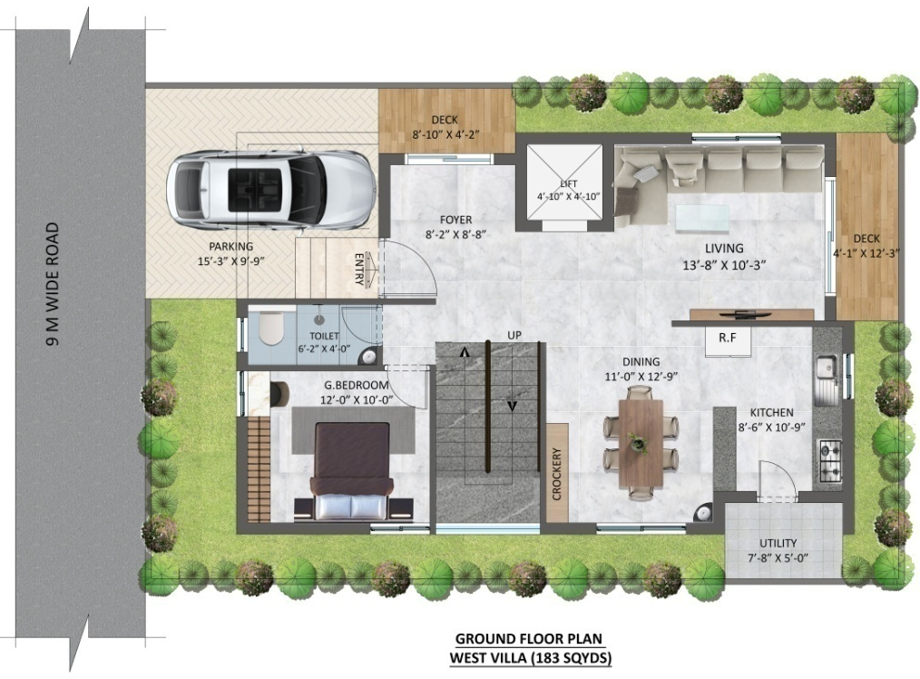
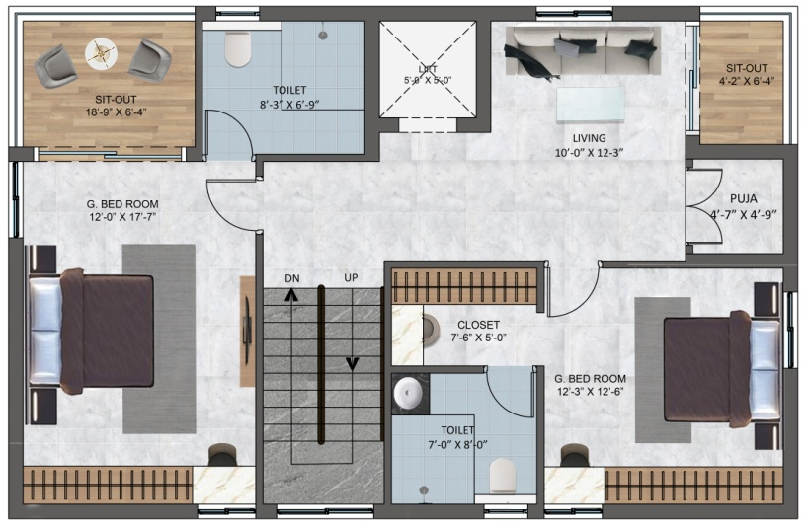
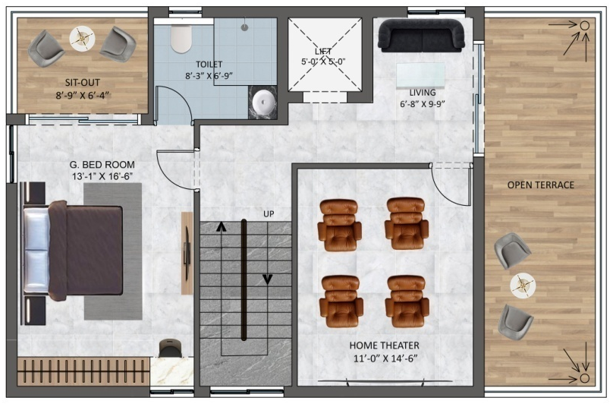
WEST REGULAR VILLA - 183 Sqyds
GROUND FLOOR PLAN
AREA STATEMENT 183 SQ.YDS (WEST VILLA)
GROUND FLOOR | 1130 SQ.FT
FIRST FLOOR | 1130 SQ.FT
SECOND FLOOR | 910 SQ.FT
TOTAL AREA | 3170 SQ.FT
FIRST FLOOR PLAN
SECOND FLOOR PLAN

Slide 10
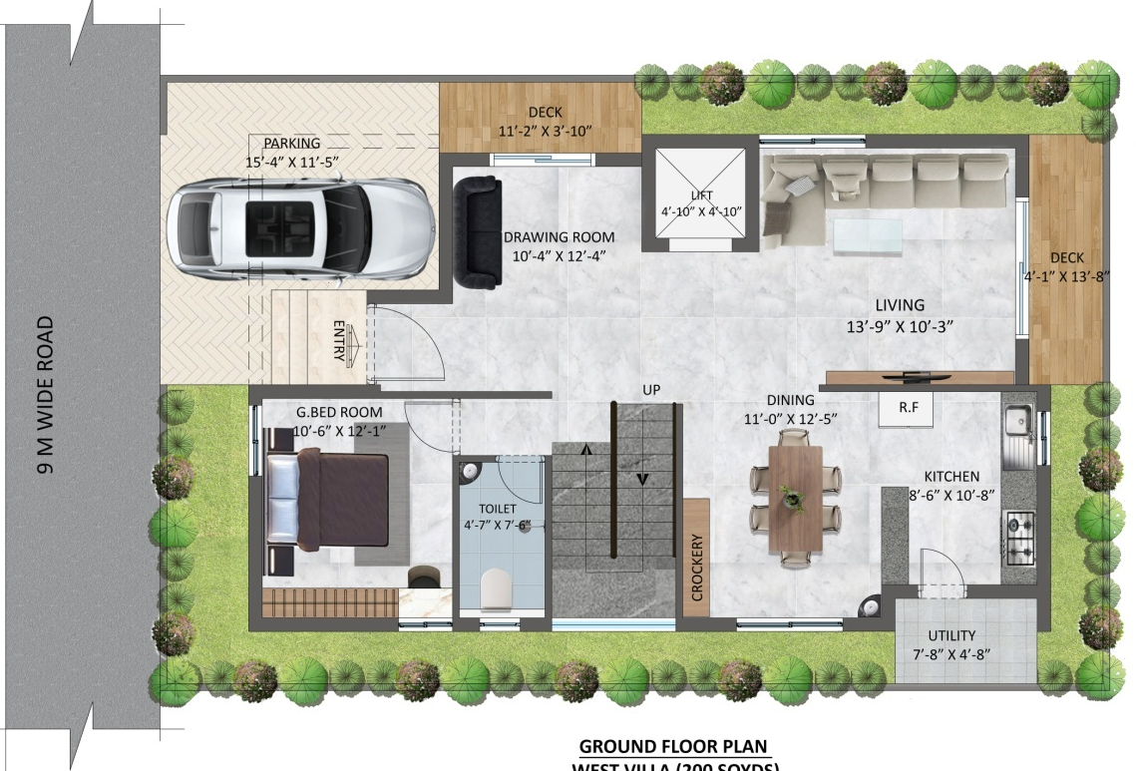
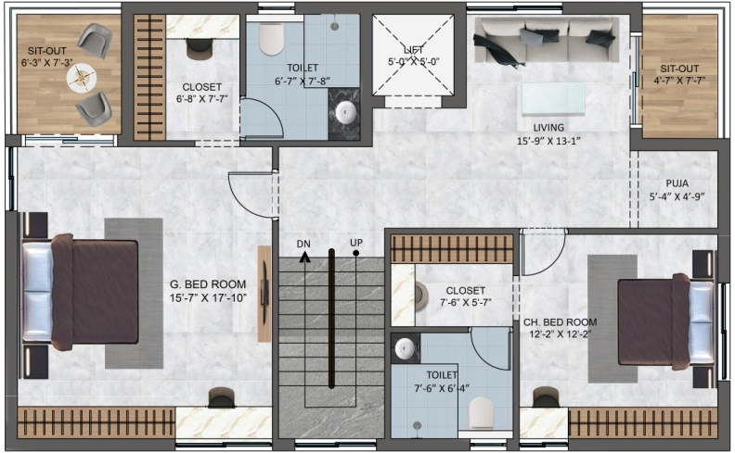
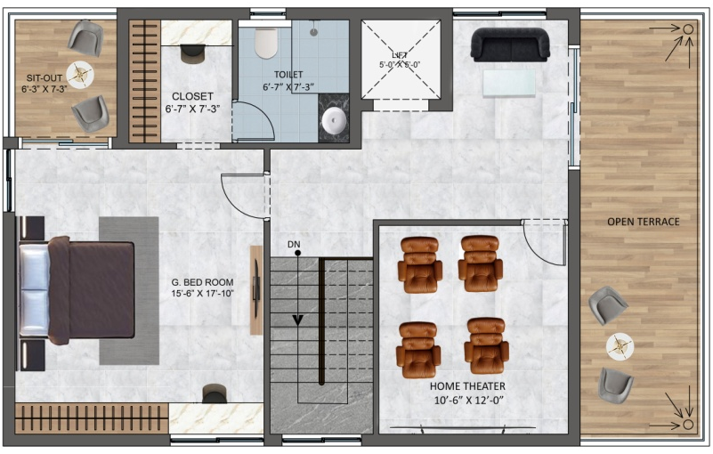
WEST REGULAR VILLA - 200 Sqyds
GROUND FLOOR PLAN
AREA STATEMENT 200 SQ.YDS (WEST VILLA)
GROUND FLOOR | 1280 SQ.FT
FIRST FLOOR | 1280 SQ.FT
SECOND FLOOR | 1060 SQ.FT
TOTAL AREA | 3620 SQ.FT
FIRST FLOOR PLAN
SECOND FLOOR PLAN

Slide 11
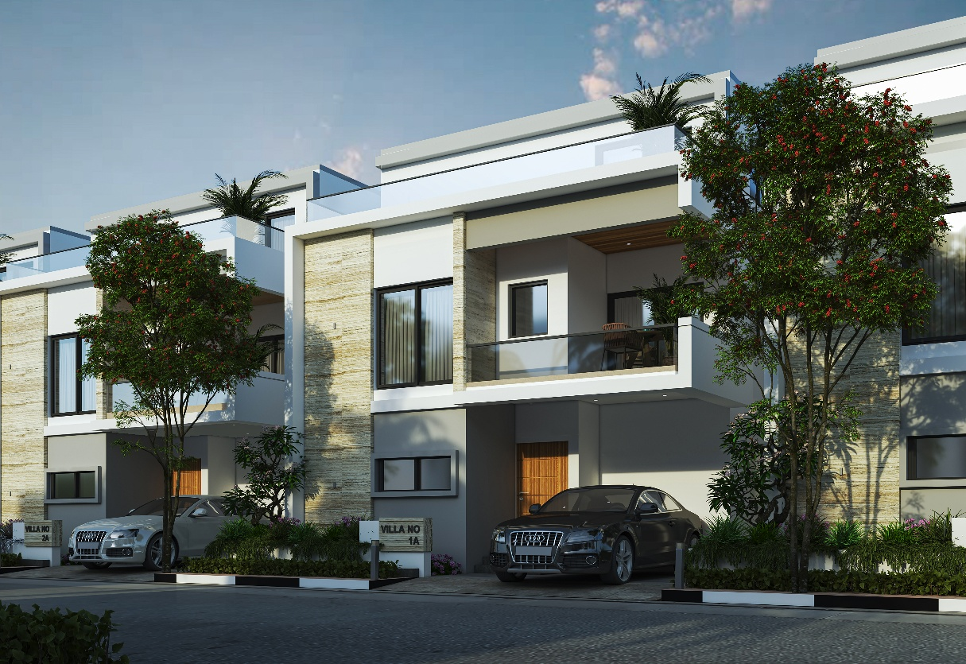
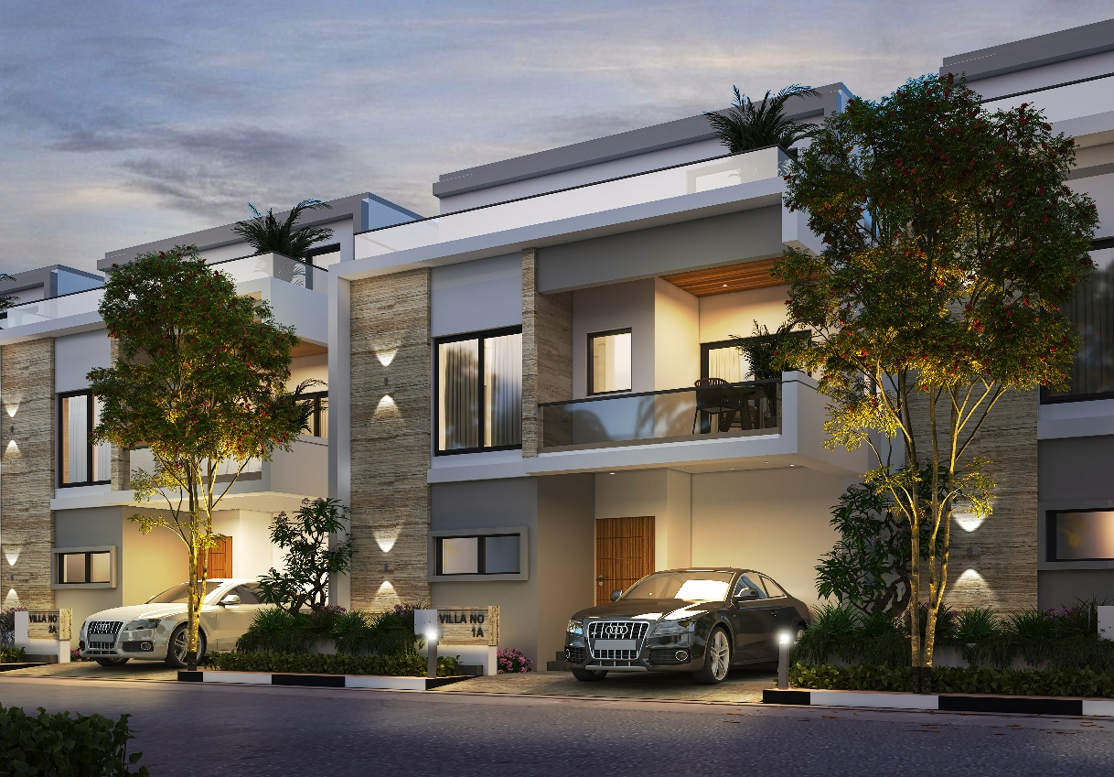
EAST VILLA ELEVATION RENDERS
DAY RENDER
EVENING RENDER

Slide 12
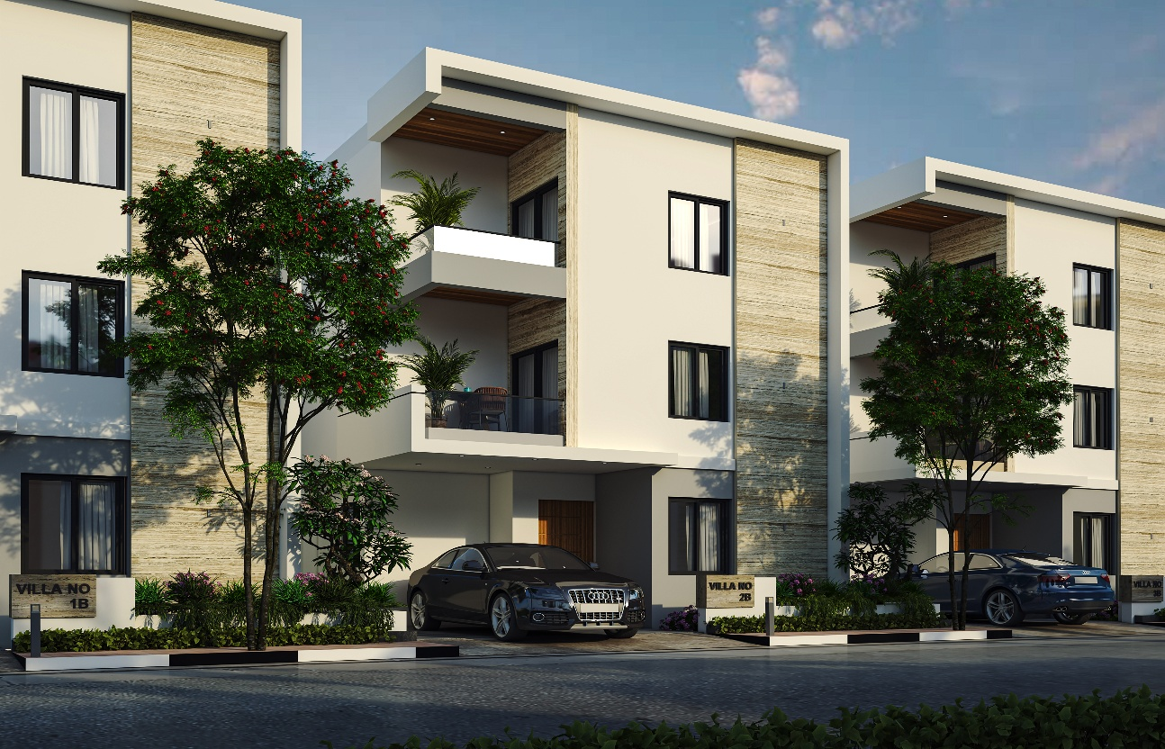
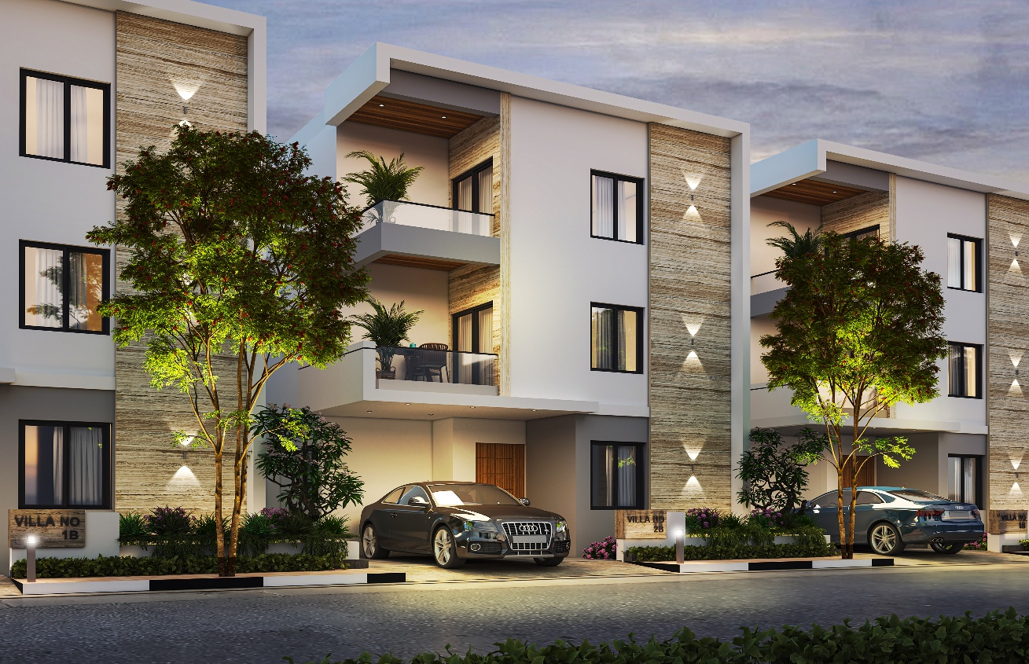
WEST VILLA ELEVATION RENDERS
DAY RENDER
EVENING RENDER

Slide 13
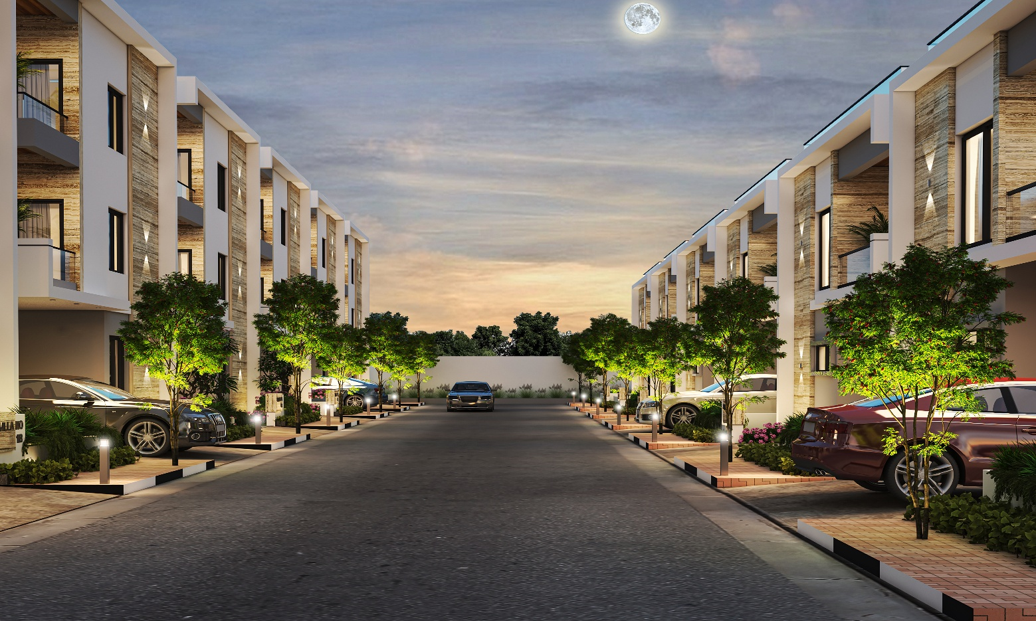
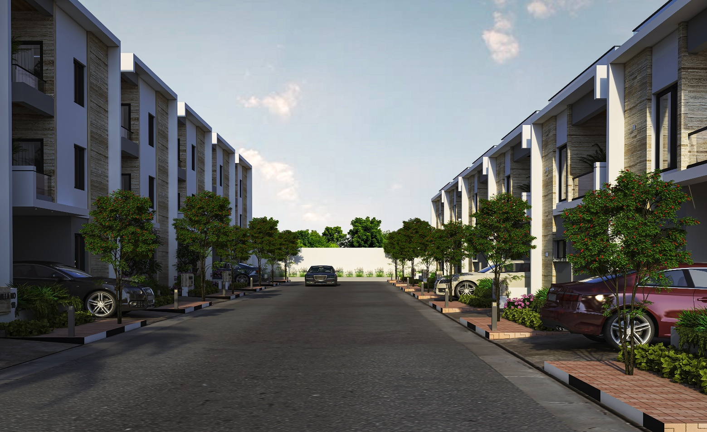
STREET RENDERS

Slide 14
THANK YOU!

