Slide 1
ASPECT-BASED SENTIMENT ANALYSIS FOR TURKISH
SE 401 Project PRESENTATION
170706003 Furkan ÖCALAN
170706007 Mustafa Tayyip BAYRAM
Project Advisor: Assist. Prof. Dr. Volkan TUNALI

Slide 2

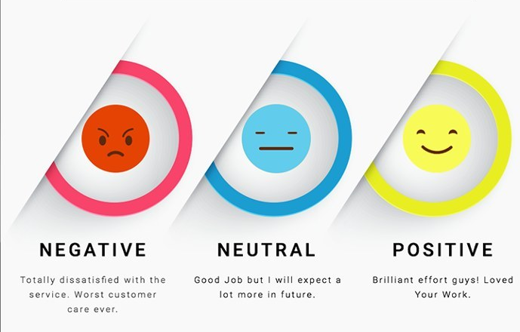
Introductıon
Aspect-based sentiment analysis (ABSA) is a text analysis technique that categorizes data by aspect and identifies the sentiment attributed to each one.
Assess the emotions and thoughts of the target audience in various sectors and to create new business plans based on the information gathered.

Slide 3
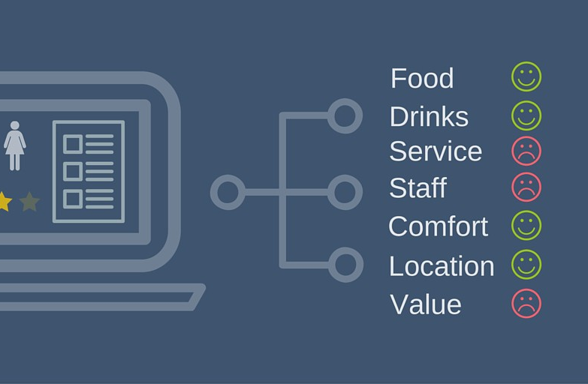
PROBLEM
Turkish is a low-resource language due to research deficiencies in NLP field.
Success rates are low to making business plans from the output.
Machine Learning algorithms and Sentiment Analysis.

Slide 4

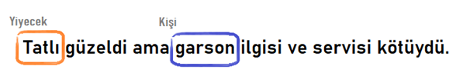

Slide 5
FunctIonal REQUIREMENTS
The user must be authorized when they log in.
1.1 User must be able to sign up with specifying their companies if user is not registered.
1.2 User shall be able to renew user’s password if user forgets the password.
2. User must be uploading the reviews file in required formats for new analyze.
2.1 The system gives an error message if the file does not match the format.
2.2 User shall be able to select current industries of the company for new analyze.
3. The system must display and save analysis results.
3.1 The system shall be able to tag outcome as positive, negative, or neutral.
3.2 The system must be visualized with tree architecture in accordance with the analysis results. From the general analysis result, the specific analysis result will be accessible through visualizations.
4. User must be able to examine previous analyze results.
4.1 User can export previous analyzes.
4.2 User shall be able to import previous analyzes in the analyze result format of the system.
5. User can edit company’s and user’s information.

Slide 6
Software Quality Attributes
Non-Functional Requirements
Named Entity Recognition success rate (F score) must be greater than 80%.
Sentiment Analysis success rate (F score) must be greater than 85%.
3. Web systems loading time must be less than 5 seconds.
4. Web system must have responsive design.
99.50% availability,
Correctness,
Continuous integration for maintainability
Great usability with well designed user interface

Slide 7
System archıtecture
Web Application Architecture
Front-end software: HTML, CSS, JavaScript, PugJS
Back-end software: NodeJS (ExpressJS), Python
Database Management System: MySQL
ORMs: SQLAlchemy, Sequalize
APIs: python-bridge API, RESTful API

Slide 8
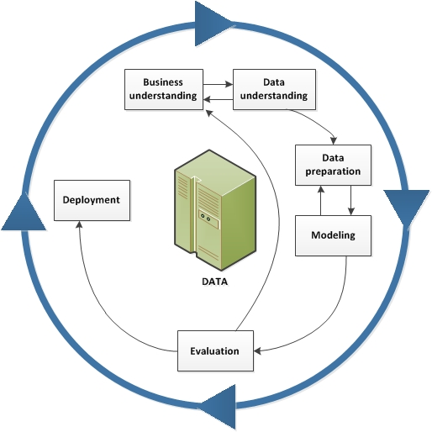
Crisp-DM Method

Slide 9
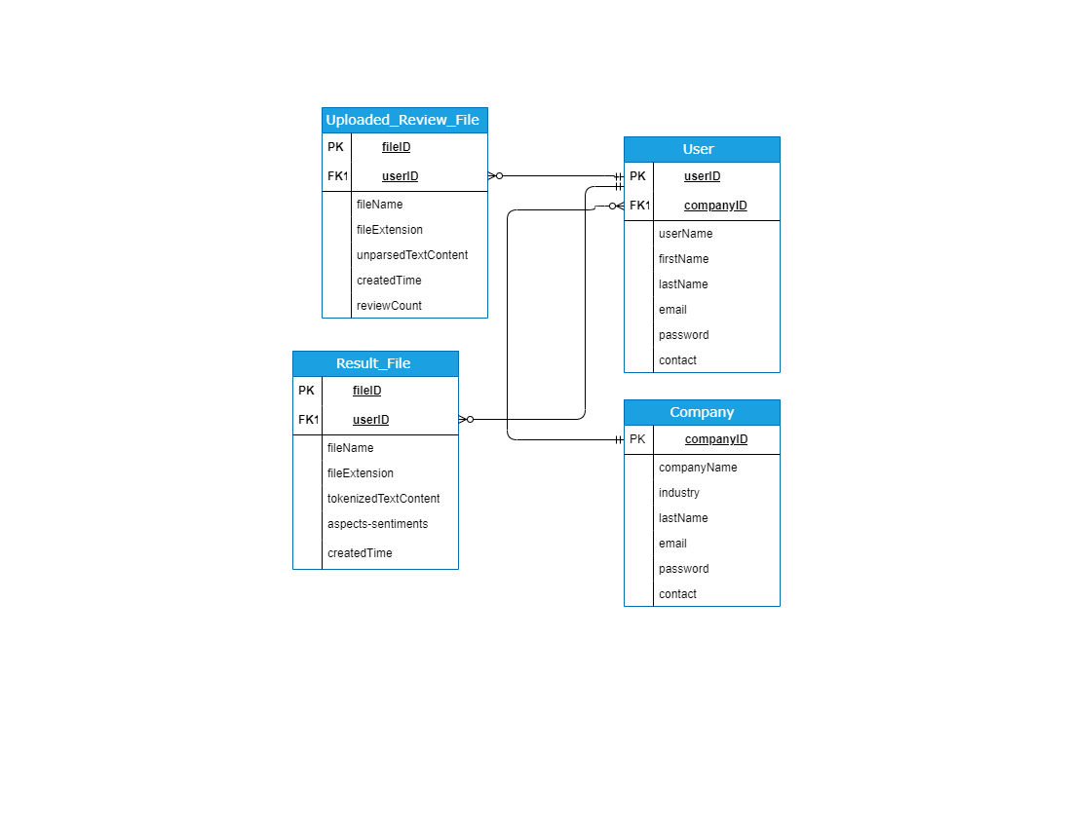
Database schema

Slide 10
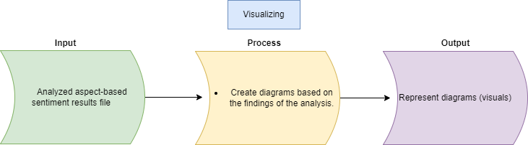
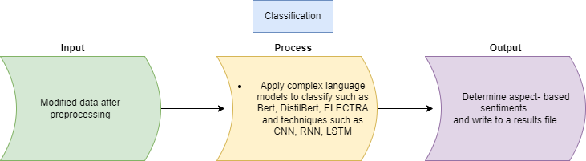
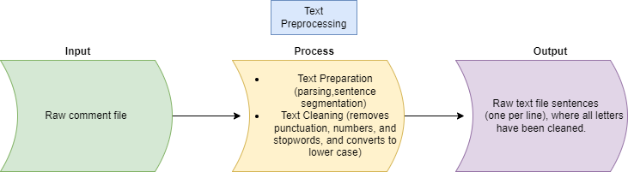
Input/output dıagram

Slide 11
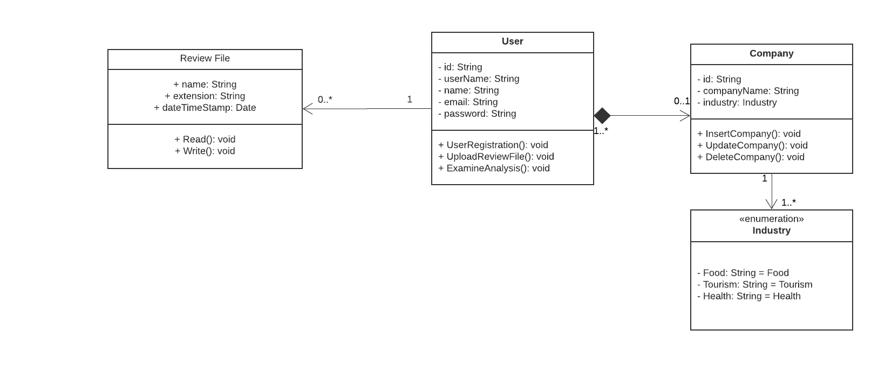
Uml class dıagram

Slide 12
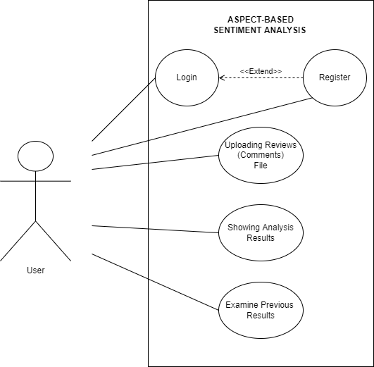
Use Case dıagram

Slide 13
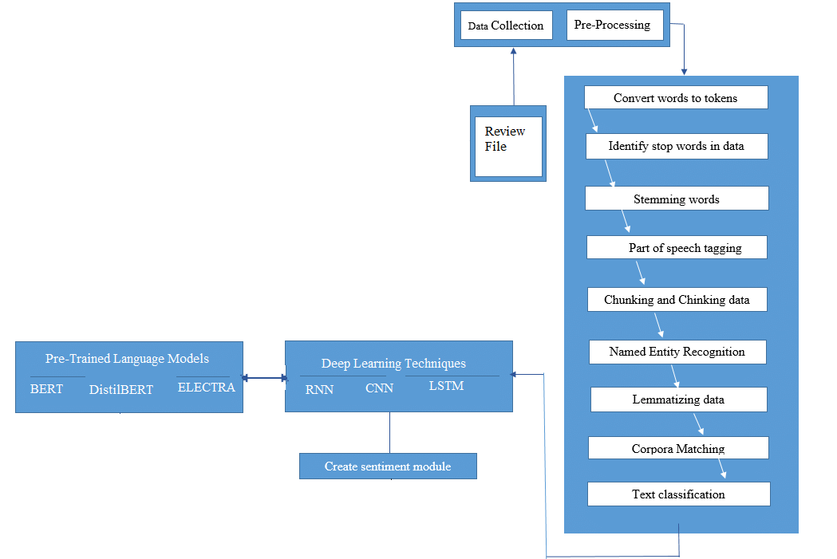
Analyze Data Flow

Slide 14
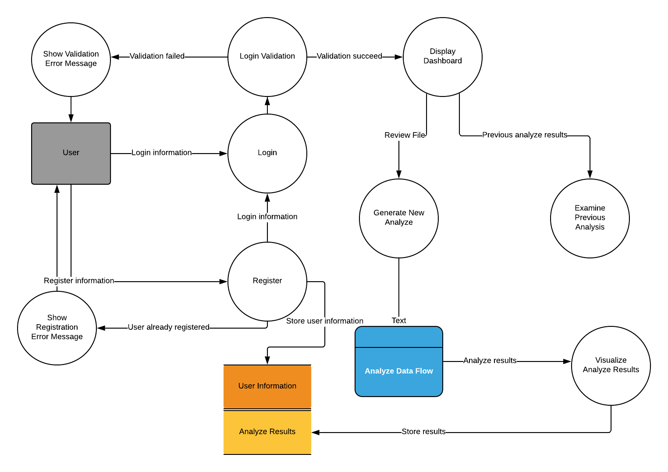
System data flow dıagram

Slide 15
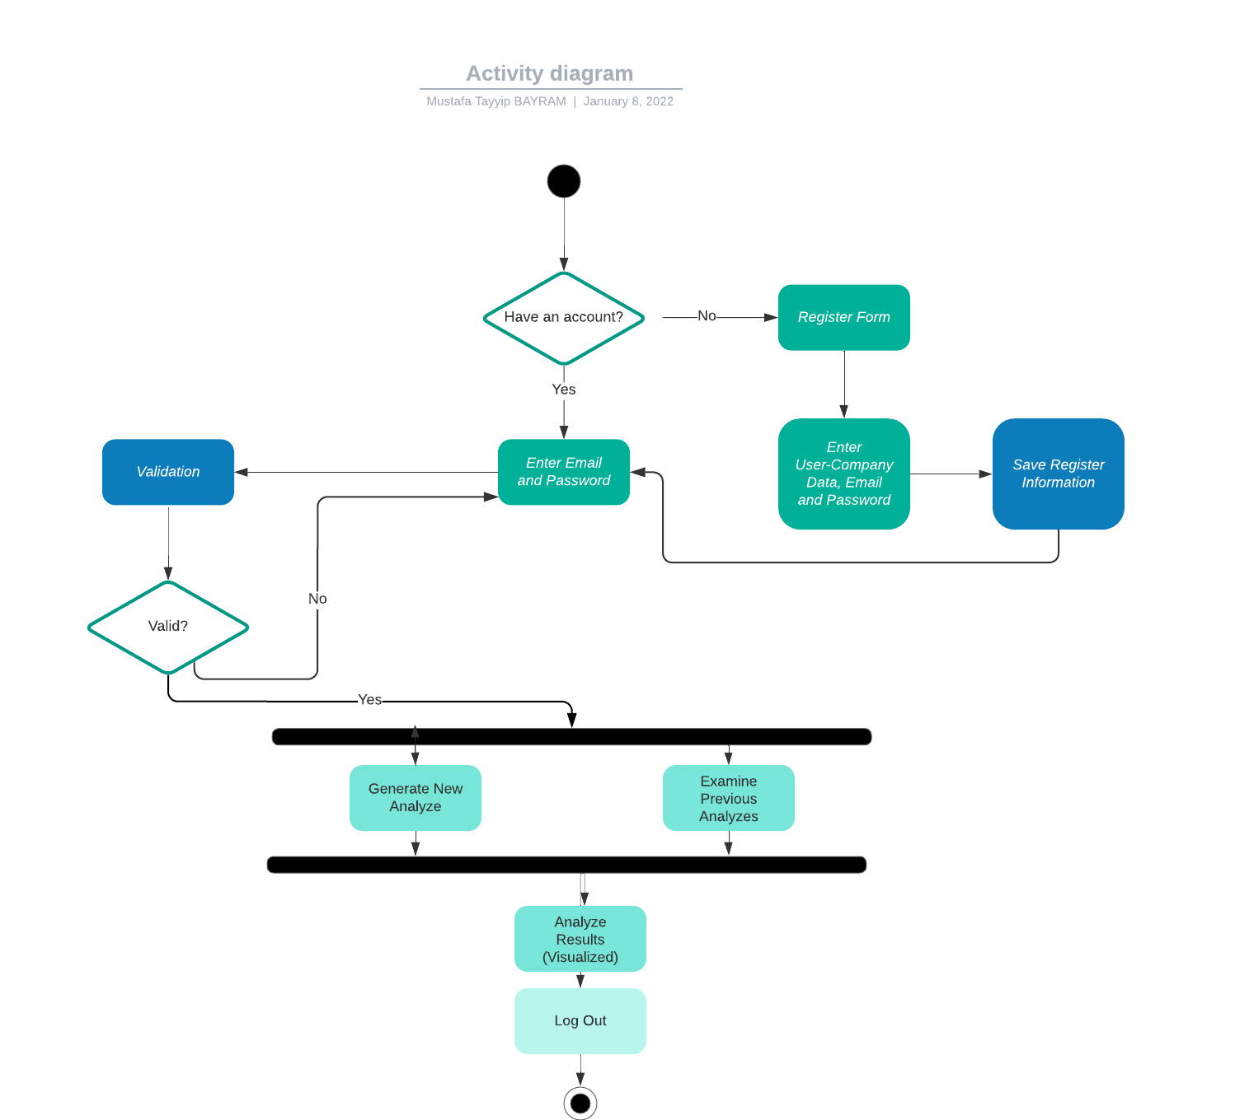
Actıvıty dıagram

Slide 16
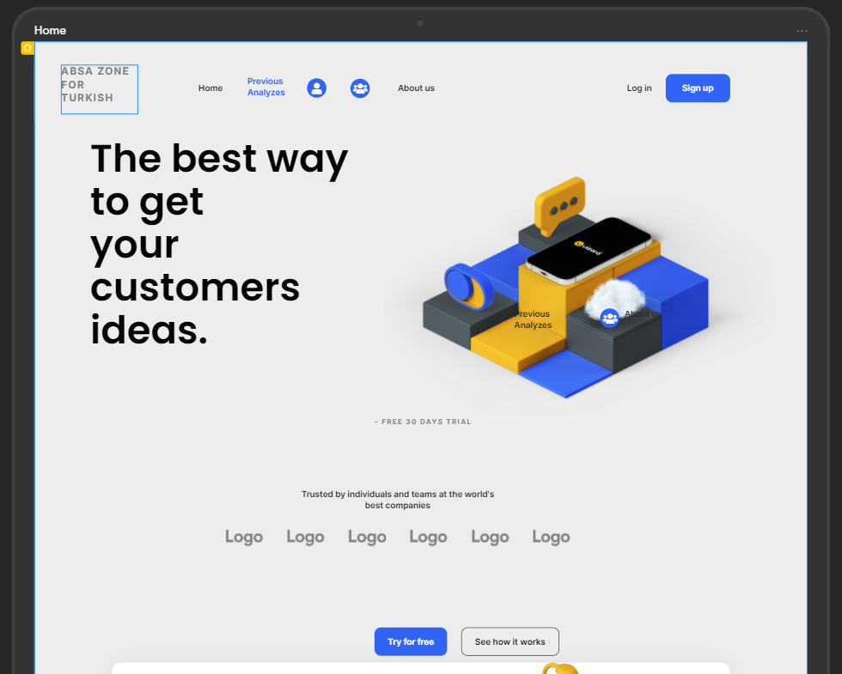
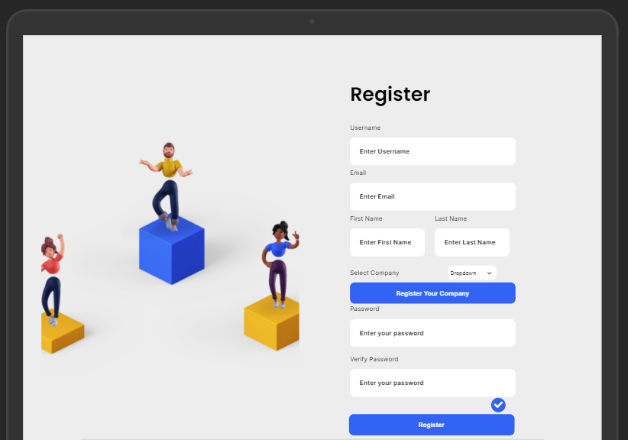
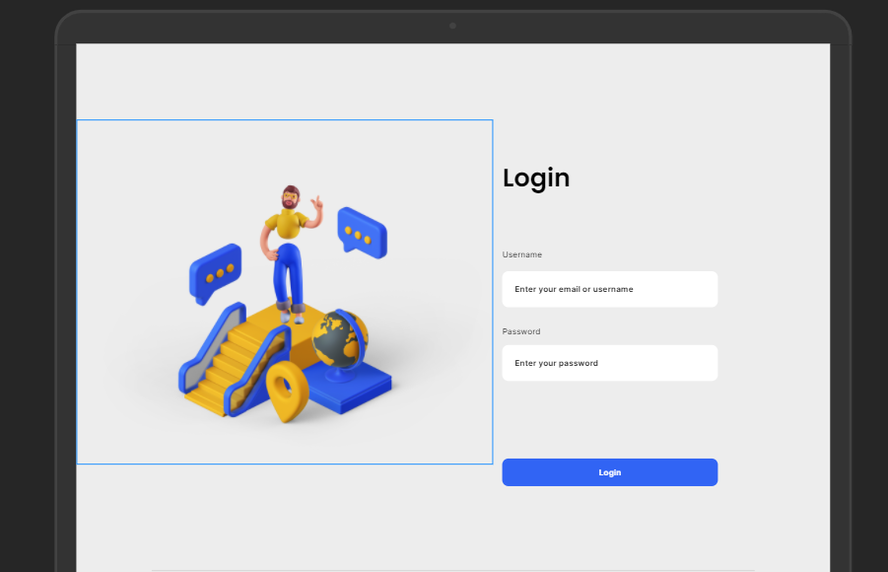
User ınterface desıgn

Slide 17
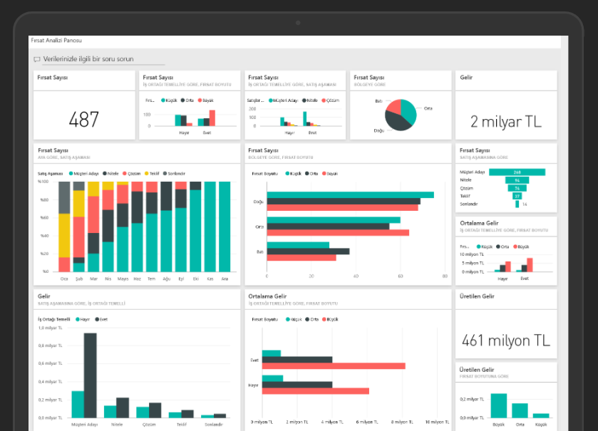
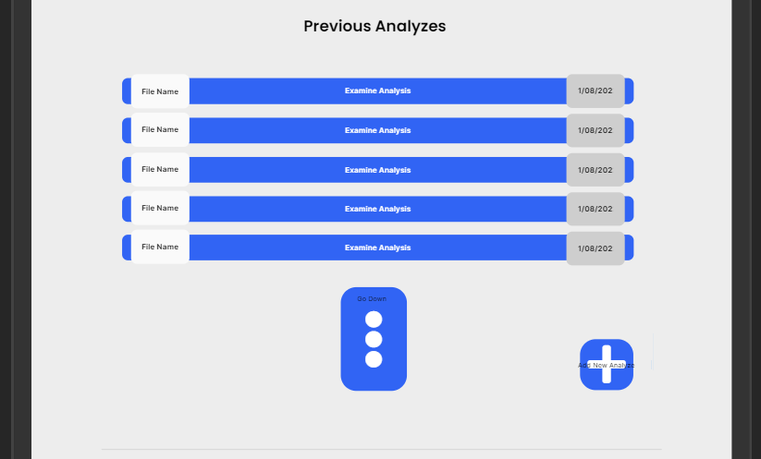
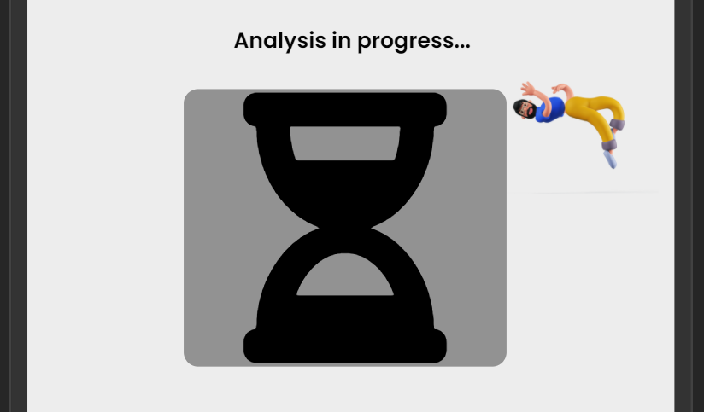

User ınterface desıgn

Slide 18

Thank you for listening We want you to be positive in your polarity

