Slide 1
String Functions
Strings has set of functions that can be used to modify themselves. We will look at these functions. All of these functions are in
#include<string.h>

Slide 2
strlen(char *s);
strlen - calculate the length of a string
The strlen() function calculates the length of the string pointed to by s, excluding the terminating null byte ('\0').

Slide 3
strcpy(char *dest, char *src);
The strcpy() function copies the string pointed to by src, including the terminating null byte ('\0'), to the buffer pointed to by dest.
The strings may not overlap,and the destination string dest must be large enough to receive the copy.

Slide 4
strcat(char *dest, char *src);
The strcat() function appends the src string to the dest string, overwriting the terminating null byte ('\0') at the end of dest, and then adds a terminating nullbyte.
The strings may not overlap, and the dest string must have enough space for the result. If dest is not large enough, program behavior is unpredictable

Slide 5
strcmp(char *s1, char *s2);
The strcmp() function compares the two strings s1 and s2.
It returns an integer less than, equal to, or greater than zero if s1 is found, respectively, to be less than, to match, or be greater than s2.

Slide 6
strchr(const char *s, int c);
The strchr() function returns a pointer to the first occurrence of the character c in the string s.
Here "character" means "byte"; these functions do not work with wide or multibyte characters.
Returns a pointer to the matched character or NULL if the character is not found.

Slide 7
strtok(char *str, char *delim);
The strtok() function breaks a string into a sequence of zero or more nonempty tokens.
On the first call to strtok(), the string to be parsed should be specified in str.
In each subsequent call that should parse the same string, str must be NULL.

Slide 8
strtok(char *str, char *delim);
The delim argument specifies a set of bytes that delimit the tokens in the parsed string.
The caller may specify different strings in delim in successive calls that parse the same string.

Slide 9
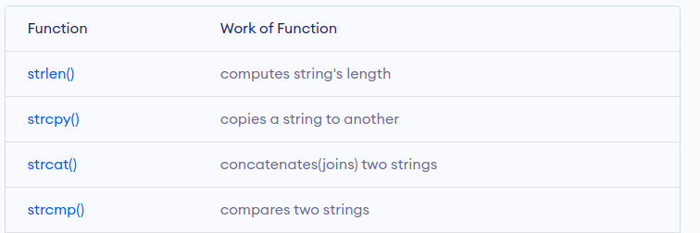
Overview

