Slide 1
Objective: Implementation of a Big Data Pipeline
Technology Set
Apache Kafka
Spark Streaming
Spark SQL
Apache Hive
Tableau

Slide 2
Introduction
Data source : twitter
Analysis: #COVID and #coronavirus

Slide 3
THE FLOW OF THE STREAMING
Kafka Producer -> Kafka Broker -> Kafka Consumer -> HDFS
HDFS-> Spark Sql ->Hive ->Tableau

Slide 4
Kafka
Kafka is a distributed streaming platform that publish and subscribe to streams of records, similar to a message queue or enterprise messaging system. It stores streams of records in a fault-tolerant durable way and process streams of records as they occur. In this project, Kafka is used to receive the streams of data from twitter and forwards it to the Spark Streaming.

Slide 5
KAFKA PRODUCER
THE API USED
Apache kafka api :
define and connect custom processors and interact with state stores
Twitter api :
provide companies, developers, and users with programmatic access to Twitter data
Gson Library :
Gson is the main actor class of Google Gson library
convert Java objects to matching JSON constructs and vice versa

Slide 6
KAFKA PRODUCER(continue)
Kafka Stream component built to support ETL(Extract, Transform, Load) type of message transformation. Means to input stream from topic, transform and output to other topic. It support real-time processing and same time support advance analytic features such as aggregation, windowing , join etc.
KafkaProducer class provides send method to send messages asynchronously to a topic.
producer.send(new ProducerRecord<byte[],byte[]>(topic,
partition, key1, value1) , callback);

Slide 7
KAFKA PRODUCER(continue)
ProducerRecord − The producer manages a buffer of records waiting to be sent.
Callback − A user-supplied callback to execute when the record has been acknowledged by the server (null indicates no callback).
KafkaProducer class provides a flush method to ensure all previously sent messages have been actually completed.
public void flush()

Slide 8
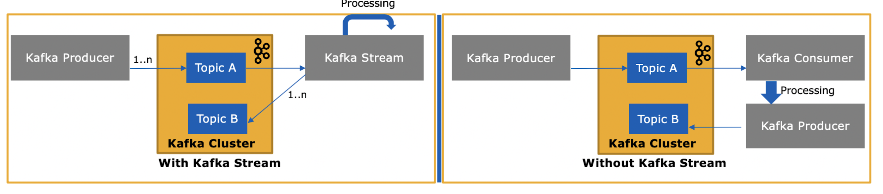
KAFKA PRODUCER(continue)

Slide 9
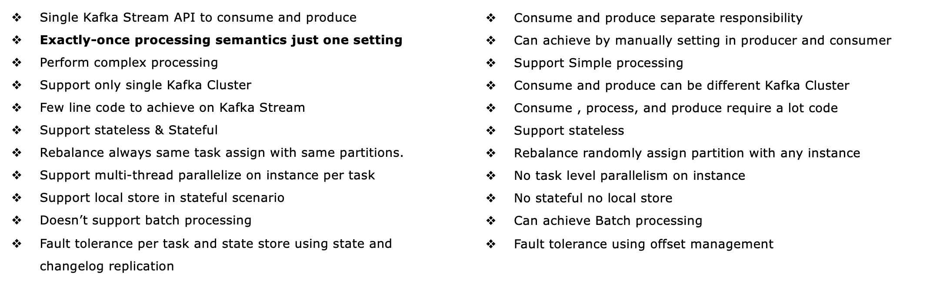
KAFKA PRODUCER(continue)

Slide 10
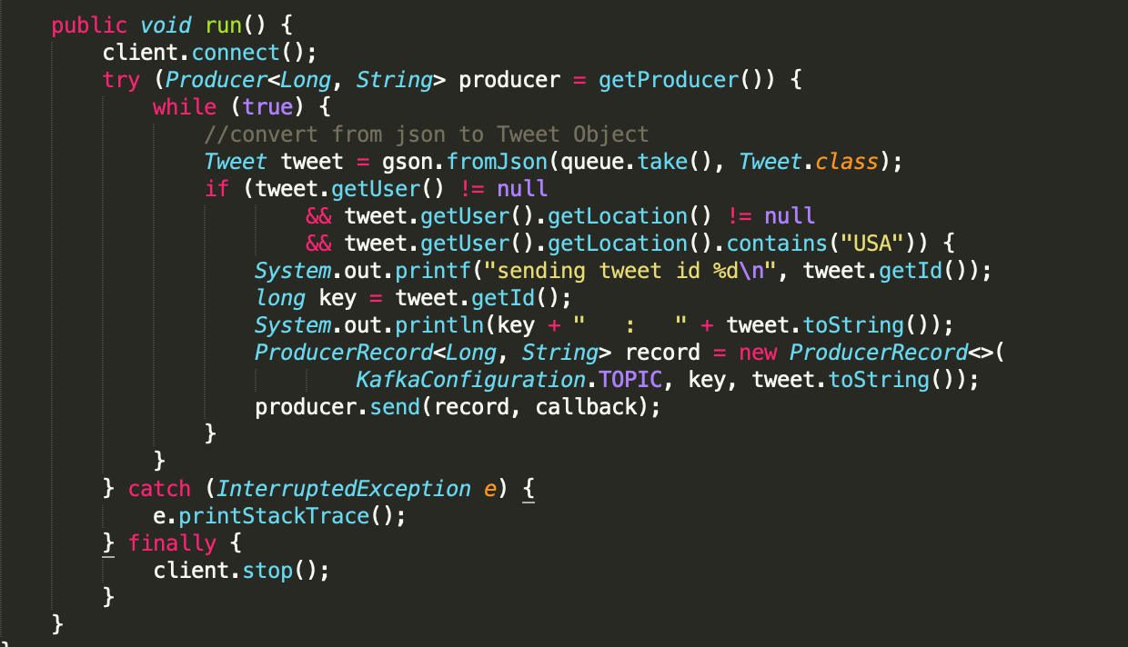

Slide 11
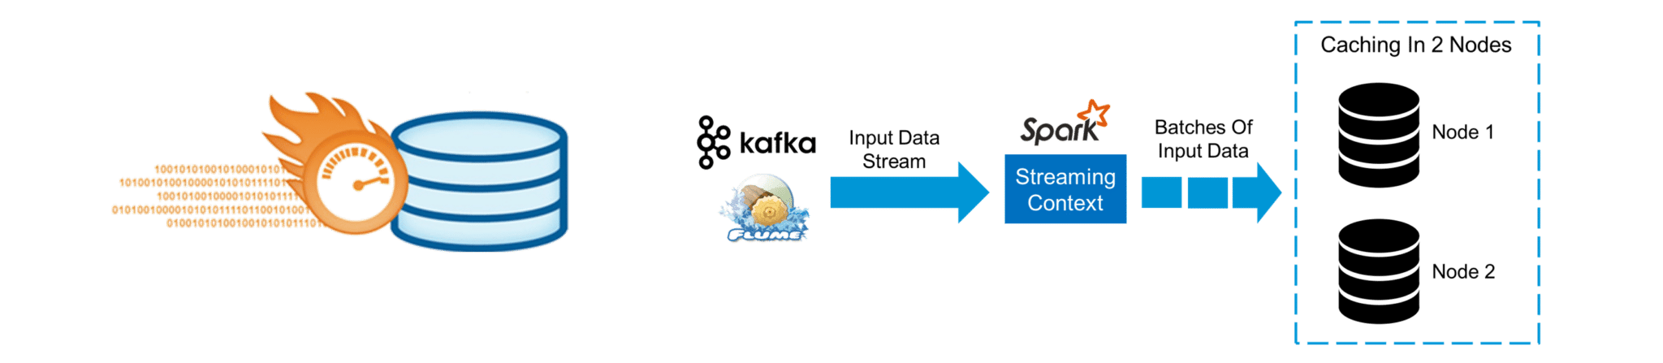

Slide 12
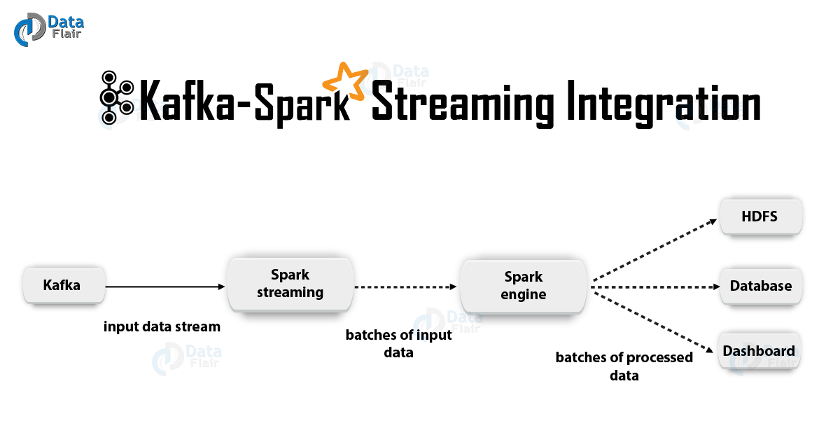

Slide 13


Slide 14
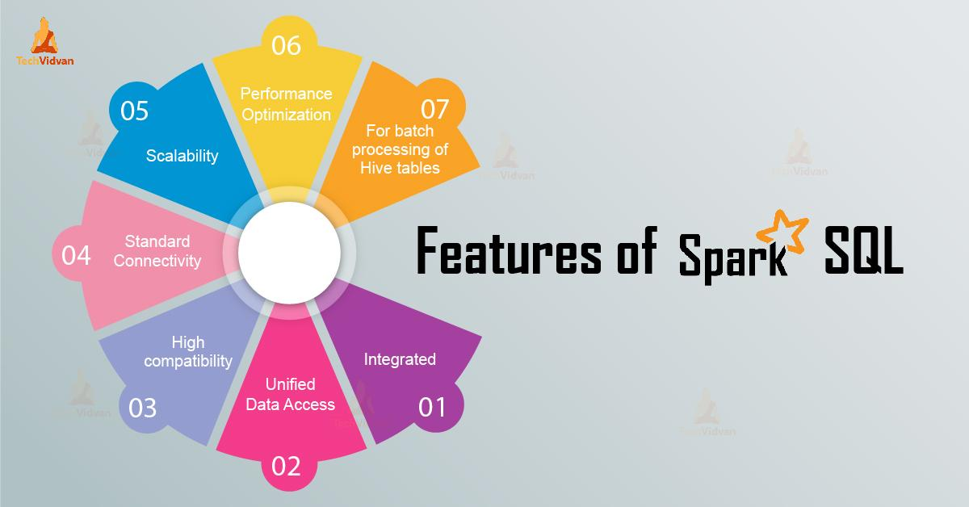

Slide 15
(5)DATA VISUALIZATION
DataVisualization is the practice of translating information into a visual context, such as a map or graph like pie charts, histograms ...etc. The main goal of data visualization is to make it easier to identify patterns, trends and outliers in large data set and helps to predict for the future what going on.
# benefits of data visualization include:
=>The ability to absorb information quickly, improve insights and make faster decisions;
=>An increased understanding of the next steps that must be taken to improve based on the data analysis

Slide 16
(5)Data Visualization with Tableau(continue)
Tableau is a visualization tool based on breakthrough technology that provides drag & drop features to analyze data on large amounts of data very easily and quickly.
The Dashboard of Tableau is very interactive and gives dynamic results. Tableau supports strong interactive capabilities and provides rich set of graphic charts. Tableau can query relational databases, cubes, cloud database, and spreadsheets and then generates a number of graph types that can be combined into dashboards and shared over a computer network or the internet.

Slide 17
# Connecting to Hive through tableau and steps we have to follow.
We have to downloaded Tableau and Hive ODBC driver.

Slide 18
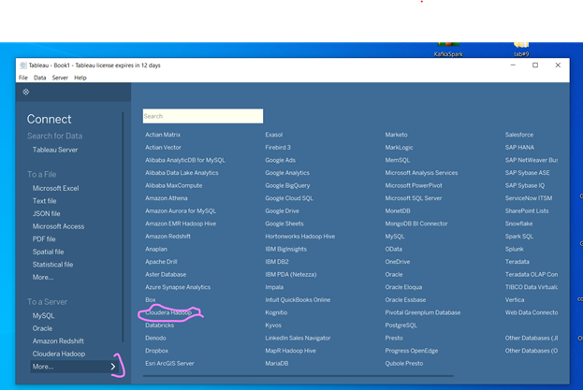
B, We have to choosing cloudera hadoop to connect with the hive server running in our cloudera VM

Slide 19
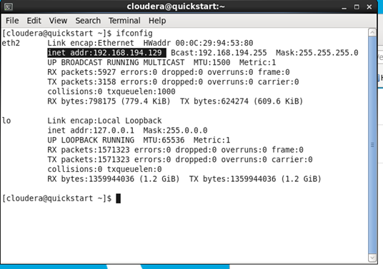
C, Then we using the server name/IP address and the user with correct authentication type to connect to the server.

Slide 20
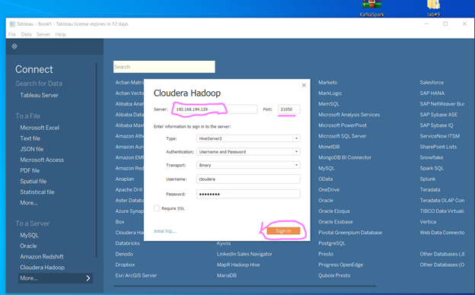

Slide 21
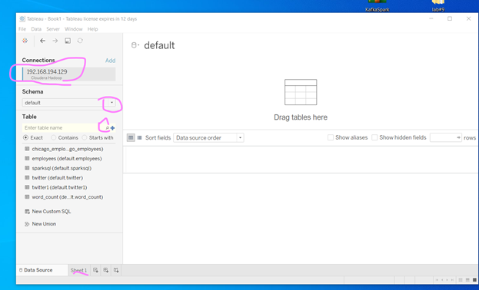
D. Finally we can search the schema and table, then we can access it what we have in the hive.

Slide 22
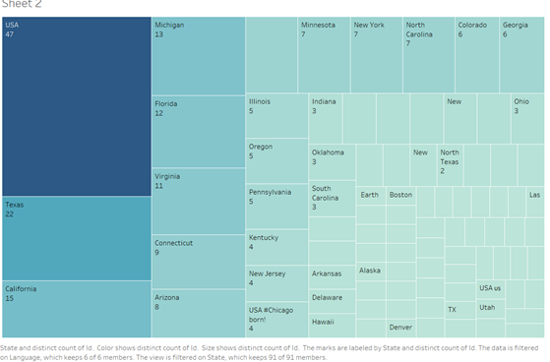
Visualization 1: State Vs CounttweetID

Slide 23
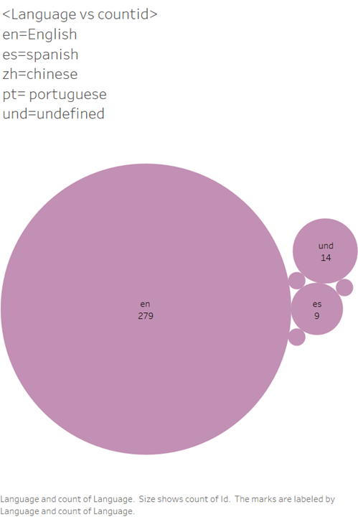
Visualization 2: Language VS TotalcountTwiteetId

Slide 24
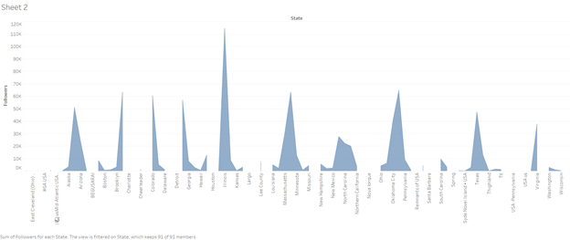
Visualization 3: State VS followers

Slide 25
Thanks for your time

