Slide 1

ASP.NET Core Interview Questions
Beginner's Guide (Hinglish)
MVC
Web API
Entity Framework
SQL Server
Aapka pehla step .NET development ki duniya mein!
Hum dekhenge sabse important concepts jo interviews mein puche jaate hain.
Focus: Simple explanation aur practical examples.
🚀 Chalo Shuru Karte Hain! 🚀

Slide 2

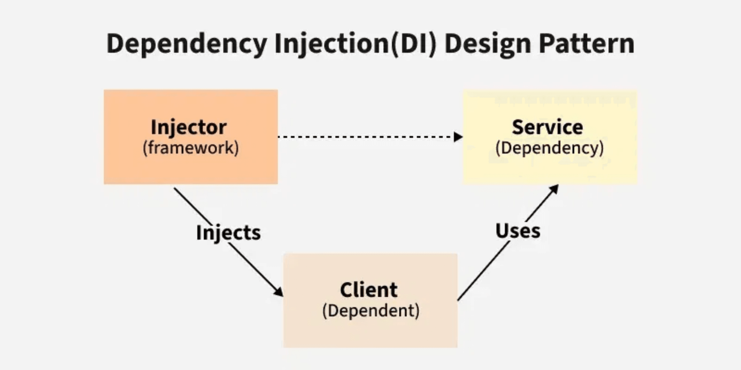
Dependency Injection (DI):
Code ko Clean aur Flexible Banata Hai
Jab ek class doosri class par depend karti hai, toh DI use hota hai.
DI Kya Hai?
DI ek design pattern hai jisme ek class apni dependencies (jin cheezon ki use zaroorat hai) khud nahi banati.
Kaun Banata Hai?
Ek special Container (jise IoC Container kehte hain) un dependencies ko bana kar class ko inject karta hai.
Fayda (Benefit):
Code loosely coupled ho jaata hai. Agar dependency change karni ho, toh sirf ek jagah change karna padta hai.
Example:
builder.Services.AddScoped<IEmployeeService, EmployeeService>();
Meaning: Jab bhi koi IEmployeeService maangega, toh EmployeeService ka object milega.

Slide 3
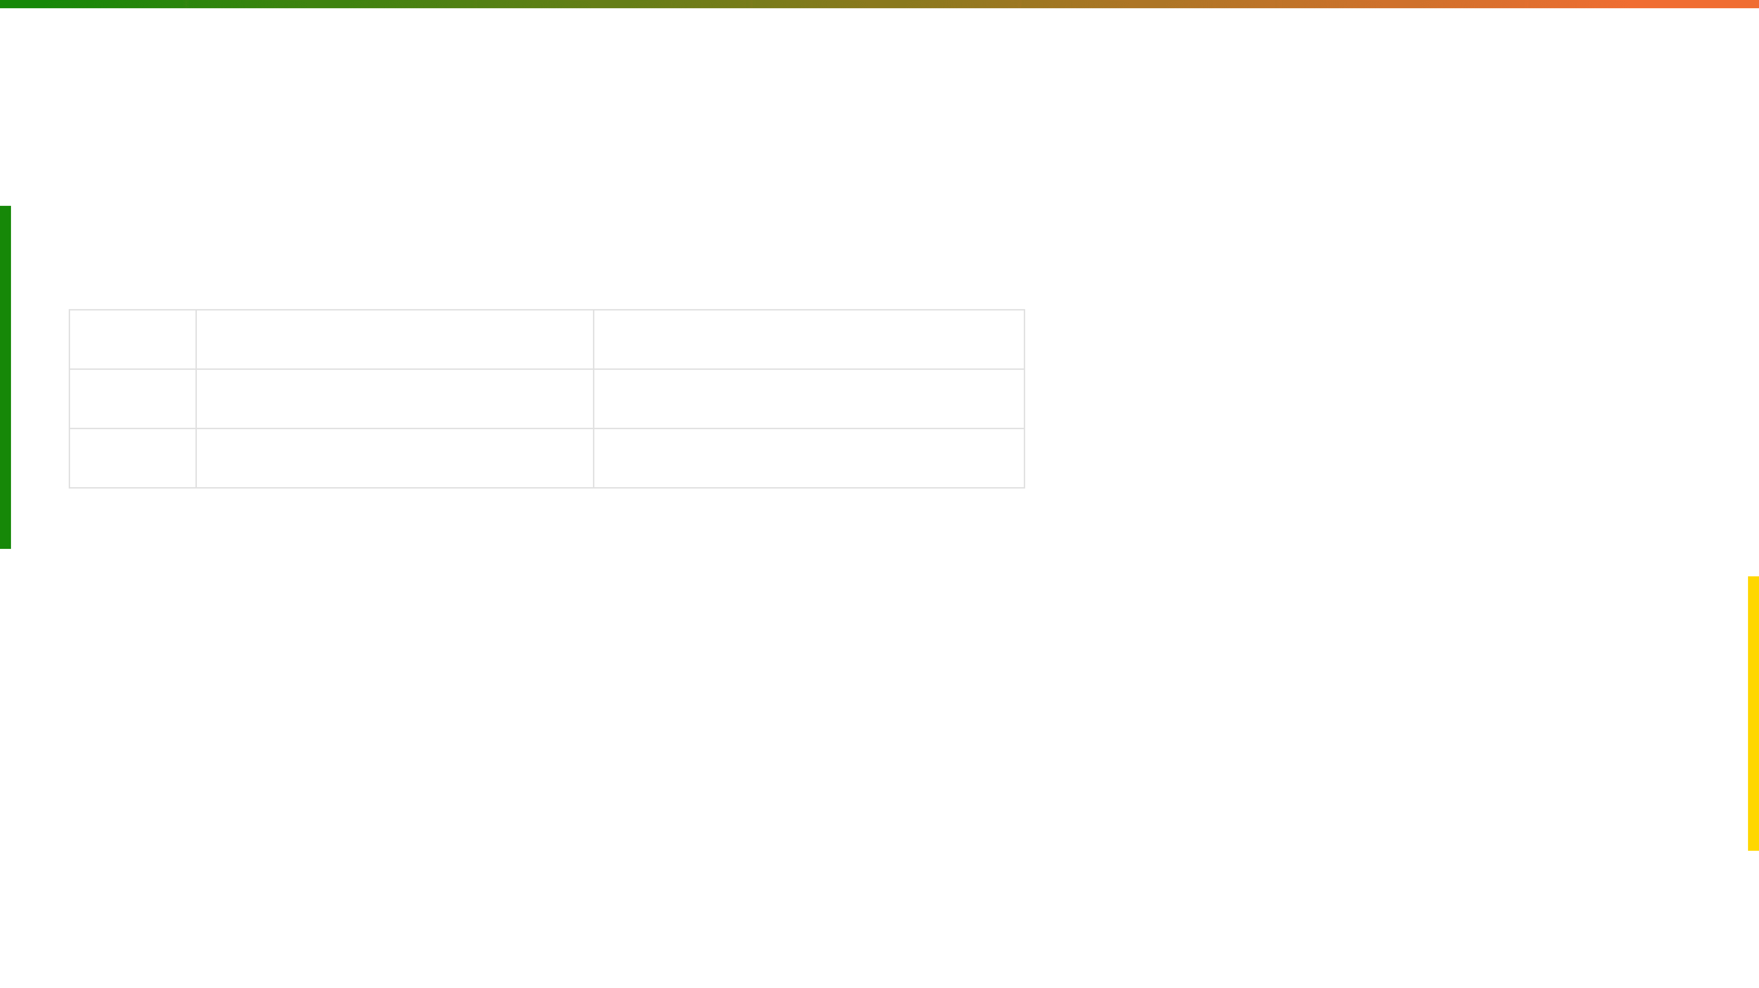
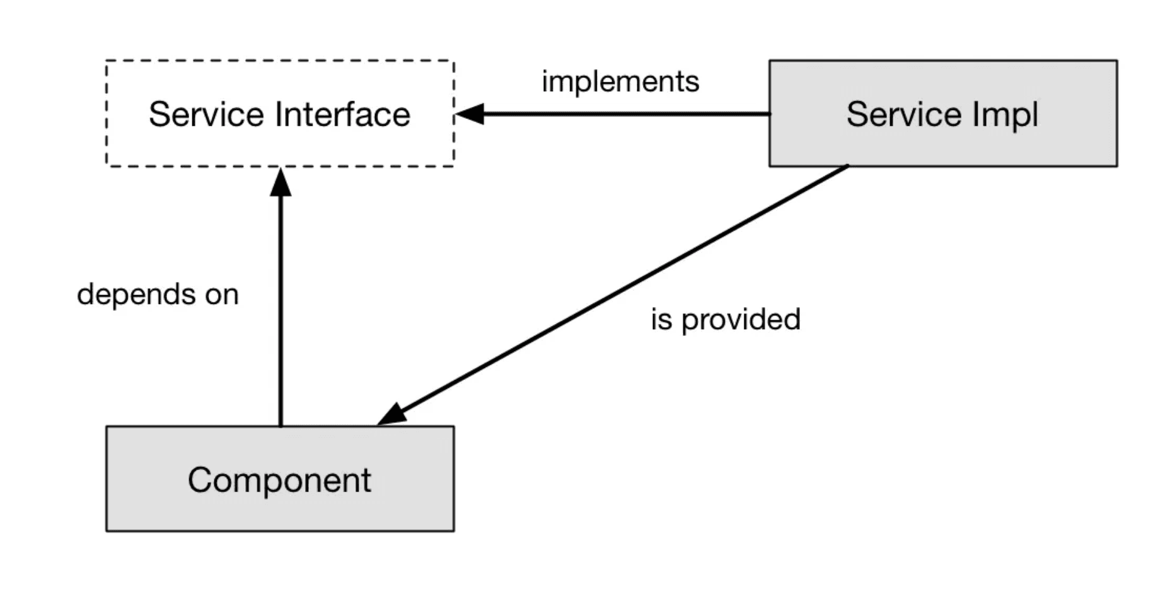
DI Lifetimes: Object ki Zindagi (Life) Kitni Hoti Hai?
Teen main tarah ki lifetimes hoti hain: Transient, Scoped, aur Singleton.
Lifetime
Meaning (Hinglish)
Example (Analogy)
Transient
Har baar naya object milega.
Har request ke liye naya Chai ka Cup.
Scoped
Ek HTTP Request ke liye same object.
Ek Lunch ki Thali jo poore lunch tak chalegi.
Singleton
Application start se end tak same object.
Ghar ka Main Gate jo hamesha wahi rehta hai.
💡 Use Case: Database connection (Scoped) ya utility service (Singleton) ke liye.

Slide 4

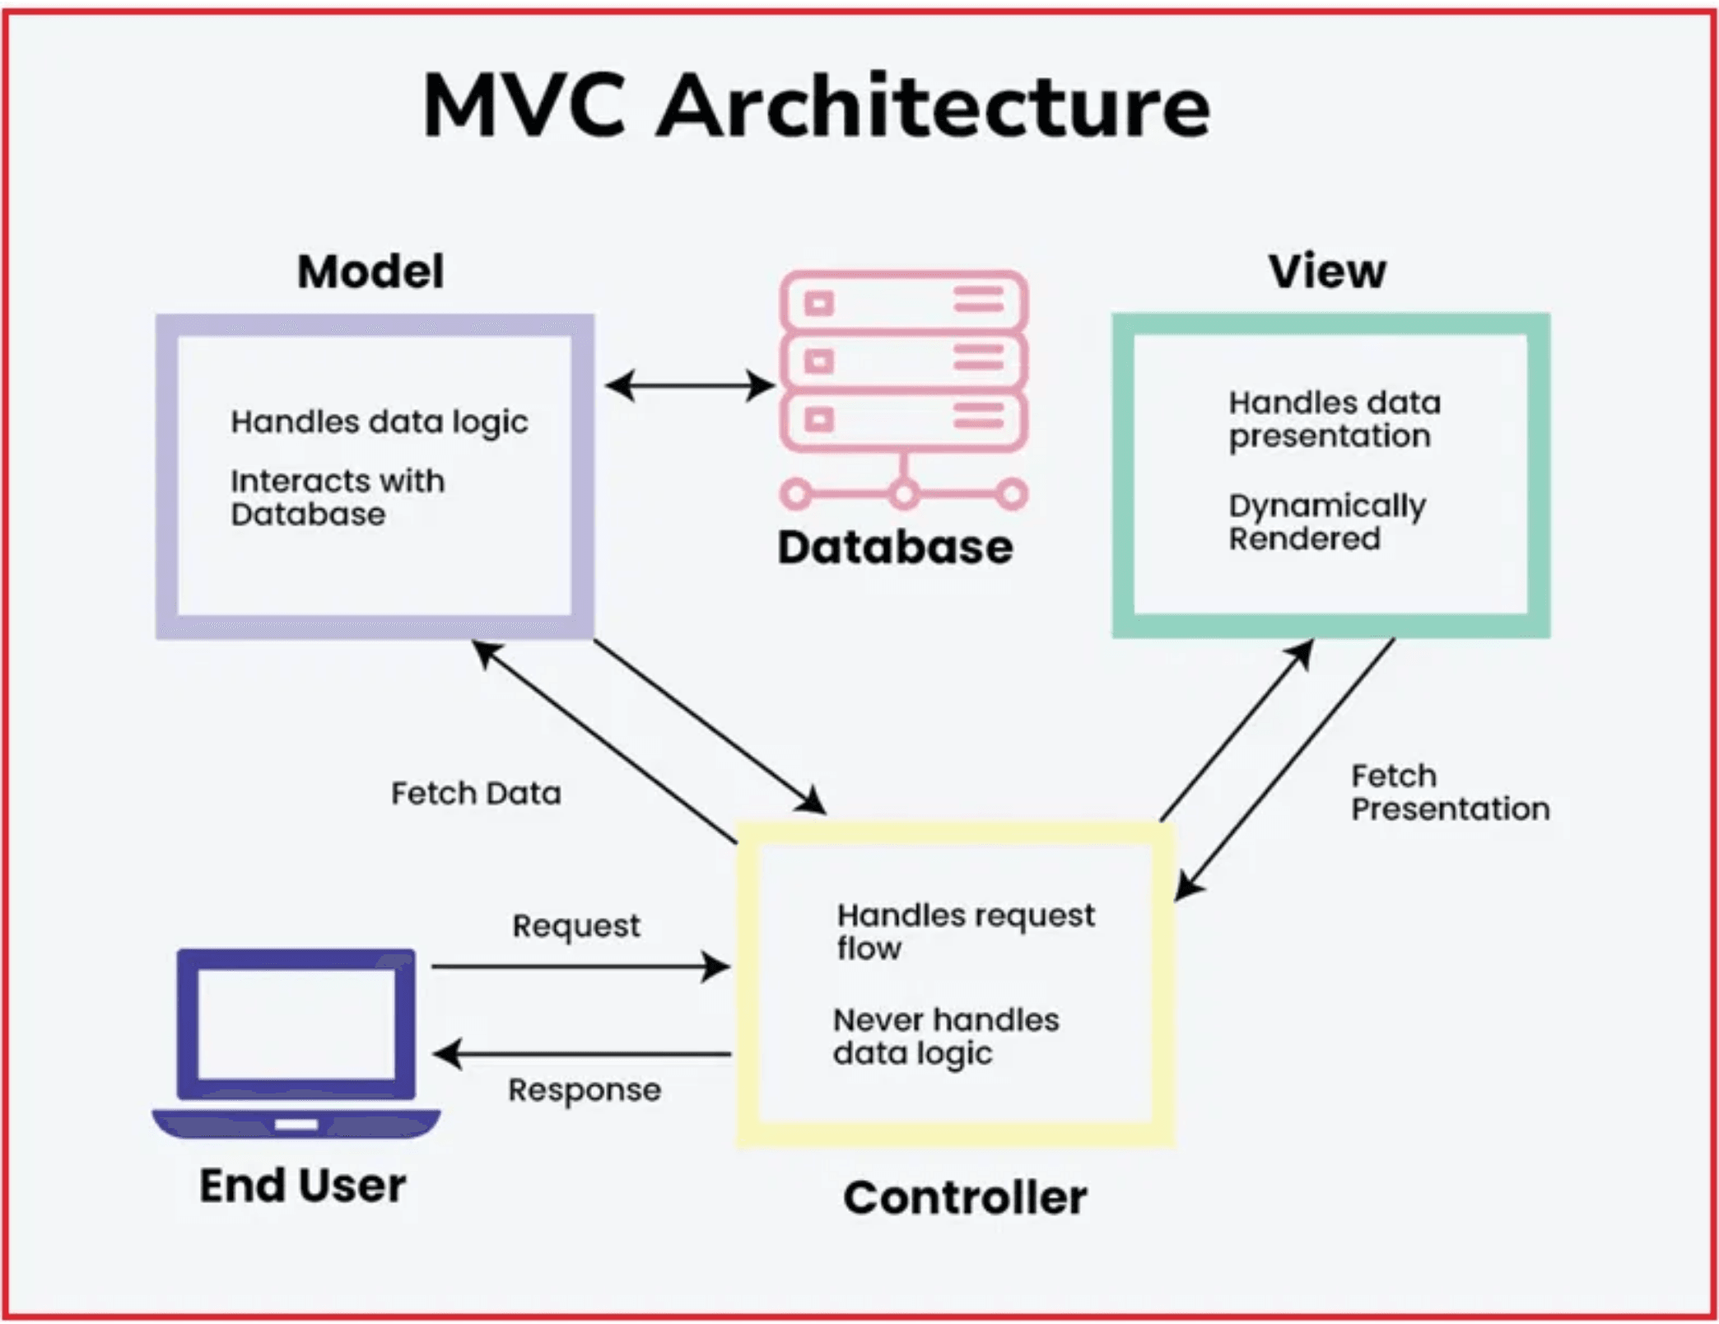
MVC aur Web API: Dono Ka Kaam Alag Hai
Dono hi ASP.NET Core mein bante hain, par unka output different hota hai.
Feature
ASP.NET Core MVC
ASP.NET Core Web API
Output
Views
(HTML, CSS, JavaScript)
Data
(JSON, XML)
Kaam
User Interface (UI) banana.
Mobile Apps ya Single Page Apps (SPA) ko data dena.
Example
return View(model);
return Ok(data);
🔗 Routing: Web API mein [ApiController] aur [Route] attributes use hote hain.

Slide 5

Controller se View Tak Data Kaise Bhejte Hain?
Teen main tareeke hain data ko Controller se View tak le jaane ke.
Method
Kaam (Hinglish)
Life Cycle
Simple data pass karna. Ek request ke liye.
ViewBag
Sirf ek request ke liye.
Jab response bhej diya, toh ViewBag khatam ho gaya.
Dynamic object
Data ko redirect ke baad bhi use karna. One-time read.
TempData
Next request tak survive karta hai.
Ek baar read ho gaya, toh delete ho jaata hai.
Dictionary-based
Reusable UI ka tukda. Header, Footer, Navigation bar.
Partial View
Main View ke andar load hota hai.
Same request mein execute hota hai.
Reusable UI
💡 Best Practice Tip:
ViewBag aur TempData se zyada better ViewModel use karna hota hai. ViewModel ek strongly-typed class hoti hai jo data ko safely pass karta hai aur code ko maintainable banata hai.

Slide 6

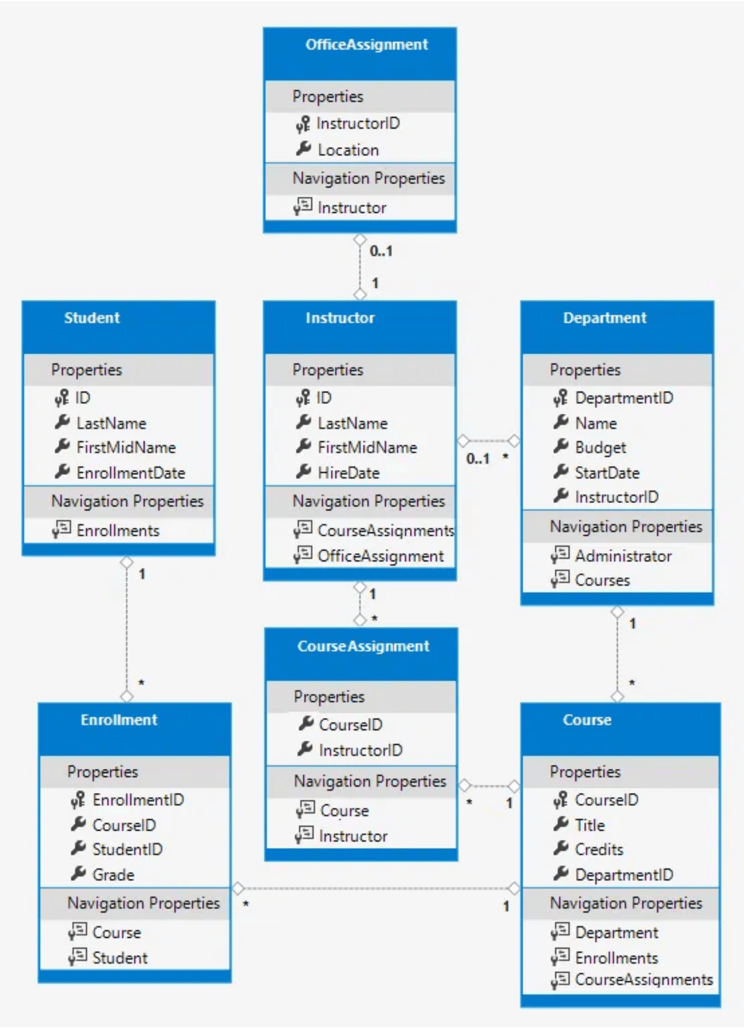
Entity Framework (EF): Code se Database
EF humare C# classes ko database tables mein convert karta hai.
CODE FIRST
Sabse popular approach. Hum C# mein classes (Models) likhte hain, aur EF unse database bana deta hai.
DBCONTEXT
Yeh class database ka gateway hai. Saare operations iske through hote hain.
DBSET
Yeh C# class database ke table ko represent karti hai.
public DbSet<Employee> Employees { get; set; }
Meaning: Employee class ke liye database mein ek Employees table banega.
🔄 Flow: C# Models → DbContext → EF → Database Tables

Slide 7

Tracking vs No-Tracking:
Performance aur Updates
📌 Code Example
// Tracking (Default)
var employees = context.Employees
.ToList();
EF ko batana ki object ko track karna hai ya nahi.
Meaning: Sab employees ko track karega. Agar kisi ka salary change hua, toh SaveChanges() par update ho jayega.
✓ Tracking
// No-Tracking (Fast)
var employees = context.Employees
.AsNoTracking()
.ToList();
Kya Hota Hai?
EF object ko monitor karta hai.
Update/Delete Ke Liye:
Agar object mein change hua, toh SaveChanges() par DB mein update ho jayega.
Meaning: Sirf data read karega, kisi ko track nahi karega. Bahut fast hai!
✓ Fayda: Data ko update aur delete karna aasan ho jaata hai.
💡 Tip: Jab sirf data display karna ho (List, Report), toh AsNoTracking() use karo.
⚡ No-Tracking
Kya Hota Hai?
EF object ko monitor nahi karta.
Speed:
Bahut Fast hota hai, kyunki monitoring ka overhead nahi hota.
✓ Fayda: Sirf data ko read karna ho (Read-only operations).

Slide 8

LINQ: C# mein Data se Baat Karne ka Tareeka
Language Integrated Query (LINQ) se hum C# code mein hi data filter kar sakte hain.
Where
Select
Data ko filter karna (condition ke basis par)
Sirf zaroori columns nikalna
Example:
Example:
employees.Where(e => e.Age > 18)
employees.Select(e => e.Name)
✓ 18 se upar age wale employees
✓ Sirf employees ke naam
Any
GroupBy
Check karna ki condition match ho rahi hai
Data ko group mein organize karna
Example:
Example:
employees.Any(e => e.Salary > 100000)
employees.GroupBy(e => e.DeptId)
✓ Check if koi 1 Lakh+ kamata hai
✓ Department ke hisaab se group
💡 LINQ ke Fayde (Benefits):
✓ Readable Code: SQL jaisa syntax, par C# mein
✓ Type-Safe: Compile time par errors catch ho jaate hain
✓ Flexible: Collections, Databases, XML - sabke saath kaam karta hai

Slide 9

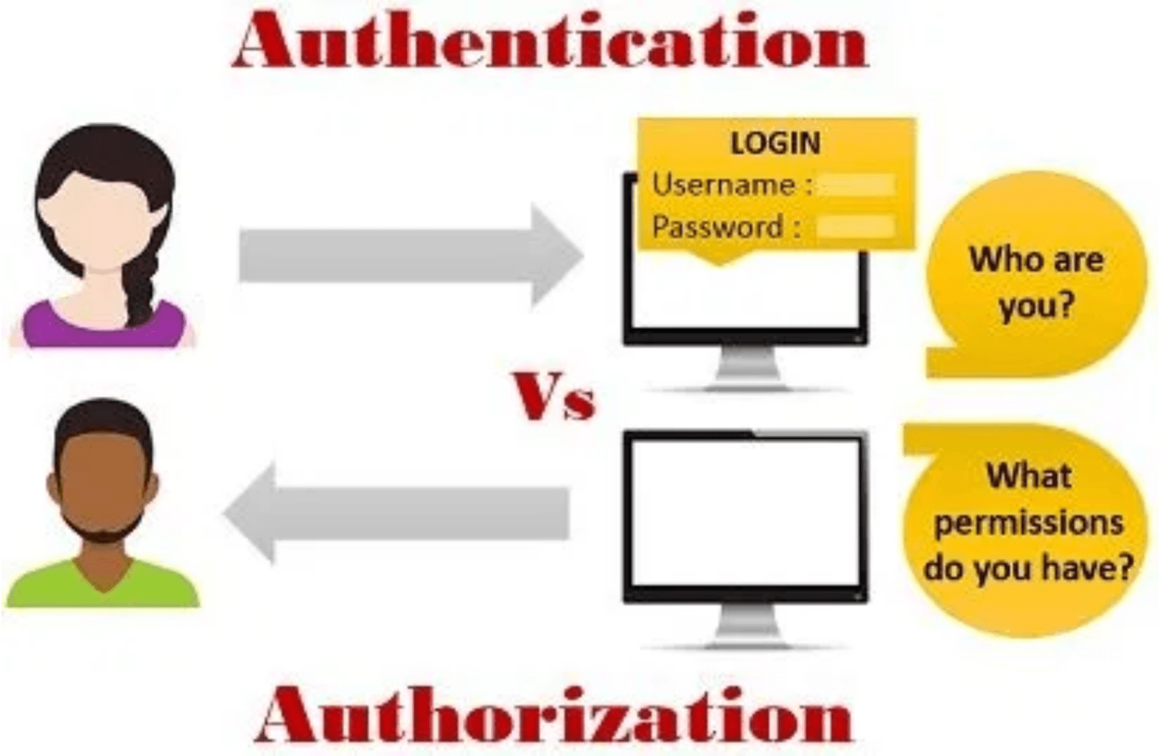
Authentication vs Authorization:
Kaun aur Kya?
Yeh do alag concepts hain jo security ke liye zaroori hain.
🔐 Authentication
Kaun ho tum? Username aur Password se Login karna.
Server check karta hai ki tum kaun ho. Agar correct credentials ho, toh login ho jaate ho.
✓ Authorization
Tum kya kar sakte ho? Login ke baad Admin page access karna.
Server check karta hai ki tum kya permissions ho. Agar Admin role ho, toh Admin page access kar sakte ho.
[Authorize(Roles = "Admin")]
✓ Sirf Admin role wale hi is function ko access kar sakte hain.
🔑 JWT (JSON Web Token): Authentication ke liye use hota hai. Server ek token deta hai, aur client har request mein woh token bhejta hai.

Slide 10

Clustered vs Non-Clustered Index: Data Search Speed
Index database mein data ko jaldi dhundhne mein help karte hain.
Feature
Clustered Index
Non-Clustered Index
Max Count
Sirf
1
per table
999
tak ho sakte hain
Data Storage
Actual data ko
sort
karta hai.
Data ki location ka
pointer
store karta hai.
Speed
Bahut
Fast
(Primary Key par banta hai)
Thoda slow
(Pointer follow karna padta hai)
Default
Primary Key par automatically banta hai
Optional - manually create karna padta hai
Use Case
Frequently searched columns (ID, Date)
Other columns jo search karte ho (Name, Email)
📖 Analogy - Kitaab ka Example:
Clustered Index = Ek kitaab jo alphabetical order mein likhi hai. Jab aap kisi word ko dhundna ho, toh directly us page par ja sakte ho kyunki data sorted hai.
Non-Clustered Index = Kitaab ke peeche ka Index Page jo important topics ke page numbers batata hai. Pehle Index dekho, phir us page par jao.
🎯 Key Takeaway: Clustered Index bahut fast hai kyunki data directly sorted rehta hai. Non-Clustered Index thoda slow hai par flexible hai - multiple indexes bana sakte ho.

Slide 11

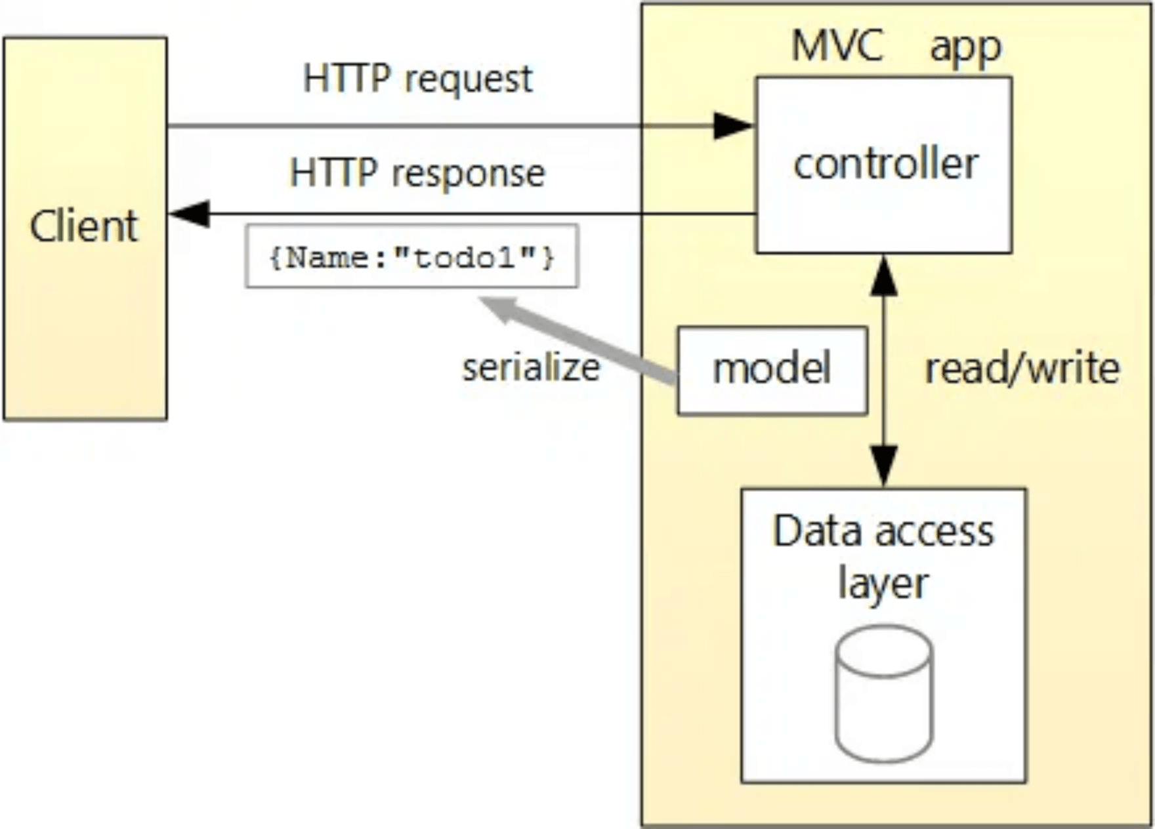
async-await: Application ki Capacity Badhana
Jab koi operation time leta hai (e.g., DB call), toh hum async-await use karte hain.
❌ Problem (Bina async-await)
Jab DB call hoti hai, toh woh thread (worker)block ho jaata hai aur doosri requests handle nahi kar pata.
Thread busy rehta hai (sirf wait kar raha hai)
Doosri requests ke liye thread available nahi hota
Server ki capacity kam ho jaati hai
Zyada users → Server slow ho jaata hai
✓ Solution (async-await ke saath)
async-await use karne se, jab DB call ho rahi hoti hai, toh woh thread free ho jaata hai aur doosri requests handle karta hai.
Thread block nahi hota
Doosri requests ke liye thread available rehta hai
Server ki capacity badh jaati hai
Zyada users ko handle kar sakte ho
public async Task<IActionResult> Get() =>
Ok(await context.Employees.ToListAsync());
🚀 Fayda: Server ki capacity badh jaati hai. Zyada requests handle ho sakti hain, aur application fast rehta hai.

Slide 12

Interview Tips aur Next Steps
Thodi si mehnat aur offer letter aapka!
💡 Interview Tips
Tip 1: Practice Code
Tip 2: Revise Loud
Sirf padhne se nahi hoga. Ek Mini CRUD Project banao aur khud se run karke dekho.
Har answer ko zor se bol kar practice karo. Confidence badhega aur memory mein bhi stick ho jayega.
Tip 3: Real Examples
Tip 4: Code Review
Har concept ke liye real-world example sochna. "Yeh concept kahan use hota hai?" - yeh socho.
GitHub par open-source projects dekho aur samjho ki professional code kaise likha jaata hai.
📊 Important HTTP Status Codes
200
201
400
401
403
404
OK - Success
Created - Resource banaya
Bad Request - Invalid data
Unauthorized - Login required
Forbidden - Permission denied
Not Found - Resource nahi mila
🚀 Next Steps (Aur Seekhne Ke Liye)
✓
Microservices:
Ek bade application ko chhote services mein divide karna
✓
Design Patterns:
Singleton, Factory, Observer patterns
✓
Docker & Kubernetes:
Application ko containers mein run karna
✓
Cloud (Azure):
Application ko cloud par deploy karna
✓
Unit Testing:
Code ko test karna aur bugs dhundhna
🔥 Offer letters aa hi jayenge! 🔥
Mehnat karo, consistent raho, aur success zaroor milegi!

