Slide 1

Weather and WORK
Furkan Emre Babadağ

Slide 2
Hypothesis
During rainy weeks, I observed that I worked longer hours and served more customers at the shops where I worked, as people preferred indoor spaces like shopping malls and coffee shops to stay dry.

Slide 3


My Dataset
Weather Data
Paycheck data(hours worked)

Slide 4

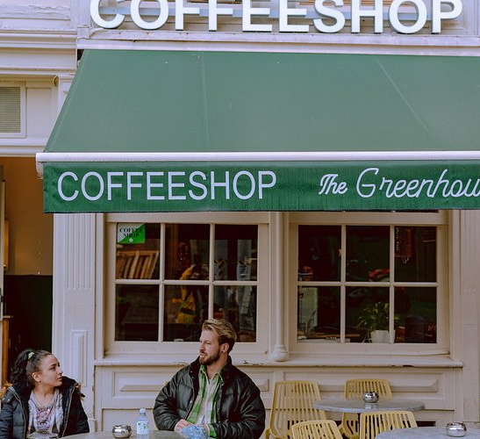
Work Data

Slide 5
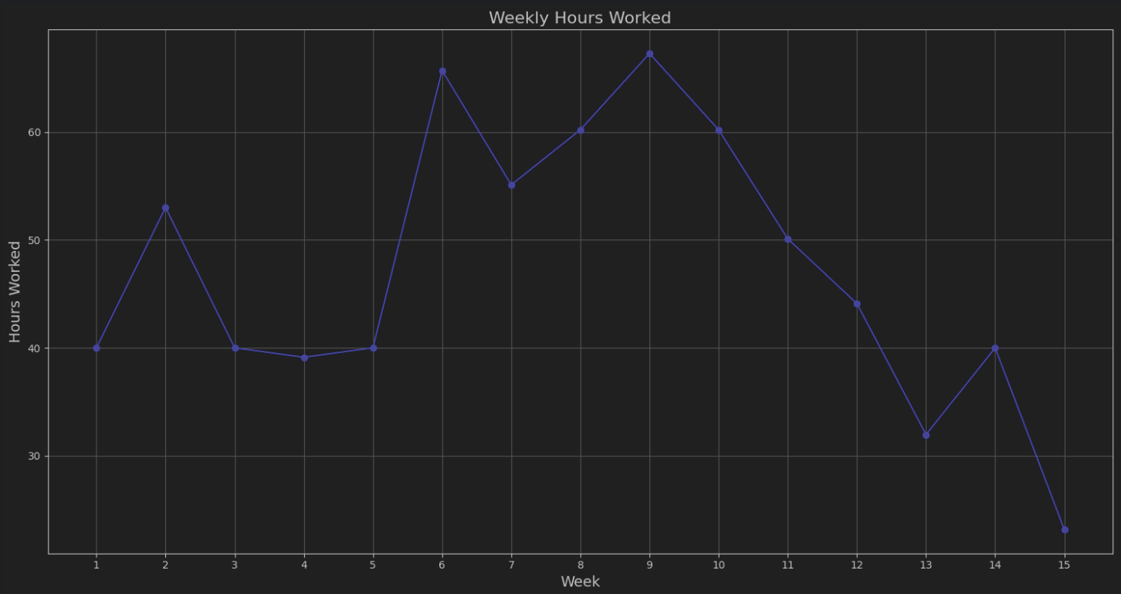
My work data
I plotted for each week how many hours did I worked.

Slide 6

Weather data

Slide 7
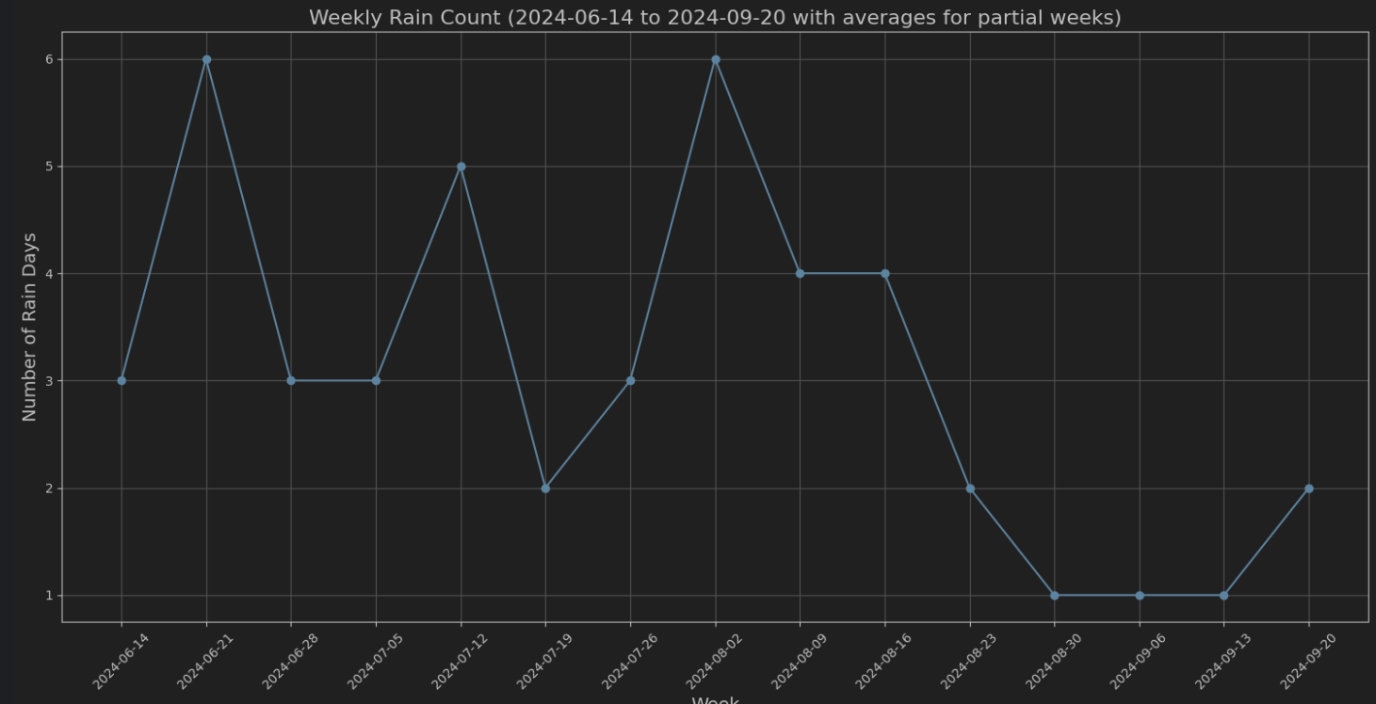
Weather data for rain
Then i plotted how many times it rained every week

Slide 8
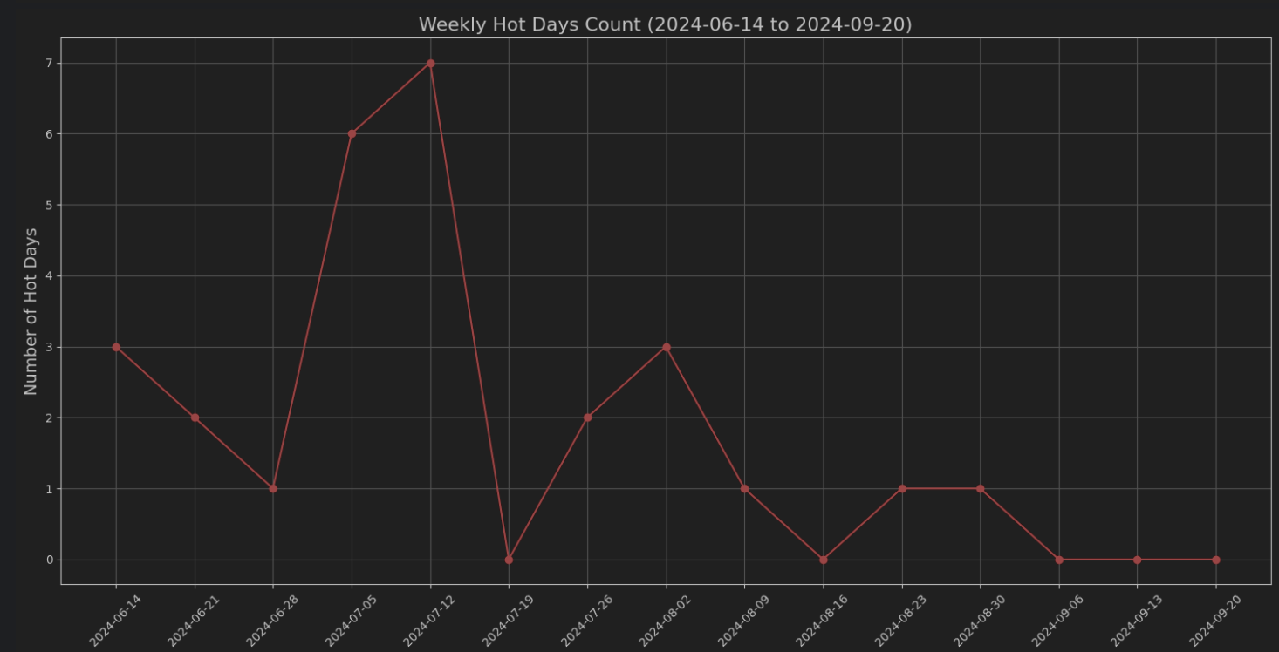
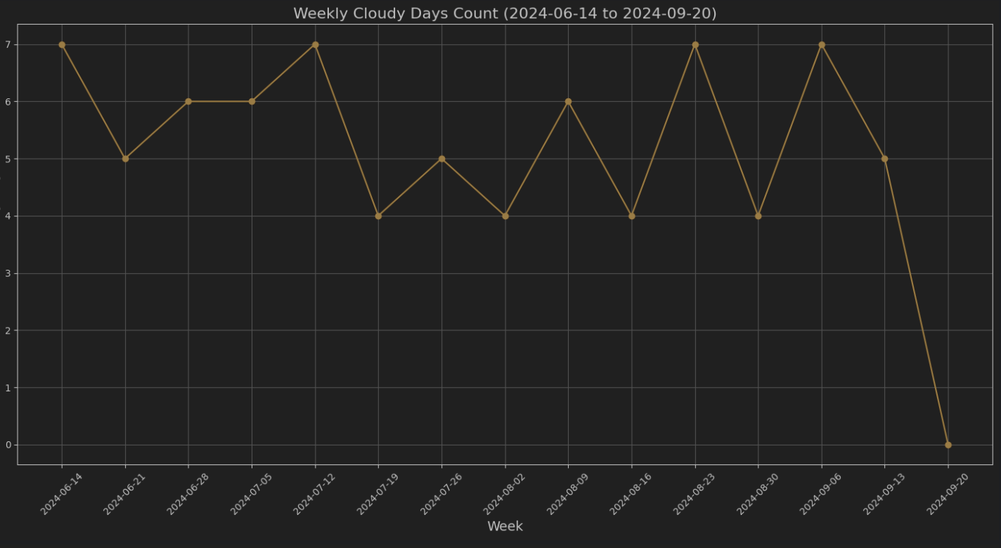
Extra weather data
I also plotted data for hot weeks (the days in which max temperature exceeds 30C) and cloudy weeks.
In same format as rain data, it shows how many times these parameters occurred per week.

Slide 9
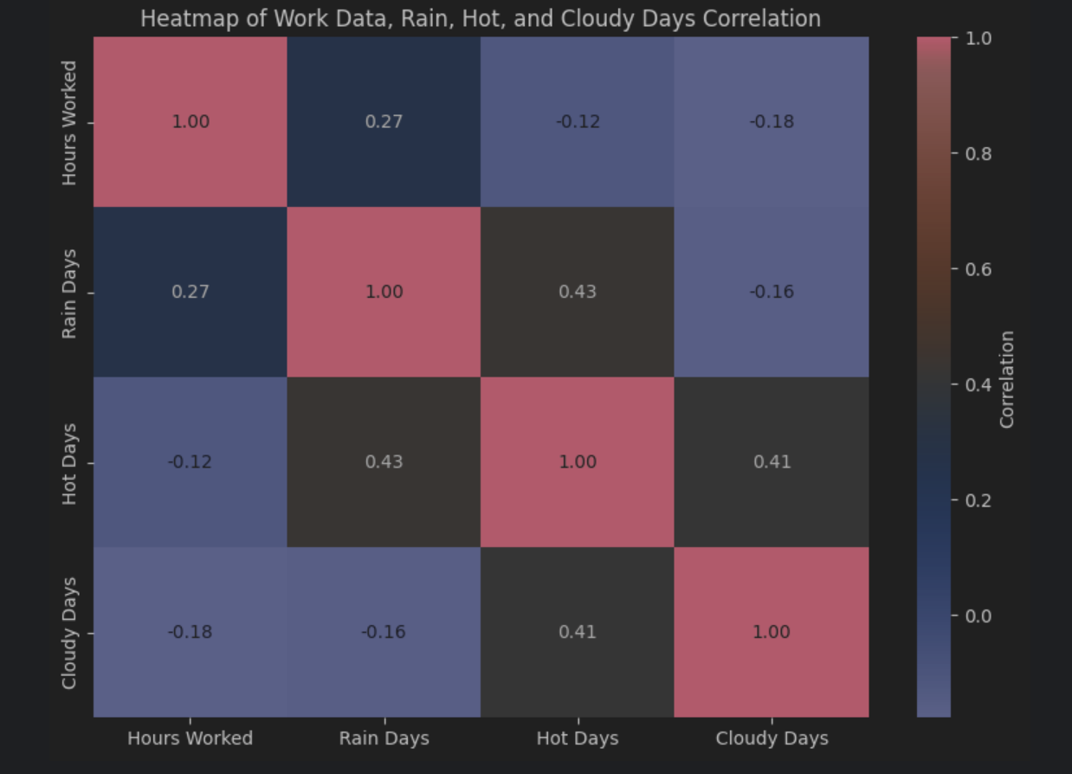
Heatmap so we can see the correlation
We can see a weak correlation between rainy weeks and hours worked
We can also see a strong correlation between hot weeks and rainy weeks

Slide 10
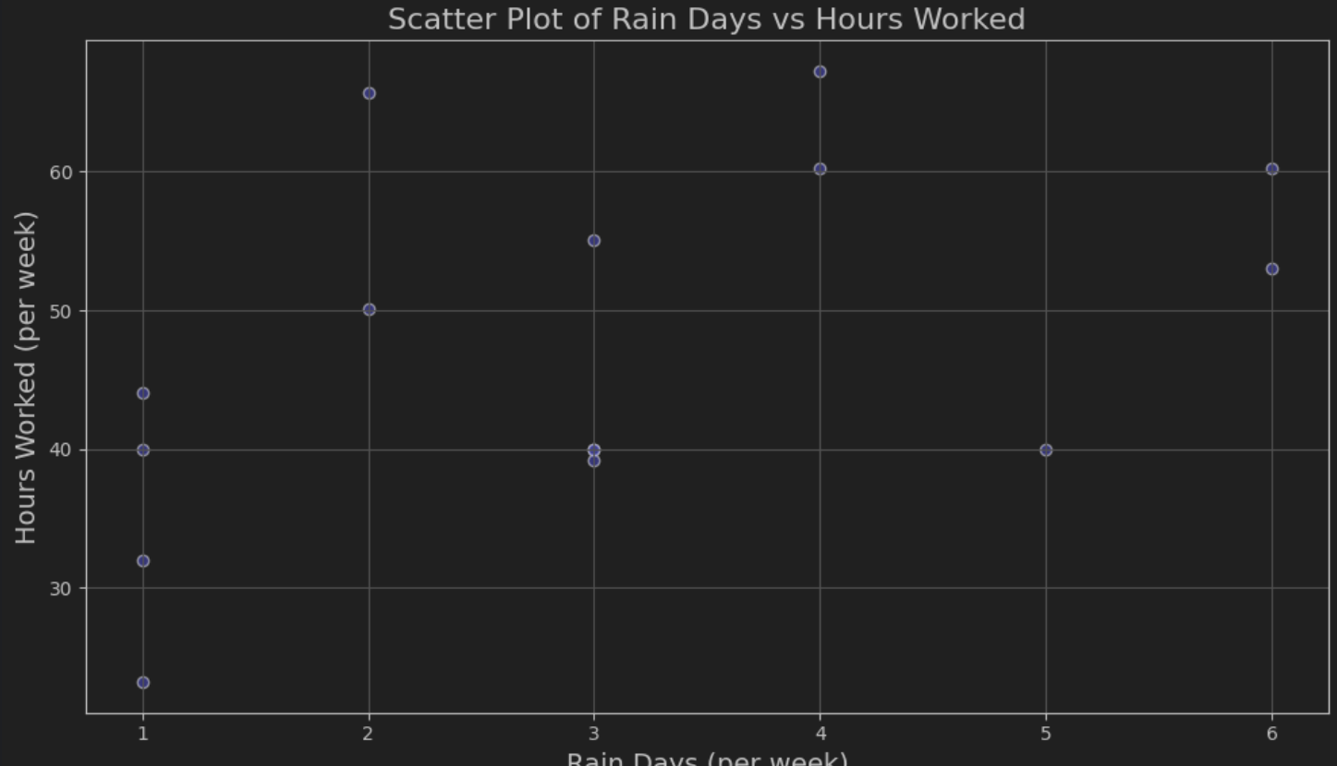
A scatter plot so we can visualize it better

Slide 11
Conclusion
I found that in weeks with more rainy days I got more time, and this also shows that there was more foot traffic indoors.

Slide 12


This means that we fail to reject the hypothesis
This is because p value is higher than 0.05

Slide 13
Thanks for seeing my work

