Slide 1
Player Behavior Analysis and Dropout Prediction in Digital Games
Using Deep Neural Networks with Steam Player Data
[Your Name] • [Student ID] • [Date]

Slide 2
Introduction
• Player churn is a key issue in digital games.
• Goal: Predict if a player will drop out based on usage trends.
• Dataset: Monthly Steam player statistics.

Slide 3
Dataset Overview
• Source: SteamCharts.com (monthly records)
• Features: Avg_players, Gain, Percent_Gain, Peak_Players, etc.
• Churn Label: Based on Percent_Gain direction.

Slide 4
Feature Engineering
• Gain_Ratio: Percent change in players.
• Gain_Direction: Positive/negative gain.
• Volatility: Absolute relative change.
• Label: churn = 1 (drop), 0 (retain).

Slide 5
Model Architecture
• Deep Neural Network (DNN) with 3 hidden layers.
• Activation: ReLU | Output: Sigmoid.
• Optimizer: Adam | Loss: Binary Crossentropy | Epochs: 50

Slide 6
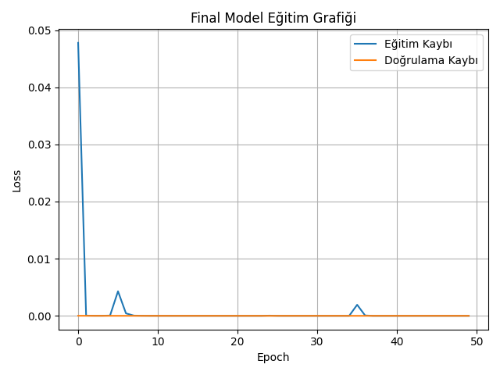
Training Results
• Test Accuracy: 100%
• Confusion Matrix: [[512, 0], [0, 520]]
• Loss curve shows perfect convergence.

Slide 7
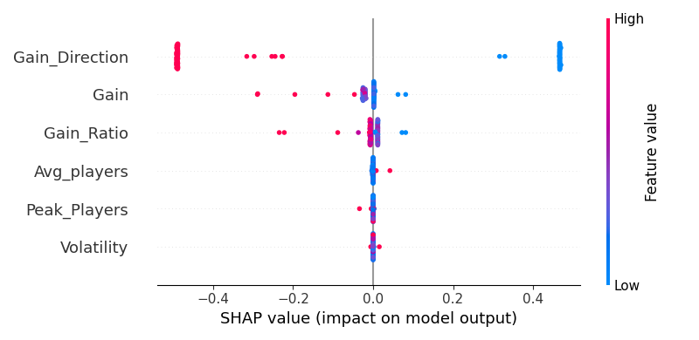
SHAP Explainability
• Explains why model made each prediction.
• Top features: Gain_Direction, Gain, Gain_Ratio.
• Visual: SHAP summary plot used.

Slide 8
Conclusion & Future Work
• Accurate churn prediction with simple features.
• Future: Use in-game metrics, extend to other games.
• Try LSTM or temporal models.

Slide 9
Q&A
• Thank you for your attention!
• Any questions?

