Slide 1
BNO085 Embedded
Heading Sensor System
Objective
Acquire calibrated magnetic-field data from BNO085
STM32F767ZI + FreeRTOS + NMEA 0183 + ROS2 lifecycle driver
Calculate magnetic heading and reduce fluctuation on STM32
Transmit standard NMEA HDM sentences over UART
Publish ROS2 IMU orientation, TF and diagnostics
Deliverable focus: reliable sensor acquisition, timing validation and ROS2 integration.
Kuartis Embedded Software Homework · 1

Slide 2
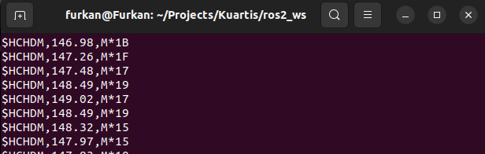
End-to-End System Architecture
From BNO085 calibrated magnetic field to ROS2 orientation and diagnostics.
BNO085
magnetometer
STM32
SPI/SHTP
Calibration
+ heading
Kalman
X/Y filters
NMEA HDM
UART
ROS2
node
NMEA output
Key interfaces
BNO085 communication through SPI and SHTP packets
UART stream uses readable NMEA 0183 HDM format
ROS2 converts heading into yaw quaternion and TF
$HCHDM,<heading>,M*checksum
Kuartis Embedded Software Homework · 2

Slide 3
Embedded Runtime Architecture
FreeRTOS tasks isolate sensor acquisition from communication output.
Task-level design
UART output path
SensorTask
BNO085 process + heading
FreeRTOS Queue
HeadingMessage
CommunicationTask
NMEA + UART output
NMEA sentence
TX ring buffer
Sensor state machine
STARTUP
WAIT
PRODUCT ID
CALIBRATING
RUNNING
Interrupt-driven UART
ROS2 serial input
RECOVERY
Timeouts and communication errors trigger recovery and re-initialization.
Complete messages are enqueued to avoid partial NMEA frames.
Kuartis Embedded Software Homework · 3

Slide 4
Heading Calculation & Kalman Filtering
Heading is calculated from calibrated X/Y magnetic components and stabilized before ROS output.
Heading calculation
Kalman parameter selection
heading = atan2(Y, X) × 180 / π
Measurement noise R
Stationary magnetic-field variance was estimated with Welford algorithm.
if heading < 0° → heading = heading + 360°
Rx = 0.433 µT² · Ry = 0.393 µT²
Process noise Q = 0.25 µT²/s was tuned for smoothness vs responsiveness.
The output is a magnetic heading in the 0° to 360° range.
Filtering strategy
Core update equations
Calibrated X
Kalman 1D
K = P- / (P- + R)
Filtered
Heading
x = x- + K(z - x-)
Calibrated Y
Kalman 1D
Kalman gain is recalculated at every update.
Kuartis Embedded Software Homework · 4

Slide 5
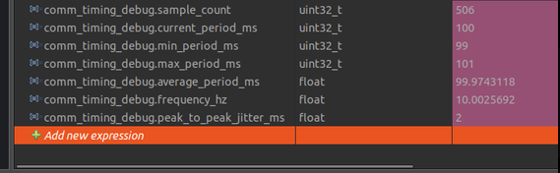
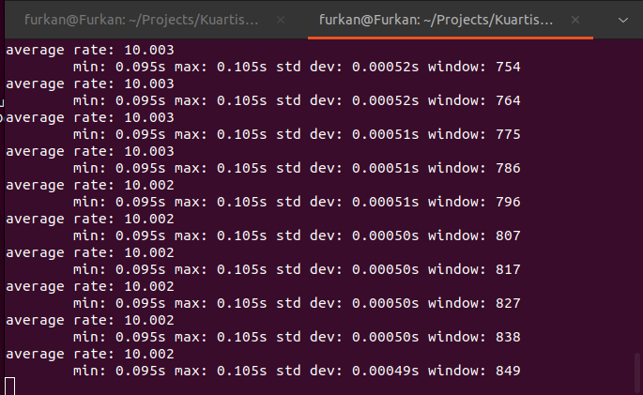
Performance Validation
Embedded timing and ROS2 publish rate were measured separately.
Embedded timing counters
ROS2 publish rate
Embedded result: 99-101 ms period, 2 ms peak-to-peak jitter, 10.003 Hz.
ROS2 result: /imu/data remains at approximately 10 Hz over 849 samples.
Kuartis Embedded Software Homework · 5

Slide 6
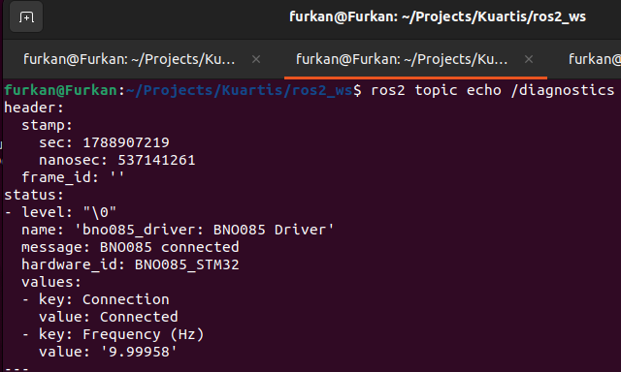
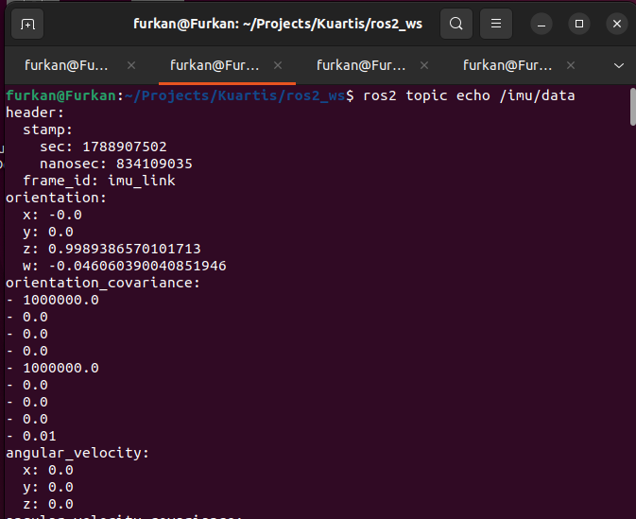
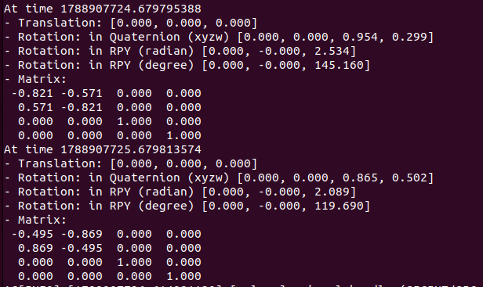
ROS2 Integration Outputs
Lifecycle node publishes standard ROS interfaces and runtime health information.
Diagnostics output
/imu/data message
TF output
Connection: Connected, frequency: ~10 Hz.
Heading is represented as a yaw quaternion.
base_link to imu_link transform exposes yaw.
Kuartis Embedded Software Homework · 6

Slide 7
Challenges, Improvements & Live Demonstration
The final step validates the complete embedded-to-ROS data path live.
Challenge
Solution
Improvement
Magnetometer data still showed short-term heading fluctuation after calibration.
Apply independent scalar Kalman filters to calibrated X and Y before heading calculation.
Add tilt compensation to improve heading reliability when the sensor is not level.
Cause: measurement noise and environmental magnetic disturbance.
R was measured from stationary variance; Q was tuned experimentally.
A future version can fuse accelerometer/orientation data for compensated heading.
Live demonstration sequence
CubeIDE debug
CubeMonitor graph
ROS2 topics
TF + diagnostics
1
2
3
4
Check calibration_ok and runtime variables.
Compare raw heading and Kalman-filtered heading.
Show /imu/data content and publish rate.
Show yaw transform and connected status.
Kuartis Embedded Software Homework · 7

