Slide 1
CS406 Project
DISTANCE-2 GRAPH COLORING
EDA DENİZ CANER, FURKAN KEMİKLİ, UFUK AKGEYİK

Slide 2
PROBLEM STATEMENT
What is the problem?
Relation with Distance-1 Coloring
What are the challenges?

Slide 3
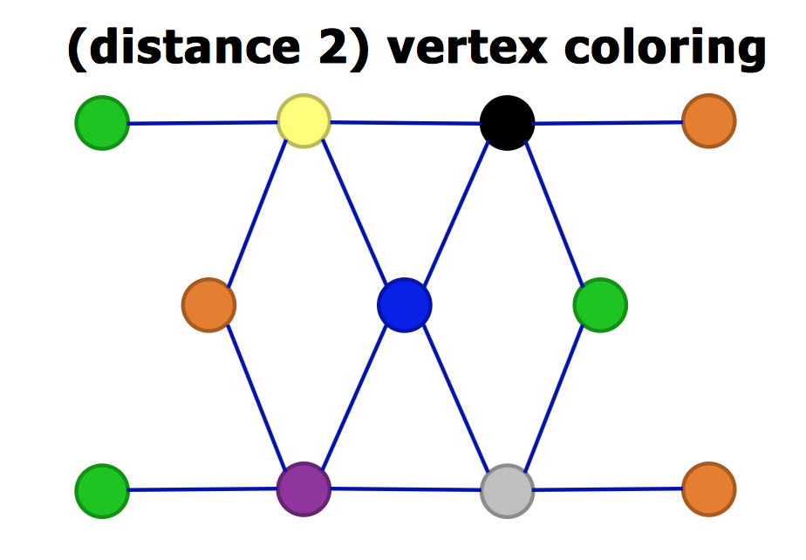
Source: http://slideplayer.com/slide/8160116/

Slide 4
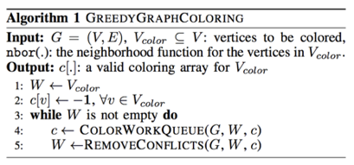
D2ColoringFirst Algorithm

Slide 5
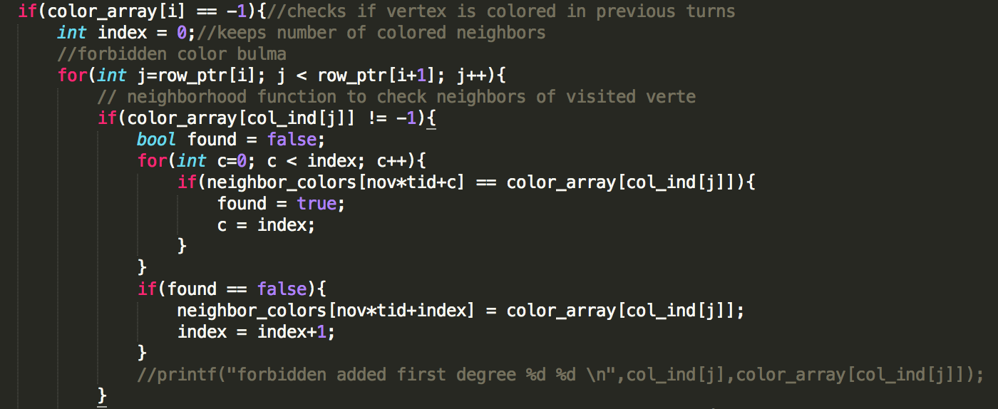
D2ColoringFirst – ColorWork(1)

Slide 6
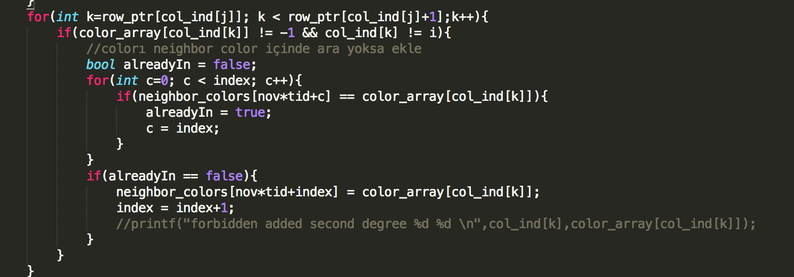
D2ColoringFirst – ColorWork(2)

Slide 7
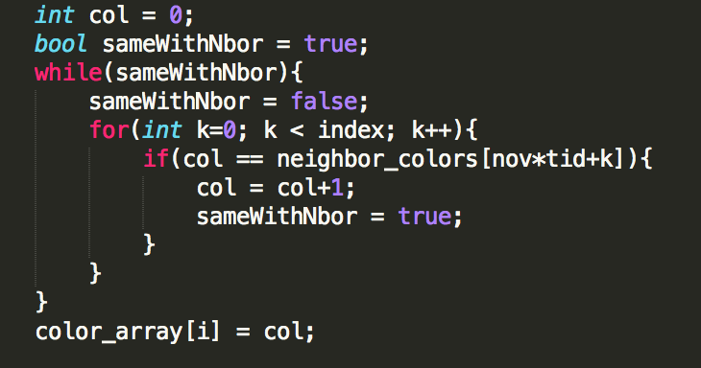
D2ColoringFirst – ColorWork(3) Add Color Step

Slide 8
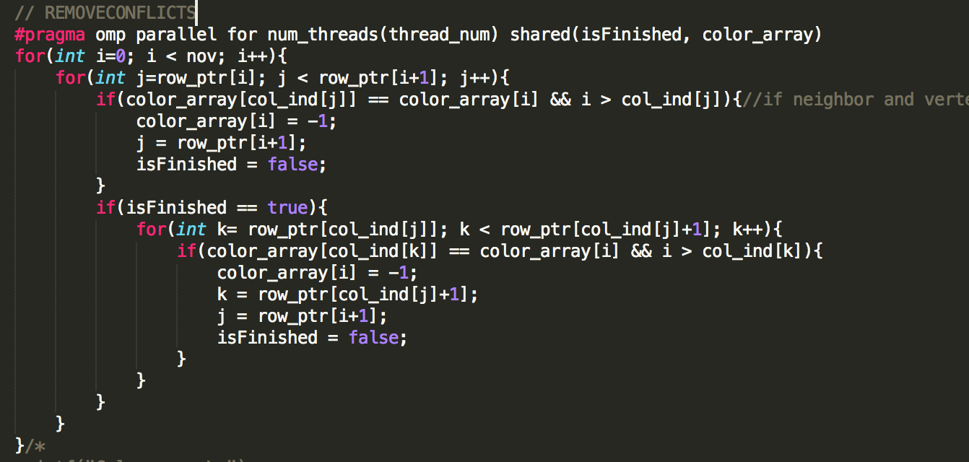
D2ColoringFirst – RemoveConflicts

Slide 9
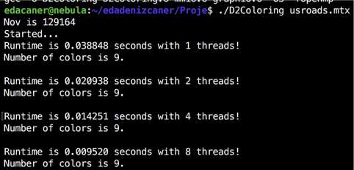
Evaluation of D2ColoringFirst Algorithm usroads.mtx
Speed up: 4.080

Slide 10
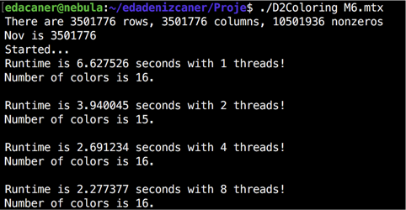
Evaluation of D2ColoringFirst Algorithm M6.mtx
Speed up: 2.910

Slide 11
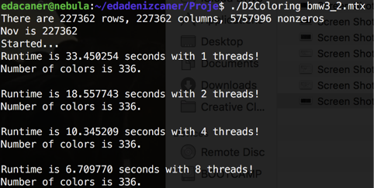
Evaluation of D2ColoringFirst Algorithm bmw3_2.mtx
Speed up: 4.985

Slide 12
D2Coloring - Another OpenMP Some tricks
an array of arrays to store the vertices and their neighbours.
another array that stores the number of neighbours of each vertex.
array to store the colours of each vertex
Let’s see the pseudocode..

Slide 13
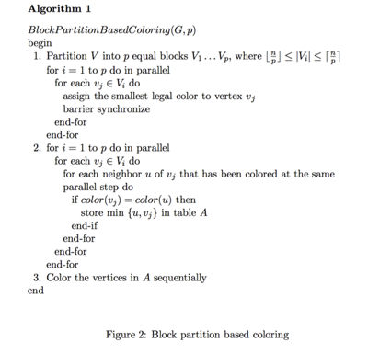
D2Coloring

Slide 14
D2Coloring
Let’s see details..

Slide 15
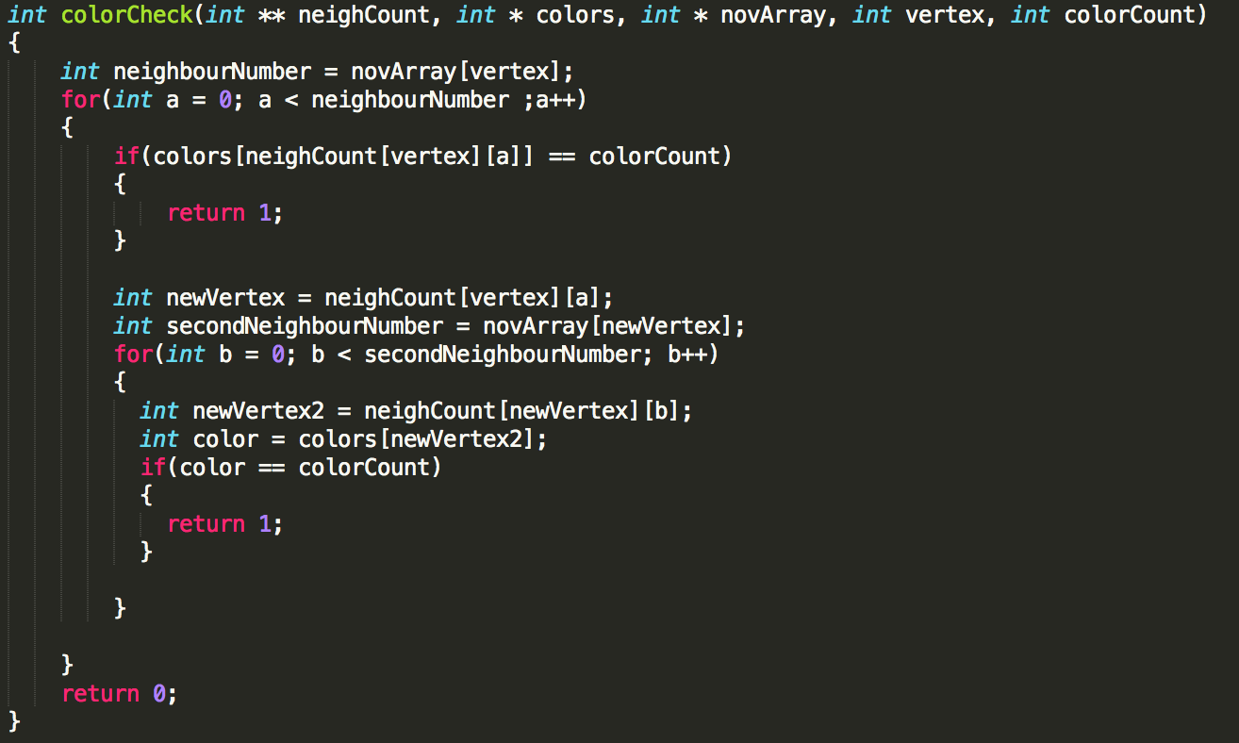
D2Coloring - ColorCheck
Let’s see details..

Slide 16
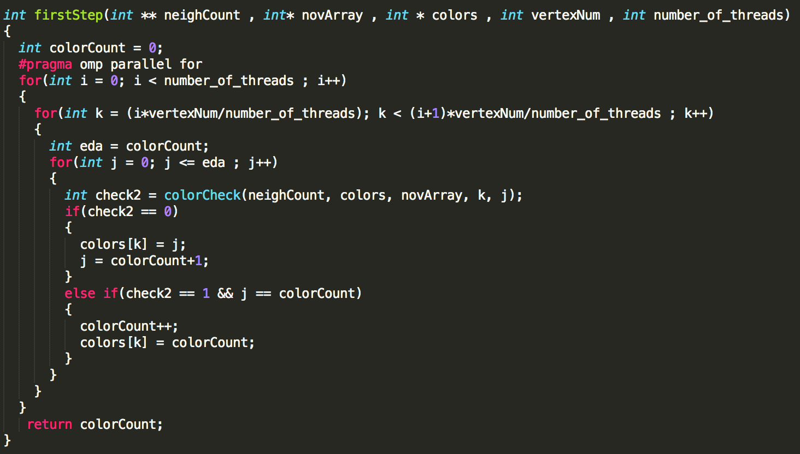
D2Coloring – First Step

Slide 17
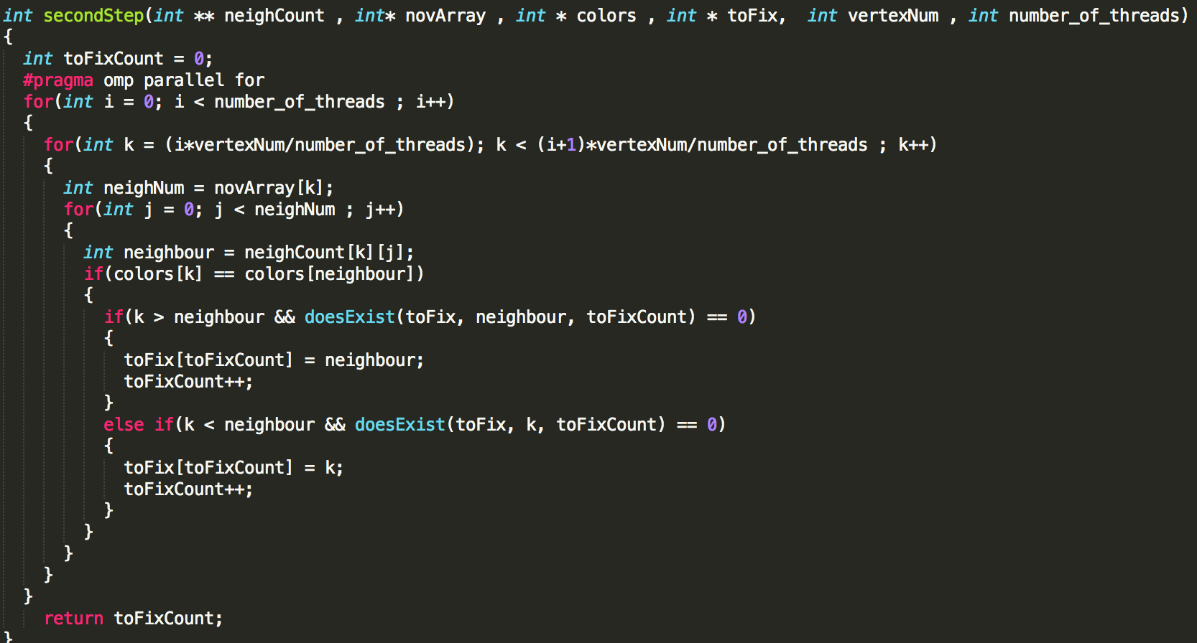
D2Coloring – Second Step
Let’s see details..

Slide 18
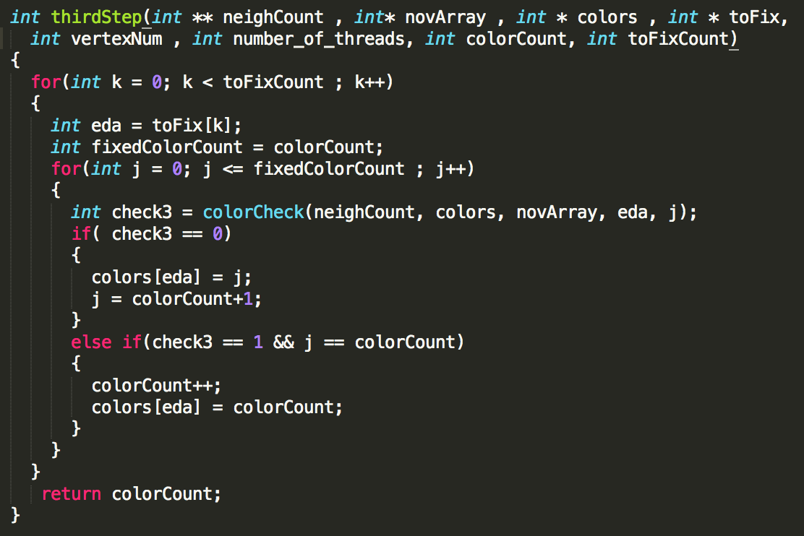
D2Coloring – Third Step
Let’s see details..

Slide 19
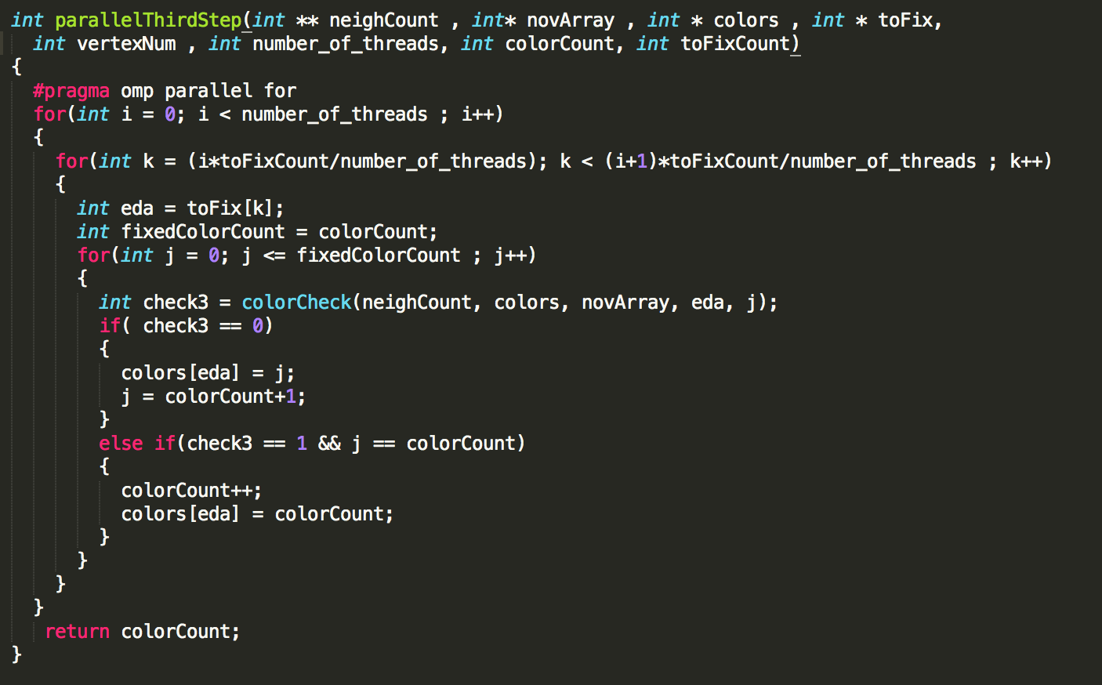
D2Coloring – Paralel Third Step
Let’s see details..

Slide 20
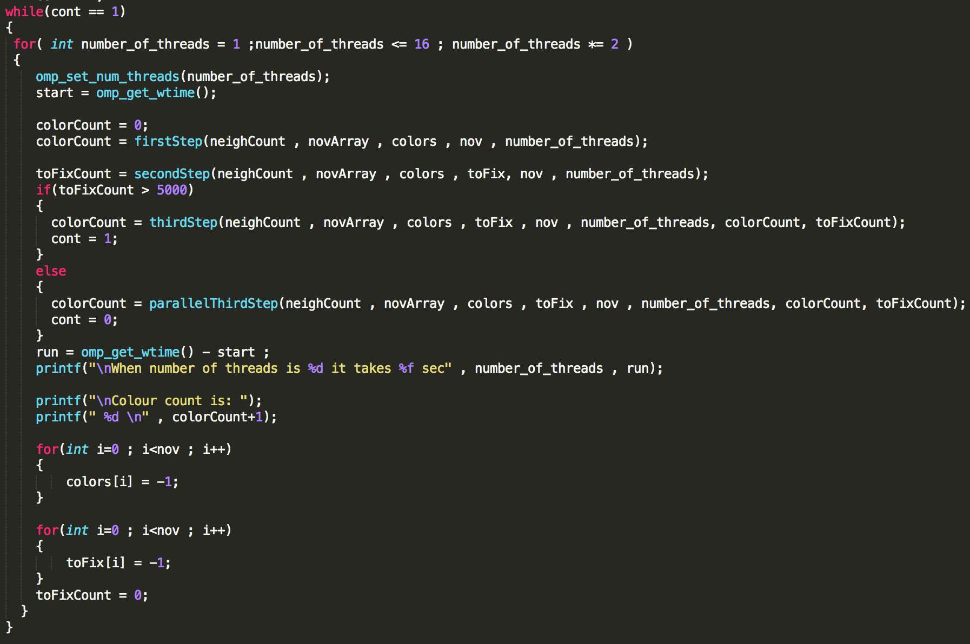
D2Coloring
Let’s see details..

Slide 21

Evaluation of D2Coloring

Slide 22
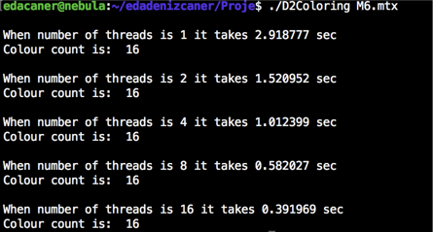
Evaluation of D2Coloring – m6
Let’s see details..
Speed up: 7.447

Slide 23
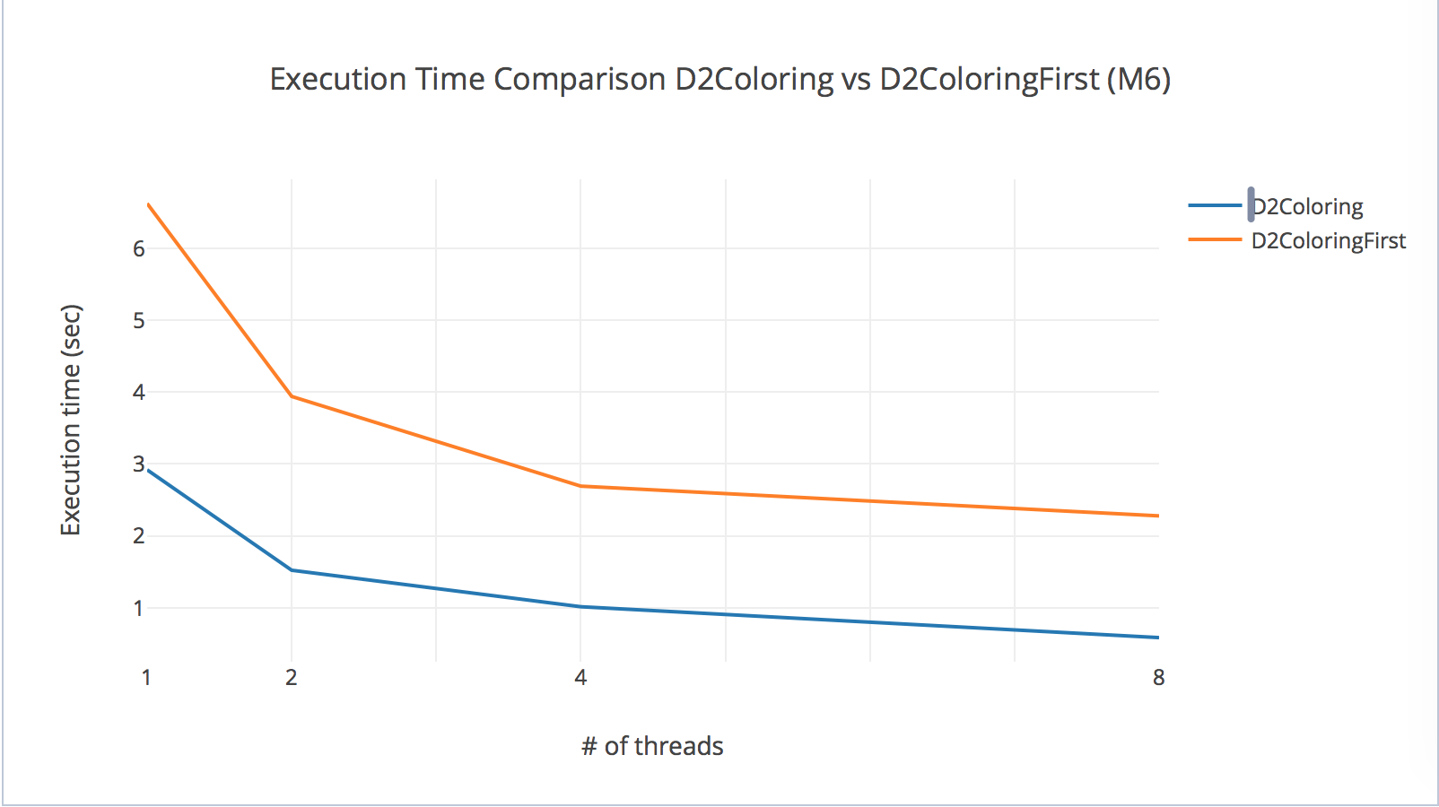
D2ColoringFirst vs. D2Coloring

Slide 24
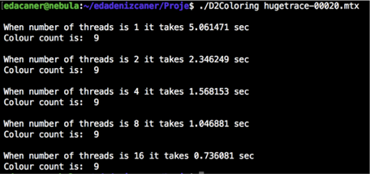
Evaluation of D2Coloring – hugetrace
Let’s see details..
Speed up: 6.876

Slide 25
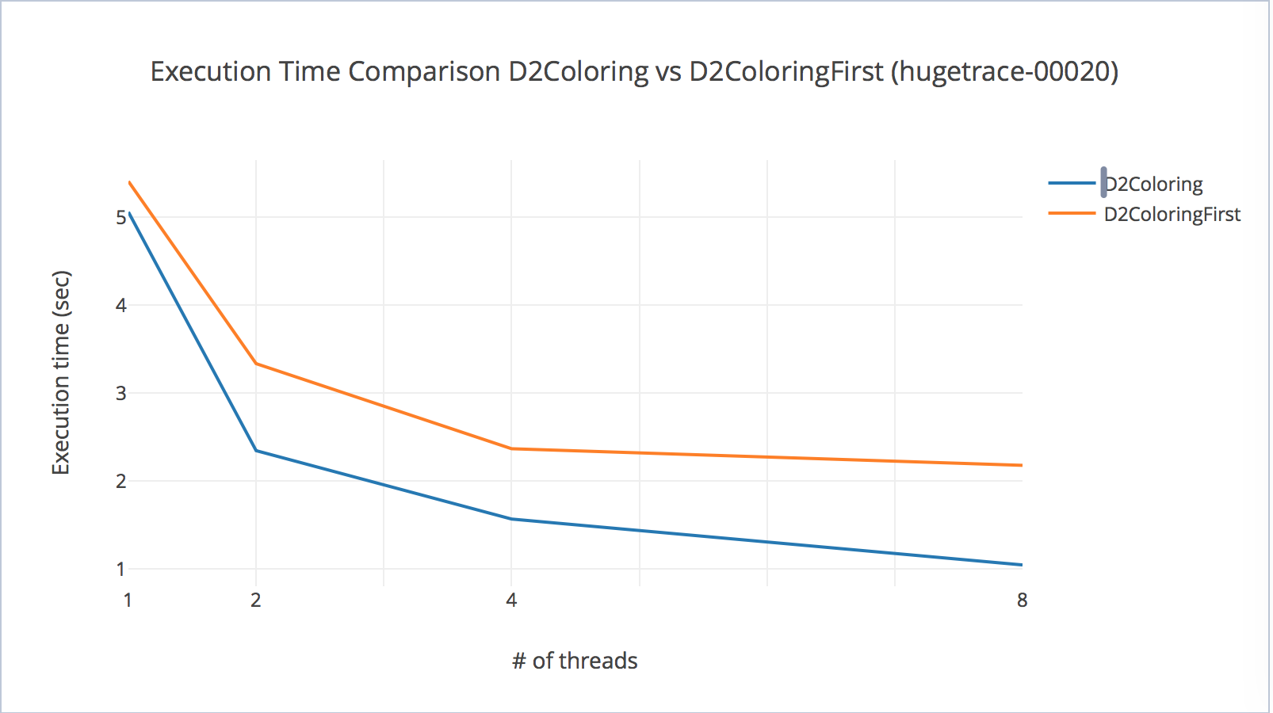
D2ColoringFirst vs. D2Coloring

Slide 26
Why don’t we have a CUDA version?
Two different approaches
Failed or successful?
Let’s see..

Slide 27
First implementation: d2gc Algorithm
Simple idea
coloring Distance-1 and Distance-2 neighbors of a vertice
is moved to a Kernel function colorWork

Slide 28
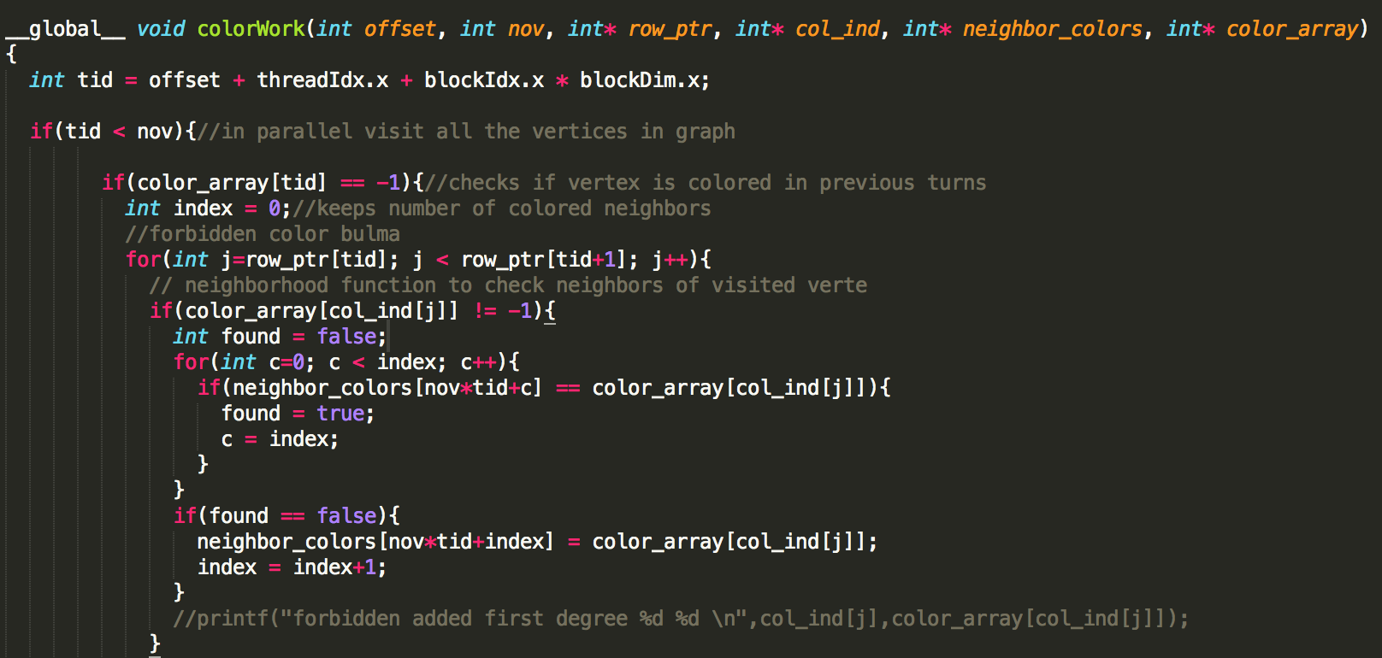
ColorWork

Slide 29
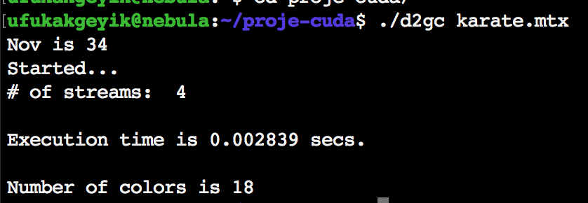
Evaluation of d2gc Algorithm
Good for small graph
BUT ?!

Slide 30
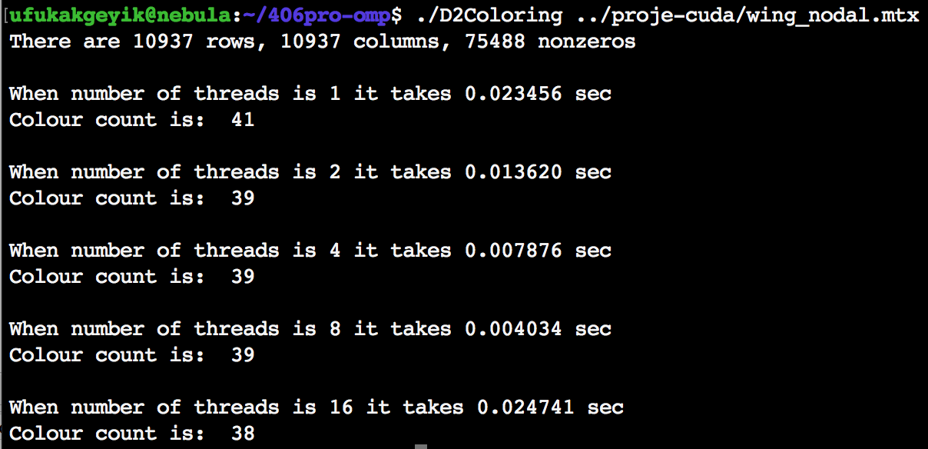
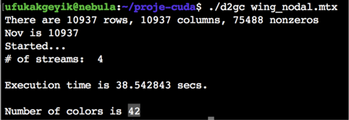
Evaluation of d2gc Algorithm
D2Coloring
D2gc(cuda)

Slide 31
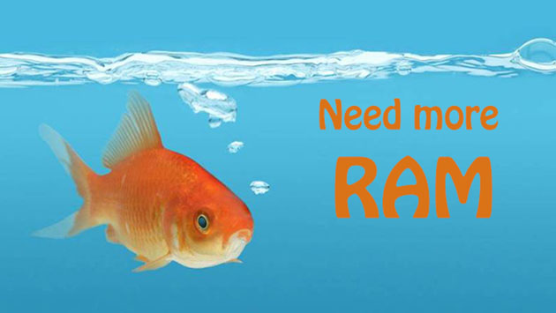
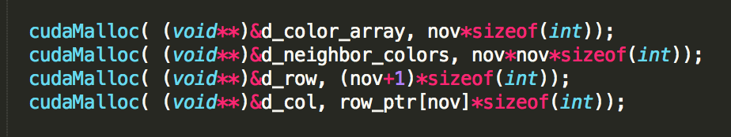
Problem

Slide 32
Second implementation: HybridD2Coloring
an hybrid approach by using both GPU and CPU structure
implemented the coloring part of our second algorithm(D2Coloring) on GPU using CUDA
The rest is still run on the CPU and parallelized by using OpenMP

Slide 33
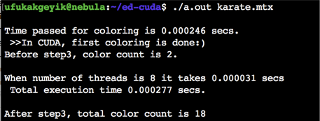

Evaluation of HybridD2Coloring
Safety check:

Slide 34
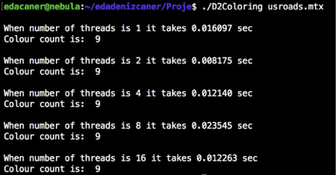
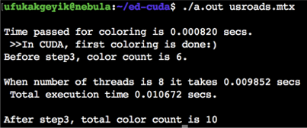

Usroads – D2Coloring vs. HybridD2Coloring

Slide 35
Thank you for listening

