Slide 1
Graphics & Plots: matplotlib & pylab
Week 11

Slide 2
Outline
Testing pylab
Download data
Basic plots
  scatter plots, histograms, boxplots
Exercises

Slide 3
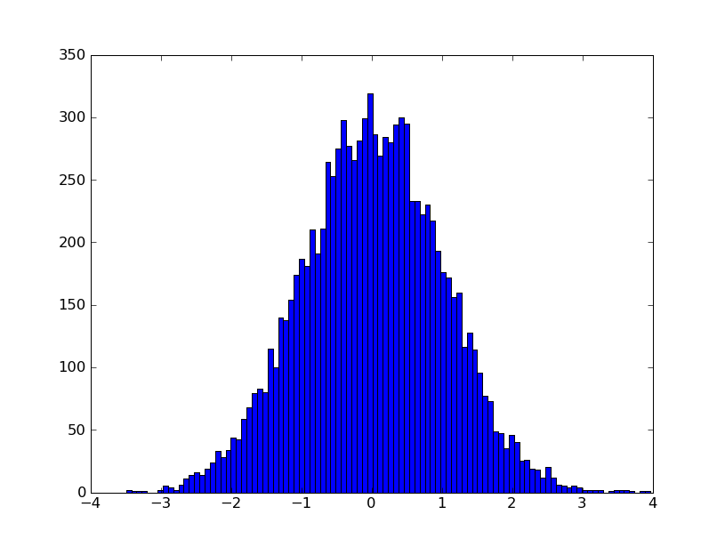
Test the pylab installation
Create the python script shown on the right
python test_pylab.py
test_pylab.py
from pylab import *
x = randn(10000)
hist(x, 100)
show()

Slide 4
Download some data
Download the data and the module for handling it, from the Tugba hoca’s eng1 page
  data.txt, data.py
Take a look!
  Open data.txt in a text-editor (IDLE or notepad)
  Run look.py
look.py
from data import *
print(genes)
print(data['AA055368'])
print(t1data['AA055368'])

Slide 5
Scatter plot
Use the plot function
for a scatter plot
  list of values
  x vs y
Choose to plot dots
or lines with last argument
  '.' for dots
  '-' for lines (default)
scatter_plot1.py
from pylab import *
from data import *
plot(data['AA055368'])
show()
scatter_plot2.py
from pylab import *
from data import *
plot(data['AA055368'],
data['R31679'],'.')
show()

Slide 6
Heatmap
heatmap1.py
from pylab import *
from data import *
pcolor(tmdata)
show()
Use the pcolor
function for a
heatmap
  list of lists, or
  numpy 2-D matrix
Choose colormap
  cool()
  hot()
Lots of tweaking options to make it
look just right
heatmap2.py
from pylab import *
from data import *
pcolor(tmdata)
clim((-6,6))
gci().set_cmap(cm.RdYlGn)
colorbar()
ylim([nsmpl,0])
axis('tight')
xlabel('Gene')
ylabel('Sample')
show()
# savefig('colormap.png',dpi=150)

Slide 7
Histogram & Boxplot
Use the hist function
for a histogram
  list of values
  number of bins
Use the boxplot
function for a boxplot
  useful for comparing distributions
  list of list of values
hist_plot1.py
from pylab import *
from data import *
hist(data['AA055368'])
show()
hist_plot2.py
from pylab import *
from data import *
hist(data['AA055368'],5)
show()
box_plot.py
from pylab import *
from data import *
boxplot([t1data['AA055368'],
t2data['AA055368']])
show()

Slide 8
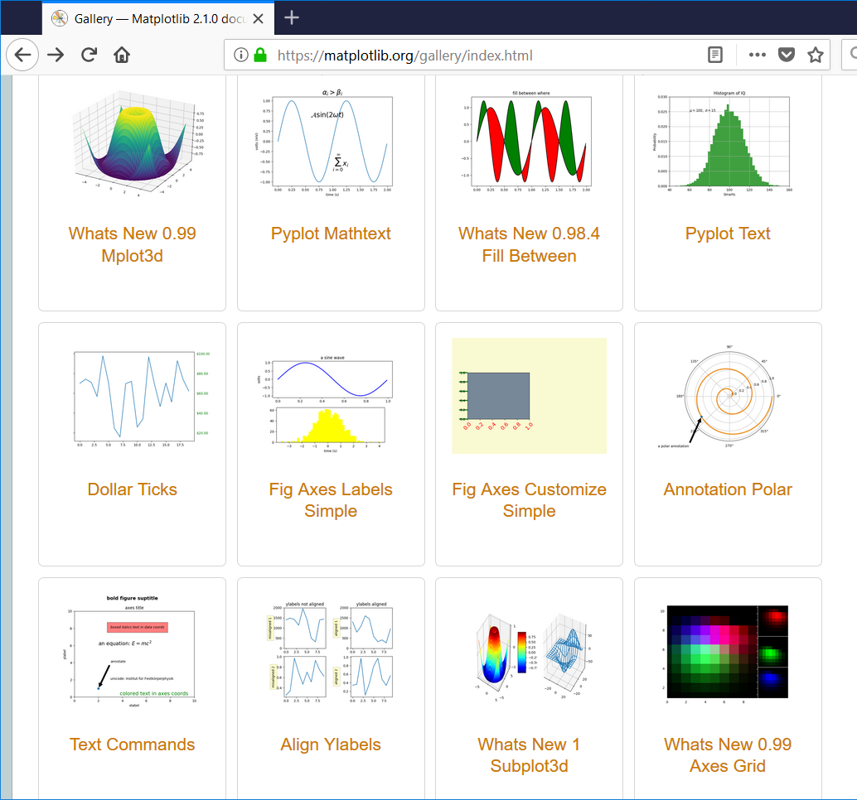
Check out the matplotlib gallery!

Slide 9
Lets analyze this dataset!
Find differentially expressed genes!
differential.py
from pylab import *
from data import *
g2t = {}
for g in genes:
g2t[g] = tstatistic(t1data[g],t2data[g])
x = g2t.values()
hist(x)
show()
bytstat = sorted(genes,key=g2t.get)
print("Min:", bytstat[0], min(x))
print("Max:", bytstat[-1], max(x))

Slide 10
Lets analyze this dataset!
Find differentially expressed genes!
differential1.py
from pylab import *
from data import *
g2t = {}
for g in genes:
g2t[g] = tstatistic(t1data[g],t2data[g])
bytstat = sorted(genes,key=g2t.get)
gene = bytstat[0]
boxplot([t1data[gene],t2data[gene]])
title(gene)
show()

Slide 11
Find correlated genes
correlated.py
from pylab import *
from data import *
gp2rho = {}
for i in range(ngene):
for j in range(i+1,ngene):
gi = genes[i]
gj = genes[j]
gp2rho[(gi,gj)] = corrcoef(data[gi],data[gj])[0,1]
hist(gp2rho.values())
show()
sx = sorted(gp2rho.keys(),key=gp2rho.get)
print(sx[0],sx[-1])

Slide 12
Find correlated genes
correlated1.py
from pylab import *
from data import *
gp2rho = {}
for i in range(ngene):
for j in range(i+1,ngene):
gi = genes[i]
gj = genes[j]
gp2rho[(gi,gj)] = corrcoef(data[gi],data[gj])[0,1]
sx = sorted(gp2rho.keys(),key=gp2rho.get)
bestpair = sx[-1]
gi = bestpair[0]
gj = bestpair[1]
plot(data[gi],data[gj],'.')
show()

Slide 13
Further work!
The numpy, scipy, matplotlib triple have become the mainstay of data-science in python
But see also:
  Pandas (R-style data-frames)
  Seaborn (R-style statistical plots)
  Statsmodels (R-style statistical models)
  scikit-learn, TensorFlow, PyTorch, Keras (ML)
  NLTK (natural language)

Slide 14
Exercises
Try each of the examples shown in these slides.
Check out the gallery of figures on the matplotlib web-site.

Slide 15
Developing Web-Applications
with no framework

Slide 16
Web-Applications
Use the web-browser as the user-interface
All application specific functionality comes directly from the web-server
No installation impediments for the user
Fast way to provide your tools to others with little operating system or user-interface barrier
Natural way to supply views into complex datasets that cannot feasibly be installed elsewhere.

Slide 17
Web-Servers
Respond to requests:
  http://google.com
with static:
  files, images, etc...
and dynamic:
  your facebook page, google search results
content.

Slide 18
Web-servers
A URL is made up of many parts.
port #
(80 if omitted)
http://eng1.mu.edu.tr:80/~tugba/cgi-bin/hello.cgi
protocol
(http,https)
computer name
resource

Slide 19
Web-servers
A URL is made up of many parts.
A dynamic resource may return different results depending on its parameters
Additional request parameters may not be visible in the URL
  Cookies, POST requests
port #
(80 if omitted)
resource/request
parameters
http://eng1.mu.edu.tr:80/~tugba/cgi-bin/formdatainserter.cgi?num=2&word=two
protocol
(http,https)
computer name
resource

Slide 20
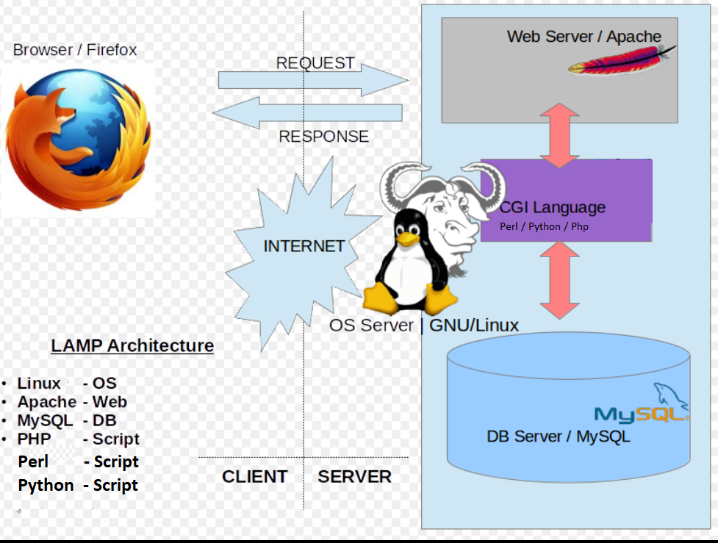


Slide 21
Setting up a MySql-Python LAMP server on your own Linux machine
https://www.digitalocean.com/community/tutorials/how-to-set-up-an-apache-mysql-and-python-lamp-server-without-frameworks-on-ubuntu-14-04
You need to be a sudo user for this!

Slide 22
Web-server
Web-servers return data in HTML format for display by the web-browser.
Any program can request URL resources and store (and display) the response.
Any program can handle the URL request and return data in whatever format they like.

Slide 23
Let’s create our first Server Side CGI!
mkdir /home/tugba/public_html/cgi-bin
nano /home/tugba/public_html/cgi-bin/hello.cgi
chmod o+x /home/tugba/public_html/cgi-bin/hello.cgi
/home/tugba/public_html/cgi-bin/hello.cgi
http://eng1.mu.edu.tr/~tugba/cgi-bin/hello.cgi
#!/usr/bin/env python3
import cgi;
import cgitb;cgitb.enable()
print("Content-Type: text/html")
print()
print("<b>hello python</b>")

Slide 24
Connect your CGI to MySQL
nano /home/tugba/public_html/cgi-bin/hello.cgi
http://eng1.mu.edu.tr/~tugba/cgi-bin/hello.cgi
#!/usr/bin/env python3
import cgi;
import cgitb;cgitb.enable()
import pymysql
print("Content-Type: text/html")
print()
# Connect to the database.
conn = pymysql.connect(
db='test',
user='testuser',
passwd='1Allowed.',
host='localhost')
c = conn.cursor()
# Insert some example data.
c.execute("INSERT INTO numbers VALUES (1, 'One!')")
c.execute("INSERT INTO numbers VALUES (2, 'Two!')")
c.execute("INSERT INTO numbers VALUES (3, 'Three!')")
conn.commit()
# Print the contents of the database.
c.execute("SELECT * FROM numbers")
print([(r[0], r[1]) for r in c.fetchall()])

Slide 25
Send the form data from client-side
nano /home/tugba/public_html/cgi-bin/hello.cgi
#!/usr/bin/env python3
import cgi;
import cgitb;cgitb.enable()
print("Content-Type: text/html")
print()
print("<form action = \"/cgi-bin/formdatainserter.cgi\" method = get> My favorite number: <input type = \"integer\" name = \"num\"> <br />My string comment: <input type = text name = word /> <input type = submit value = Submit /> </form>")

Slide 26
Receiver on server-side: formdatainserter.cgi
nano /home/tugba/public_html/cgi-bin/formdatainserter.cgi
chmod o+x /home/tugba/public_html/cgi-bin/formdatainserter.cgi
public_html/cgi-bin/formdatainserter.cgi 'num=3&word=three'
#!/usr/bin/env python3
import cgi;
import cgitb;cgitb.enable()
import pymysql
print("Content-Type: text/html")
print()
form = cgi.FieldStorage()
num = form.getvalue('num')
word = form.getvalue('word')
connection = pymysql.connect(host = 'localhost', user='testuser', password='1Allowed.', db='test', charset='utf8mb4', cursorclass=pymysql.cursors.DictCursor)
with connection.cursor() as cursor:
#create a new record in the database
sql = "INSERT INTO `numbers` (`num`, `word`) VALUES (%s, %s)"
cursor.execute(sql, (num, word))
# connection is not autocommit by default. So you must commit to save your changes.
connection.commit()
newcursorforselect = connection.cursor()
# Print the contents of the database.
newcursorforselect.execute("SELECT * FROM numbers")
try:
records=newcursorforselect.fetchall()
for r in records:
print("Number is ", r["num"]," and the word is ",r["word"])
newcursorforselect.close()
except pymysql.Error as error:
print("This is a very bad mistake: ",error)

Slide 27
Homework 5
Find potential covid and human papilloma virus orthologs
  Download FASTA files HPV.fasta.gz and cov.fasta.gz from http://eng1.mu.edu.tr/~tugba/Bioinformatics
  Uncompress and format each FASTA file for BLAST
  Search covid proteins against HPV ribosomal proteins
  For each covid query, output the best HPV protein if it has a significant E-value (evalue < 1e-5)
    What cov2 protein is most highly conserved between cov2 and HPV?

