Slide 1
Bioinformatics Programming
Week 7

Slide 2
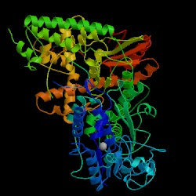
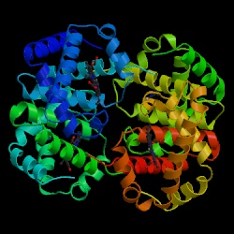
Proteins are…
…3-D molecules that interact with other (biological) molecules to carry out biological functions…
DNA Polymerase Hemoglobin

Slide 3
Protein Data Bank (PDB)
Repository of the 3-D conformation(s) / structure of proteins.
The result of laborious and expensive experiments using X-ray crystallography and/or nuclear magnetic resonance (NMR).
  (x,y,z) position of every atom of every amino-acid
Some entries contain multi-protein complexes, small-molecule ligands, docked epitopes and antibody-antigen complexes…

Slide 4
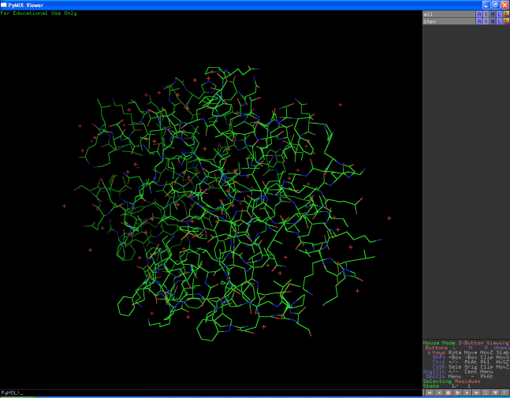
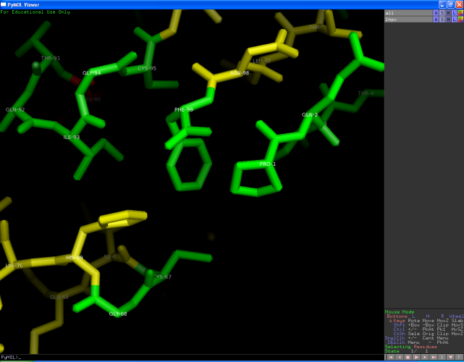
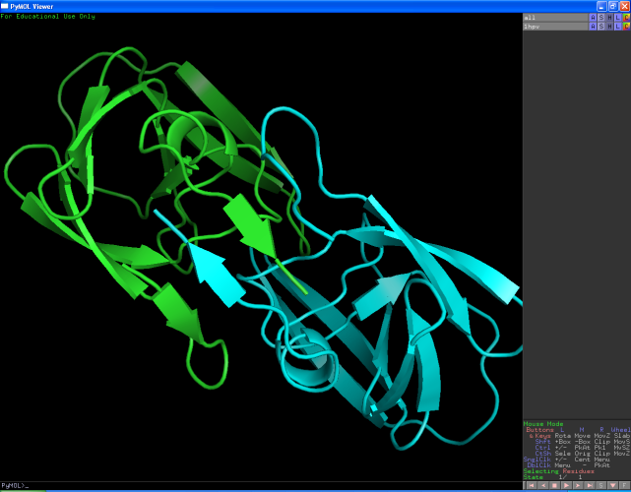
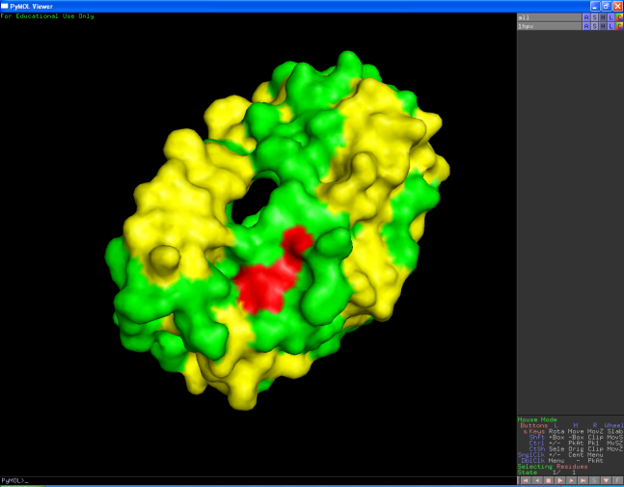
Visualization (PyMOL)

Slide 5
Biopython Bio.PDB
Parser for PDB format files
Navigate structure and answer atom-atom distance/angle questions.
Structure (PDB File) >> Model >> Chain >> Residue >> Atom >> (x,y,z) coordinates
  SMCRA representation mirrors PDB format

Slide 6
Download PDB files from Internet
import Bio.PDB.PDBParser
import sys
from Bio.PDB import PDBList
# Use QUIET=True to avoid lots of warnings...
parser = Bio.PDB.PDBParser(QUIET=True)
pdbl = PDBList()
pdbl.retrieve_pdb_file('1KCW',pdir=".",file_format="pdb")
pdbl.retrieve_pdb_file('1HPV',pdir=".",file_format="pdb")

Slide 7
SMCRA (Structure/Model/Chain/Residue/Atom)
Data-Model
Each PDB file represents one “structure”
Each structure may contain many models
  In most cases there is only one model, index 0.
Each polypeptide (amino-acid sequence) is a “chain”.
  A single-protein structure has one chain, “A”
  1HPV is a dimer and has chains “A” and “B”.

Slide 8
SMCRA Data-Model
Please download https://www.rcsb.org/structure/1HPV
import Bio.PDB.PDBParser
import sys
# Use QUIET=True to avoid lots of warnings...
parser = Bio.PDB.PDBParser(QUIET=True)
structure = parser.get_structure("1HPV", "pdb1hpv.ent")
model = structure[0]
# This structure is a dimer with two chains
achain = model['A']
bchain = model['B']
print(model)

Slide 9
SMCRA
Chains are composed of amino-acid residues
  Access by iteration, or by index
  Residue “index” may not be sequence position
Residues are composed of atoms:
  Access by iteration or by atom name
  …except for H!
Water molecules are also represented as atoms – HOH residue name, het=“W”

Slide 10
SMCRA Data-Model
import Bio.PDB.PDBParser
import sys
from Bio.PDB import PDBList
# Use QUIET=True to avoid lots of warnings...
parser = Bio.PDB.PDBParser(QUIET=True)
structure = parser.get_structure("1HPV", "pdb1hpv.ent")
model = structure[0]
for chain in model:
for residue in chain:
for atom in residue:
print(chain, residue, atom, atom.get_coord())

Slide 11
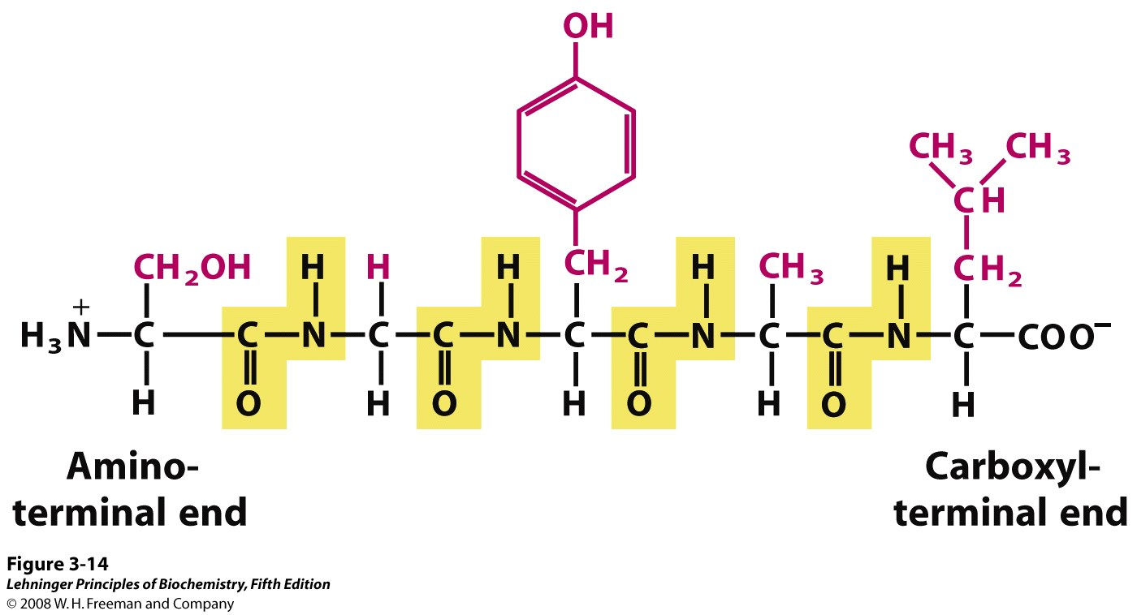
Polypeptide molecules
S-G-Y-A-L

Slide 12
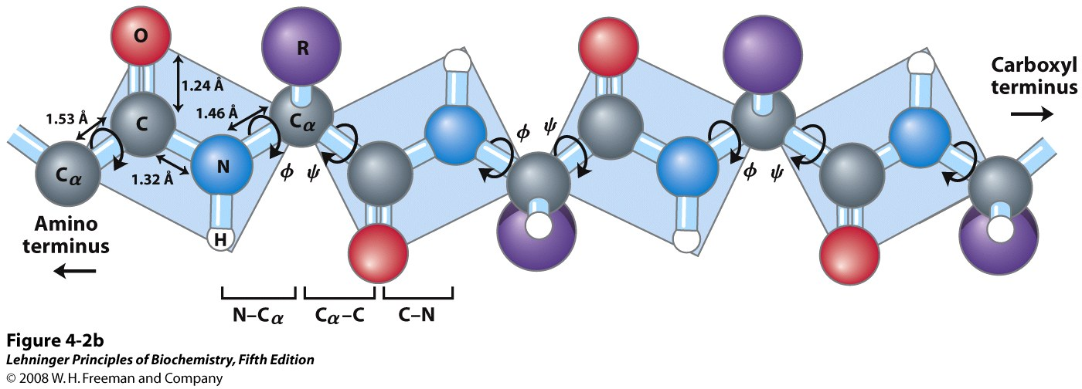
SMCRA Atom names

Slide 13
Check polypeptide backbone
import Bio.PDB.PDBParser
import sys
from Bio.PDB import PDBList
# Use QUIET=True to avoid lots of warnings...
parser = Bio.PDB.PDBParser(QUIET=True)
structure = parser.get_structure("1HPV", "pdb1hpv.ent")
model = structure[0]
achain = model['A']
for residue in achain:
try:
index = residue.get_id()[1]
calpha = residue['CA']
carbon = residue['C']
nitrogen = residue['N']
oxygen = residue['O']
print("Residue:",residue.get_resname(),index)
print("N - Ca",(nitrogen - calpha))
print("Ca - C ",(calpha - carbon))
print("C - O ",(carbon - oxygen))
except KeyError:
print("something is missing in this residue"+ residue.get_resname())

Slide 14
Check polypeptide backbone
import Bio.PDB.PDBParser
import sys
from Bio.PDB import PDBList
# Use QUIET=True to avoid lots of warnings...
parser = Bio.PDB.PDBParser(QUIET=True)
structure = parser.get_structure("1HPV", "pdb1hpv.ent")
model = structure[0]
achain = model['A']
for residue in achain:
try:
index = residue.get_id()[1]
calpha = residue['CA']
carbon = residue['C']
nitrogen = residue['N']
oxygen = residue['O']
if achain.has_id(index+1):
nextresidue = achain[index + 1]
nextnitrogen = nextresidue['N']
print("C - N ", (carbon - nextnitrogen))
except KeyError:
print("something is missing in this residue"+ residue.get_resname())

Slide 15
Find potential disulfide bonds
The sulfur atoms of Cys amino-acids often form “di-sulfide” bonds if they are close enough – less than 8 Å.
Compare with PDB file contents: SSBOND
Bio.PDB does not provide an easy way to access the SSBOND annotations

Slide 16
Find potential disulfide bonds
import Bio.PDB.PDBParser
import sys
from Bio.PDB import PDBList
# Use QUIET=True to avoid lots of warnings...
parser = Bio.PDB.PDBParser(QUIET=True)
structure = parser.get_structure("1KCW", "pdb1kcw.ent")
model = structure[0]
achain = model['A']
cysresidues=[]
for residue in achain:
if residue.get_resname() == 'CYS':
cysresidues.append(residue)
for c1 in cysresidues:
c1index = c1.get_id()[1]
for c2 in cysresidues:
c2index = c2.get_id()[1]
if (c1['SG'] - c2['SG']) < 8.0:
print("possible di-sulfide bond:")
print("Cys",c1index,"-“,)
print("Cys", c2index,)
print(round(c1['SG'] - c2["SG"],2))

Slide 17
Find contact residues in a dimer
import Bio.PDB.PDBParser
import sys
parser = Bio.PDB.PDBParser(QUIET=True)
structure = parser.get_structure("1HPV","pdb1hpv.ent")
achain = structure[0]['A']
bchain = structure[0]['B']
for res1 in achain:
try:
r1ca = res1['CA']
r1ind = res1.get_id()[1]
r1sym = res1.get_resname()
for res2 in bchain:
try:
r2ca = res2['CA']
r2ind = res2.get_id()[1]
r2sym = res2.get_resname()
if (r1ca - r2ca) < 6.0:
print("Residues",r1sym,r1ind,"in chain A",)
print("and",r2sym,r2ind,"in chain B",)
print("are close to each other:",round(r1ca-r2ca,2))
except ValueError:
pass
except ValueError:
pass

Slide 18
Find contact residues in a dimer – better version
import Bio.PDB.PDBParser
import sys
# Use QUIET=True to avoid lots of warnings...
parser = Bio.PDB.PDBParser(QUIET=True)
structure = parser.get_structure("1HPV", "1hpv.pdb")
achain = structure[0]['A']
bchain = structure[0]['B']
bchainresidues=[]
for r in bchain:
if(r.get_resname()!="HOH"):
try:
r["CA"]
bchainresidues.append(r)
except KeyError:
pass
bchainca = [r["CA"] for r in bchainresidues]
neighbors = Bio.PDB.NeighborSearch(bchainca)
for res1 in achain:
r1ca = res1['CA']
r1ind = res1.get_id()[1]
r1sym = res1.get_resname()
for r2ca in neighbors.search(r1ca.get_coord(), 5.0):
res2 = r2ca.get_parent()
r2ind = res2.get_id()[1]
r2sym = res2.get_resname()
print("Residues", r1sym, r1ind, "in chain A",)
print("and", r2sym, r2ind, "in chain B",)
print("are close to each other:", round(r1ca - r2ca, 2))

Slide 19
Superimpose two structures
(make sure you download 2WFJ.pdb and 2GW2.pdb!)
import Bio.PDB
import Bio.PDB.PDBParser
import sys
# Use QUIET=True to avoid lots of warnings...
parser = Bio.PDB.PDBParser(QUIET=True)
structure1 = parser.get_structure("2WFJ","2WFJ.pdb")
structure2 = parser.get_structure("2GW2","2GW2.pdb")
ppb=Bio.PDB.PPBuilder()
# Manually figure out how the query and subject peptides correspond...
# query has an extra residue at the front
# subject has two extra residues at the back
query = ppb.build_peptides(structure1)[0][1:]
target = ppb.build_peptides(structure2)[0][:-2]
query_atoms = [ r['CA'] for r in query ]
target_atoms = [ r['CA'] for r in target ]
superimposer = Bio.PDB.Superimposer()
superimposer.set_atoms(query_atoms, target_atoms)
print("Query and subject superimposed, RMS:", superimposer.rms)
superimposer.apply(structure2.get_atoms())
# Write modified structures to one file
outfile=open("2GW2-modified.pdb", "w")
io=Bio.PDB.PDBIO()
io.set_structure(structure2)
io.save(outfile)
outfile.close()

Slide 20
Superimpose two chains
import Bio.PDB
parser = Bio.PDB.PDBParser(QUIET=1)
structure = parser.get_structure("1HPV","1HPV.pdb")
model = structure[0]
ppb=Bio.PDB.PPBuilder()
# Get the polypeptide chains
achain,bchain = ppb.build_peptides(model)
aatoms = [ r['CA'] for r in achain ]
batoms = [ r['CA'] for r in bchain ]
superimposer = Bio.PDB.Superimposer()
superimposer.set_atoms(aatoms, batoms)
print("Query and subject superimposed, RMS:", superimposer.rms
superimposer.apply(model['B'].get_atoms())
# Write structure to file
outfile=open("1HPV-modified.pdb", "w")
io=Bio.PDB.PDBIO()
io.set_structure(structure)
io.save(outfile)
outfile.close()

Slide 21
Exercises (Optional)
Read through and try the examples from Chapter 11 of the Biopython Tutorial and the Bio.PDB FAQ.
https://biopython.org/wiki/The_Biopython_Structural_Bioinformatics_FAQ

