Slide 1
Advanced Python:
Exceptions
NCBI E-Utils

Slide 2
Class Project: Expectations
60% of your grade!
Project Report
Project Presentation
  Demo your program
  Describe your project solution

Slide 3
Exceptions
How to handle errors at run-time?
KeyError is an exception we've seen a lot!
compl_dict = {'A':'T', 'T':'A', 'C':'G', 'G':'C'}
print(compl_dict)
print(compl_dict['X'])

Slide 4
Exceptions
How to handle errors at run-time?
IndexError is an exception we've seen a lot!
alist = [1,2,3,4,5]
print(alist)
print(alist[10])

Slide 5
Exceptions
How to handle errors at run-time?
ValueError is an exception we've seen a lot!
shouldBeAnInt = 'jkfldsjlfalsjfdalja'
print(int(shouldBeAnInt))

Slide 6
Exceptions
Traditionally, we program around these potential errors:
compl_dict = {'A':'T', 'T':'A', 'C':'G', 'G':'C'}
print(compl_dict)
if 'X' in compl_dict:
print(compl_dict['X'])
alist = [1,2,3,4,5]
print(alist)
if len(alist) > 10:
print(alist[10])

Slide 7
Exceptions
But others are much more difficult:
Traditionally, folks have used regular expressions to check these types of things.
intstr = '1 4 bad integer'
good = True
for c in intstr:
if c not in '0123456789':
good = False
break
if not good:
print("Not an integer")
else:
print("Integer")
print(int(intstr))

Slide 8
Exceptions
Python provides the "try/except" block for these (and other) run-time errors.
compl_dict = {'A':'T', 'T':'A', 'C':'G', 'G':'C'}
alist = [1,2,3,4,5]
intstr = 'fdjklsafjlajflajlfa'
try:
print(compl_dict['X'])
except KeyError:
print("No such nucleotide")
try:
print(alist[10])
except IndexError:
print("List is too short")
try:
print(int(intstr))
except ValueError:
print("Not an integer")

Slide 9
Exceptions
If you know what you are doing, you can ignore the error! (pass means "do nothing")
compl_dict = {'A':'T', 'T':'A', 'C':'G', 'G':'C'}
alist = [1,2,3,4,5]
intstr = 'fdjklsafjlajflajlfa'
try:
print(compl_dict['X'])
except KeyError:
pass
try:
print(alist[10])
except IndexError:
pass
try:
print(int(intstr))
except ValueError:
pass

Slide 10
Exceptions
except by itself catches any error...
  ...usually this is a bad idea!
compl_dict = {'A':'T', 'T':'A', 'C':'G', 'G':'C'}
try:
print(compl_dict['X'])
except:
print("Exception occurred")
try:
print(compl_dict['X'])
except KeyError:
print("KeyError exception occurred")

Slide 11
Exceptions can really simplify things!
Do you understand how this automatically converts strings to their correct type?
line = '1,3.2,abcdef,-1,1.3e+20, -.4 , +10 ,e+20'
for valstr in line.split(','):
try:
value = valstr
value = float(valstr)
value = int(valstr)
print(“I can convert yey”,repr(valstr), type(value), value)
except ValueError:
print(“cannot convert something”,repr(valstr), type(value), value)
print(repr(valstr), type(value), value)

Slide 12
Exceptions can really simplify things!
# Import the required modules
import sys
import os.path
# Check there is user input
if len(sys.argv) < 2:
print("Please provide a DNA sequence file", end=" ")
print("on the command-line.")
sys.exit(1)
# Assign the user input to variables
seqfile = sys.argv[1]
if not os.path.exists(seqfile):
print("Can't find sequence file:",seqfile)
sys.exit(1)
# define functions
def readseq(filename):
return ''.join(open(seqfile).read().split())
seq = readseq(seqfile)
# rest of program
print(seq)

Slide 13
Exceptions can really simplify things!
# Import the required modules
import sys
# define functions
def readseq(filename):
return ''.join(open(seqfile).read().split())
try:
seqfile = sys.argv[1]
seq = readseq(seqfile)
except IndexError:
print("Please provide a DNA sequence file", end=" ")
print("on the command-line.")
sys.exit(1)
except IOError:
print("Can't find sequence file:",seqfile)
sys.exit(1)
# rest of program
print(seq)

Slide 14
NCBI E-Utilities
NCBI E-Utilities
  …from a script, via the internet
NCBI Blast
  …from a script, via the internet
Exercises

Slide 15
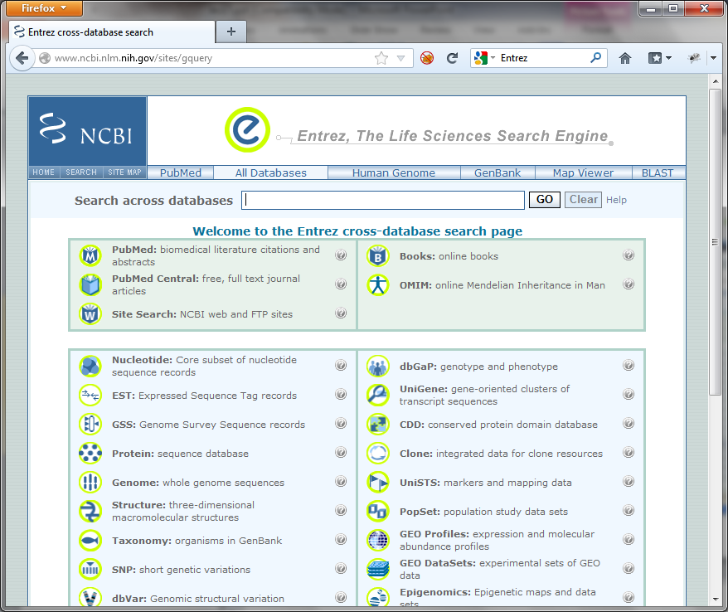
NCBI Entrez
Powerful web-portal for NCBI's online databases
  Nucleotide
  Protein
  PubMed
  Gene
  Structure
  Taxonomy
  OMIM
  etc…

Slide 16
NCBI Entrez
We can do a lot using a web-browser
  Look up a specific record
    nucleotide, protein, mRNA, EST, PubMed, structure,…
  Search for matches to a gene or disease name
  Download sequence and other data associated with a nucleotide or protein
Sometimes we need to automate the process
  Use Entrez to select and return the items of interest, rather than download, parse, and select.

Slide 17
NCBI E-Utilities
Used to automate the use of Entrez capabilities.
Google: Entrez Programming Utilities
  http://www.ncbi.nlm.nih.gov/books/NBK25501
See also, Chapter 9 of the BioPython tutorial
  http://biopython.org/DIST/docs/tutorial/Tutorial.html
Play nice with the Entrez resources!
  At most 100 requests during the day
  Supply your email address
  Use history for large requests
  …otherwise you or your computer could be banned!
  BioPython automates many of the requirements...

Slide 18
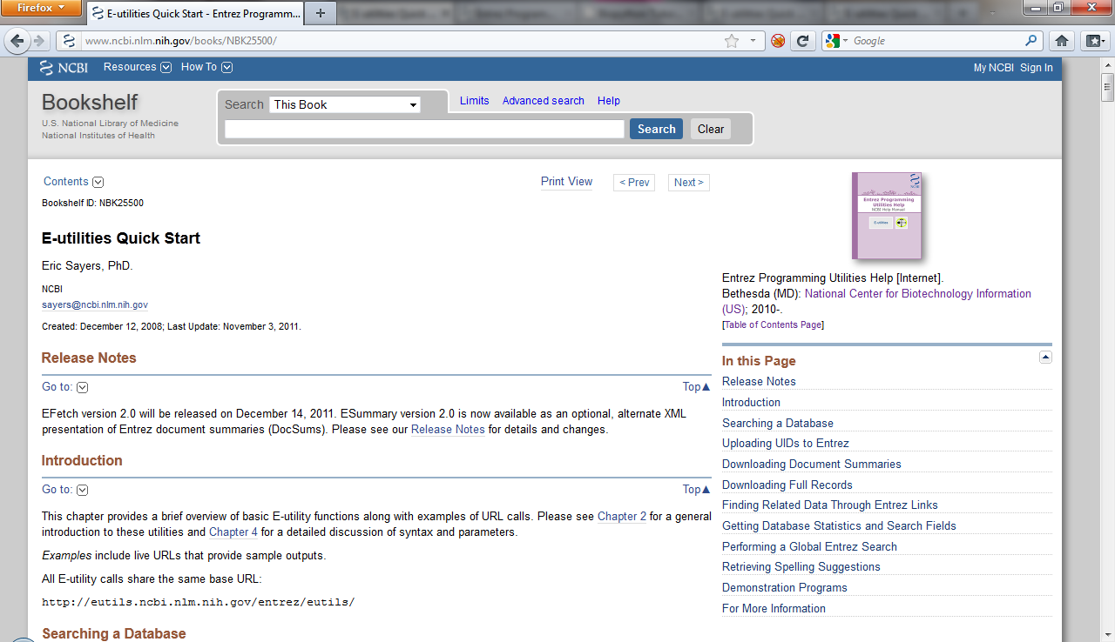
NCBI E-Utilities
No need to use Python, BioPython
Can form urls and parse XML directly.
E-Info
PubMed Info

Slide 19
BioPython and
Entrez E-Utilities
As you might expect BioPython provides some nice tools to simplify this process
from Bio import Entrez
Entrez.email = 'tugbasuzek@mu.edu.tr'
handle = Entrez.einfo()
result = Entrez.read(handle)
print(result["DbList"])
handle = Entrez.einfo(db='pubmed')
result = Entrez.read(handle,validate=False)
print(result["DbInfo"]["Description"])
print(result["DbInfo"]["Count"])
print(result["DbInfo"].keys())

Slide 20
BioPython and Entrez E-Utilities
"Thin" wrapper around E-Utilities web-services
  Use E-Utilities argument names
    db for database name, for example
Use Entrez.read to make a simple dictionary from the XML results.
  Could also parse XML directly (ElementTree), or get results in genbank format (for sequence)
Use result.keys() to "discover" structure of returned results.

Slide 21
E-Utilities Web-Services
E-Info
  Discover database names and fields
E-Search
  Search within a particular database
  Returns "primary ids"
E-Fetch
  Download database entries by primary ids
Others:
  E-Link, E-Post, E-Summary, E-GQuery

Slide 22
Using ESearch
By default only get back some of the ids:
  Use retmax to get back more…
  Meaning of returned id is database specific…
from Bio import Entrez
Entrez.email = ‘tugbasuzek@mu.edu.tr'
handle = Entrez.esearch(db="pubmed", term="BRCA1")
result = Entrez.read(handle)
print(result["Count"])
print(result["IdList"])
handle = Entrez.esearch(db="nucleotide",
term="Cypripedioideae[Orgn] AND matK[Gene]")
result = Entrez.read(handle)
print(result["Count"])
print(result["IdList"])

Slide 23
Using EFetch
from Bio import Entrez, SeqIO
Entrez.email = ‘tugbasuzek@mu.edu.tr'
handle = Entrez.efetch(db="nucleotide", id="186972394",
rettype="gb")
print(handle.read())
handle = Entrez.esearch(db="nucleotide",
term="Cypripedioideae[Orgn] AND matK[Gene]")
result = Entrez.read(handle)
idlist = ','.join(result["IdList"])
handle = Entrez.efetch(db="nucleotide",
id=idlist,
rettype="gb")
for r in SeqIO.parse(handle, "genbank"):
print(r.id, r.description)

Slide 24
ESearch and EFetch together
Entrez provides a more efficient way to combine ESearch and EFetch
  After esearch, Entrez already knows the ids you want!
  Sending the ids back with efetch makes Entrez work much harder
Use the history mechanism to "remind" Entrez that it already knows the ids
Access large result sets in "chunks".

