Slide 1
Advanced Python:
NCBI E-Utils

Slide 2
NCBI E-Utilities
NCBI E-Utilities
  …from a script, via the internet
NCBI Blast
  …from a script, via the internet
Exercises

Slide 3
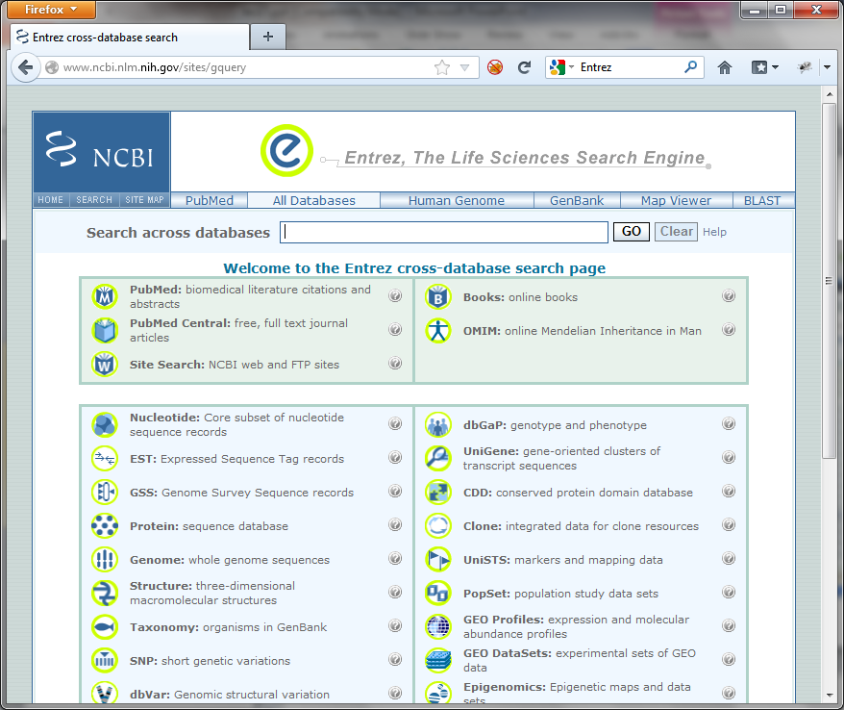
NCBI Entrez
Powerful web-portal for NCBI's online databases
  Nucleotide
  Protein
  PubMed
  Gene
  Structure
  Taxonomy
  OMIM
  etc…

Slide 4
NCBI Entrez
We can do a lot using a web-browser
  Look up a specific record
    nucleotide, protein, mRNA, EST, PubMed, structure,…
  Search for matches to a gene or disease name
  Download sequence and other data associated with a nucleotide or protein
Sometimes we need to automate the process
  Use Entrez to select and return the items of interest, rather than download, parse, and select.

Slide 5
NCBI E-Utilities
Used to automate the use of Entrez capabilities.
Google: Entrez Programming Utilities
  http://www.ncbi.nlm.nih.gov/books/NBK25501
See also, Chapter 9 of the BioPython tutorial
  http://biopython.org/DIST/docs/tutorial/Tutorial.html
Play nice with the Entrez resources!
  At most 100 requests during the day
  Supply your email address
  Use history for large requests
  …otherwise you or your computer could be banned!
  BioPython automates many of the requirements...

Slide 6
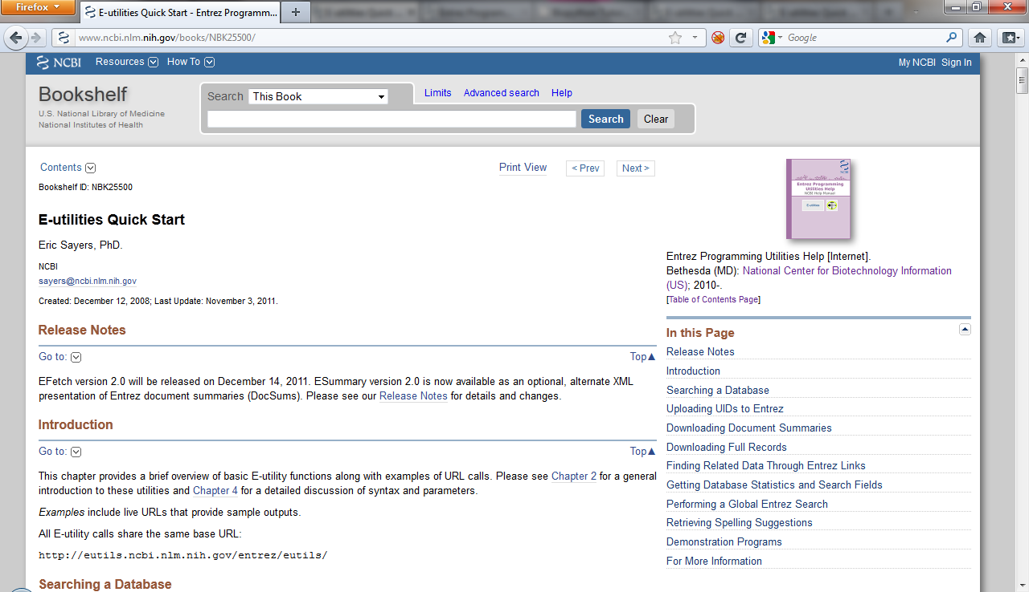
NCBI E-Utilities
No need to use Python, BioPython
Can form urls and parse XML directly.
E-Info
PubMed Info

Slide 7
BioPython and
Entrez E-Utilities
As you might expect BioPython provides some nice tools to simplify this process
from Bio import Entrez
Entrez.email = 'tugbasuzek@mu.edu.tr'
handle = Entrez.einfo()
result = Entrez.read(handle)
print(result["DbList"])
handle = Entrez.einfo(db='pubmed')
result = Entrez.read(handle,validate=False)
print(result["DbInfo"]["Description"])
print(result["DbInfo"]["Count"])
print(result["DbInfo"].keys())

Slide 8
BioPython and Entrez E-Utilities
"Thin" wrapper around E-Utilities web-services
  Use E-Utilities argument names
    db for database name, for example
Use Entrez.read to make a simple dictionary from the XML results.
  Could also parse XML directly (ElementTree), or get results in genbank format (for sequence)
Use result.keys() to "discover" structure of returned results.

Slide 9
E-Utilities Web-Services
E-Info
  Discover database names and fields
E-Search
  Search within a particular database
  Returns "primary ids"
E-Fetch
  Download database entries by primary ids
Others:
  E-Link, E-Post, E-Summary, E-GQuery

Slide 10
Using ESearch
By default only get back some of the ids:
  Use retmax to get back more…
  Meaning of returned id is database specific…
from Bio import Entrez
Entrez.email = ‘tugbasuzek@mu.edu.tr'
handle = Entrez.esearch(db="pubmed", term="BRCA1")
result = Entrez.read(handle)
print(result["Count"])
print(result["IdList"])
handle = Entrez.esearch(db="nucleotide",
term="Cypripedioideae[Orgn] AND matK[Gene]")
result = Entrez.read(handle)
print(result["Count"])
print(result["IdList"])

Slide 11
Using EFetch
from Bio import Entrez, SeqIO
Entrez.email = ‘tugbasuzek@mu.edu.tr'
handle = Entrez.efetch(db="nucleotide", id="186972394",
rettype="gb")
print(handle.read())
handle = Entrez.esearch(db="nucleotide",
term="Cypripedioideae[Orgn] AND matK[Gene]")
result = Entrez.read(handle)
idlist = ','.join(result["IdList"])
handle = Entrez.efetch(db="nucleotide",
id=idlist,
rettype="gb")
for r in SeqIO.parse(handle, "genbank"):
print(r.id, r.description)

Slide 12
ESearch and EFetch together
Entrez provides a more efficient way to combine ESearch and EFetch
  After esearch, Entrez already knows the ids you want!
  Sending the ids back with efetch makes Entrez work much harder
Use the history mechanism to "remind" Entrez that it already knows the ids
Access large result sets in "chunks".

Slide 13
ESearch and EFetch using esearch history
import time
from Bio import Entrez, SeqIO
Entrez.email = “tugbasuzek@mu.edu.tr”
handle = Entrez.esearch(db="nucleotide", term="Cypripedioideae[Orgn]",
usehistory="y")
result = Entrez.read(handle)
handle.close()
count = int(result["Count"])
session_cookie = result["WebEnv"]
query_key = result["QueryKey"]
print(count, session_cookie, query_key)
# Get the results in chunks of 100
chunk_size = 100
for chunk_start in range(0,count,chunk_size) :
handle = Entrez.efetch(db="nucleotide", rettype="gb",
retstart=chunk_start, retmax=chunk_size,
webenv=session_cookie, query_key=query_key)
for r in SeqIO.parse(handle,"genbank"):
print(r.id, r.description)
handle.close()

Slide 14
Using Ebot
https://www.ncbi.nlm.nih.gov/Class/PowerTools/eutils/ebot/ebot.cgi

Slide 15
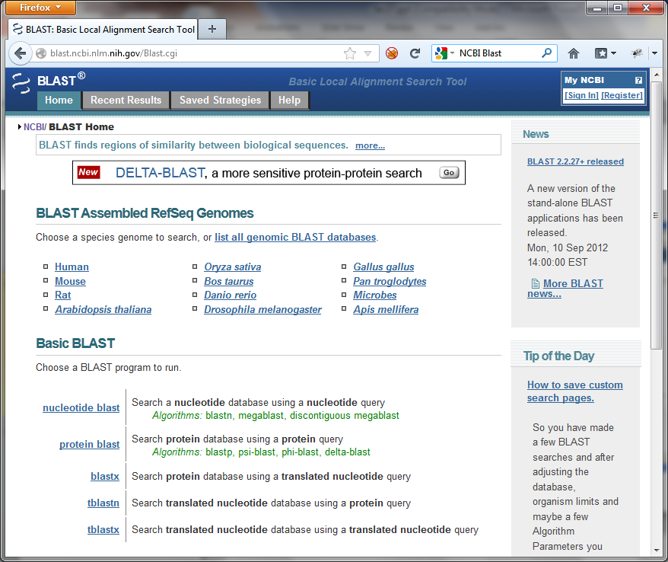
NCBI Blast
NCBI provides a very powerful blast search service on the web
We can access this infrastructure as a web-service
BioPython makes this easy!
  Ch. 7.1 in Tutorial

Slide 16
NCBI Blast
Help on function qblast in module Bio.Blast.NCBIWWW:
qblast(program, database, sequence, ...)
Do a BLAST search using the QBLAST server at NCBI.
Supports all parameters of the qblast API for Put and Get.
Some useful parameters:
program blastn, blastp, blastx, tblastn, or tblastx (lower case)
database Which database to search against (e.g. "nr").
sequence The sequence to search.
ncbi_gi TRUE/FALSE whether to give 'gi' identifier.
descriptions Number of descriptions to show. Def 500.
alignments Number of alignments to show. Def 500.
expect An expect value cutoff. Def 10.0.
matrix_name Specify an alt. matrix (PAM30, PAM70, BLOSUM80, BLOSUM45).
filter "none" turns off filtering. Default no filtering
format_type "HTML", "Text", "ASN.1", or "XML". Def. "XML".
entrez_query Entrez query to limit Blast search
hitlist_size Number of hits to return. Default 50
megablast TRUE/FALSE whether to use MEga BLAST algorithm (blastn only)
service plain, psi, phi, rpsblast, megablast (lower case)
This function does no checking of the validity of the parameters
and passes the values to the server as is. More help is available at:
http://www.ncbi.nlm.nih.gov/BLAST/blast_overview.html
Lots of parameters…
Essentially mirrors blast options
You need to know how to use blast first!

Slide 17
NCBI Blast
Required parameters:
  Blast program, Blast database, Sequence
  Returns XML format results, by default.
import os.path
from Bio.Blast import NCBIWWW
result_handle = NCBIWWW.qblast("blastn", "nr", "8332116")
blast_results = result_handle.read()
print(blast_results)

Slide 18
NCBI Blast
Required parameters:
  Blast program, Blast database, Sequence
  Returns XML format results, by default.
Save results to a file, for parsing…
import os.path
from Bio.Blast import NCBIWWW
if not os.path.exists("8332116.xml"):
result_handle = NCBIWWW.qblast("blastn", "nr", "8332116")
blast_results = result_handle.read()
result_handle.close()
save_file = open("blastn-nr-8332116.xml", "w")
save_file.write(blast_results)
save_file.close()
# Do something with the blast results in blastn-nr-8332116.xml
Notes:
import os.path
from Bio.Blast import NCBIWWW
if not os.path.exists("blastn-nr-8332116.xml"):
result_handle = NCBIWWW.qblast("blastn", "nr", "8332116")
blast_results = result_handle.read()
result_handle.close()
save_file = open("blastn-nr-8332116.xml", "w")
save_file.write(blast_results)
save_file.close()
# Do something with the blast results in blastn-nr-8332116.xml

Slide 19
NCBI Blast Parsing
Results need to be parsed in order to be useful…
from Bio.Blast import NCBIXML
result_handle = open("8332116.xml")
for blast_result in NCBIXML.parse(result_handle):
for desc in blast_result.descriptions:
if desc.e < 1e-5:
print('****Alignment****’)
print('sequence:', desc.title)
print('e value:', desc.e)
Notes:
from Bio.Blast import NCBIXML
result_handle = open("blastn-nr-8332116.xml")
for blast_result in NCBIXML.parse(result_handle):
for desc in blast_result.descriptions:
if desc.e < 1e-5:
print('****Alignment****'
print('sequence:', desc.title
print('e value:', desc.e

Slide 20
Clustalw
from Bio.Align.Applications import ClustalwCommandline
help(ClustalwCommandline)

Slide 21
Modules
We've already used these from the python standard library and from BioPython
import sys
filename = sys.argv[1]
file_handle = open(filename)
import Bio.SeqIO
seq_records = Bio.SeqIO.parse(file_handle, "swiss")
import gzip
file_handle = gzip.open(filename)
import urllib
file_handle = urllib.urlopen(url)
import math
x = math.sqrt(y)

Slide 22
Modules
Modules contain previously defined functions, variables, and (soon!) classes.
Store useful code for re-use in many programs
Structure
related code
together
import sys
import MyNucStuff
seqfilename = sys.argv[1]
seq = MyNucStuff.read_seq_from_filename(seqfilename)
cseq = MyNucStuff.complement(seq)
rcseq = MyNucStuff.reverseComplement(seq)
print(" Sequence:",seq)
print(" C sequence:",cseq)
print("RC sequence:",rcseq)

Slide 23
Modules
In MyNucStuff.py
def read_seq_from_filename(seq_filename):
seq_file = open(seq_filename)
dna_seq = ''.join(seq_file.read().split())
dna_seq = dna_seq.upper()
seq_file.close()
return dna_seq
compl_dict = {'A':'T', 'T':'A', 'C':'G', 'G':'C'}
def complement(seq):
return ''.join(map(compl_dict.get,seq))
def revseq(seq):
return ''.join(reversed(seq))
def reverseComplement(seq):
return complement(revseq(seq))
# plus anything else you like...

Slide 24
Modules
We can import specific functions directly…
And reference them without the module name
import sys
from MyNucStuff import read_seq_from_filename
from MyNucStuff import complement
from MyNucStuff import reverseComplement
seqfilename = sys.argv[1]
seq = read_seq_from_filename(seqfilename)
cseq = complement(seq)
rcseq = reverseComplement(seq)
print(" Sequence:",seq)
print(" C sequence:",cseq)
print("RC sequence:",rcseq)

Slide 25
Modules
We can even import all the functions from a module…
import sys
from MyNucStuff import *
seqfilename = sys.argv[1]
seq = read_seq_from_filename(seqfilename)
cseq = complement(seq)
rcseq = reverseComplement(seq)
print(" Sequence:",seq)
print(" C sequence:",cseq)
print("RC sequence:",rcseq)
Notes:
import sys
from MyNucStuff import *
seqfilename = sys.argv[1]
seq = read_seq_from_filename(seqfilename)
cseq = complement(seq)
rcseq = reverseComplement(seq)
print(" Sequence:",seq
print(" C sequence:",cseq
print("RC sequence:",rcseq

Slide 26
Packages
Packages are collections of modules, grouped together. All equivalent:
Implemented using files and folders/directories.
import Bio.SeqIO
Bio.SeqIO.parse(handle, "swiss")
from Bio import SeqIO
SeqIO.parse(handle, "swiss")
from Bio.SeqIO import parse
parse(handle, "swiss")

Slide 27
What can go wrong?
Sometimes our own .py files can "collide" with Python's packages.
Test what happens with an "empty" module in files:
  xml.py (and then try to import ElementTree)
  Bio.py (and then try to import SeqIO)
  etc…

Slide 28
A module for codon tables
Module is called: codon_table
Functions:
  read_codons_from_filename(filename)
    returns dictionary of codons –
    value is pair: (amino-acid symbol, initiation codon true/false)
  amino_acid(codon_table,codon)
    returns amino-acid symbol for codon
  is_init(codon_table,codon)
    returns true if codon is an initiation codon, false, otherwise
  get_ambig_aa (codon_table,codon)
    Returns the single amino-acid consistent with ambiguous codon (containing N's), or X.
  translate(codon_table,seq,frame)
    returns amino-acid sequence for DNA sequence seq

Slide 29
A module for codon tables
from MyNucStuff import *
from codon_table import *
import sys
if len(sys.argv) < 3:
print("Require codon table and DNA sequence on command-line.“)
sys.exit(1)
table = read_codons_from_filename(sys.argv[1])
seq = read_seq_from_filename(sys.argv[2])
if is_init(table,seq[:3]):
print("Initial codon is an initiation codon“)
for frame in (1,2,3):
print("Frame",frame,"(forward):",translate(table,seq,frame))

Slide 30
A module for codons
In codon_table.py:
def read_codons_from_filename(codonfile):
# magic
return codon_table
def amino_acid(table,codon):
# magic
return aa
def is_init(table,codon):
# magic
return init
def get_ambig_aa(table,codon):
# magic
return aa
def translate(table,seq,frame):
# magic
return aaseq

Slide 31
A module for codons
def read_codons_from_filename(codonfile):
f = open(codonfile)
data = {}
for l in f:
sl = l.split()
key = sl[0]
value = sl[2]
data[key] = value
f.close()
b1 = data['Base1']
b2 = data['Base2']
b3 = data['Base3']
aa = data['AAs']
st = data['Starts']
codon_table = {}
n = len(aa)
for i in range(n):
codon = b1[i] + b2[i] + b3[i]
isInit = (st[i] == 'M')
codon_table[codon] = (aa[i],isInit)
return codon_table
In codon_table.py:

