Slide 1
Bioinformatics Programming
Tugba Suzek, PhD Lecture 1
Adapted from Dr. Nathan Edwards’s bchb524 class slides
1

Slide 2
Course Objectives
Programming skills
Problem solving and debugging
Reading and writing documentation
Data Munging: Data filtering and transformation
Pattern matching and data mining
Visualization and web presentation
Object-oriented programming
Bioinformatics skills
Biological sequence analysis
Interacting with biological databases
Using BioPython
2

Slide 3
Tentative Syllabus (subject to change)
Date | Subject
6-Oct | Overview of Bioinformatics and Linux and Awk commands
13-Oct | Collecting and Storing Sequences with Python
20-Oct | Python (continued)
27-Oct | Python (continued) and Alignment of Pairs of Sequences
3-Nov | NCBI Eutils using BioPython
10-Nov | Protein Structure (Bio.PDB)
17-Nov | Multiple Sequence Alignment
24-Nov | Machine Learning with Python
01-Dec | Object Oriented Programming and Blast using BioPython
08-Dec | Next-Gen Sequencing using Python (PySAM)
15-Dec | Primer on High Throughput Computing using Cluster Computer Systems (Truba)
22-Dec | Graphics and Plots using pylab
29-Dec | Web applications using Python
05-Jan | Midterm
12-Jan | Gene Expression Analysis

Slide 4
Course Info
Lecturer:
Tuğba Önal Süzek, reach me out anytime via Whatsapp
Course Page:
https://piazza.com/mu.edu.tr/fall2020/binf6001/resources
Grading:
Homework (3-4) (30%)
Midterm (20%)
Final Project (50%)
Final project
Project will be individually developed using Python
For your final project, we would like you to process a REAL high throughput biological dataset
Preferably using Tubitak TRUBA Interface
4

Slide 5
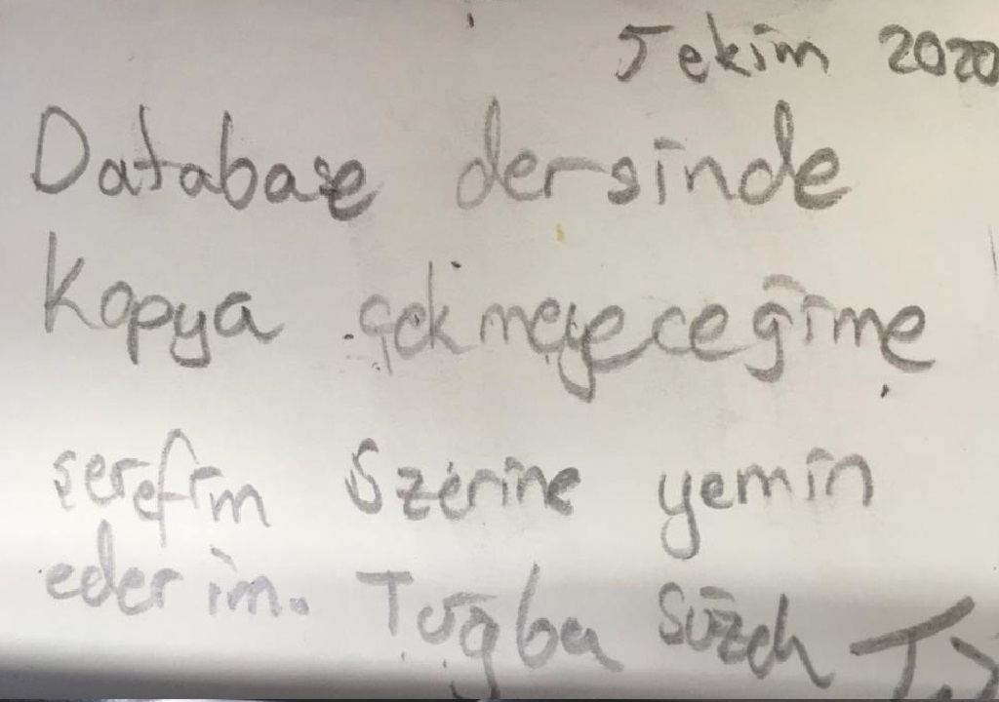
Academic Honesty
You are responsible from your own learning! Manage your time wisely
You may help each other but no copy-paste
Please do not look at your friend’s screen
Learn by doing
Confront initial steep learning curve head-on
Learn by imitating
Change working programs for new functionality
Learn by observation
See cause and effect of program changes
5

Slide 6
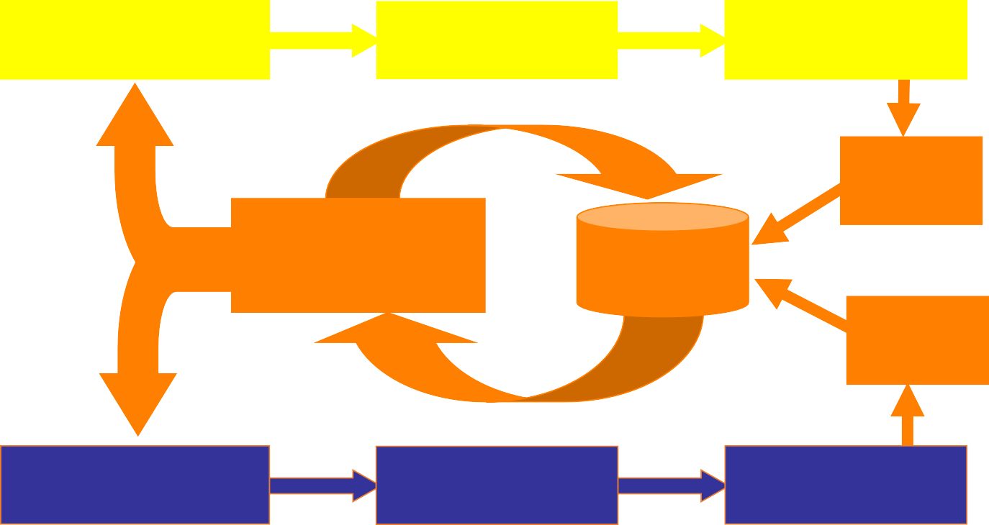
Experimental Biology
vs. Computational Biology/Bioinformatics
Computational Biology
Problem Statement
Simulation
Results
SIMS
Analysis Tools
Database
LIMS
Problem Statement
Experiment
Results
Rick Stevens
Experimental Biology
6

Slide 7
Bioinformatics Programming Tasks
Manage large experimental data sets
Sequence data
Microarray data (gene expression)
Mass spec data (proteomics)
Genotype data (mutations etc.)
Clinical data
Build tools for Knowledge Discovery
Find motifs in sequence data
Data enrichment
Data clustering
Visualization
Build analysis pipelines
Glue several analysis steps together into a single automated process
"Munge" data: Take data from one application or database and format it for input to another application of database
7

Slide 8
Course Preparation
Install Python to your PC
https://www.python.org/downloads/
Install PyCharm to your PC if you prefer to use an IDE
https://www.jetbrains.com/pycharm/download/#section=windows
For the class, simple editors; Nano or Notepad++ will be OK
Use Linux
Find a Linux working environment for yourself to practice your commands
Install virtualbox if you need one
Some basic commands will be reviewed
8

Slide 9
Introduction to Python

Slide 10
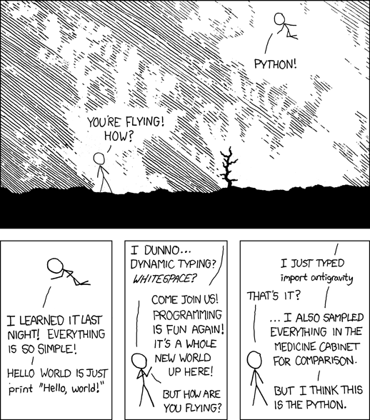
Why Python?
Free
Portable
Object-oriented
Clean syntax
Dynamic typing
Scientific, Commercial
Support libraries
Extensible
Interactive
Modern
http://xkcd.com/353/

Slide 11
Why Python for Bioinformatics?
Good with
Strings
Files and Formats
Web and Databases
Objects and Concepts
BioPython
Good support for bioinformatics data-formats
NumPy, SciPy, Matplotlib
Good support for scientific computing

Slide 12
Hello World!
# Output Hello World to the terminal
print("Hello World!")
print("Hello Georgetown!")
print('Hello Everyone')
select with your mouse, Ctrl-C
goto eng1.mu.edu.tr commandline window
nano lec1.1.py
Ctrl-V Ctrl-X
type yes

Slide 13
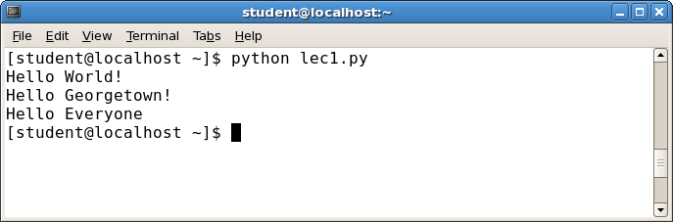
Hello World!
Start the terminal, type “python lec1.py”

Slide 14
Experiment with Hello World
Quotes: single or double? mixed?
How to change the order of output?
What does the red line do?
How to change what is printed? Add or remove?
What happens if you misspell print?
What happens if you forget a quote?
What happens if you forget a #?
Do the blank lines matter?

Slide 15
Lessons
Statements are executed from top to bottom
Single or double quotes – either works as long as they match
Comments (#) are ignored, so use to explain
Syntax error means something is wrong
Sometimes the colors will help
But not necessarily at the exact position indicated.
Blank lines don’t matter, so use them for readability

Slide 16
Simple Numbers
# Program input
cars = 100
people_per_car = 4
drivers = 30
passengers = 90
# Compute the dependent values
cars_not_driven = cars - drivers
cars_driven = drivers
carpool_capacity = cars_driven * people_per_car
average_people_per_car = ( drivers + passengers ) / cars_driven
people_in_last_car = ( drivers + passengers - 1 ) % people_per_car + 1
# Output the results
print("There are", cars, "cars available.")
print("There are only", drivers, "drivers available.")
print("There will be", cars_not_driven, "empty cars today.")
print("We can transport", carpool_capacity, "people today.")
print("We have", passengers, "to carpool today.")
print("We need to put about", average_people_per_car, "in each car.")
print("There are", people_in_last_car, "people in the last car.")

Slide 17
Experiment with Simple Numbers
What names can we use to store values?
What values can we store?
What happens if we change a “variable” name?
What happens if we change the statement order?
How do we print out numbers? By themselves?
What happens if we change the input values?
What is the difference between / and // ? What does % mean? When are decimals shown?
Why is “people in last car” so complicated?
Are there values that produce strange answers?

Slide 18
Lessons
Variables store values for later use
We can use whatever name makes sense
Letters, numbers, and _
Can store explicit numbers or the result of arithmetic
If you change the name in one place, you have to change it everywhere.
You must store a value before you use the variable.

Slide 19
Installation of Linux distributions

Slide 20
Multiple install options
1. Straight forward install*
give your complete hard drive to Linux (clean install) This will remove ALL other files from your hard drive
2. Or Virtualization**
install VirtualBox and install Linux on a virtual partition on your hard drive (not recommended for small hard drive)
3. Or Dual boot***
Seperate a partition of you hard drive and install Linux on the new partition. During booting you get the option to select an OS

Slide 21
Multiple install options
First things first: download the OS installation file
https://www.ubuntu.com/
VirtualBox
https://www.virtualbox.org/
How to make a dual boot device?
Ask Prof. Google
Other Linux distributions?
Wikipedia list of Linux distributions

Slide 22
Live modus
Another option to try out Linux on your device is running it in ‘live modus’. This way you can test a
Linux distribution without making changes to your computer!
How do I do that?
Use an empty USB stick or CD-ROM
Download the ISO file of the distribution of your choice
Copy or write the ISO file on the USB drive or CD-ROM
Boot your computer from the USB drive or CD-ROM
Optional: install the Linux distribution
Then you have a full functional system without installing it. Note that nothing will be saved once you shut down!

Slide 23
Linux Commands I
cat --- for creating and displaying short files
chmod --- change permissions
cd --- change directory
cp --- for copying files
date --- display date
echo --- echo argument
ftp --- connect to a remote machine to download or upload files
grep --- search file
head --- display first part of file
ls --- see what files you have
lpr --- standard print command
more --- use to read files
mkdir --- create directory
mv --- for moving and renaming files

Slide 24
Linux Commands II
pwd --- find out what directory you are in
rm --- remove a file
rmdir --- remove directory
setenv --- set an environment variable
sort --- sort file
tail --- display last part of file
tar --- create an archive, add or extract files
ssh --- log in to another machine
wc --- count characters, words, lines
This site has a nice reference card
http://www.digilife.be/quickreferences/QRC/UNIX%20commands%20reference%20card.pdf

Slide 25
What is awk ??
The word awk is derived from the names of its inventors!!!
awk is actually Aho Weinberger and Kernighan ;)
From the original awk paper published by Bell Labs, awk is
“ Awk is a programming language designed to make many common information retrieval and text manipulation tasks easy to state and to perform.”
Simply put, awk is a programming language designed to search for, match patterns, and perform actions on files.

Slide 26
A few basic things about awk
awk reads from a file or from its standard input, and outputs to its standard output.
awk recognizes the concepts of "file", "record" and "field".
A file consists of records, which by default are the lines of the file. One line becomes one record.
awk operates on one record at a time.
A record consists of fields, which by default are separated by any number of spaces or tabs.
Field number 1 is accessed with $1, field 2 with $2, and so forth. $0 refers to the whole record.

Slide 27
A simple example
Problem : Get the userid of user “tugba” from the /etc/passwd file.
Suppose /etc/passwd file contains the following entries tugba:x:504:504::/home/tugba:/bin/bash
try:x:500:500::/home/try:/bin/bash
optima:x:501:501::/home/optima:/bin/bash
optimal:x:502:502::/home/optimal:/bin/bash
awk will see this file as follows
1 line = 1 record (by default) so in total there are 4 records in the file.
1 record = 7 fields separated by “:” (Not by default)
Note : Default field separator is space.

Slide 28
A simple example (cont..)
$ awk –F”:” ‘/tugba/ {print $1 “ “ $3}’ /etc/passwd
Awk
executable
Field
Separator
Action to
perform on line
If pattern matches
pattern
to search
The file
to operate
upon

Slide 29
A simple example (cont..)
The output of the above command will be
awk -F":" ‘/tugba/ {print $1 " " $3}’ /etc/passwd
tugba 504
Another way to write the command is
awk ‘BEGIN { FS=“:” } /tugba/ {print $1 " " $3}’ /etc/passwd
tugba 504

Slide 30
Advanced awk features
Awk borrows a lot from the C language.
The if loop, for loop and while loop have the same constructs as in C.
Awk’s variables are stored internally as strings.
eg. x = “1.01”
x = x + 1
print x
The above will print the value 2.01
Comparison operators in awk are : "==", "<", ">", "<=", ">=", "!=“, "~" and "!~“.
“~” and “!~” operators mean "matches" and "does not match".

Slide 31
Awk examples (cont..)
awk 'BEGIN { RS = "/" } ; { print $0 }' file1.txt
RS is the record separator (default is \n). In this example the RS is modified to “/”
and then the file is processed. So awk will distinguish between records by “/”
character.
awk '$1 ~ /foo/ { print $0 }' file.txt
The pattern will print out all records from file file.txt whose first fields contain the
string “foo”.
awk '{ print $(2*2) }' file.txt
In the above example the field number is an expression. So awk will print the 4th fields
of all the records.

Slide 32
Awk Examples
awk '{ print $0 }' /etc/passwd
Prints all the lines in /etc/passwd
awk -F":" '{ print "username: " $1 "\t\tuid:" $3" }' /etc/passwd
Prints the 1st and 3rd fields of each line in /etc/passwd. The fields are separated by “:”
awk 'BEGIN{num=0}{if (/^$/) num++}END{ print "I found "num" lines"}' /etc/passwd
The below script calculates the number of null lines. Note that BEGIN and END are
special patterns.
awk 'BEGIN{num=0}{if num++}END{ print "I found "num" lines"}' /etc/passwd
The below script calculates the number of null lines. Note that BEGIN and END are special patterns.

Slide 33
Awk examples (cont..)
Consider that we have the following input in a file called grades
john 85 92 78 94 88
andrea 89 90 75 90 86
jasper 84 88 80 92 84
The following awk script will find the average
awk '{total = $2 + $3 + $4 + $5 + $6 ;avg = total / 5; print $1" "avg}' grades
Will print
john 85 92 78 94 88
andrea 89 90 75 90 86
jasper 84 88 80 92 84

Slide 34
awk '{ if (NF > max) max = NF }

Slide 35
Advantages of Awk
awk is an interpreted language so you can avoid the usually lengthy edit-compile-test-debug cycle of software development .
Can be used for rapid prototyping.
The awk language is very useful for producing reports from large amounts of raw data, such as summarizing information from the output of other utility programs like ls.

Slide 36
awk references
The GNU Awk manual
Awk -- A Pattern Scanning and Processing Language (Original AWK paper)
http://www-106.ibm.com/developerworks/library/l-awk1.html
http://www-106.ibm.com/developerworks/library/l-awk2.html
http://www-106.ibm.com/developerworks/library/l-awk3.html
Sed and Awk 2nd Edition (O’reilly)

