Slide 1
Bioinformatics Programming
Week 2

Slide 2
Last Week: Checklist
Did you email Tübitak to get your Truba accounts?
Wait 5 business days for activation if you did email
Did you try/install Jupiter on your machines?
First you need to run “Windows Command Prompt”
Then follow the instructions from Jupiter web site: https://jupyter.org/install

Slide 3
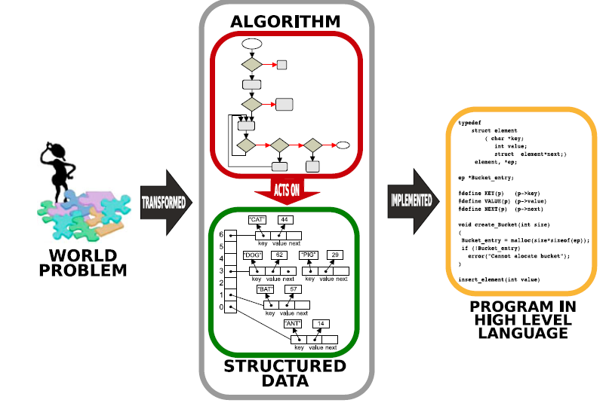
Programming
Data: The first ingredient of a program
Actions: The second ingredient of a program
Complexity: A measure for "solution hardness"
Organizing Data
Objects: Reunion of Data and Actions

Slide 4
Interactive Python Tutorial
http://interactivepython.org/runestone/static/thinkcspy/GeneralIntro/SpecialWaystoExecutePythoninthisBook.html
https://piazza.com/mu.edu.tr/fall2020/binf6001/resources
Python Book with Case Studies (Göktürk Üçoluk)

Slide 5
Why Python?
Ease of Programming
Excellent pattern matching features
Good for gluing other programs together
Easy to learn (enough to get started)
Rapid Prototyping
Few lines of code needed for many problems
One-liners

Slide 8
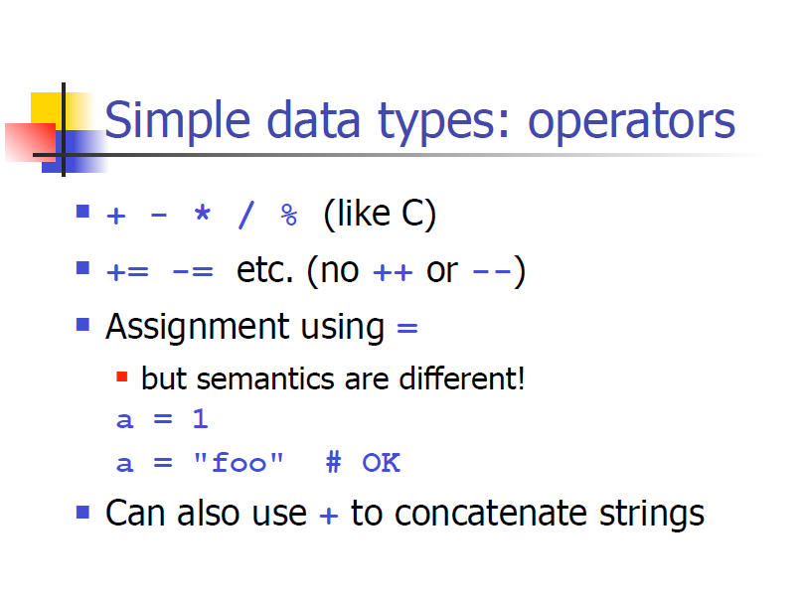

Slide 9
Simple Numbers (Review of last week)
Variables (names) to store values
Variables to store the result of expressions
The variable name itself does not matter, but should be descriptive
Variables must have a value before you use them
Arithmetic operators +, -, *, /, //, % are available
Arithmetic can use variables and values
Result of division is always a float, use // if integer division is desired.

Slide 10
Simple Numbers II
# Program input
cars = 100.0
people_per_car = 4.0
drivers = 30.0
passengers = 90.0
# Compute the dependent values
cars_not_driven = cars - drivers
cars_driven = drivers
carpool_capacity = cars_driven * people_per_car
average_people_per_car = ( drivers + passengers ) / cars_driven
people_in_last_car = ( drivers + passengers - 1 ) % people_per_car + 1
# Output the results
print("There are", cars, "cars available.")
print("There are only", drivers, "drivers available.")
print("There will be", cars_not_driven, "empty cars today.")
print("We can transport", carpool_capacity, "people today.")
print("We have", passengers, "to carpool today.")
print("We need to put about", average_people_per_car, "in each car.")
print("There are", people_in_last_car, "people in the last car.")

Slide 11
Experiment with Simple Numbers II
How are fractional values treated differently than whole numbers?
How do we write a “float” vs an “int”
What happens if we mix integers and floats?
What happens if we divide by zero?
How can we convert an integer to a float, or vice versa?
How can we round a floating point number?

Slide 12
Lessons
Fractional numbers (floats) print with a decimal point, division (“/”) makes a float.
Specify the fractional digits to make a float (even if zero!)
A single float in an expression will "force" a fractional value.
Divide by zero is an error!
Convert to float using float(10)
Convert to int using int(1.2345)
Round using round(1.234,1)

Slide 13
DNA Sequence
# DNA is cool!
dna_sequence = 'gcatgacgc'
# Compute dependent values
first_nucleotide = dna_sequence[0]
last_nucleotide = dna_sequence[-1:]
first_four_nucs = dna_sequence[0:4]
last_three_nucs = dna_sequence[-3:]
sequence_length = len(dna_sequence)
# Output results
print("First nucleotide",first_nucleotide)
print("Last nucleotide",last_nucleotide)
print("First four nucleotides",first_four_nucs)
print("Last three nucleotides",last_three_nucs)
print("Sequence length",sequence_length)

Slide 14
Experiment with DNA Sequence
Does it matter what quotes we use? Forget them?
Can we change the order of the statements?
How do we access the symbols of a string?
How can we get the second nucleotide?
How can we get the second last nucleotide?
How can we get the nucleotide in the middle?
What if the DNA sequence has an even number of nucleotides? Odd?
Can the “index” be a float? What if it is?

Slide 15
Experiment with DNA Sequence
When we get a subsequence, what do the first and second numbers represent?
What does it mean if they are missing?
How can we get the first half of the nucleotide sequence? The last half?
What happens if the DNA sequence is really short?
Do we need all of these variables?

Slide 16
Lessons
Symbols are accessed using [index].
Index starts at 0!
Negative index counts from the end
Index can be an (integer) variable or an expression
Subsequences are accessed using [start:end] where symbol at end is NOT included
Missing start is 0, missing end is end of string
Can’t access index that isn’t there, but subsequence access is tolerant
We can use the expressions directly.

Slide 17
DNA Sequence II
# DNA is cool!
dna_sequence = 'gcatgacgttattacgactctgtgtggcgtctgctggg'
oligo1 = 'ATTCG'
oligo2 = 'TCGAT'
# Compute dependent values, using arithmetic and string methods
ligated_oligos = oligo1 + oligo2
tandem_repeat = oligo1*6
polya = 'A'*20
in_uppercase_symbols = dna_sequence.upper()
NumberOfA = dna_sequence.count('a')
PositionOfT = dna_sequence.find('t')
rna_sequence = dna_sequence.replace('t','u')
# Output results
print("Ligated oligos",ligated_oligos)
print("Tandem repeat",tandem_repeat)
print("Polynucleotide run",polya)
print("Uppercase",in_uppercase_symbols)
print("Number of Adenine",NumberOfA)
print("Position of first Thymine",PositionOfT)
print("As RNA",rna_sequence)

Slide 18
Experiment with DNA Sequence II
What other arithmetic operators work?
What happens if we mix upper-case and lower-case?
Can we find multi-symbol motifs?
Can we count multi-symbol motifs?
How might we get lower-case symbols?
Can we multiply a string with a float?
What if the find argument isn’t there?

Slide 19
Lessons
Limited arithmetic for strings, restricted operations
Upper and lower-case symbols are different
A does not match a, etc.
Find and count can match multi-symbol motifs
Use lower for lower-case symbols
Find needs to indicate when motif is not found

Slide 20
DNA Sequence (Review)
Strings are sequences of symbols (characters)
Variables can store strings! (and ints and floats)
Access characters from a string stored in a variable using an index (integer) between [ and ]
Positive index from beginning of string 0…
Negative index from end of string -1…
The index may be stored in a variable
The index may be the result of arithmetic
Chunks of the sequence, using [s:e]
Chunk starts at index s, ends before index e.
If s is missing, start at beginning of string
If e is missing, end at end of string.
Function len(…) returns the length of the string

Slide 21
DNA Sequence II
# DNA is cool!
dna_sequence = 'gcatgacgttattacgactctgtgtggcgtctgctggg'
oligo1 = 'ATTCG'
oligo2 = 'TCGAT'
# Compute dependent values, using arithmetic and string methods
ligated_oligos = oligo1 + oligo2
tandem_repeat = oligo1*6
polya = 'A'*20
in_uppercase_symbols = dna_sequence.upper()
NumberOfA = dna_sequence.count('a')
PositionOfT = dna_sequence.find('t')
rna_sequence = dna_sequence.replace('t','u')
# Output results
print("Ligated oligos",ligated_oligos)
print("Tandem repeat",tandem_repeat)
print("Polynucleotide run",polya)
print("Uppercase",in_uppercase_symbols)
print("Number of Adenine",NumberOfA)
print("Position of first Thymine",PositionOfT)
print("As RNA",rna_sequence)

Slide 22
DNA Sequence II (Review)
Strings can be added (concatenation)
Strings can be multiplied by an integer (concatenated copies)
Upper and lower-case characters are not the same
s.find(t) → (integer) position of the string t in string s, if t is in s. Otherwise, -1.
s.count(t) → (integer) count of string t in string s.
s.upper() → upper-case version of string s.
s.replace(u,v) → string s with string u replaced by string v.

Slide 23
String Methods
# String methods are very useful!
seq = 'gcatgacgttattacgactctgtgtggcgtctgctggg'
# A few important string methods
print("The number of 'a' symbols:",seq.count('a'))
print("The sequence in uppercase:",seq.upper())
print("Does it end with tggg:",seq.endswith('tggg'))
print("Does it start with atg:",seq.startswith('atg'))
print("What position is tggg in:",seq.find('tggg'))
print("After conversion to uppercase?",seq.upper().find('TGGG'))

Slide 24
Control Flow: if statement
# The input DNA sequence
seq = 'atggcatgacgttattacgactctgtgtggcgtctgctggg'
# Remove the initial Met codon if it is there
if seq.startswith('atg'):
print("Sequence without initial Met:",seq[3:])
elif seq.startswith('aaa’):
print("Sequence starts with a polyA:",seq[3:])
else:
print("Sequence (no initial Met):",seq)
Execution path depends on string in seq.
Make sure you change seq to different values.

Slide 25
HOMEWORK 1
Write a python program to find the position of the first stop-codon (TAG, TGA, or TAA ) in the DNA sequence:
gcatcacgttatgtcgactctgtgtgagcgtctgctggg

