Slide 1
Bioinformatics Programming
Week 3

Slide 2
Last Week: Checklist
Did you all install Jupyter or PyCharm?
Did you run the Python commands we practiced during class?
Did you get your Truba accounts? (Truba is optional this year )
Did you submit your Python homework?
Due Friday midnight
2

Slide 3
Outline
Python File operations
Python Control Flow
Python Variables
Python Data Structures
List
Tuples
String
Dictionary
String functions

Slide 4
File Iteration
f=open("myfile.txt","r")
for line in f:
print(line[3:])

Slide 5
File Iteration
f=open("myfile.txt",“r")
outputfile=open("myfile2.txt",“w")
for line in f:
outputfile.write(line[3:]+”\n”)

Slide 6
File reading ,writing and mix and match
f=open(“inputfile.txt","r")
for line in f:
print(line)
print("writing the first 3 letters to outputfile")
f=open(“inputfile.txt","r")
outputfile=open(“outputfile.txt","w")
for line in f:
outputfile.write(line[0:3]+”\n”)
outputfile.close()
print("reading from outputfile")
f2=open(“outputfile.txt","r")
for line in f2:
print(line,end=“”)

Slide 7
Outline
Python File operations
Python Control Flow
Python Variables
Python Data Structures
List
Tuples
String
Dictionary
String functions

Slide 8
Control Flow: odds & ends
continue statement like in C
a=0
while a < 10:
a=a+1
if a % 2 == 0:
continue
else:
print(a)

Slide 9
Control Flow: odds & ends
pass statement like ; in C
a=0
while a < 10:
a=a+1
if a == 0:
pass
else:
print(a)

Slide 10
Defining and Executing Functions
All variables are local unless specified as global
Arguments are passed by value
#Defining your function
def foo(x):
y= x*10 +2
return y
#Executing the functions
print(foo(5))

Slide 11
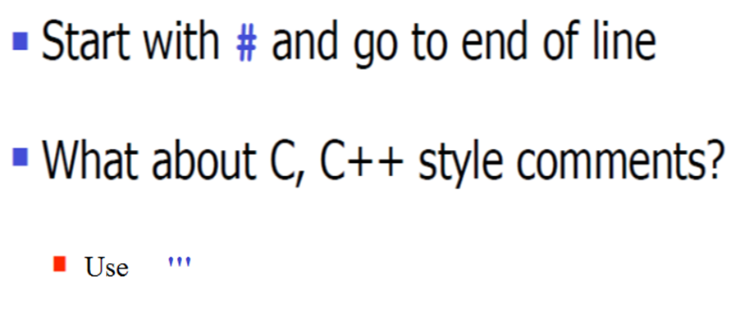
Comments

Slide 12
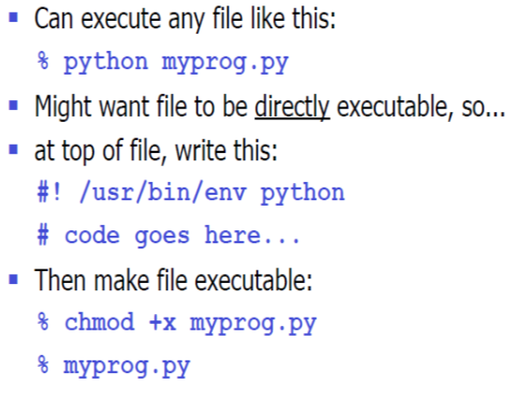
Writing standalone scripts (without PyCharm or Jupyter)

Slide 13
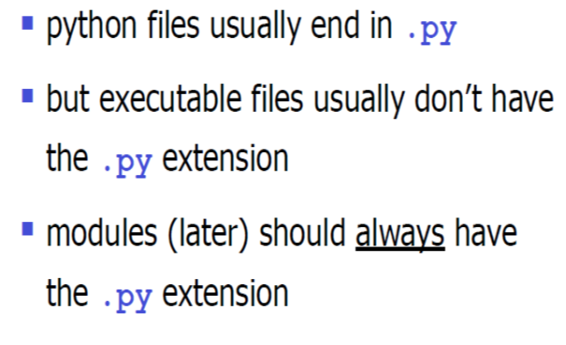
File naming conventions

Slide 14
Outline
Python File operations
Python Variables
Python Data Structures
List
Tuples
String
Dictionary
String functions

Slide 15
Variables
Named location that stores a value
Unlike other programming languages, Python has no command for declaring a variable.
x = 5 y = "John"
Variables do not need to be declared with any particular type and can even change type after they have been set.
x = 4 # x is of type int x = "Sally" # x is now of type str
<number>
Notes:
<number>

Slide 16
Variables
String variables can be declared either by using single or double quotes
x = "John" # is the same as x = 'John'
A variable can have a short name (like x and y) or a more descriptive name (age, carname, total_volume). Rules for Python variables:
A variable name must start with a letter or the underscore character
A variable name cannot start with a number
A variable name can only contain alpha-numeric characters and underscores (A-z, 0-9, and _ )
Variable names are case-sensitive (age, Age and AGE are three different variables)
Python allows you to assign values to multiple variables and assign the same value to multiple variables in one line
x, y, z = "Orange", "Banana", "Cherry"
x = y = z = "Orange“
How about this? x=(y=“Orange”)
<number>
Notes:
<number>

Slide 17
Data Types
Python has the following data types built-in by default, in these categories:
Text Type: str
Numeric Types: int, float, complex
Sequence Types: list, tuple, range
Mapping Type: dict
Set Types: set, frozenset
Boolean Type: bool
Binary Types: bytes, bytearray, memoryview
You can get the data type of any object by using the type() function
x = 5 print(type(x))
To make the variables constant (immutable)
<number>
Notes:
<number>

Slide 18
Outline
Python File operations
Python Variables
Python Data Structures
List
Tuples
Set
String
Dictionary
String functions

Slide 19
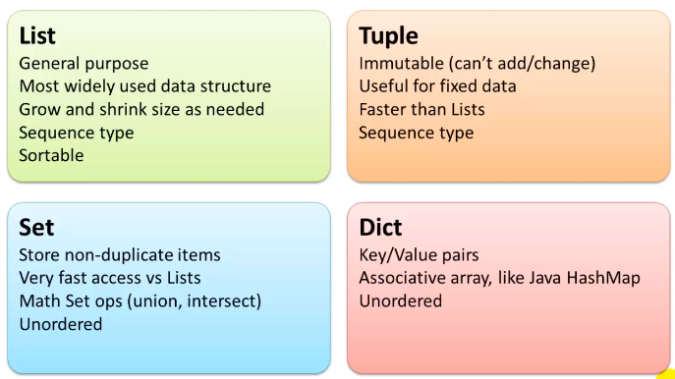

Slide 20
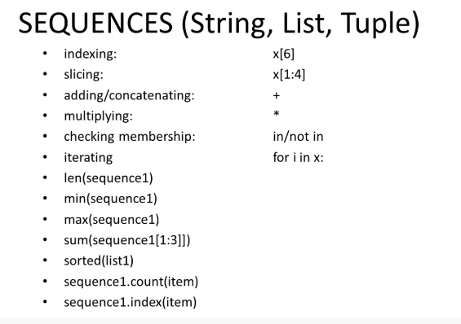

Slide 21
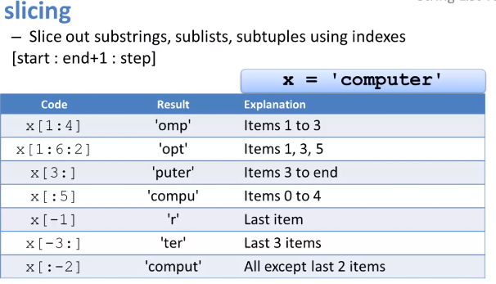

Slide 22
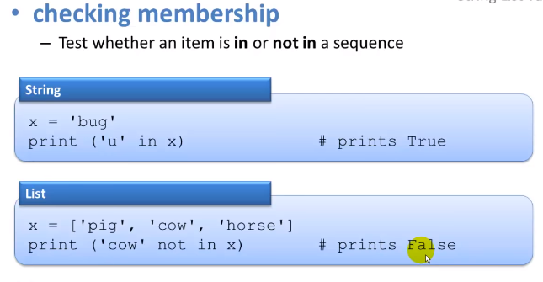

Slide 23
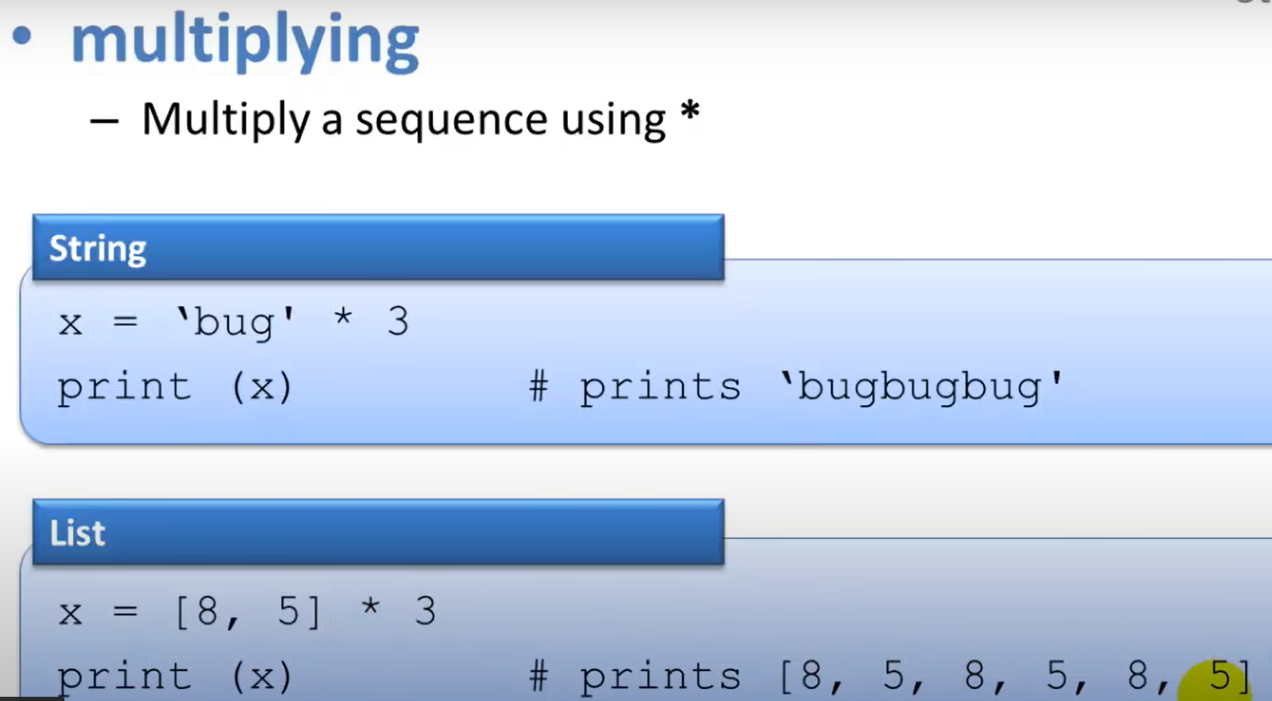

Slide 24
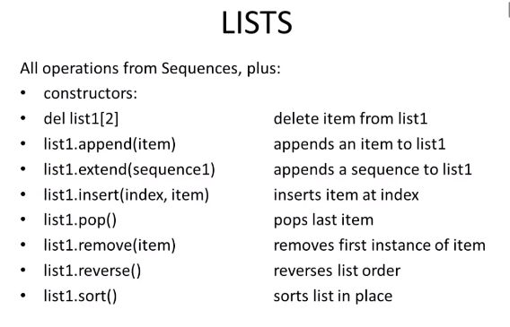

Slide 25
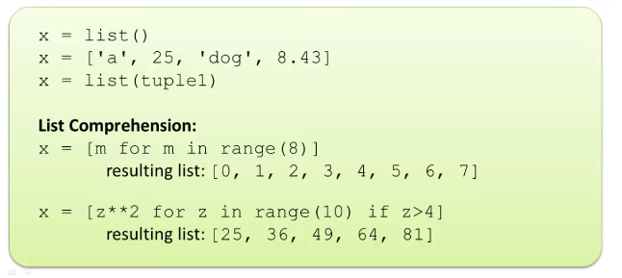
Constructors: creating a new list

Slide 26
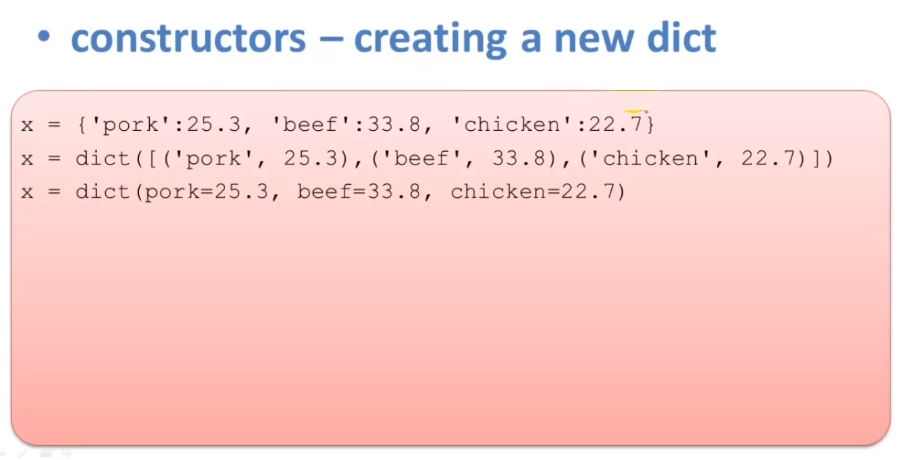

Slide 27
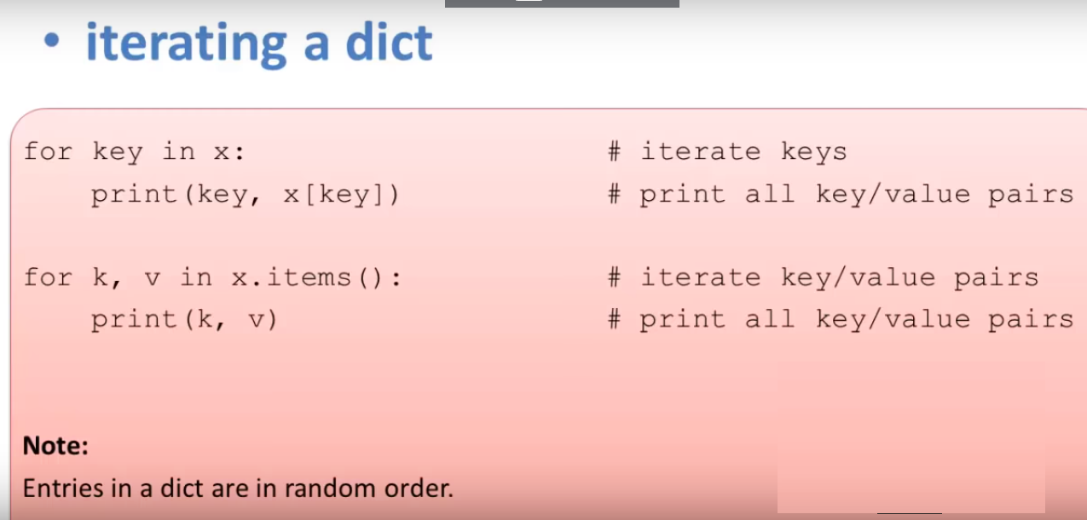

Slide 28
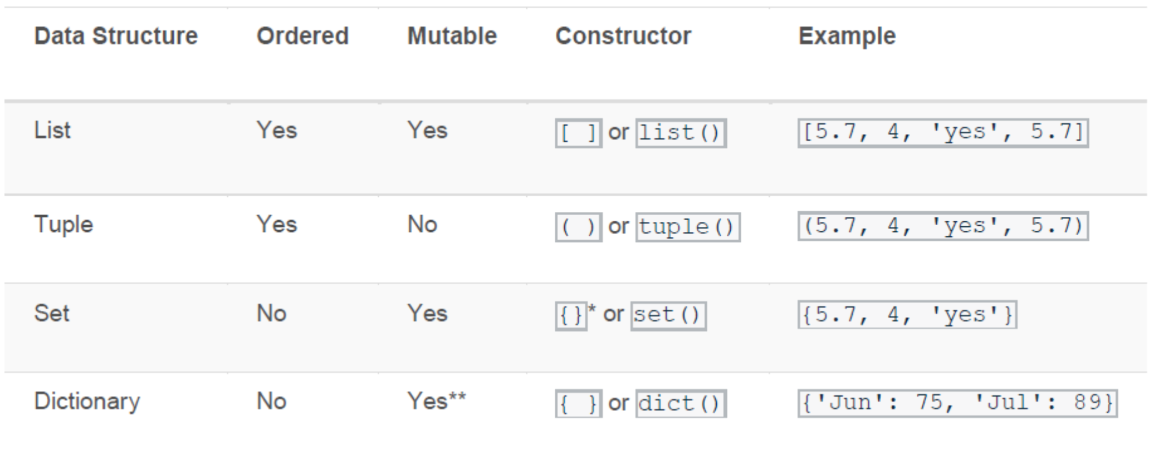
Summary of List/Tuple/Set/Dictionary

Slide 29
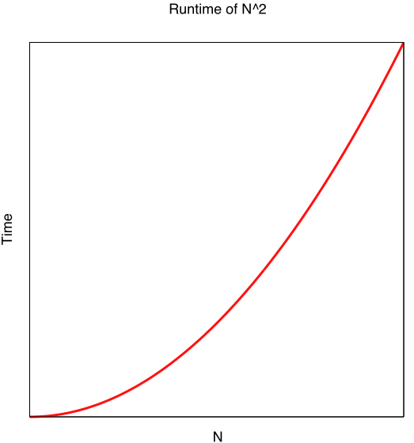
Why does the Data Structure matter?
# An inefficient way to compute intersections
a = list("ABCDEFGHIJKXYZ")
b = list("QRSACDTUGHVIJKXZ")
intersection = []
for i in a:
for j in b:
if i == j:
intersection.append(i)
print(*intersection)
Output:
A C D G H I J K X Z
Algorithm is O(N²)
N = size of Lists
Notes:
<number>

Slide 30
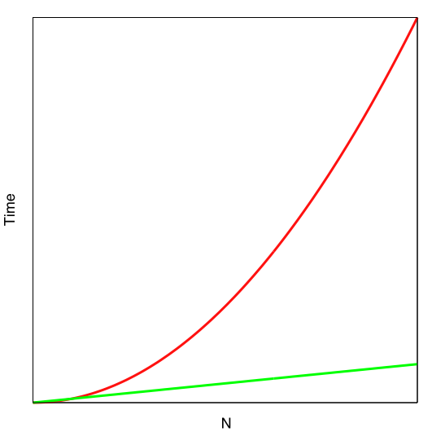
Same code, using Dictionary instead of List
# A better way to compute intersections
a = list("ABCDEFGHIJKXYZ")
b = list("QRSACDTUGHVIJKXZ")
intersection = []
# "mark" each item in a
mark = {}
for i in a:
mark[i] = 0
# intersection = any "marked" item in b
for j in b:
if j in mark.keys():
intersection.append(j)
print(*intersection)
Output:
A C D G H I J K X Z
Algorithm is O(N)
version 1
version 2
N = size of Lists
Notes:
<number>

Slide 31
Use Linux time function to demonstrate time efficiency
Unix commands:
/usr/bin/time
head
diff
cmp
% wc -l list1 list2
24762 list1
12381 list2
37143 total
% /usr/bin/time python3 intersect1.py list1 list2 > out1
22.91 real 22.88 user 0.02 sys
% /usr/bin/time python3 intersect2.py list1 list2 > out2
0.06 real 0.05 user 0.00 sys
22.88/.05 = 458
Notes:
<number>

Slide 32
Dictionaries(Hashes in Python) and Efficiency
Dictionaries provide a very fast way to look up information associated with a set of values (keys)
Examples:
Count how many time each word appears in a file
Count how many time each codon appears in a DNA sequence
Whether a given codon appears in a sequence
How many time an item appears in a given list
Intersections
Notes:
<number>

Slide 33
Dictionary Examples
Write a function get_intersection(a, b) that returns the intersection of two lists.
Write a function first_list_only(a, b) that returns the items that are in list a but not in b.
Write a function unique(a) that return the unique items in list a (that is, remove the duplicates).
Write a function dups(n, a) that returns a list of items that appear in a at least n times.
Notes:
<number>

Slide 34
Homework II
Please convert the code on Slide 24 and Slide 25 to a standalone python file so that you can run from command line Linux (by writing #! /usr/bin/env python at the top)
Compute the time difference from Linux command line
Upload both of your codes and a snapshot of your Linux screen to DYS showing the magnificent time difference (Slide 26) you observed

