Slide 1
Veritabanı Proje
Hazırlayanlar :
Furkan Lebit
Umut Can Yılmaz
Şerif Emre Bülbül
Zeynep Yavuz
Kullanılan Teknolojiler :
HTML, CSS, Javascript,
PHP, MySQL, Bootstrap
Konu :
Kariyer Sitesi

Slide 2
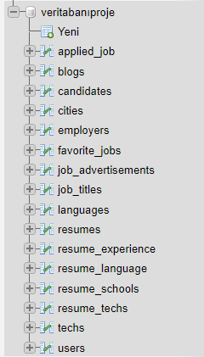
MySQL Tabloları ve Özellikleri

Slide 3
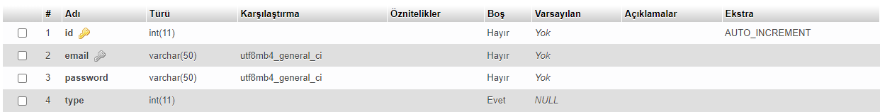
Users
id → AUTO_INCREMENT ve primary key.
Email → unique key

Slide 4
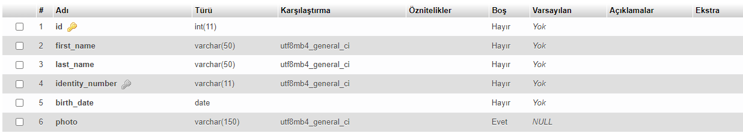
Candidates
id → primary key.
İdentity_number → unique key

Slide 5
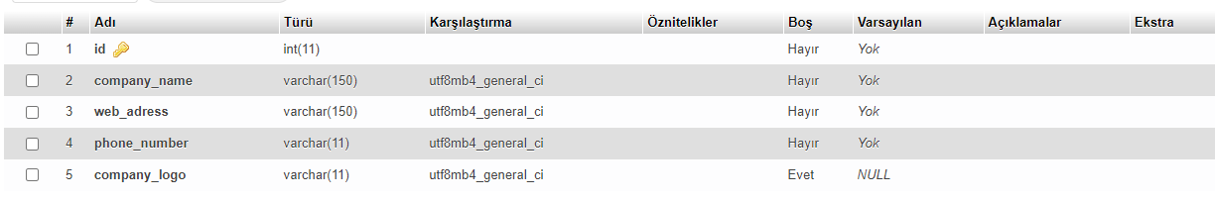
Employers
id → primary key.

Slide 6
Cities
id → primary key.

Slide 7
Techs
id → primary key.

Slide 8
Job_titles
id → primary key.
title → unique key

Slide 9
Languages
id → primary key.

Slide 10
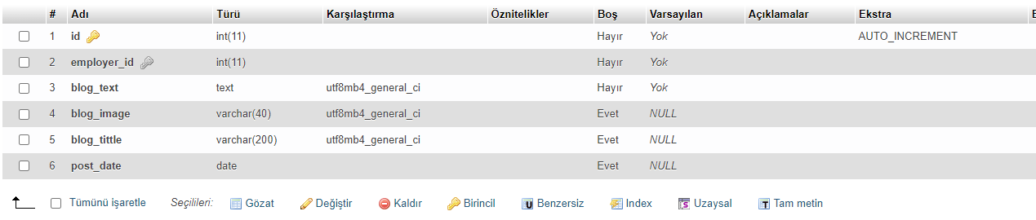
Blogs
id → primary key.
Employer_id → foreign key

Slide 11
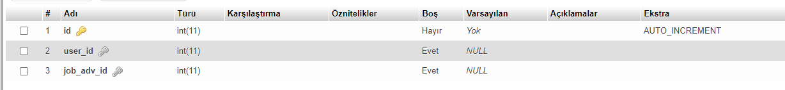
applied_job
id → primary key.
User_id → foreign key
Job_adv_id → foreign key

Slide 12
Favorite_jobs
id → primary key.
User_id → foreign key
Job_adv_id → foreign key

Slide 13
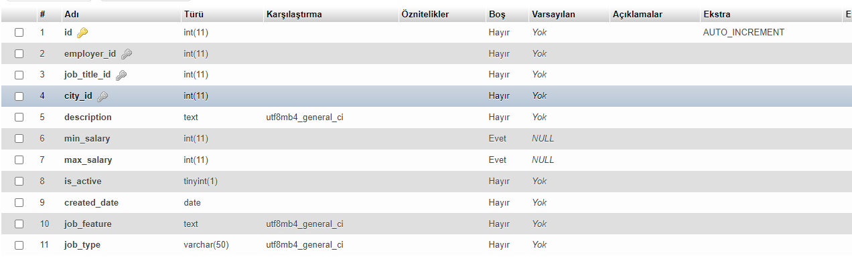
Job_advertisements
id → primary key.
employer_id → foreign key
city_id → foreign key
Job_title_id → foreign key

Slide 14
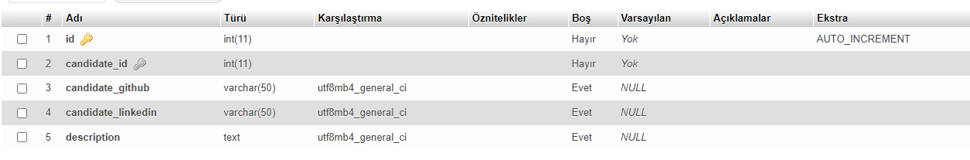
resumes
id → primary key.
candidate_id → foreign key

Slide 15
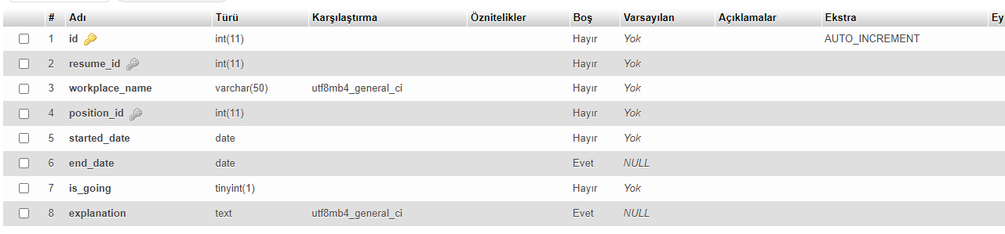
Resume_experiences
id → primary key.
resume_id → foreign key
Position_id → foreign key

Slide 16
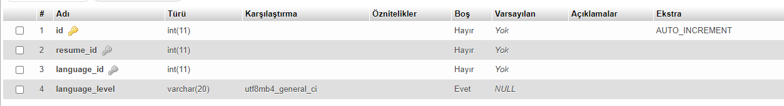
Resume_language
id → primary key.
resume_id → foreign key
Language_id → foreign key

Slide 17
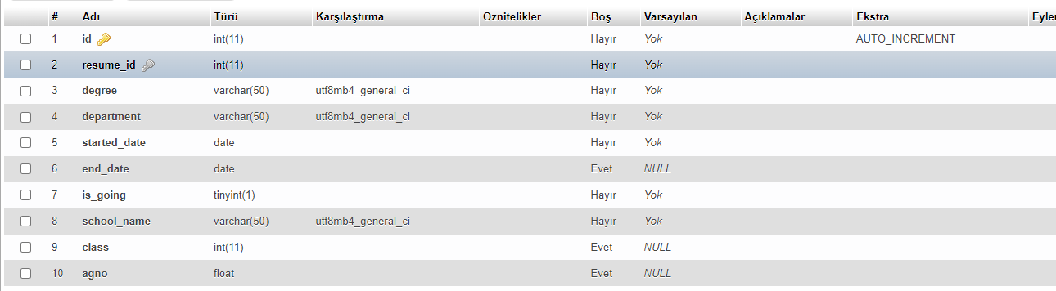
Resume_schools
id → primary key.
resume_id → foreign key

Slide 18
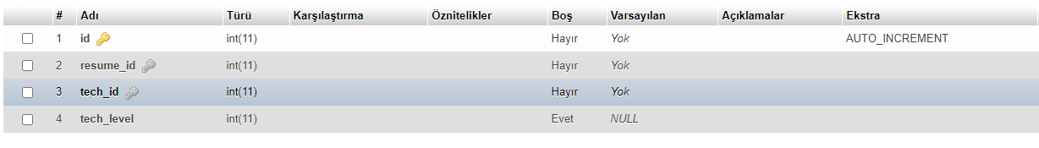
Resume_techs
id → primary key.
resume_id → foreign key
tech_id → foreign key

Slide 19
Derste Gördüğümüz Bazı Sorguların
Projedeki Kullanımı

Slide 20
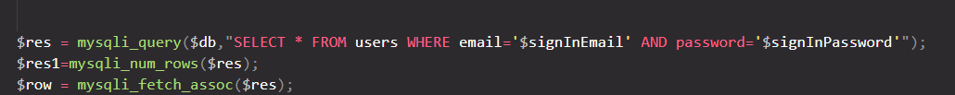
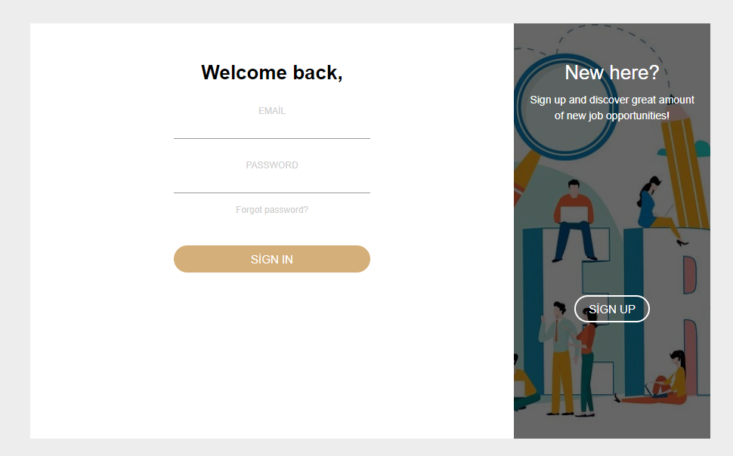
SELECT

Slide 21
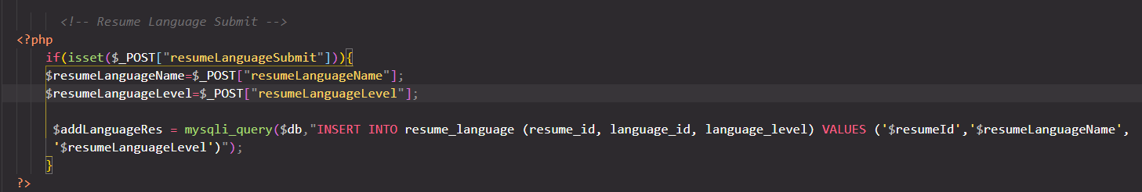
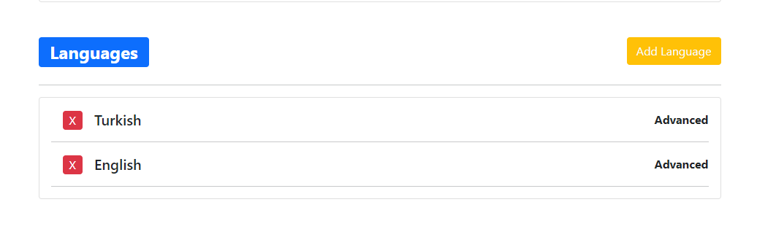
INSERT

Slide 22
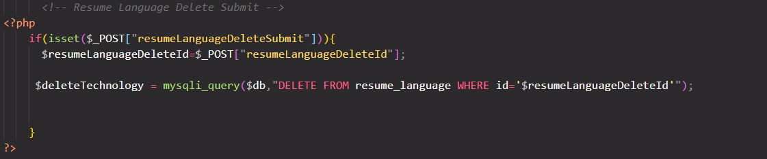
DELETE

Slide 23
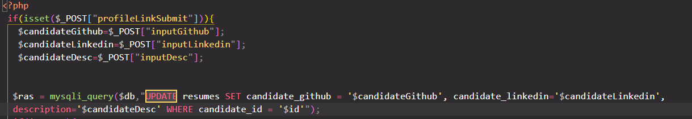
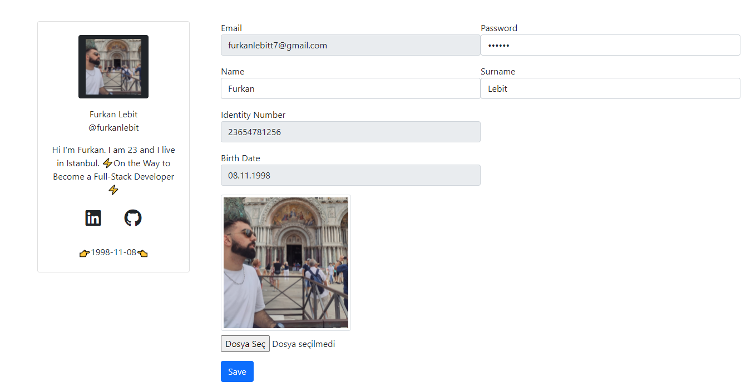
UPDATE

Slide 24
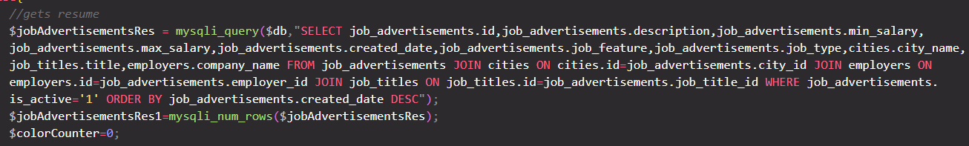
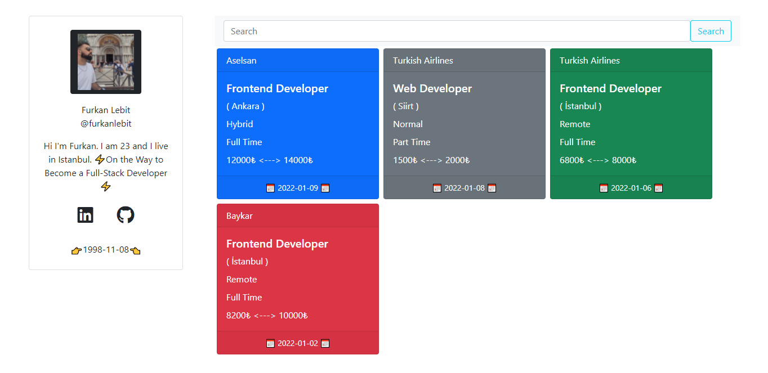
JOIN

Slide 25
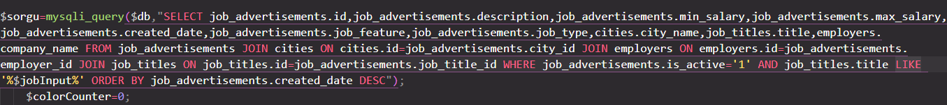
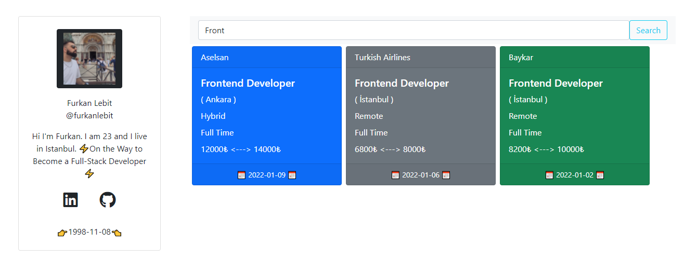
LIKE

Slide 26
ORDER BY

