Slide 1
Covid-19's effect on the stock market
Furkan SALKIN
17030411036

Slide 2
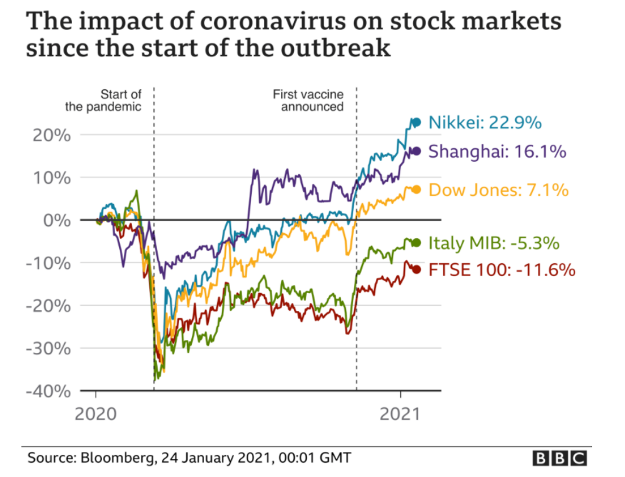
This chart shows the change in the world's leading stock market indices from the beginning of the coronavirus to the announcement of the first vaccine. These countries are Tokyo, China, USA, Italy and England. In the first months of the virus, the stock markets of other countries, excluding the Chinese stock market, lost an average of -30% in value. The increase in cases, especially in Italy and England, has significantly affected the national stock markets.

Slide 3
With the news of the vaccine, some stock markets began to rise and reached record levels. American, Tokyo and Chinese stock markets reacted positively to the news of the vaccine. The MIB and FTSE 100 indexes did not rise as Italy and the UK had too many cases.

Slide 4
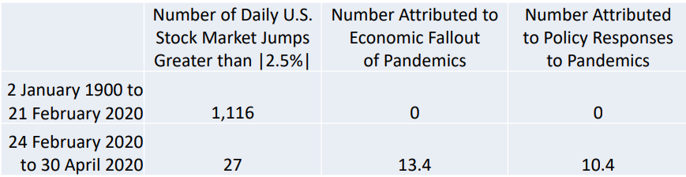
Tabulated from results in Baker, Bloom, Davis and Sammon (2020), who consider all daily jumps in the U.S. stock market greater than 2.5%, up or down, since 1900. They classify the reason for each jump into 16 categories based on human readings of nextday (or same-evening) accounts in the Wall Street Journal (and New York Times in 2020). Fractional counts arise when newspapers differ in their jump attribution or human readers differ in their classification of the attribution. Number Attributed to Economic Fallout of Pandemics includes jumps on 3/12 and 3/16 that a subset of coders classified as Macroeconomic Outlook. As can be seen from the data, the coronavirus has significantly affected the stock markets.

Slide 5
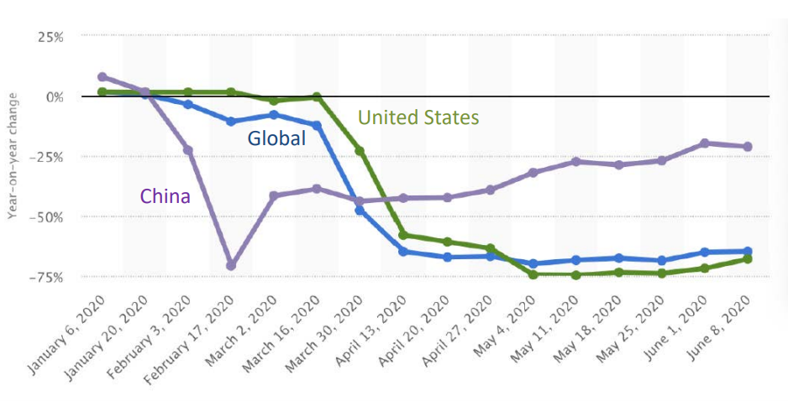
With the virus that first appeared in China, flights from all world to China were canceled. Along with the increasing number of cases in other countries in the future, a large decrease in flight flights was observed all over the world, and with this drop, airline companies dropped significantly in the stock market.

Slide 6
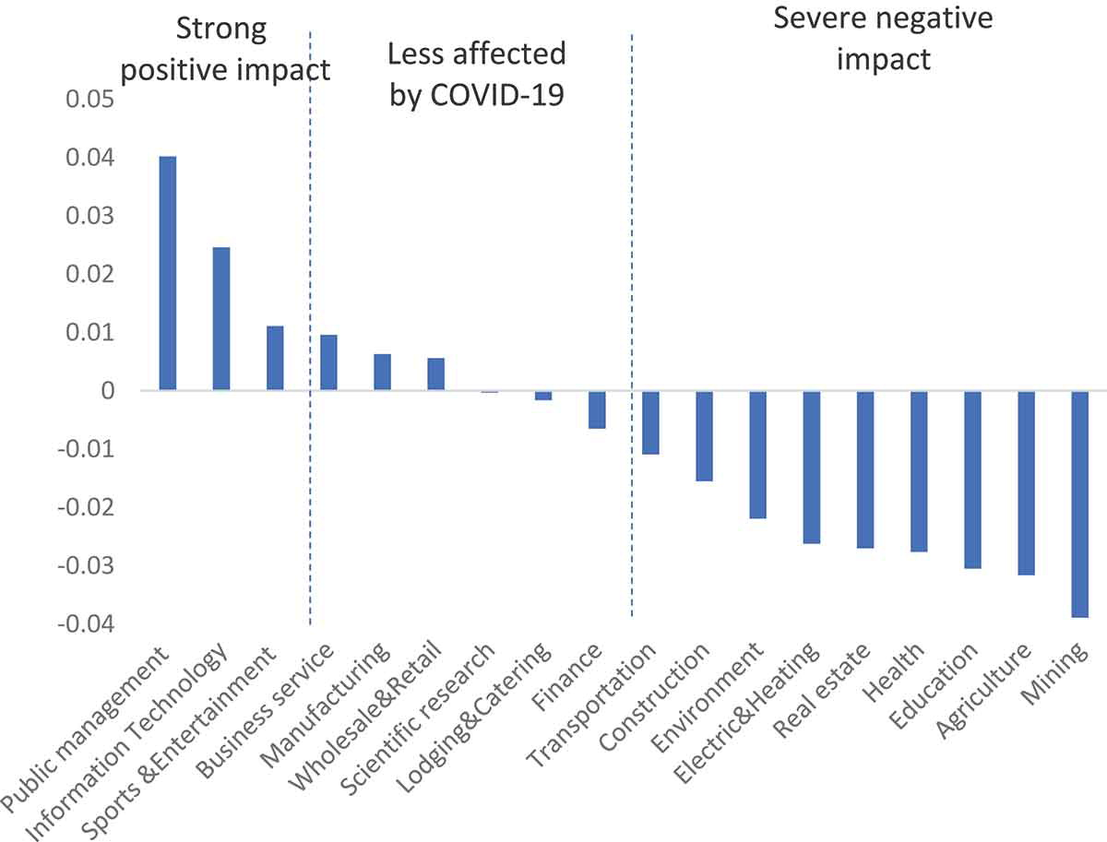
The data in the table refer to the stock price fluctuations of various industries on the event day, which can be divided into strong positive impact, less affected by COVID-19, and severe negative impact according to the size of the fluctuation.Overall, most industries suffered strong negative impacts, among which the mining industry and agriculture were the most severely impacted. As the COVID-19 pandemic intensified globally, mining companies took measures to protect extractors and communities, postponed projects, and closed mines. Some companies closed their headquarters and implemented the home office to help curb the spread of the virus. Judging from the agricultural situation, the spread of the pandemic caused the country to halt large-scale assembly activities, which hindered agricultural activities and caused severe damage to the agricultural economy.

Slide 7
The pandemic quickly swept across the country and had a major impact on agricultural production, migrant workers, and rural investment. These were quickly reflected in the capital market. The business service, manufacturing, retail, and other industries are less affected by COVID-19. The public management, information technology, and sports and entertainment industries did not only withstand the negative impact on the day of the incident, but also showed a strong coping ability – stock prices increased, to a certain extent, across these industries.

Slide 8
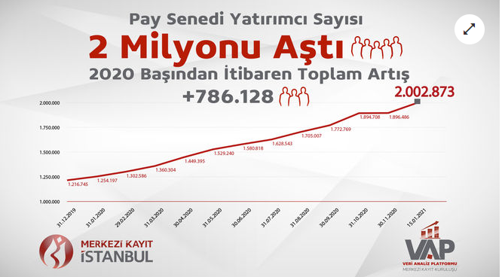
Central Registry Agency (MKK) announced that the number of investors in the stock markets has exceeded 2 million and reached 2 million 2 thousand 873 people. According to MKK data, there was an increase of 786 thousand 128 in the number of investors from the beginning of 2020 until January 15, 2021. With the coronavirus epidemic, interest in stock markets has increased around the world. In 2012, the number of investors in the stock markets was 1 million 88 thousand. At the end of 2019, it increased to 1 million 216 thousand. In other words, the number of investors increased at a very low rate for many years. There were also occasional declines.

