Slide 1
Pattern Find in Sequence
Furkan Sarıhan
1421221009
Machine Learning

Slide 2
Main Problem
Clustering - No label - Unsupervised, Kmean

Slide 3
How Data Looks Like
First Data
Two dimensional
12x?, ~1000
Dimensions: row = 12, column =~ 1000
Kmean n_cluster= large, with chunk?
Second Data
Two dimensional,
Dimensions: row = chunk, column = (length - chunk)

Slide 4
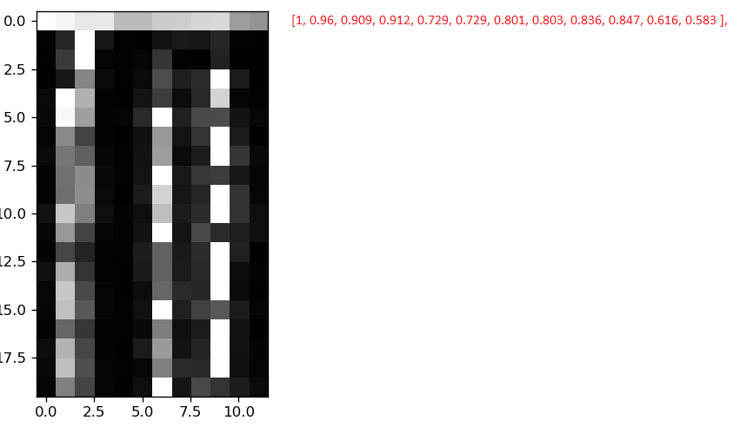
Data - First Kmean

Slide 5
First Problem
Classified, Clustered data with Kmean, Specified chunks

Slide 6
Data for Pattern - Second Kmean
Cluster numbers after First Kmean:
[56, 17, 17, 31, 67, 34, 31, 31, 7, 13, 13, 7, 31, 13, 13, …………………………..], n_cluster = 80

Slide 7
Manipulate Dataset
Generating offset base new arrays with size=4,8,16?
Cluster numbers after First Kmean:
[56, 17, 17, 31, 67, 34, 31, 31, 7, 13, 13, 7, 31, 13, 13, …………………………..]
[56, 17, 17, 31, 67, 34, 31], index = 0, chunk = 6
[17, 17, 31, 67, 34, 31, 31], index = 1, chunk = 6
[17, 31, 67, 34, 31, 31, 7 ], index = 2, chunk = 6
[31, 67, 34, 31, 31, 7, 13 ], index = 3, chunk = 6

Slide 8
Second Problem
Classified data with Kmean, Specified chunks
Better classification
Find patterns in different parts of data
0 1 3 3 2 0 2 1 1 2 1 3 3 2 0 2 4 1 0

Slide 9
Second Kmean
Large n_cluster size, find unique ones

Slide 10
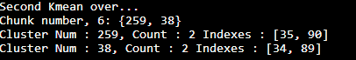
Result

