Slide 1
♫

Slide 2
IS POPULAR MUSIC GETTING DUMBER?
A LYRICAL ANALYSIS

Slide 3
POPULAR MUSIC
The first half of this decade has seen the rise of EDM and beat fetishism among other instrumental-focused trends
Are lyrics becoming less complex?
Are songs with simpler lyrics more popular?

Slide 4
MEASURING LYRICS
The US Billboard Top 100 remains the benchmark for popular music although has undergone recent composition changes
Can we measure complexity of song lyrics by measuring the number of unique words and repetitiveness

Slide 5
AVAILABILITY OF LYRICS DATA
The Billboard Top 100 Chart for each year is readily available online
Lyrics data is less accessible, often behind paywalls or incomplete
GENIUS (formerly RapGenius) has high quality data for recent years and an API
BUT this API does not provide access to lyrics

Slide 6
OBTAINING LYRICS DATA
Formatted the 2011-2015 Top 100 artist and songname data to make list of lyrics page URLs
‘http://genius.com/Mark-ronson-uptown-funk-lyrics’
Requests package used to get the HTML data to locate lyrics data
BeautifulSoup package used to scrape lyrics data from HTML

Slide 7
OBTAINING LYRICS DATA
"[Verse 1] / This hit, that ice cold / Michelle Pfeiffer, that white gold / This one, for them hood girls / Them good girls, straight masterpieces / Stylin', wilin' / Livin’ it up in the city / Got Chucks on with Saint Laurent / Gotta kiss myself I’m so pretty / [Pre-Chorus] / I’m too hot (hot damn) / Call the police and the fireman / I’m too hot (hot damn) / Make a dragon wanna retire man / I’m too hot (hot damn) / Say my name you know who I am / I’m too hot (hot damn) / And my band 'bout that money / Break it down / [Chorus] / Girls hit your hallelujah (Woo!) / Girls hit your hallelujah (Woo!) / Girls hit your hallelujah (Woo!) / Cause Uptown funk gon’ give it to you / Cause Uptown funk gon’ give it to you / Cause Uptown funk gon’ give it to you / Saturday night and we in the spot / Don’t believe me, just watch (come on) / Don’t believe me, just watch / Don’t believe me, just watch / Don’t believe me, just watch / Don’t believe me, just watch / Don’t believe me, just watch / Hey, hey, hey, oh! / [Verse 2] / Stop / Wait a minute / Fill my cup put some liquor in it / Take a sip, sign the check / Julio! Get the stretch! / Ride to Harlem, Hollywood, Jackson, Mississippi / If we show up, we gon’ show out / Smoother than a fresh jar of Skippy / [Pre-Chorus 2] / I’m too hot (hot damn) / Call the police and the fireman / I’m too hot (hot damn) / Make a dragon wanna retire man / I’m too hot (hot damn) / Bitch, say my name you know who I am! / I’m too hot (hot damn) / And my band 'bout that money / Break it down / [Chorus] / Girls hit your hallelujah (Woo!) / Girls hit your hallelujah (Woo!) / Girls hit your hallelujah (Woo!) / Cause Uptown Funk gon’ give it to you / Cause Uptown Funk gon’ give it to you / Cause Uptown Funk gon’ give it to you / Saturday night and we in the spot / Don’t believe me, just watch (come on) / Don’t believe me, just watch / Don’t believe me, just watch / Don’t believe me, just watch / Don’t believe me, just watch / Don’t believe me, just watch / Hey, hey, hey, oh! / [Bridge] / Before we leave / Lemme tell y’all a lil’ something / Uptown Funk you up, Uptown Funk you up / Uptown Funk you up, Uptown Funk you up / I said Uptown Funk you up, Uptown Funk you up / Uptown Funk you up, Uptown Funk you up / Come on, dance / Jump on it / If you sexy then flaunt it / If you freaky then own it / Don’t brag about it, come show me / Come on, dance / Jump on it / If you sexy then flaunt it / Well it’s Saturday night and we in the spot / [Part-Chorus] / Don’t believe me, just watch (come on) / Don’t believe me, just watch / Don’t believe me, just watch / Don’t believe me, just watch / Don’t believe me, just watch / Don’t believe me, just watch / Hey, hey, hey, oh! / [Outro] / Uptown Funk you up, Uptown Funk you up (say whaa?!) / Uptown Funk you up, Uptown Funk you up / Uptown Funk you up, Uptown Funk you up (say whaa?!) / Uptown Funk you up, Uptown Funk you up / Uptown Funk you up, Uptown Funk you up (say whaa?!) / Uptown Funk you up, Uptown Funk you up / Uptown Funk you up, Uptown Funk you up (say whaa?!) / Uptown Funk you up"

Slide 8
CLEANING LYRICS DATA
Used NLTK to remove punctuation and tokenize lyrics
UNIQUE WORD COUNT:
Describes the diversity of lyrics BUT does not indicate repetitiveness
TOTAL WORD COUNT:
Total number of words in each song’s lyrics

Slide 9
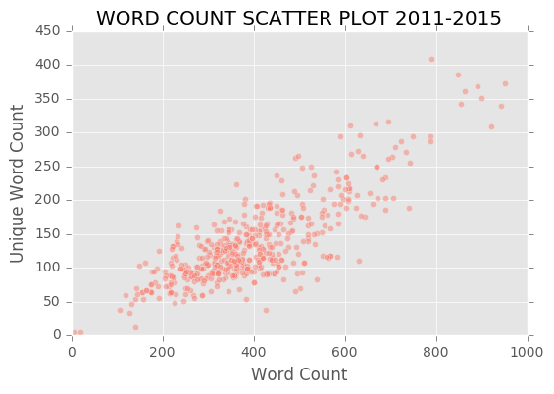
PLOTTING LYRICS DATA

Slide 10
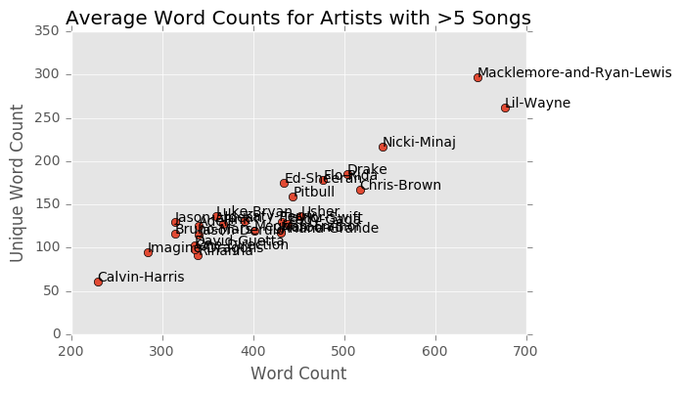
PLOTTING TOP ARTISTS

Slide 11
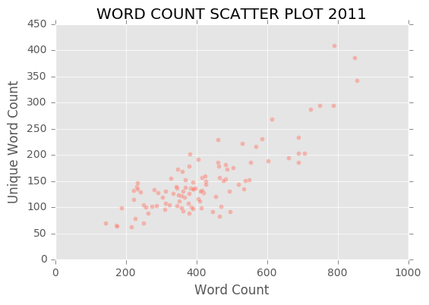
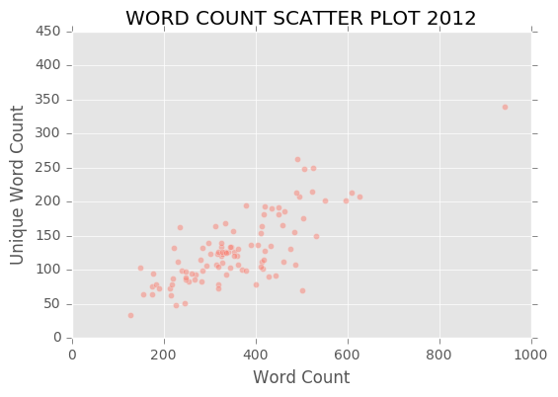
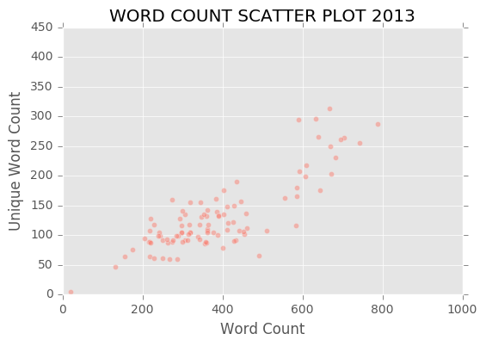
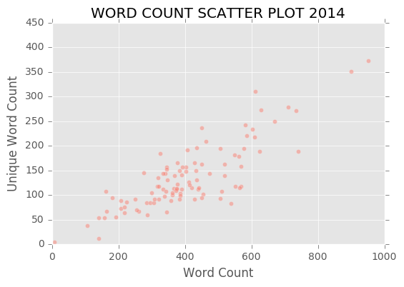

PLOTTING LYRICS DATA

Slide 12
THE LYRKL SCORE
Combine lyrical diversity and repetitiveness into a single feature
UWC*(UWC/WC)

Slide 13
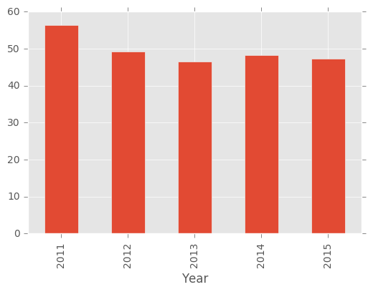
MEAN LYRKL SCORE BY YEAR
56.41
49.28
48.32
47.31
46.54

Slide 14
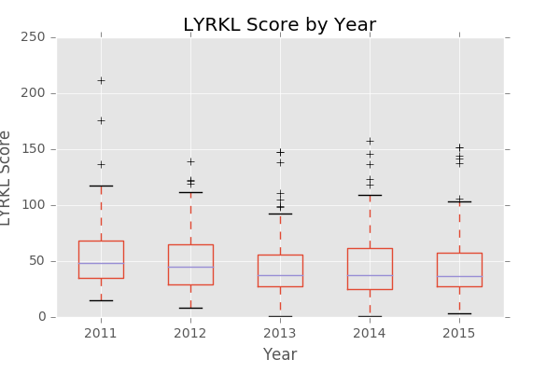
LYRKL SCORE BOXPLOTS

Slide 15
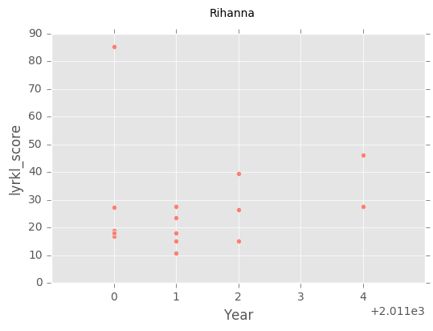
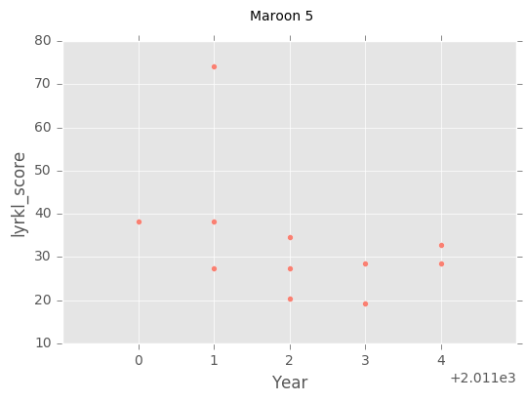
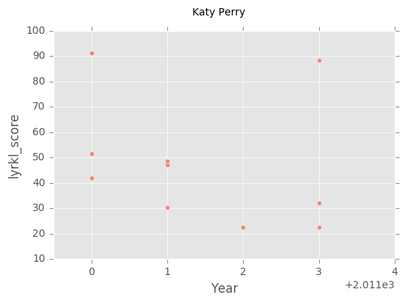
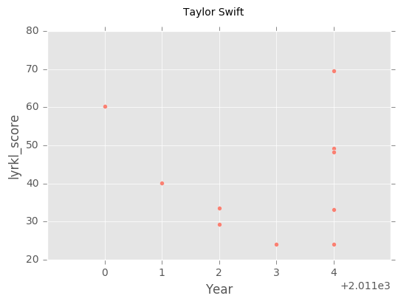
LYRKL TRENDS OF ARTISTS WITH OVER 10 SONGS IN THE DATASET

Slide 16
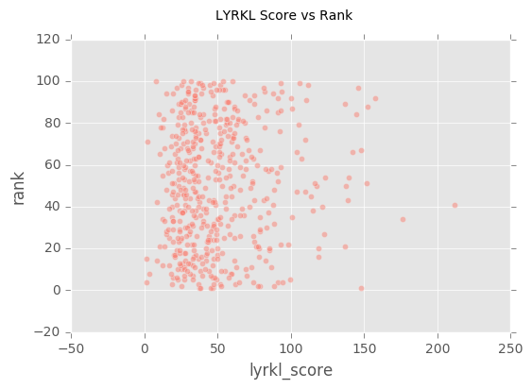
CORRELATION ANALYSIS
No suggestion of correlation between LYRKL score and rank

Slide 17
CONCLUSION
Analysis suggested a gradual downtrend in lyrical complexity
No evidence that simpler lyrics are more popular
Web scraping packages proved useful for obtaining data
Analyze the composition of lyrics using NLTK
A longer observation timeframe would be preferable
Could adopt and compare alternative benchmarks such as Spotify global streaming ranking or JJJ Hottest 100
Genre and song length data would provide greater depth to the analysis
Apply Markov Chains to generate song lyrics based on each year
NEXT STEPS

