Slide 1
超级企鹅SuperTux
Supertux is a cross-platform game similar to Super Mario Bros that supports Windows, Linux, MacOSX and many other operating system platforms.
The 2D game, which supports keyboards and controllers, allows a penguin called Tux to jump up a brick and eat gold COINS or snowballs or flowers, which make penguins bigger and flowers invincible. I'm sure anyone who has played Super Mario will jump right into the game. Compared to the classic Super Mario, SuperTux has a more beautiful background and richer game content.
汇报人：朱成淼 符溶芷 张鸿蓝

Slide 2
1
Module division
目录
2
Game's content
CONTENTS
3
Slove difficulties
4
Group work division

Slide 3
PART 01
Module division
We divided the game into three modules.

Slide 4
Module division
The division of the game is divided into three modules, namely entity setting, scene setting and reset
01
Setting scene
.
02
Setting entity.
03
Reset.

Slide 5
PART 02
Game's content
How to set up the scene, import and collision between entities, and finally reset the problem.

Slide 6
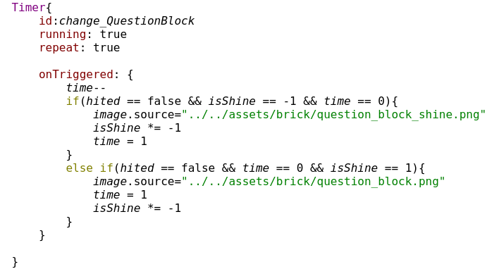
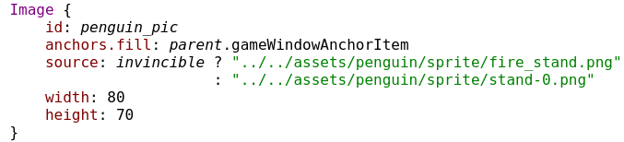
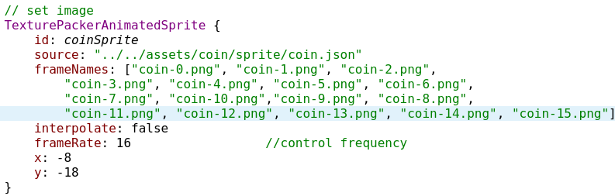






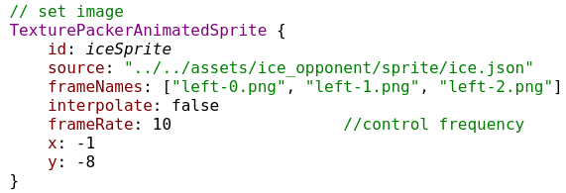
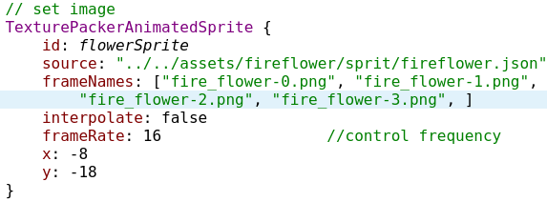
Setting entity
The physical objects in the game include penguins, gold COINS, flowers, snowballs, bricks, various monsters and the end house. Animate the entities in the scene by setting their Sprite animations.
penguin.
Coin
.
block
snowball.
flower
.
monster

Slide 7
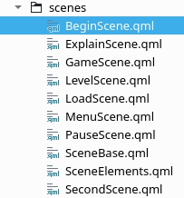
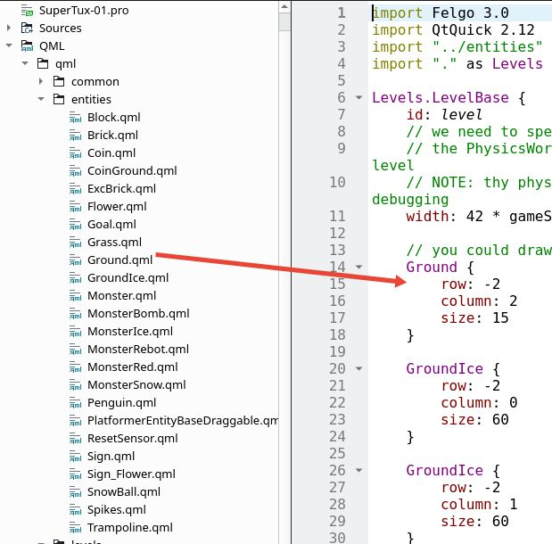
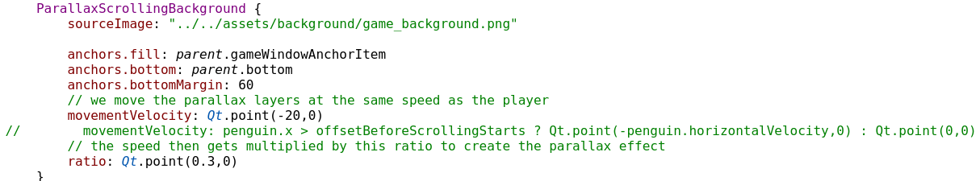
Setting scene
The scene basically positions the entities in the scene grid by setting the sizes of the row and colum in each entity.
01
Scene background
Declare a QML component and import each component into another to set up the interface switch.
Scene splicing and entity import
02
Declare a component, call each entity, and control the position of the entity in the grid by locating the size of row and column.
03
Scene animation

Slide 8
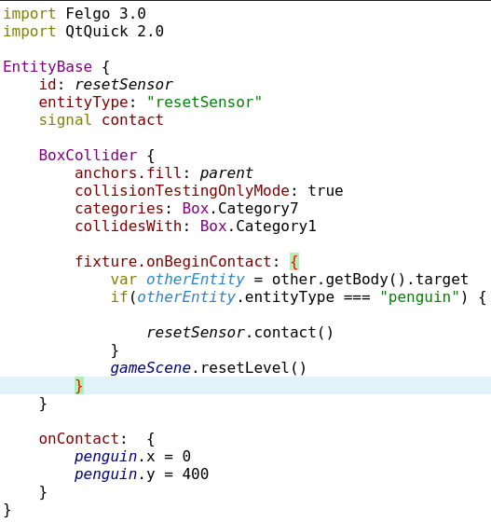
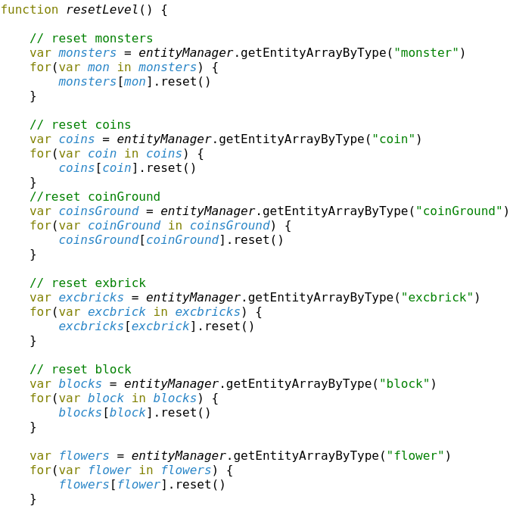
Reset
ResetSensor.qml
A ResetSensor is a reset collider that detects the reset signal.
GameScene.qml
Declare a function in GameScene to reset the various physical objects in the game

Slide 9
PART 03
Solve difficulties

Slide 10
Solve diffculty
Reset
Reset all entities and penguin.
Collision
Entitys’s collision.
Sprite
Sprite animation.

Slide 11
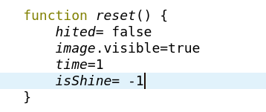
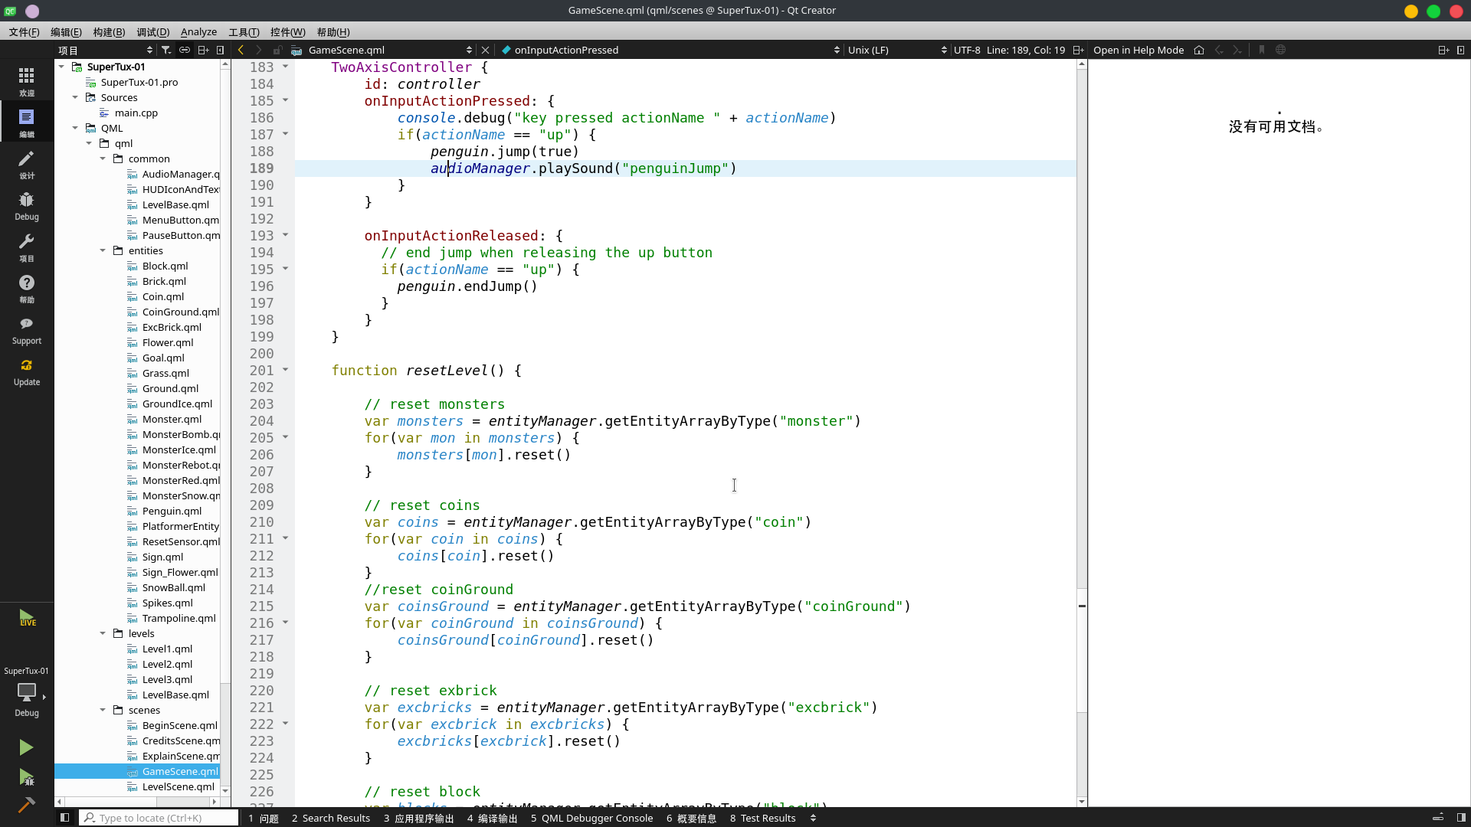
Solve diffcult
Reset
Block
Reset:
Reset includes entity reset, scene reset and Penguin reset.
Entity reset: Entity reset mainly calls the reset function written in each entity. When a reset is required, the reset function of each entity is called with resetlevel.
Scene reset:Scene reset calls the function called resetlevel in gameScene.qml. In this function,use the function getEntityArrayByType() of entityManager to get an array of all entities using the same entity.
Penguin reset:When the penguin is dead, the penguin returns to its original position, and then uses the resetlevel function to reset the scene and entity.

Slide 12
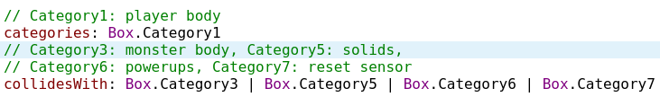
Solve diffcult
Collision
Collision:
Collision include penguin with other entities,eg:coin or block. monster and ground.
Penguin with other entities:
The collision between Pengin body and monster,ground,sensor,flower,coin...
The collision between Pengin head and brick,block...
The collision between Pengin feet and monster,ground,block...
Monster with Monster,Spikes,Ground:
Monster with Monster: monster turn around after collision
Monster with Spikes: monster die
Monster with Ground:walk

Slide 13

Solve diffcult
Sprite
Sprite animator:
Reader the document.
Use TexurePacker software get json document and all pictures.
Use json document and pictures and the Sprite functions complete the creation of Sprite animation.

Slide 14
PART 04
Group work division

Slide 15
Group work division
This section briefly introduces the division of labor of each person in the team in the game project
朱成淼：
Responsible for the physical parts of the game:
entity collision,
entity function,
Animated sprite
张鸿蓝：
Responsible for the resets in the game:
physical resets,
level resets
符溶芷：
Be responsible for the scenes in the game:
level scenes,
other scenes

Slide 16
Thanks for your watching
汇报人：朱成淼 符溶芷 张鸿蓝

