Slide 1
超级企鹅SuperTux
Supertux is a cross-platform game similar to Super Mario Bros that supports Windows, Linux, MacOSX and many other operating system platforms.
The 2D game, which supports keyboards and controllers, allows a penguin called Tux to jump up a brick and eat gold COINS or snowballs or flowers, which make penguins bigger and flowers invincible. I'm sure anyone who has played Super Mario will jump right into the game. Compared to the classic Super Mario, SuperTux has a more beautiful background and richer game content.
汇报人：朱成淼 符溶芷 张鸿蓝

Slide 2
1
Module division
2
Game's content
目录
3
Project innovation
CONTENTS
4
Slove difficulties
5
Group work division and experience

Slide 3
PART 01
Module division
We divided the game into three modules.

Slide 4
Module division
The division of the game is divided into three modules, namely entity setting, scene setting and reset
01
Setting scene
.
02
Setting entity.
03
Reset.

Slide 5
PART 02
Game's content
How to set up the scene, import and collision between entities, and finally reset the problem.

Slide 6
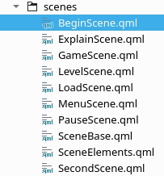
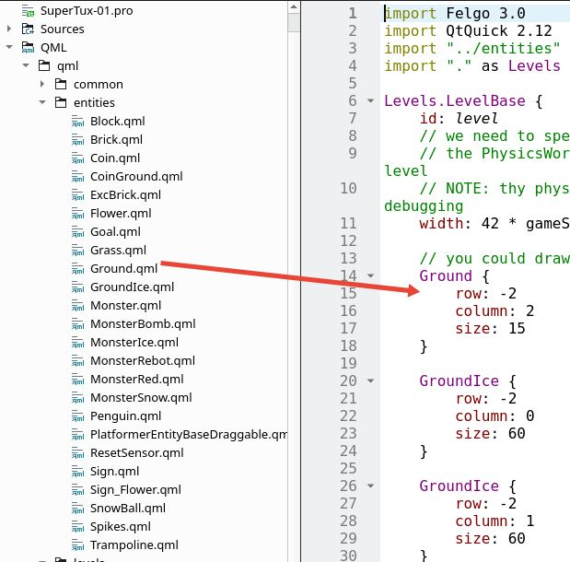
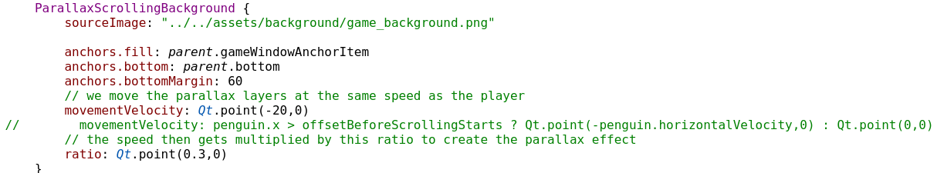
Setting scene
The scene basically positions the entities in the scene grid by setting the sizes of the row and colum in each entity.
01
Scene background
Declare a QML component and import each component into another to set up the interface switch.
Scene splicing and entity import
02
Declare a component, call each entity, and control the position of the entity in the grid by locating the size of row and column.
03
Scene animation

Slide 7
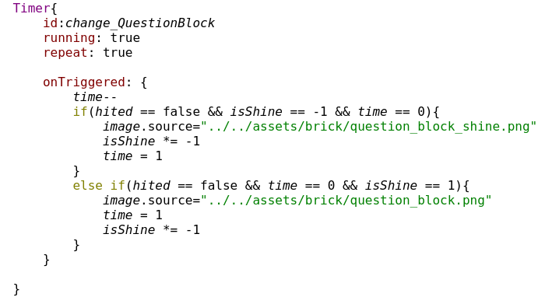
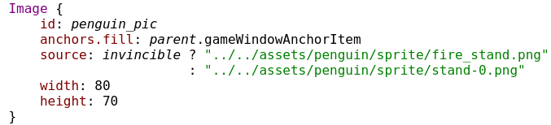
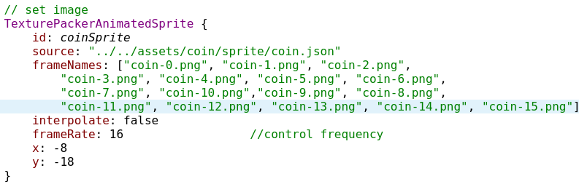






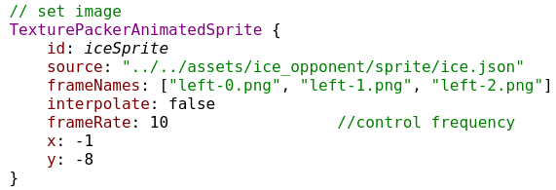
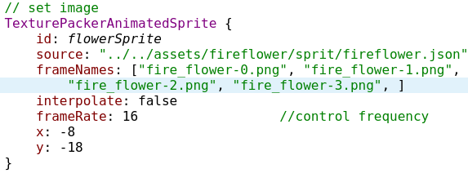
Setting entity
The physical objects in the game include penguins, gold COINS, flowers, snowballs, bricks, various monsters and the end house. Animate the entities in the scene by setting their Sprite animations.
penguin.
Coin
.
block
snowball.
flower
.
monster

Slide 8
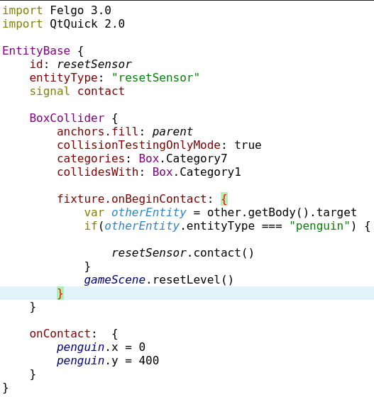
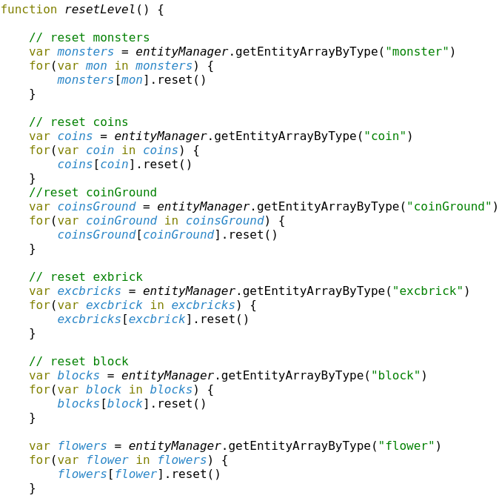
Reset
ResetSensor.qml
A ResetSensor is a reset collider that detects the reset signal.
GameScene.qml
Declare a function in GameScene to reset the various physical objects in the game

Slide 9
PART 03
Project innovation

Slide 10
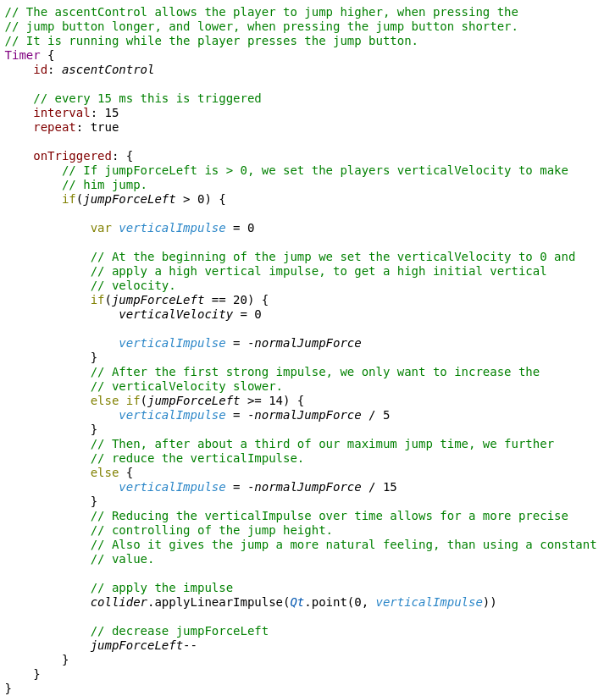
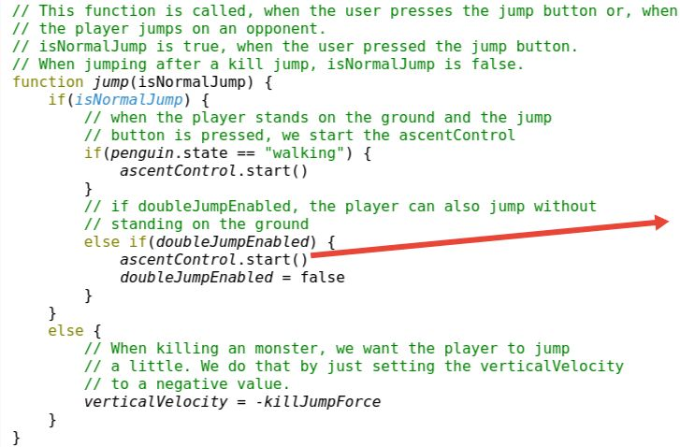
01 Player action
In the original version of the game, penguins could only jump up by pressing the space bar, and did so once. In our enhancements, penguin players can double jump, meaning they can jump twice if they hit the ground once or brick once. If you hold down the up key and walk left (right), the penguin will appear to fly.

Slide 11
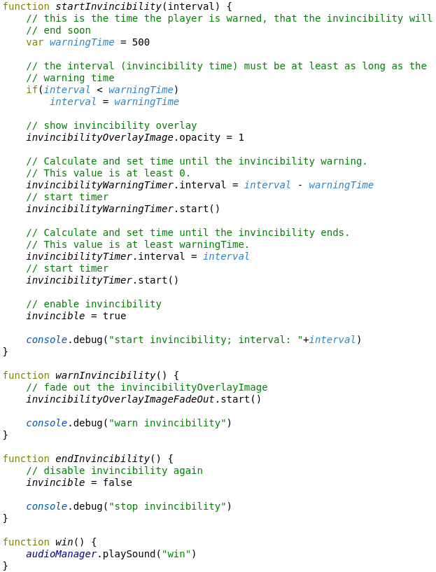
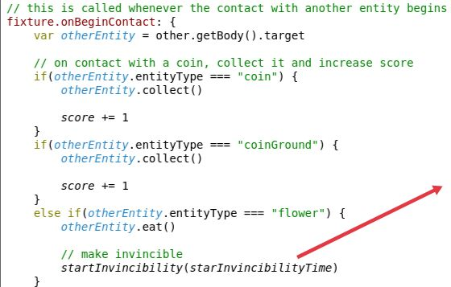
02 Entity function
The original game penguin players through eating flowers can obtain a chance of immortality, and encounter any monster will lose this opportunity. And we improved on that in the game - penguin players can become invincible by eating flowers, only when they encounter certain monsters will they lose the chance to become invincible.

Slide 12
PART 04
Solve difficulties

Slide 13
Solve diffculty
Reset
Reset all entities and penguin.
Collision
Entitys’s collision.
Sprite
Sprite animation.

Slide 14
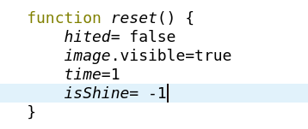
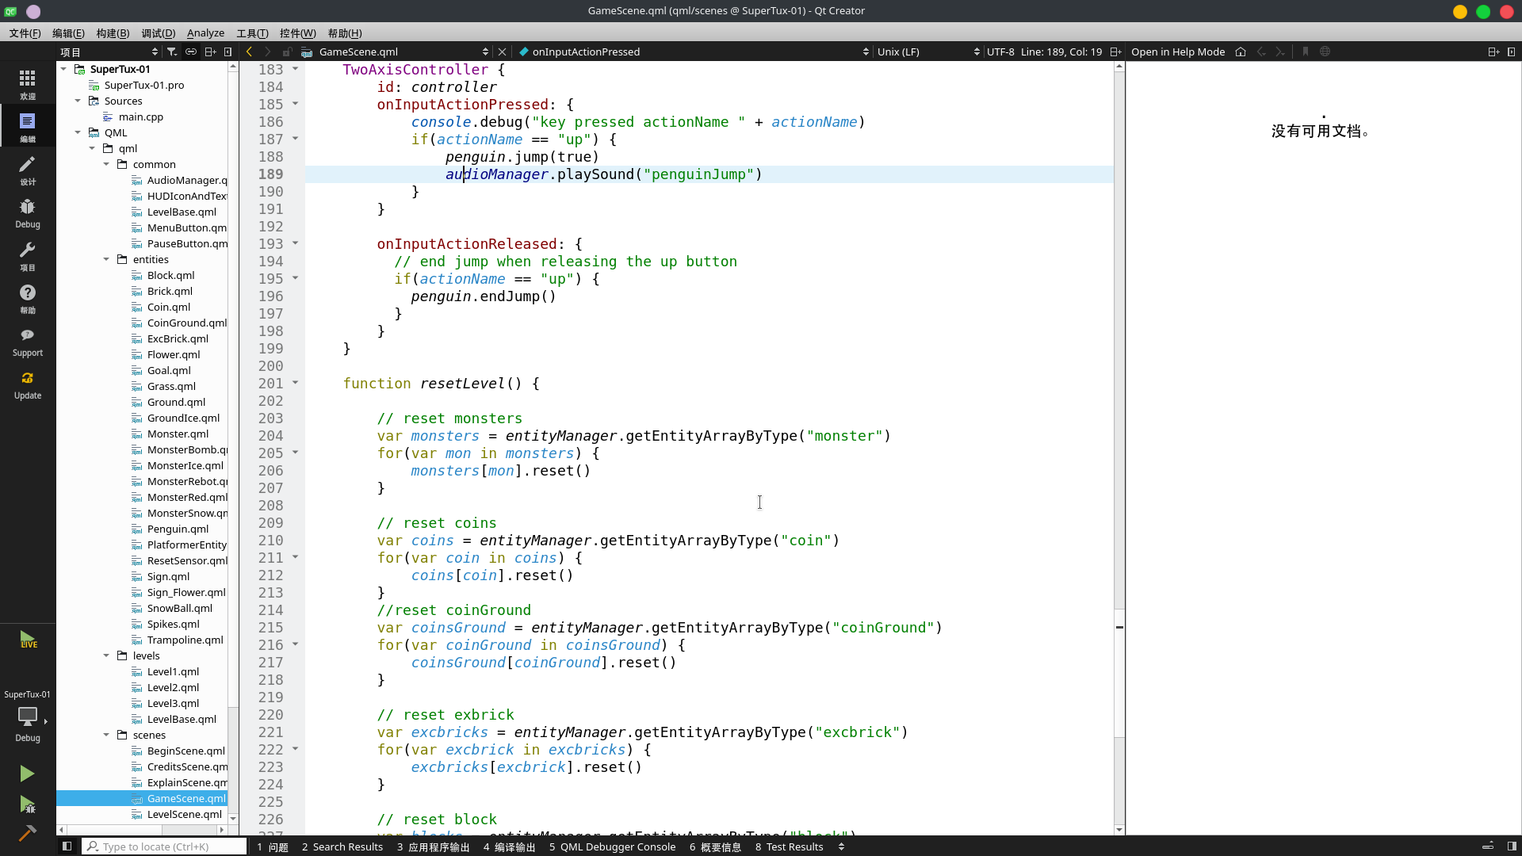
Solve diffcult
Reset
Block
Reset:
Reset includes entity reset, scene reset and Penguin reset.
Entity reset: Entity reset mainly calls the reset function written in each entity. When a reset is required, the reset function of each entity is called with resetlevel.
Scene reset:Scene reset calls the function called resetlevel in gameScene.qml. In this function,use the function getEntityArrayByType() of entityManager to get an array of all entities using the same entity.
Penguin reset:When the penguin is dead, the penguin returns to its original position, and then uses the resetlevel function to reset the scene and entity.

Slide 15
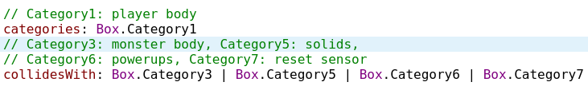
Solve diffcult
Collision
Collision:
Collision include penguin with other entities,eg:coin or block. monster and ground.
Penguin with other entities:
The collision between Pengin body and monster,ground,sensor,flower,coin...
The collision between Pengin head and brick,block...
The collision between Pengin feet and monster,ground,block...
Monster with Monster,Spikes,Ground:
Monster with Monster: monster turn around after collision
Monster with Spikes: monster die
Monster with Ground:walk

Slide 16

Solve diffcult
Sprite
Sprite animator:
Reader the document.
Use TexurePacker software get json document and all pictures.
Use json document and pictures and the Sprite functions complete the creation of Sprite animation.

Slide 17
PART 05
Group work division
and experience

Slide 18
Group work division
This section briefly introduces the division of labor of each person in the team in the game project
朱成淼：
Responsible for the physical parts of the game:
(1)entity collision,
(2)entity function,
(3)Animated sprite
张鸿蓝：
Responsible for the resets in the game:
(1)physical resets,
(2)level resets
符溶芷：
Be responsible for the scenes in the game:
(1)level scenes,
(2)game scene and other scenes

Slide 19
Personal experience
朱成淼：On entities and collisions between entities: Analyze which entities will appear in the game, then find which entities will collide with which entities, and implement the collision between entities, initialization and correlation function after the collision in each entity QML. By writing the entity collisions section, I learned about collisions between entities.
张鸿蓝：By reading the game tutorials on Felgo‘s official website and felgo game examples ,I learned how to use sprite animation、collision、level setting 、scene setting how to reset the scene and entities. Regarding the scene reset that I am responsible for, first analyze the entity that needs to be reset, and then improve the corresponding reset function, and then complete all the resets by calling the corresponding reset function in the game scene.
符溶芷：By reading the game tutorials on Felgo's official website, I learned how to switch scenes by clicking buttons. Second, refer to the game scene code in the Felgo example. In the game scene, the Ground, coins, players and various entities are determined by locating their Row and Column positions. For example, the Ground is joined by a single Ground positioning Row and Column coordinates. Other entities are similar.

Slide 20
Group lessons
Group lessons：
Each of us is involved in some part of the other, equivalent to each of us being involved in every part of the game. The hardest part of the game we find is the collision and reset between entities. The collision between entities involves the coordinates and positions of colliders, and the colliding entities should also set the coordinates and positions of corresponding colliders. The intermediate also overcomes the problems between various entities due to colliders. The problem with the reset part is where the player is positioned to touch monsters, traps, fall off cliffs, and enter the next level.
Through this training, we really learned a lot, such as the ability to quickly read documents by ourselves, the division of labor and integration between groups, and quickly find out the problem. Times of headaches and late nights are still fresh in my mind.

Slide 21
Thanks for your watching
汇报人：朱成淼 符溶芷 张鸿蓝

