Slide 1
The Dataset Provided:
Used the sleep dataset from SC Sleep-EDF Database
Three sleep categories :
1) SC1 - Light sleep + REM category
2) SC2 - Deep sleep category
3) SC3 - Awake Category
800 observations for each sleep category
14 features
15 columns including class labels

Slide 2
What is the goal?
Primary Goal : To check which classifier has the best performance with the lowest number of features
Additionally :
Plotting a curve that compares the accuracy of all methods versus the number of features
Providing the test performance and calculate the confusion matrix, accuracy, sensitivity, specificity, F1-score, false positive rate, and false negative rate for each class using the best number of features for that class
Notes:
Mobile devices do not have enough storage, and thus the need for the user of the devices to get extra space from services such as AWS. The solution will be finding an algorithm that can best address these issues. The main thing holding back the adoption of cloud computing is the ongoing issue of data security. This worry stems from the fact that personal information kept in public clouds is handled by for-profit service providers who might not be completely reliable.

Slide 3
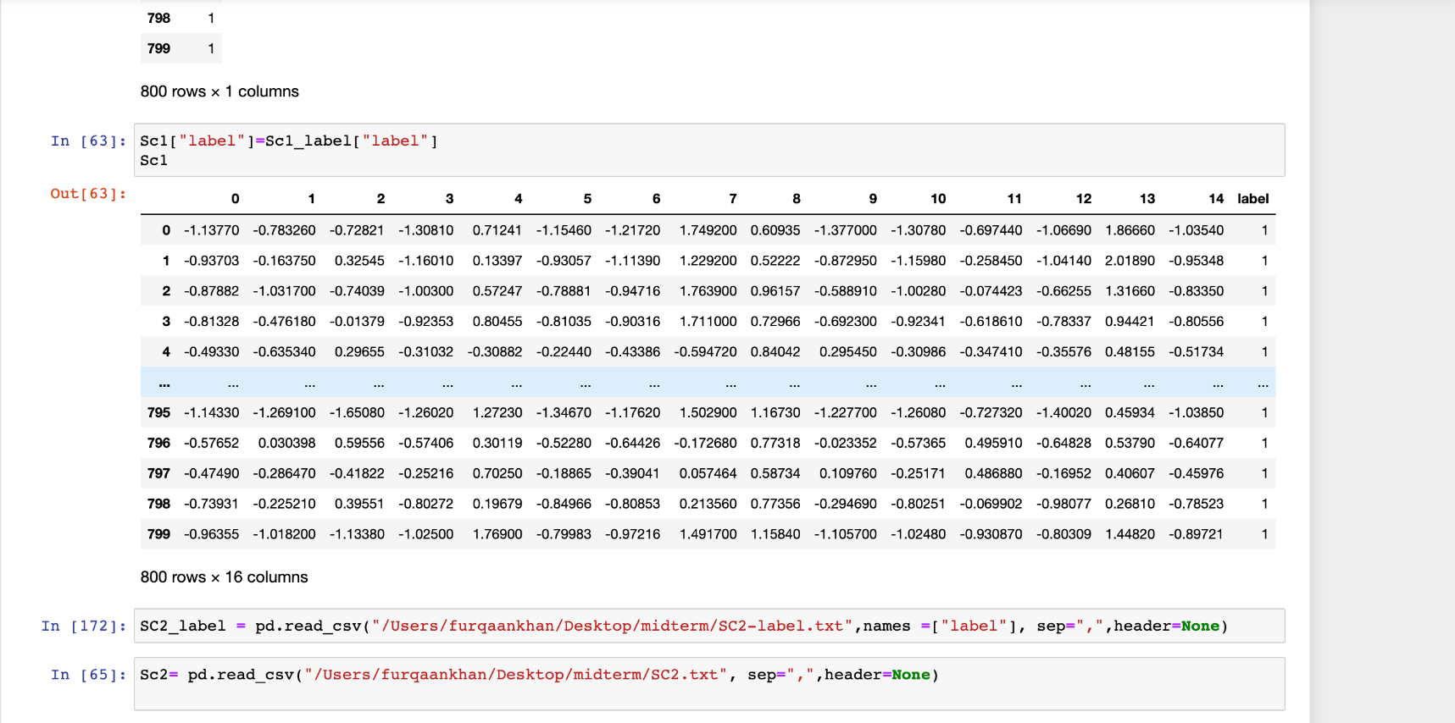
The Dataset :
Notes:
Mobile devices do not have enough storage, and thus the need for the user of the devices to get extra space from services such as AWS. The solution will be finding an algorithm that can best address these issues. The main thing holding back the adoption of cloud computing is the ongoing issue of data security. This worry stems from the fact that personal information kept in public clouds is handled by for-profit service providers who might not be completely reliable.

Slide 4
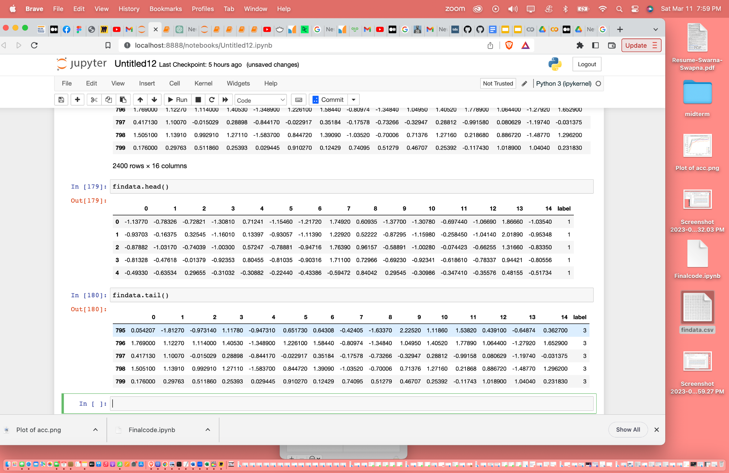
After Merging:
Notes:
Mobile devices do not have enough storage, and thus the need for the user of the devices to get extra space from services such as AWS. The solution will be finding an algorithm that can best address these issues. The main thing holding back the adoption of cloud computing is the ongoing issue of data security. This worry stems from the fact that personal information kept in public clouds is handled by for-profit service providers who might not be completely reliable.

Slide 5

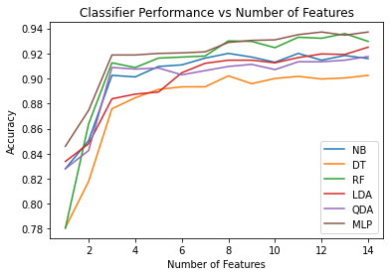
The curve that compares the accuracy of all methods versus the number of features

Slide 6
Classifier | Best Features | Accuracies
Naive Bayes | 14 | 0.915
Decision Tree | 14 | 0.898
Random Forest | 12 | 0.932
LDA | 11 | 0.917
QDA | 14 | 0.916
MLP | 14 | 0.934

Slide 7
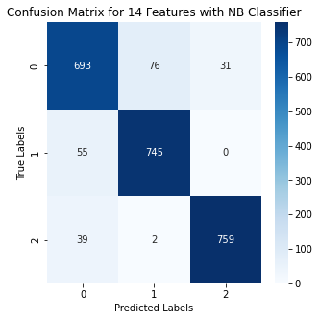
Naive Bayes
Best Features : 14
Accuracy: 0.916
Sensitivity: 0.069
Specificity: 0.643
F1-Score: 0.915
False Positive Rate: 0.099
False Negative Rate: 0.039

Slide 8
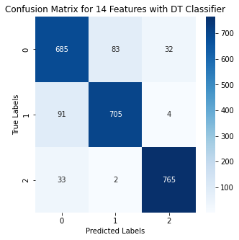
Decision Tree
Best Features : 14
Accuracy: 0.0898
Sensitivity: 0.114
Specificity: 0.635
F1-Score: 0.898
False Positive Rate: 0.0104
False Negative Rate: 0.040

Slide 9
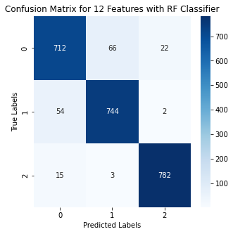
Random Forest
Best Features : 12
Accuracy: 0.932
Sensitivity: 0.068
Specificity: 0.646
F1-Score: 0.932
False Positive Rate: 0.085
False Negative Rate: 0.028

Slide 10
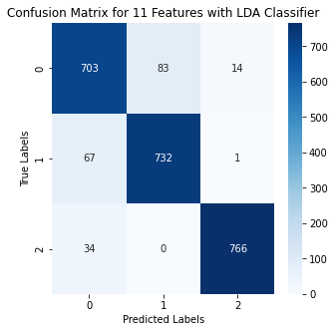
LDA
Best Features : 11
Accuracy: 0.917
Sensitivity: 0.084
Specificity: 0.642
F1-Score: 0.917
False Positive Rate: 0.106
False Negative Rate: 0.018

Slide 11
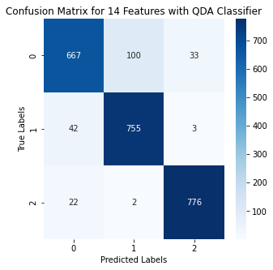
QDA
Best Features : 14
Accuracy: 0.916
Sensitivity: 0.052
Specificity: 0.640
F1-Score: 0.915
False Positive Rate: 0.130
False Negative Rate: 0.041

Slide 12
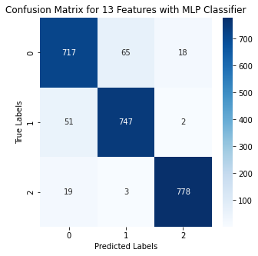
MLP
Best Features : 13
Accuracy: 0.934
Sensitivity: 0.064
Specificity: 0.647
F1-Score: 0.934
False Positive Rate: 0.083
False Negative Rate: 0.022

Slide 13
Which Classifier performed best with the lowest number of features?
In my opinion, the random forest classifier performed Exceptionally well with only 12 features.

