Slide 1
Furqan Jan week : 03
“Understanding how machines learn complex patterns from data.”

Slide 2
What is Deep Learning?
Deep Learning is a branch of Machine Learning that uses artificial neural networks with multiple layers to learn complex patterns from data automatically.

Slide 3
Deep Learning
It is inspired by the way the human brain processes information.
It uses Artificial Neural Networks (ANNs).
“Deep” means the network contains multiple hidden layers.
It can automatically learn useful features from large amounts of data.
It is widely used for images, speech, text, prediction, and pattern recognition

Slide 4
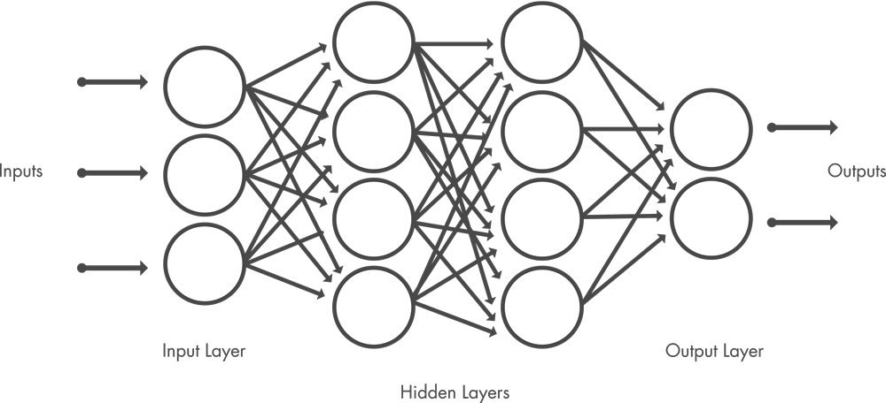
Structure of a Deep Learning

Slide 5
Neural Network
A deep neural network consists of an input layer, multiple hidden layers, and an output layer. Each circle represents a neuron, while the connecting lines represent weights or connections between neurons.

Slide 6
Structure of a Deep Neural Network
Input Layer: Receives the original data or features.
Hidden Layers: Learn increasingly complex patterns from the input data.
Neurons: Process the received information using weights, bias, and an activation function.
Connections: Carry information from one neuron to neurons in the next layer.
Output Layer: Produces the final prediction or classification.

Slide 7
Types of Neural Networks
Different neural network architectures are designed for different kinds of data and problems. The most common types include ANN, CNN, RNN, and GANs.

Slide 8
Artificial Neural Network (ANN)
An Artificial Neural Network is the basic form of a neural network. It consists of an input layer, one or more hidden layers, and an output layer.
Main idea: Neurons are connected through weighted connections and learn patterns from data.
Common uses:
Classification
Regression
Prediction
Customer behavior analysis
Medical diagnosis

Slide 9
Convolutional Neural Network (CNN)
A Convolutional Neural Network is mainly designed for images and visual data. It automatically learns features such as edges, shapes, textures, and objects.
Main idea: Uses convolution and pooling operations to extract important features from images.
Common uses:
Image classification
Face recognition
Object detection
Medical image analysis
Handwritten digit recognition

Slide 10
Recurrent Neural Network (RNN)
A Recurrent Neural Network is designed for sequential or time-dependent data. Unlike a normal ANN, an RNN can use information from previous steps.
Main idea: It has a form of memory, allowing previous information to influence the current output.
Common uses:
Time-series forecasting
Speech recognition
Text processing
Language modeling
Stock or weather prediction

Slide 11
Generative Adversarial Network (GAN)
A GAN is a neural network architecture used to generate new data that resembles real data.
It contains two networks:
Generator: Creates fake or synthetic data.
Discriminator: Tries to determine whether the data is real or generated.
The two networks compete with each other, causing the generator to improve.
Common uses:
Image generation
Face generation
Data augmentation
Creating synthetic datasets

Slide 12
Why is Deep Learning So Popular?
Deep Learning has become very popular because of its wide applicability, high performance, and ability to learn automatically from large amounts of data.

Slide 13
Wide ApplicabilityWide Applicability
Deep Learning can be applied to many different areas, such as:
Image and face recognition
Speech recognition
Natural language processing
Medical diagnosis
Self-driving cars
Recommendation systems
Time-series forecasting
Generative AI

Slide 14
High Performance
Deep learning models can achieve very high accuracy, especially when:
Large datasets are available
Powerful computers or GPUs are used
The problem contains complex patterns
Traditional machine-learning methods struggle to capture those patterns

Slide 15
Automatic Feature Learning
Traditional machine learning often requires humans to manually select important features.
Deep Learning can automatically learn useful features directly from raw data.

Slide 16
Handles Complex and Large Data
Deep learning works especially well with:
Images
Videos
Audio
Text
Large-scale datasets

Slide 17
Improvement in Computing Power
Modern GPUs, cloud computing, and specialized AI hardware have made it possible to train very large neural networks much faster.
Deep Learning became popular because it combines broad applicability, automatic feature learning, and strong performance on complex real-world problems.

Slide 18
History of Deep Learning
1943: First mathematical model of an artificial neuron.
1958: Perceptron introduced — an early neural network.
1986: Backpropagation became popular for training neural networks.
1998: CNNs became successful for image recognition.
2006: Deep neural networks became popular again.
2012: AlexNet showed very high performance in image classification using GPUs.
2014: GANs were introduced for generating new images/data.
2017: Transformers were introduced.
2020s: Deep Learning became the base of ChatGPT, image generation,
speech AI, and other Generative AI systems.

Slide 19
Applications of Deep Learning
Image Recognition – face detection, object detection, medical images
Speech Recognition – voice assistants and speech-to-text
Natural Language Processing – translation, chatbots, text generation
Healthcare – disease detection and medical diagnosis
Self-Driving Cars – recognizing roads, vehicles, and pedestrians
Finance – fraud detection and risk prediction
Recommendation Systems – YouTube, Netflix, Amazon suggestions
Time-Series Forecasting – weather, sales, and stock prediction
Generative AI – creating images, text, audio, and video
Cybersecurity – detecting unusual or malicious activity

Slide 20
Neuron vs Perceptron
A neuron is the basic processing unit of a neural network, while a perceptron is one of the simplest mathematical models of a neuron.
A perceptron is a simple artificial neuron used for basic classification, while “neuron” is the broader term used throughout neural networks.

Slide 21
What is a Neuron?
A neuron is the basic processing unit of a neural network.
A neuron:
Receives information
Processes information
Produces an output
In an artificial neural network, neurons are connected with other neurons to learn patterns from data.

Slide 22
Biological Neuron
A biological neuron is a cell in the human brain and nervous system.
Main parts:
Dendrites – receive signals
Cell Body – processes signals
Axon – sends signals
Synapse – connects one neuron to another

Slide 23
Artificial Neuron
An artificial neuron is a mathematical model inspired by a biological neuron.
It contains:
Inputs
Weights
Bias
Weighted sum
Activation function
Output
An artificial neuron is a mathematical model inspired by a biological neuron.
It contains:
Inputs
Weights
Bias
Weighted sum
Activation function
Output

Slide 24
Biological vs Artificial NeuronBiological vs Artificial NeuronBiological vs Artificial Neuron
Biological Neuron | Artificial Neuron
Dendrites | Inputs
Synaptic strength | Weights
Cell body | Weighted sum
Firing mechanism | Activation function
Axon | Output

Slide 25
Neuron vs PerceptronNeuron vs Perceptron
Neuron vs Perceptron
A neuron is a general processing unit used in neural networks.
A perceptron is one of the simplest types of artificial neurons.
Perceptron
Takes several inputs
Multiplies inputs by weights
Adds a bias
Calculates a weighted sum
Uses a threshold function
Produces an output

Slide 26
Structure of an Artificial Neuron
Structure of an Artificial Neuron
Suppose
we have three inputs: x1, x2 , x3
Each input has a weight: w1, w2,w3
The neuron calculates: z = w1x1 + w2x2 + w3x3 + b
Then: Output = f(z) here:
x = Input
w = Weight
b = Bias
f= Activation function
z= Weighted sum

Slide 27
What is an Input?
An input is the information given to the neural network.
Inputs are usually represented as:x1 , x2 ,x3 …………xn
Example: Predicting Student Result
Possible inputs:
x_1 = Study hours
x_2 = Attendance
x_3 = Previous marks
The neural network uses these inputs to make a prediction.

Slide 28
What is a Weight?
A weight represents the importance of an input.
Each input has its own weight.
For example:
x1 w1
x2w2
x3w3
Large Weight
The input may have a stronger influence on the prediction.
Small Weight
The input may have less influence.

Slide 29
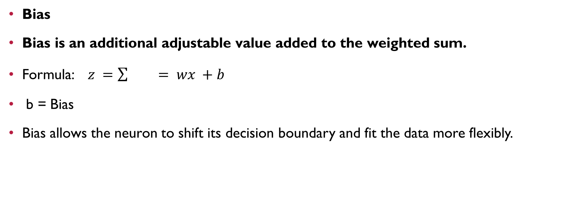
What is Bias?
Bias
Bias is an additional adjustable value added to the weighted sum.
Formula:$z =\sum{}= wx +b$
b = Bias
Bias allows the neuron to shift its decision boundary and fit the data more flexibly.

Slide 30
Weighted Sum
Weighted Sum
The neuron multiplies every input by its corresponding weight and then adds them together.
Example:
z = x1w1 + x2w2 + x3w3 + b
Suppose: x1=2, w1=0.5
x2=3, w2=0.4
b=0.2
Then : z=(2)(0.5)+(3)(0.4)+0.2
z=1+1.2+0.2
z=2.4

Slide 31
Activation Function
Activation Function
An activation function decides how the neuron should respond to the weighted sum.
It transforms:
z
into:
Output=f(z)
Activation functions help neural networks learn complex and nonlinear relationships.

Slide 32
Activation Functions
Step Function
Sigmoid
Tanh
ReLU
Softmax

