Slide 1


Synopsis Presentation on Plant Disease Prediction Using Symptoms Analysis
Guided By: Presented By:
Prof. Mahendra K. Verma Mo. Furqan Qureshi(0827IT231086)
Sudarshan Rajput (0827IT231136)
Yogesh Mali (0827IT231152)
Zoya Qureshi (0827IT231156)

Slide 2
Contents
Introduction
1.1 Overview
1.2 Purpose
Literature Review
Problem Statement
Proposed Solution
Objectives
Theoretical Analysis
6.1 Block Diagram
6.2 Hardware Requirements
6.3 Software Requirements
Applications

Slide 3
1. Introduction
1.1 Overview
The system is an AI-powered web application designed to predict plant diseases using symptom analysis provided by farmers.
Users can enter symptoms such as leaf discoloration, spots, wilting, dryness, curling, and fungal infections through a simple interface.
Machine learning algorithms analyze the symptoms and predict the most probable disease affecting the plant.
The system displays the predicted disease, confidence score, and basic preventive measures to support timely decision-making.
1.2 Purpose
To enable early detection of plant diseases and minimize crop damage.
To provide farmers with quick and accessible disease prediction without depending entirely on agricultural experts.
To reduce crop losses and improve agricultural productivity through timely diagnosis and treatment suggestions.
To promote the use of AI-based agricultural technologies that are affordable, user-friendly, and suitable for rural farming communities.

Slide 4
2. Literature Review
Existing plant disease detection systems mainly focus on image-based diagnosis and require expert supervision or high-quality images. Many solutions lack symptom-based analysis, making them less accessible for farmers in rural areas.
Sr. No. | Name of Solution/System | Features | Limitations/ Drawbacks
1. | Plantix | Disease Detection using images and crop information | Requires clear images and internet connectivity
2. | Leaf Doctor | Plant health analysis through leaf images | Limited symptom-based prediction support

Slide 5
3. Problem Statement
Based on the literature review, existing plant disease detection systems primarily rely on image-based analysis and often require high-quality images, continuous internet connectivity, or expert assistance for accurate diagnosis. These limitations make such systems less effective for farmers in rural and remote areas. Additionally, current solutions provide limited support for symptom-based disease prediction, resulting in delayed identification and treatment of plant diseases. Therefore, there is a need to develop an AI-based Plant Disease Prediction System that can accurately identify diseases using symptom analysis, provide quick preliminary diagnosis, and assist farmers in taking timely preventive measures to reduce crop losses and improve agricultural productivity.

Slide 6
4. Proposed Solution
Develop an AI-based web application that predicts plant diseases using symptom analysis.
Allow farmers to enter symptoms such as leaf discoloration, spots, wilting, dryness, curling, and fungal infections through a simple user interface.
Use Machine Learning algorithms trained on plant disease datasets to analyze symptoms and identify the most probable disease.
Provide real-time disease prediction, confidence score, and preventive measures for early treatment.
Reduce dependency on agricultural experts and enable quick preliminary diagnosis in rural areas.

Slide 7
5. Objectives
To develop a web-based plant disease prediction system using AI techniques.
To predict selected plant diseases using symptom analysis.
To improve prediction accuracy using machine learning algorithms.
To provide preliminary disease information and preventive suggestions to farmers.

Slide 8
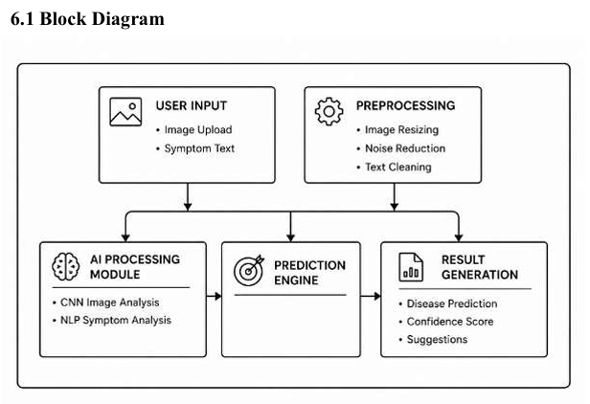
6. Theoretical Analysis

Slide 9
6. Theoretical Analysis
6.2 Hardware Requirements
Computer/Laptop with minimum 4GB RAM and dual-core processor
Stable internet connection for accessing datasets and web application
Storage (at least 20GB free space) for project files, datasets, and database
Camera/Smartphone (optional) for capturing plant images and symptoms
6.3 Software Requirements
Operating System: Windows / Linux / macOS
Frontend: HTML, CSS, JavaScript
Backend: Python (Flask)
Database: MySQL / Firebase
Machine Learning Libraries: Scikit-learn, Pandas, NumPy
Development Tools: VS Code, Jupyter Notebook
Version Control: Git & GitHub

Slide 10
Applications
Smart Agriculture Helps farmers identify plant diseases early and take timely preventive measures to improve crop health.
Crop Health Monitoring Continuously monitors plant conditions and predicts possible diseases based on observed symptoms.
Rural Farming Assistance Provides accessible disease prediction support to farmers in remote areas where agricultural experts may not be readily available.
Agricultural Research & Development Assists researchers and agricultural organizations in studying disease patterns and improving disease management strategies.

Slide 11
GitHub Link
https://github.com/sudarshanr04/EARLY-DISEASE-DETECTION.git

Slide 12
REFERENCES
[1] Mohanty, S.P., Hughes, D.P., Salathé, M. (2016). "Using Deep Learning for Image-Based Plant Disease Detection." Frontiers in Plant Science.
[2] Too, E.C. et al. (2019). "A Comparative Study of Fine-Tuning Deep Learning Models for Plant Disease Identification." Computers and Electronics in Agriculture.
[3] TensorFlow Official Documentation. Available: https://www.tensorflow.org
[4] OpenCV Documentation. Available: https://docs.opencv.org
[5] PlantVillage Dataset. Available: https://plantvillage.psu.edu
[6] Kaggle Plant Disease Datasets. Available: https://www.kaggle.com/datasets
[7] Ferentinos, K.P. (2018). "Deep Learning Models for Plant Disease Detection and Diagnosis." Computers and Electronics in Agriculture.
[8] Liakos, K.G., Busato, P., Moshou, D., Pearson, S., Bochtis, D. (2018). "Machine Learning in Agriculture: A Review." Sensors Journal.
[9] Ramesh, S., Vydeki, D. (2020). "Recognition and Classification of Paddy Leaf Diseases Using Optimized Deep Neural Network." International Journal of Intelligent Engineering and Systems.
[10] Zhang, S., Huang, W., Zhang, C. (2020). "Three-Channel Convolutional Neural Networks for Vegetable Leaf Disease Recognition." Cognitive Systems Research.
[11] Kumar, P., Singh, A. (2021). "Symptom-Based Plant Disease Prediction Using Machine Learning Techniques." International Journal of Agricultural Technology.
[12] Sharma, R., Patel, H., Verma, D. (2023). "Hybrid CNN Model for Plant Disease Classification." Journal of Artificial Intelligence in Agriculture.
[13] Chen, L., Wang, Y., Zhao, H. (2024). "Explainable AI for Plant Disease Detection Systems." IEEE Access.
[14] Gupta, R., Jain, M. (2025). "Lightweight AI Models for Mobile Plant Disease Detection." International Journal of Smart Agriculture Systems.
[15] FAO. "Digital Technologies in Agriculture and Rural Areas." Available: https://www.fao.org
[16] Scikit-learn Official Documentation. Available: https://scikit-learn.org

Slide 13
Thank You
Queries ?

