Slide 1



Slide 2

Advocate and Client Management

Slide 3
Group Members Introduction
Muhammad Furqan MC170401410

Slide 4

INTRODUCTION OF PROJECT
Advocate and Client Management is a online web application. It is meant to be used by both Advocate and Applicant. Any advocate who is using this system does not need to worry about maintaining any paperwork. This system enables advocates to save and manage unlimited clients, cases, payments, hearings, and documents. It also helps applicant in finding best advocate.

Slide 5
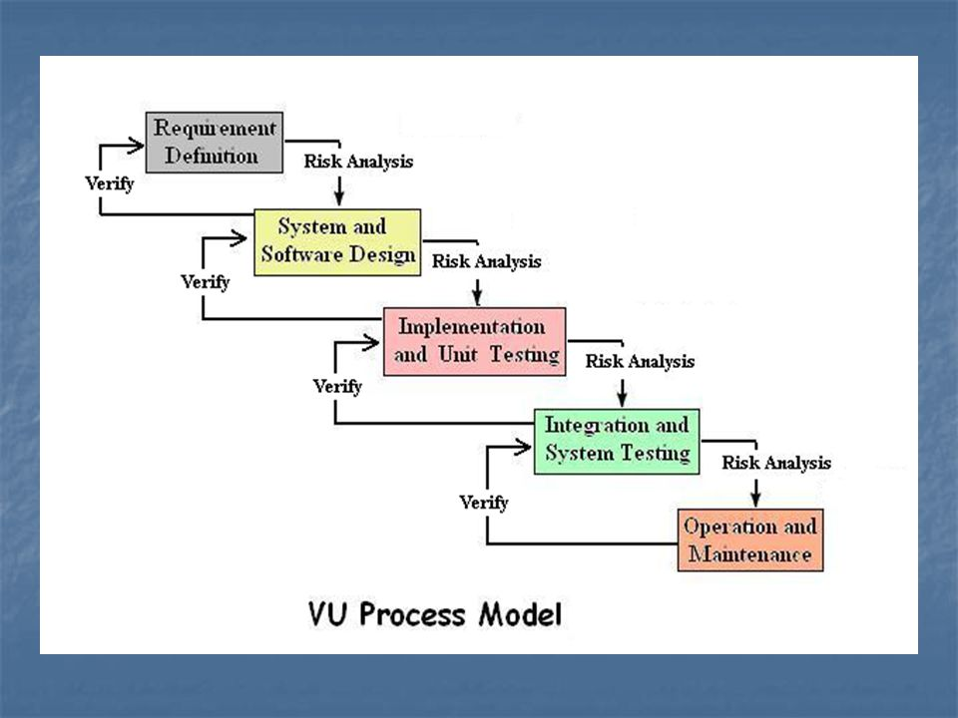

Slide 6
Use Case Diagram
Send Email
View Advocates
Send appointment request
Register
Administrator
Plaintiff
Manage Blog
Login
View
Add
Edit
Delete
Visit Site
Manage Clients
Manage Client’s
Payments
Guest
Manage Cases
Advocate
Manage Hearings
Manage Cases
Documents

Slide 7
Business Rules Catalog
Admin can login.
Admin manages blog and send emails.
Advocate and Applicant can register and login.
Advocate manages his clients, cases, payments, documents, hearing, and appointments
Applicant views advocates and send appointment request.

Slide 8
Architectural Design
Architectural Design
MVC
Controller
Model
Request
Data
Data
Response
View
Client
Initial Request
Server
SPA
HTML Response
Data
Model
AJAX Request
JSON Response

Slide 9
Team Structure
Project Manager
Analyst
Designer
Developer
Tester
Representative

Slide 10
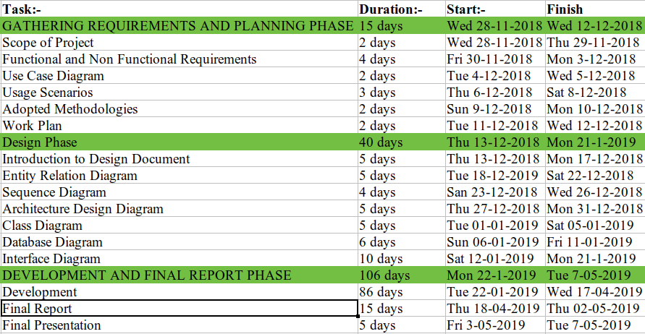
Project Schedule

Slide 11
Sequence Diagrams
Register into the system:
Advocate
Plaintiff
Homepage
Web API
Database
Click on register
Request register page
Return register page
Display register field
Enter user detail and
click submit
Check validity of
register fields
Save user
Redirect back with
errors
Save user
Redirect to dashboard
User saved

Slide 12
Login into the system:
Administrator
Advocate
Plaintiff
Homepage
Web API
Database
Click on register
Request register page
Return register page
Display register field
Enter user detail and
click submit
Check validity of
register fields
Save user
Redirect back with
errors
Save user
User saved
Redirect to dashboard

Slide 13
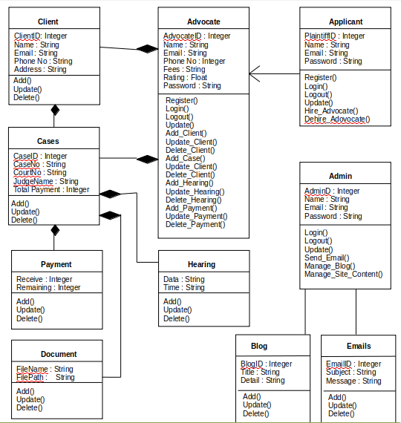
Logical Model/Class Diagram

Slide 14
Entity-Relationship Diagram
Password
Rating
Fees
ID
Name
Email
Password
Name
ID
Time
Date
Email
Hearing
Administrator
Hearing
Add
Add
Advocate
Hire
Remaining
Payment
Add
Hire
Applicant
Receive
Contains
Case
Password
Email
Name
ID
Court No
Case No
ID
Judge
Name
Total
Payment

Slide 15
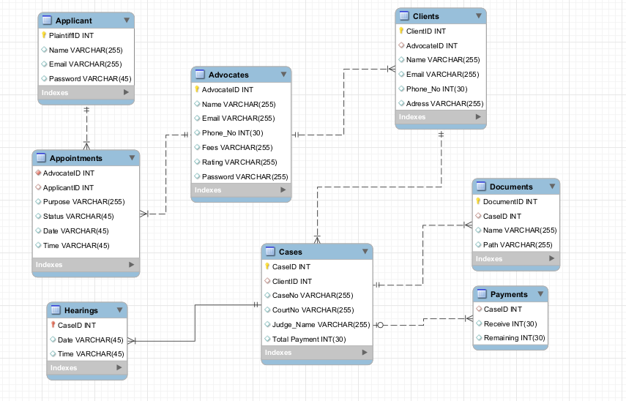
Database Diagram

Slide 16
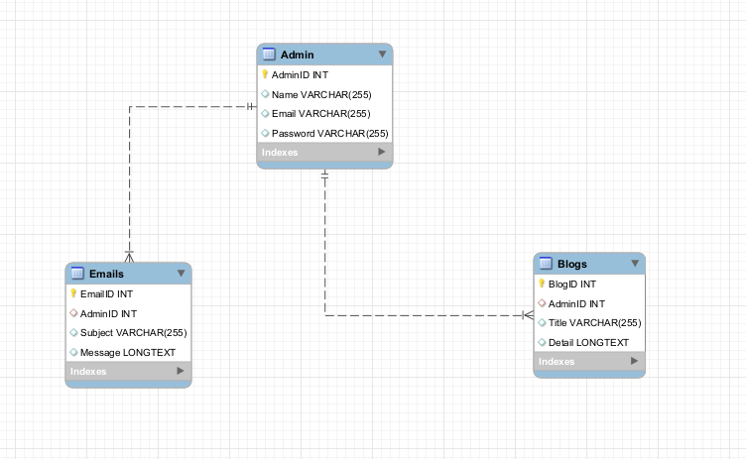

Slide 17
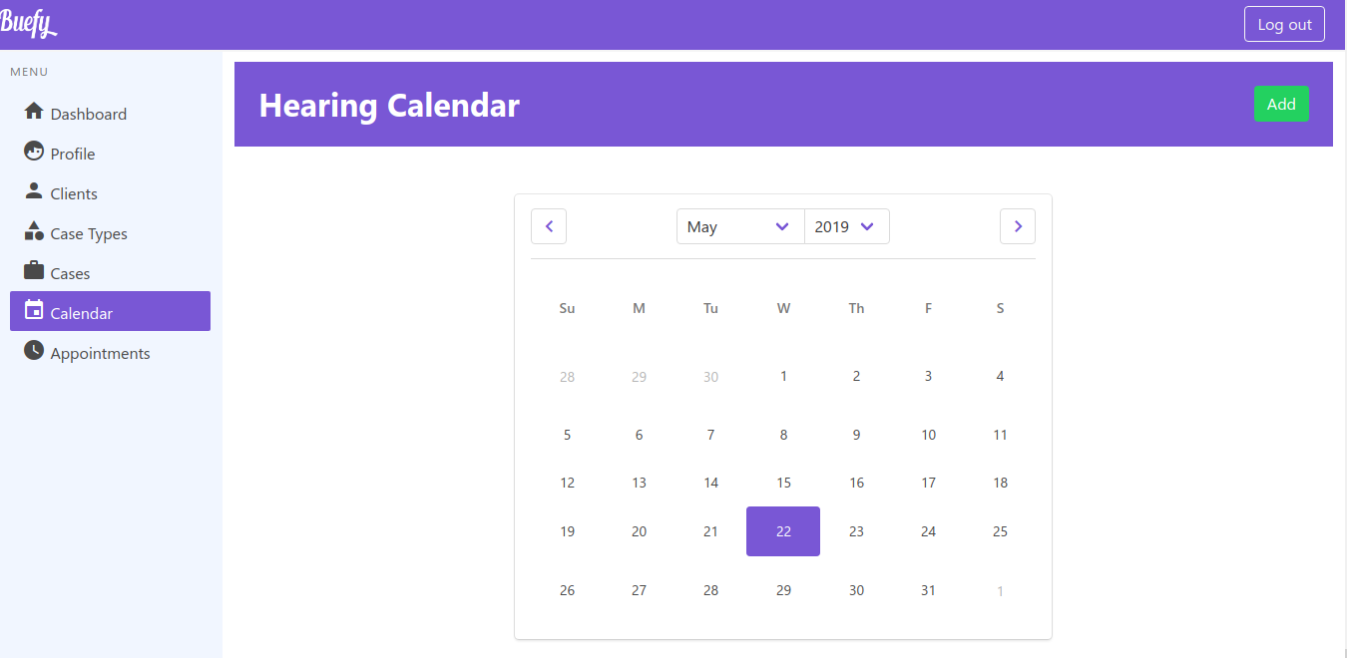
User Interfaces

Slide 18
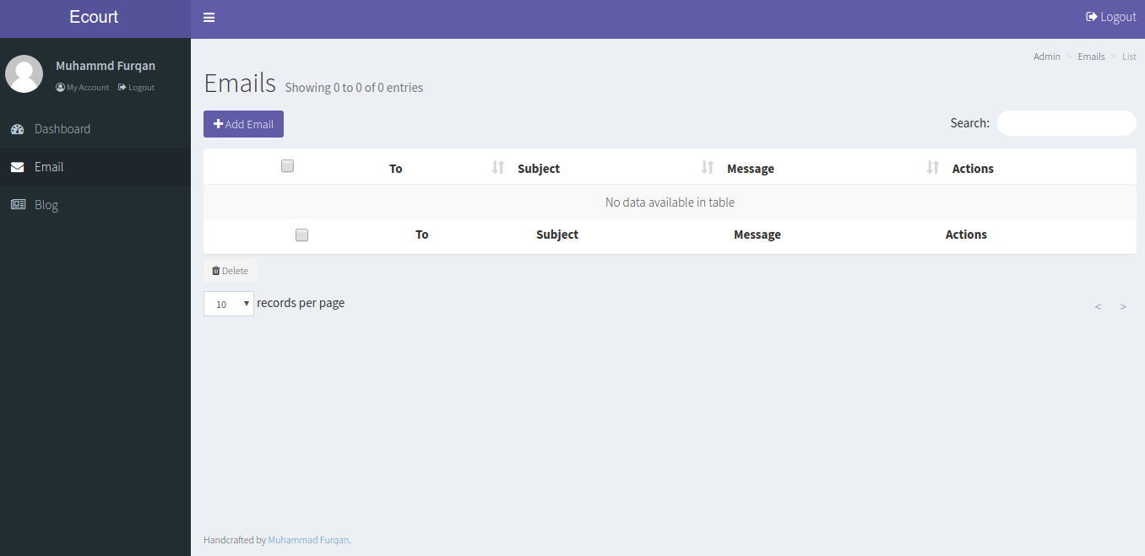

Slide 19
Tools
Laravel
Backpack Admin Panel
Nuxt.js
Buefy

