Slide 1
Usage monitoring of your Java applications during runtime
Paul René Jørgensen (Telenor) & Steinar Cook (Balder Programvare)

Slide 2

The problem
What’s going on?

Slide 3
The problem cont.
Traffic volume per:
  Application server, cluster, package, class, method, principal per time unit?
Runtime dependencies?
Applications or classes no longer in use?
Who uses how much CPU?
Irregular usage of exceptions?
Server load and balancing?

Slide 4
Even more questions!
Differences between versions of my application?
Installing applications; into which cluster?
What are the main paths through the entire system?
If I change this application, who will be affected?
Which class does my class invoke?
What is the response time for a given service?

Slide 5

Current solutions?
Many solutions in the market
  Jconsole
  HP (Mercury)
  Performasure / Foglight
  YourKit
  jProfiler
But, they are;
  Costly
  Proprietary
  Complicated!

Slide 6

Difficult to use!
Is this how you feel?

Slide 7

Our solution - KISS
Simple as possible, but no simpler!
Harvest data with an agent
Collect raw data into SQL database
Data model with OLAP/BI capabilities
GUI of choice

Slide 8
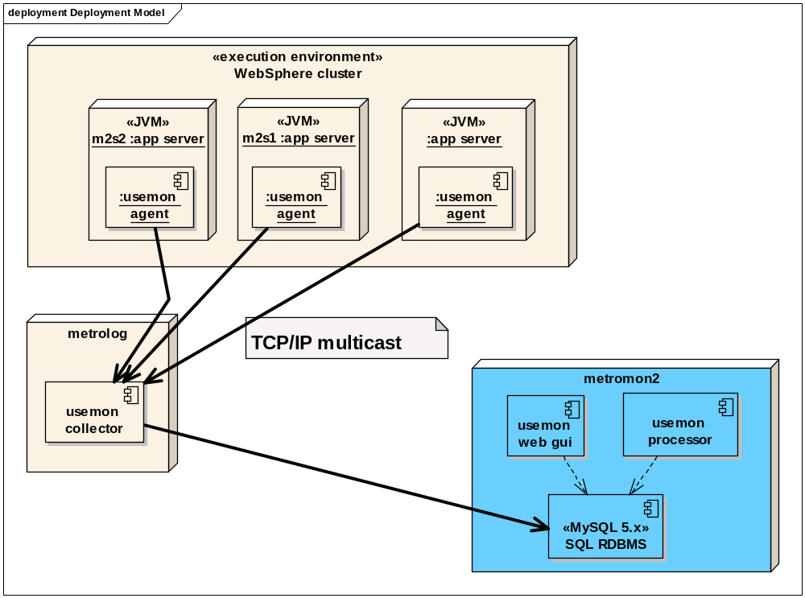
Technical overview

Slide 9

The Usemon Agent <= JDK 1.4
Modify java.lang.ClassLoader
Modified class loader prepended to bootstrap class path
Public methods modified
  EJBs, Servlets, MDBs,
  POJOs (custom declared)
Observations are multicasted

Slide 10

The Usemon agent >= JDK 1.5
Java Agent API for bootstrap
Interception of public methods through byte code manipulation like JDK <= 1.4

Slide 11

The non-intrusive agent
Yields if application threads
  Uses excessive memory
  Heap is growing too large

Slide 12
The Usemon Collector
Receives multicasted observations from agent
Stores data into SQL database
Drops observations if free memory falls below threshold of 5% in the Collector JVM (Java Virtual Machine)
JMX enabled for monitoring and managment

Slide 13
Data Model
Method observation (statistics) per minute
  Invocation counter
  Maximum response time
  Average response time
  Checked / Unchecked Exceptions
Invocation observation (call graph)
  Source
  Target
Heap observations
  Free, total and maximum memory
  Derivates : Used memory

Slide 14
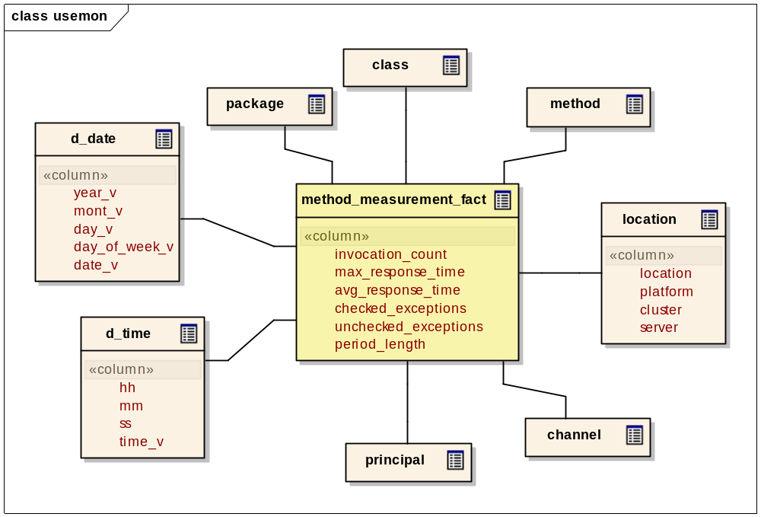
Method statistics observation

Slide 15
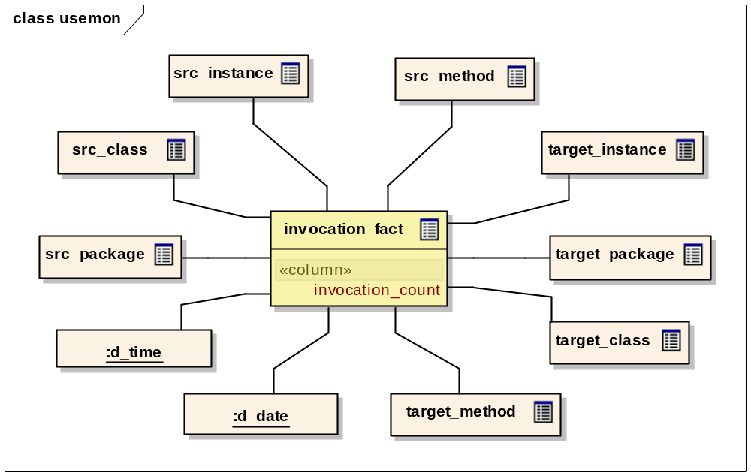
Invocation observation

Slide 16
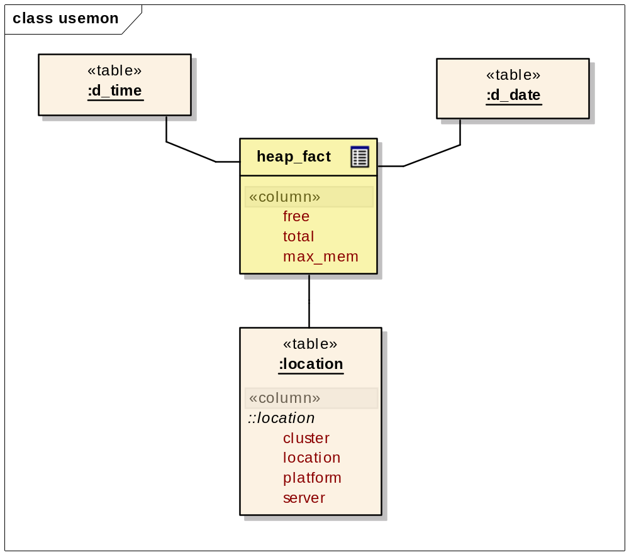
Heap observation

Slide 17
SQL examples – “live demo”
Latest 30 method observations
Which method is invoked by a given method
Notes:
Start up the MySQL Query Browser and execute the statements in
usemon-service/src/main/resouces/sql/presentation

Slide 18
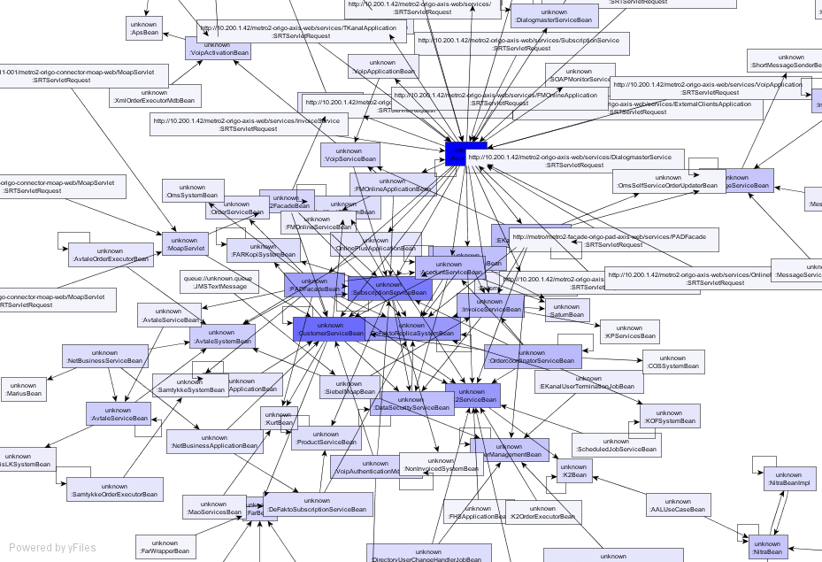
Demo : Dependency graph

Slide 19
OLAP / BI
Several OLAP/BI tools available
  Mostly commercial and expensive
  A few OSS tools based upon Mondrian
Requires detailed knowledge of the OLAP cube model and MDX query language
  Cube model based upon Usemon dimensional model
Demo : Jasper Server & Jasper Analysis
  Data from February and specific samples from February 12th (2008)

Slide 20
MDX Example Query
select
crossjoin(
crossjoin(
{[Location].[Metro].[Metro2Cluster]},
[Location].[Metro].[Metro2Cluster].children
),
{[Invocations], [Average Response Time]}
) on columns,
non empty
crossjoin(
{[Date].[2008].[2].[12]},
[Time].children
) on rows
from Usemon

Slide 21
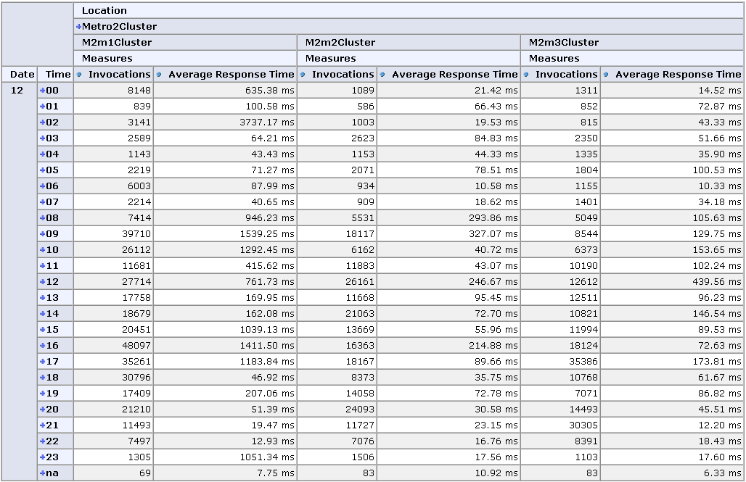
Invocations & Response Time per Server over time

Slide 22
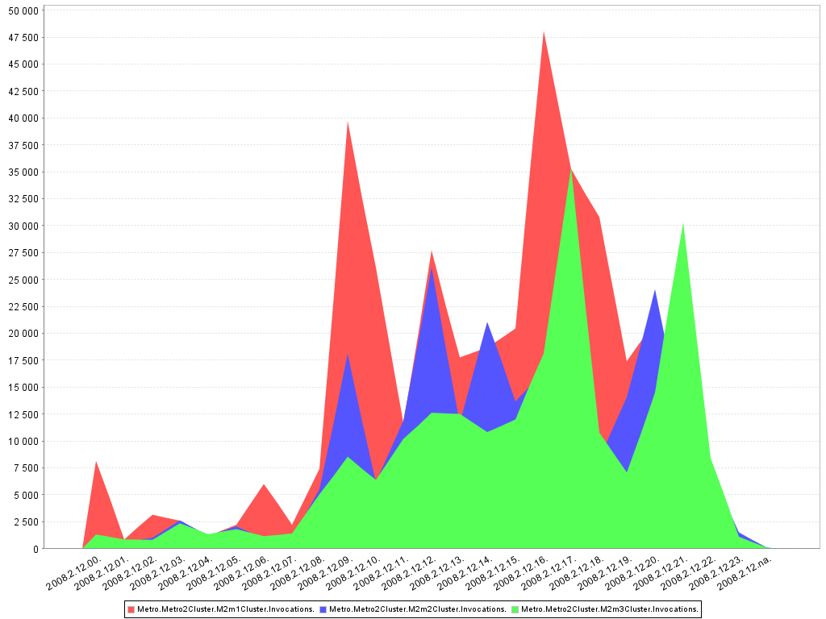
Invocations per server over time

Slide 23
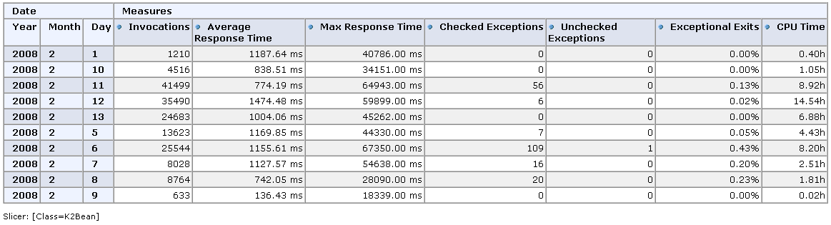
K2Bean Usage (Random sample)

Slide 24
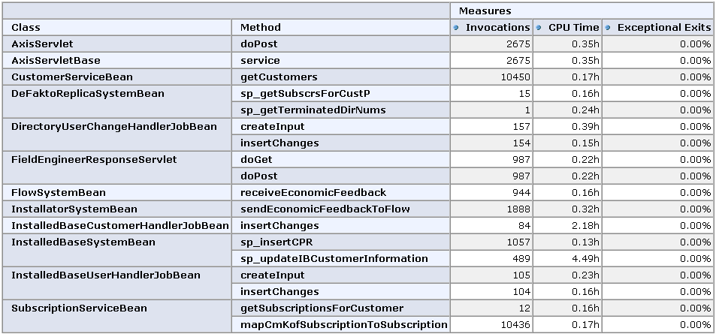
Top Thread time users (>0.1h)

Slide 25
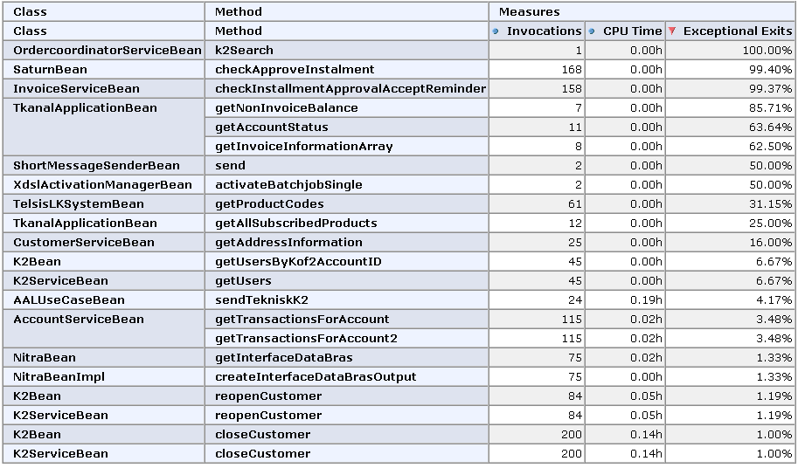
Top Exception throwers (>0.5%)

Slide 26
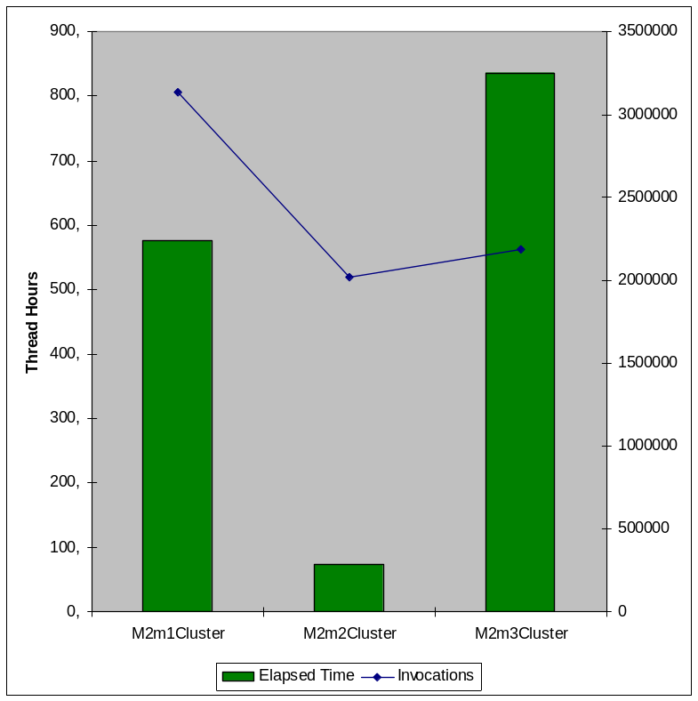
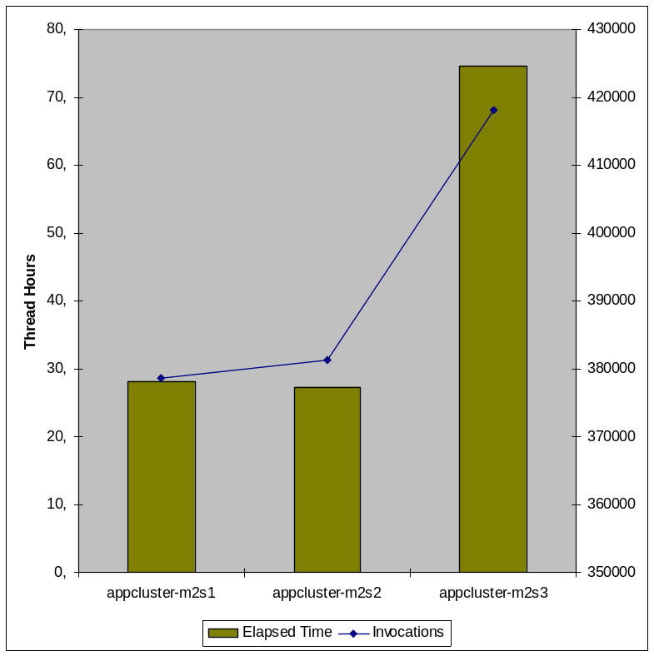
Excel : Load Balancing
Metro2Cluster
appcluster

Slide 27
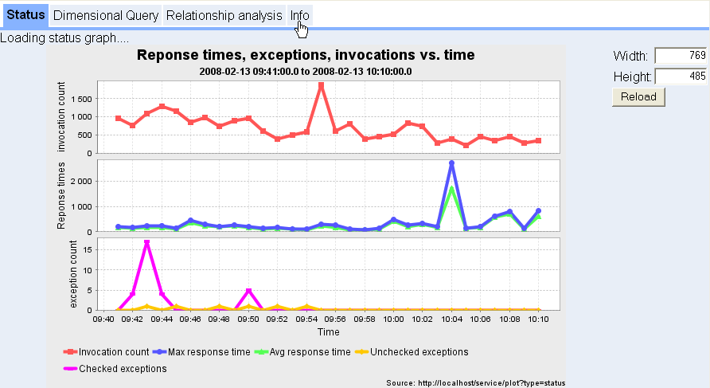
GWT based prototype GUI

Slide 28

Current state of project
Release 1.0 available on February 15, 2008
Deployed to production within next two weeks
Collection and storage of observations – complete
Processing of collected data requires manual operations

Slide 29
Future possibilities
User friendly GUI, which does not require detailed knowledge of data model
Detect abnormal behaviour through application of statistical methods
Distribution of alerts via SMS, email etc.
User friendly and domain specific analysis and reports
  Most OLAP/BI tools require detailed knowledge
Integration with source repository (Fish eye)
Analyse SQL statements and look at usage trends

