Slide 1
git merge –squash squash changes from A to C Create S1, whose only parent is O
Contributor can fetch and merge S3 to their develop branch, so that they work with the latest code. (They need to do this carefully, since public settings may not match their local ones. But ideally, local specific env settings should not go to a collaborative repo)
dev commits A and B can be messy with PHI and secret
C clean up mess in A and B and ready to publish
O
A
B
C
I
J
Squash merge
develop1 (GitLab/…)
Pull Request. If accept with merge (no squash) and the PR platform (i.e. GitHub) allows fast forward, this will result in Public_GitHub fast forwarded to S1. If not, a new merge commit S1’ will be created
Merge S3 into S4, resolve conflicts,
compile and test. If work, submit PR
Contributor 1 Private
Pull Request.
We SHOULD use Squash merge to accept PR in general, which always creates a new commit.
ForGitHub (GitLab)
clone
S1
S4
M2
Public GitHub has already progressed from O to S1, so contributor 2 needs to merge S1 into S2 and make sure they work together before submit a pull request. (they can merge S1 earlier to E or F, but we don’t care what happened on their develop2 or clearUp branches)
O
Pull Request.
To keep GitHub history clear, we accept with squash merge.
GitHub
Public
S1
S3
S5
git merge –squash squash changes from D to G, all changes and cleanup Create S2, whose only parent is O
Public_GitHub (GitHub)
S2
M1
Fix if needed
M1’
clone
The center orange-colored Public_GitHub branch is public, everything else is private (local or in an internally managed remote, like GitLab for UM). Public can be merged into private side, but private branches must be squash merged into public.
Solid line indicate parent child relationship,
Dotted line (only in Squash merge, which doesn’t create parent child relationship. M is for typical merge
S is for squash merge
Caveat: If updates entered main (i.e. Public_GitHub) via squash merge
Then bringing main back into a long-lived dev branches can become awkward. Git tracks commits by hash and parentage, not by “same overall effect.”
G
cleanUp (GitLab/…)
Contributor 2 Private
Create a new branch “cleanUp” from F and clean the mess there to create commit G, so that branch develop2 is not altered for the purpose of publication and thus local development can move on smoothly. This is useful when the develop2 env has local dependencies that are not suitable for public but is needed/useful for local dev.
O
D
E
F
H
develop2 (GitLab/…)
dev commits D, E, and F can be messy with PHI and secret

Slide 2
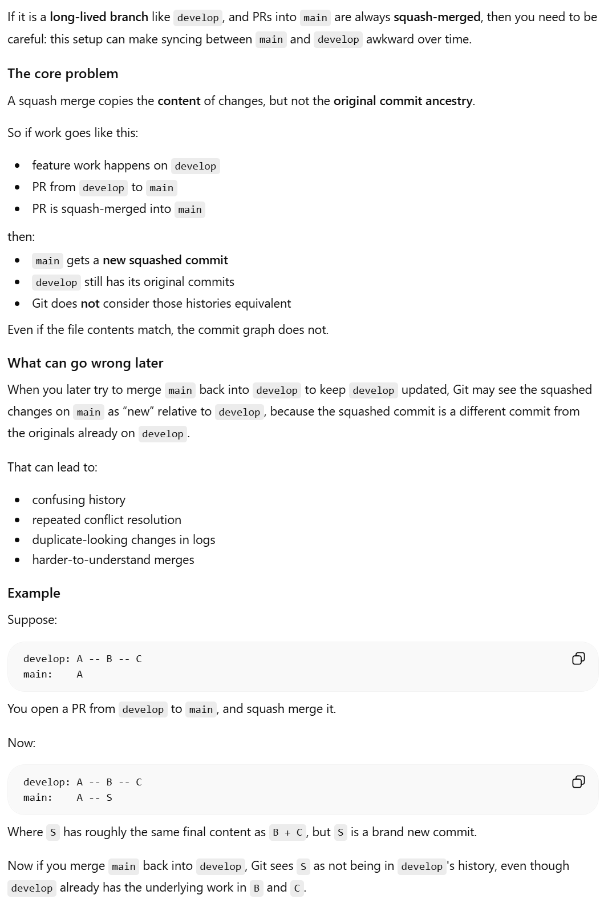
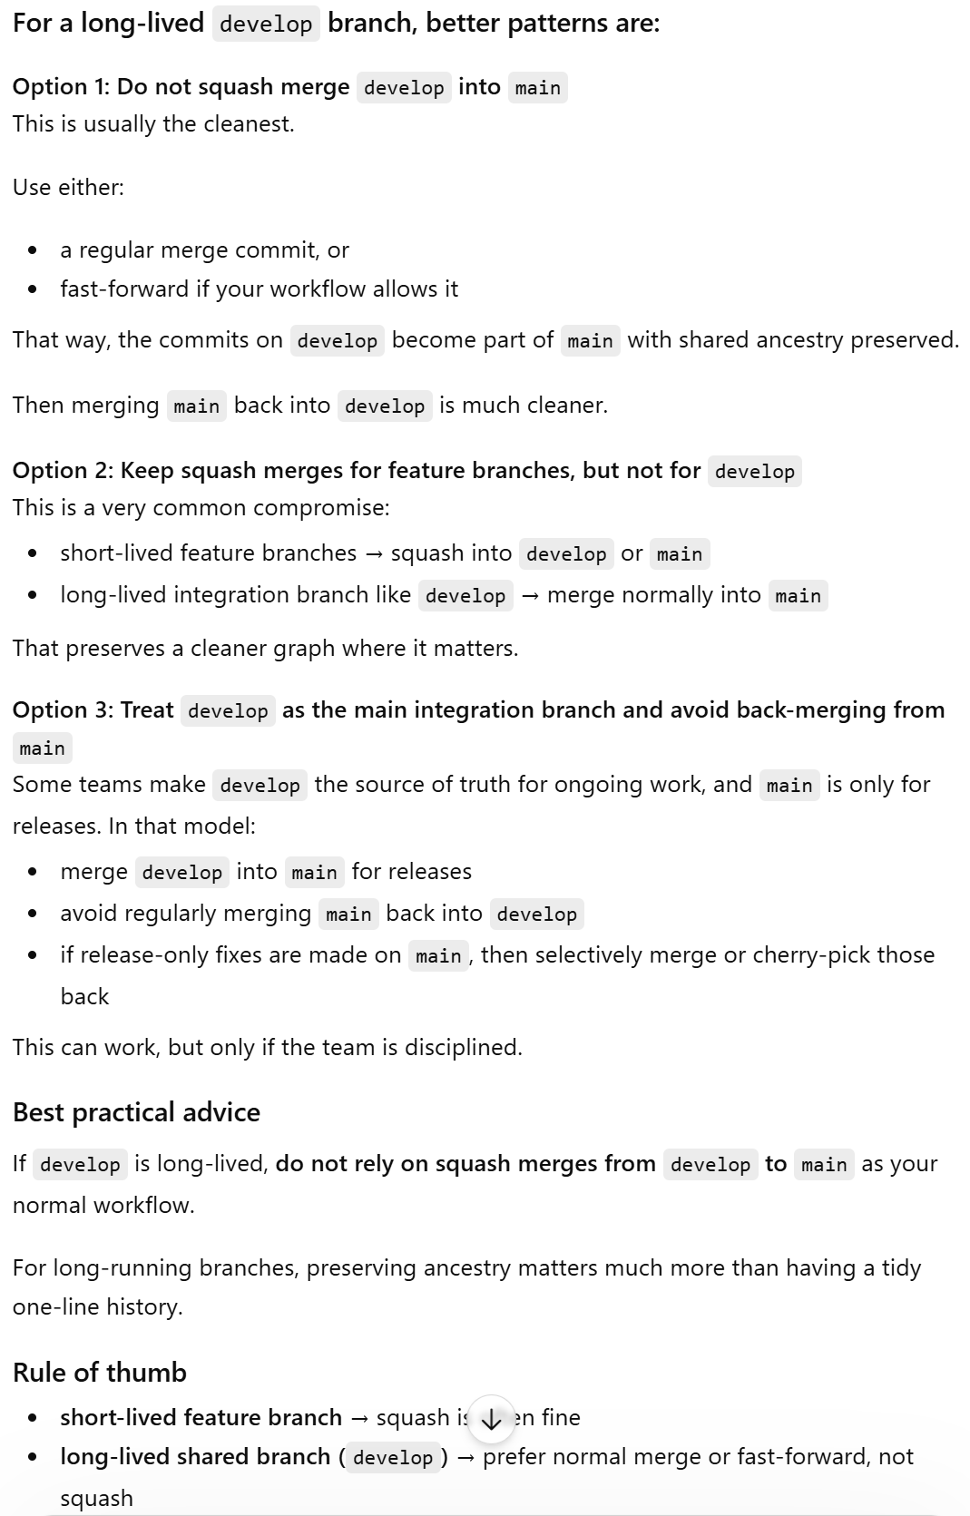
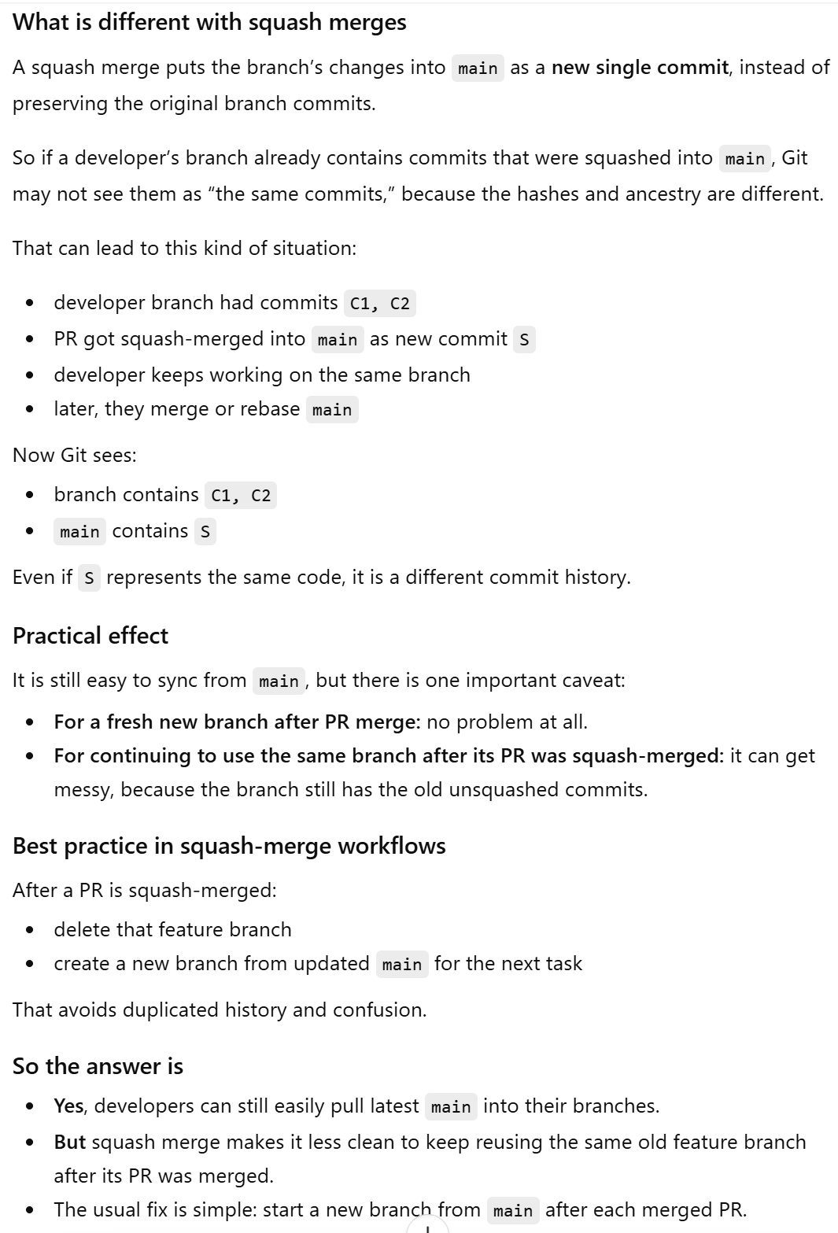

Slide 3
git merge –squash squash changes from A to C Create S1, whose only parent is O
C clean up mess in A and B and ready to publish
Contributor can fetch and merge S3 to their develop branch, so that they work with the latest code. (They need to do this carefully, since public settings may not match their local ones. But ideally, local specific env settings should not go to a collaborative repo)
J clean up mess in I and ready to publish
dev commits A and B can be messy with PHI and secret
dev branches (GitLab/…)
A
Branch out a new feature2
branch from S1
O
B
C
Delete feature1 branch after squash merge, at least stop further development on it!
I
J
Squash merge
K
L
Delete feature2 branch or stop working on it after squash merge
Pull Request. If we use Squash merge to accept PR, which always creates a new commit (S5). If we wish to continue working on ForGitHub branch (make it long-lived), we should use a regular merge here (S5 will be M2 in this case)
Pull Request. If accept with merge (no squash) and the PR platform (i.e. GitHub) allows fast forward, this will result in Public_GitHub fast forwarded to S1. If not, a new merge commit S1’ will be created
branch feature2
Merge S3 into S4, resolve conflicts,
compile and test. If work, submit PR
branch feature3
Contributor 1 Private
branch feature1
If M2 is squashed into S5, new dev feature3 branch need to be created from S5, not M2. And development on ForGitHub should stop. (rule of thumb, once squash merged, no further work, new branch please)
clone
S1
S4
M2
ForGitHub (GitLab)
O
S1
S3
S5
GitHub
Public
Public GitHub has already progressed from O to S1, so contributor 2 needs to merge S1 into their dev to make sure their changes work together with S1 before submit a pull request.
Merge from private dev to Public squashed to remove messy local dev history
Public_GitHub (GitHub)
Regular merge from public to private is OK. Private branch can contain public history.
Most simplified workflow. Recommended.
Pull Request.
To keep GitHub history clear, we accept PR with squash merge. S3 included all squashed changes from D to M1’, but it only has one parent S1
clone
The center orange-colored Public_GitHub branch is public, everything else is private (local or in an internally managed remote, like GitLab for UM). Public can be merged into private side, but private branches must be squash merged into public.
Solid line indicate parent child relationship,
Dotted line (only in Squash merge, which doesn’t create parent child relationship. M is for typical merge
S is for squash merge
Caveat: If updates entered main (i.e. Public_GitHub) via squash merge
Then bringing main back into a long-lived dev branches can become awkward. Git tracks commits by hash and parentage, not by “same overall effect.”
Contributor 2 Private
F clean up mess in D and E and ready to publish
O
D
E
F
M1
Fix if needed
M1’
Delete this feature branch or just stop working on it after squash merge. Do NOT delete branch if you want to keep this part of the history. Commits without a branch pointer to trace down will go to garbage collection after a month.
H
New feature branch (GitLab/…)
dev commits D, E, and F can be messy with PHI and secret

Slide 4
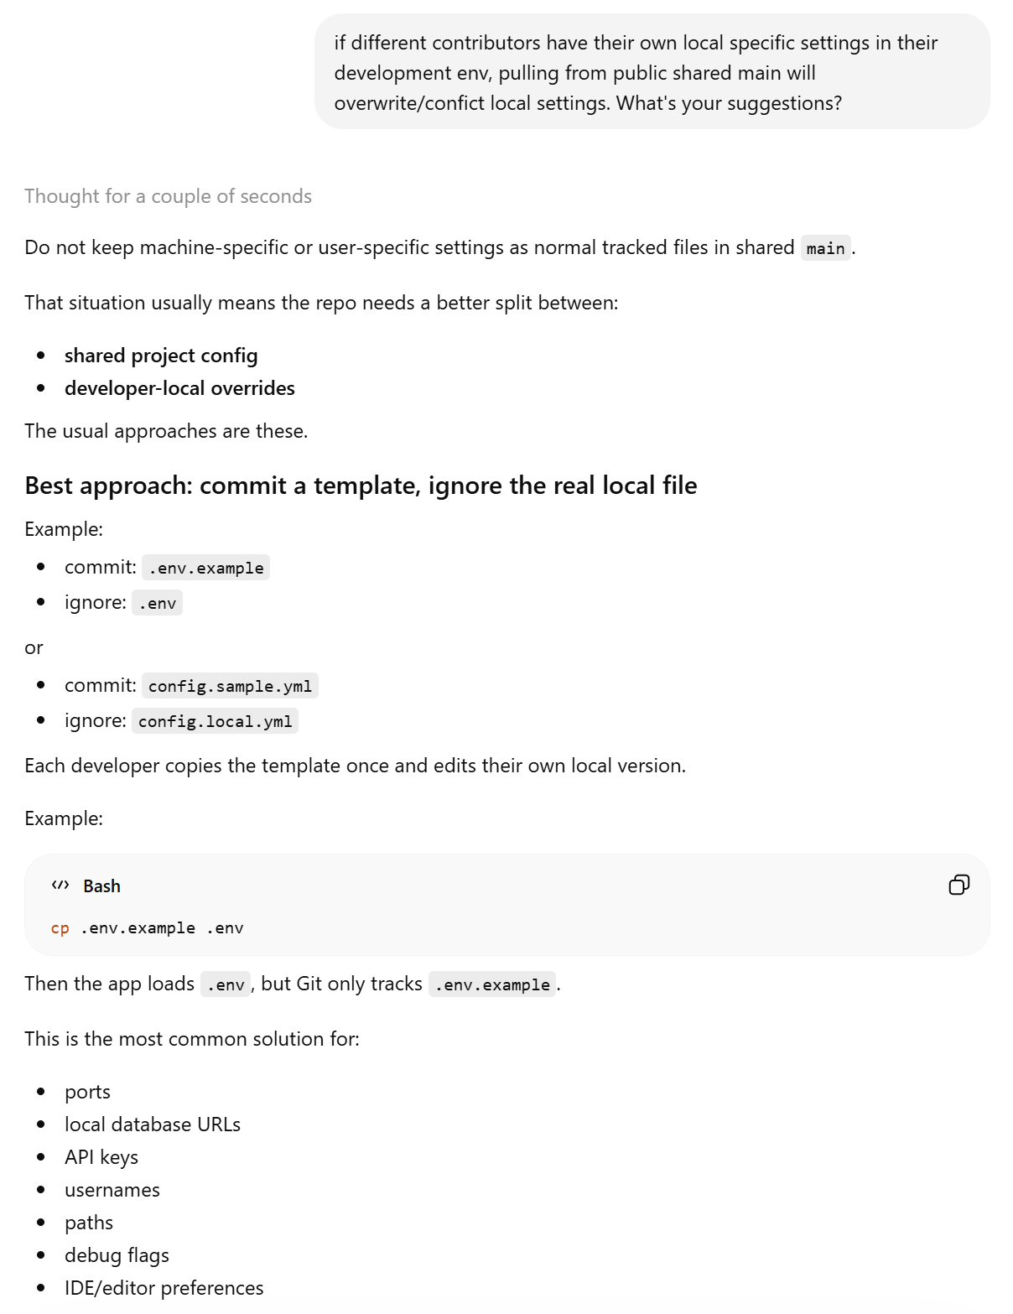

Slide 5
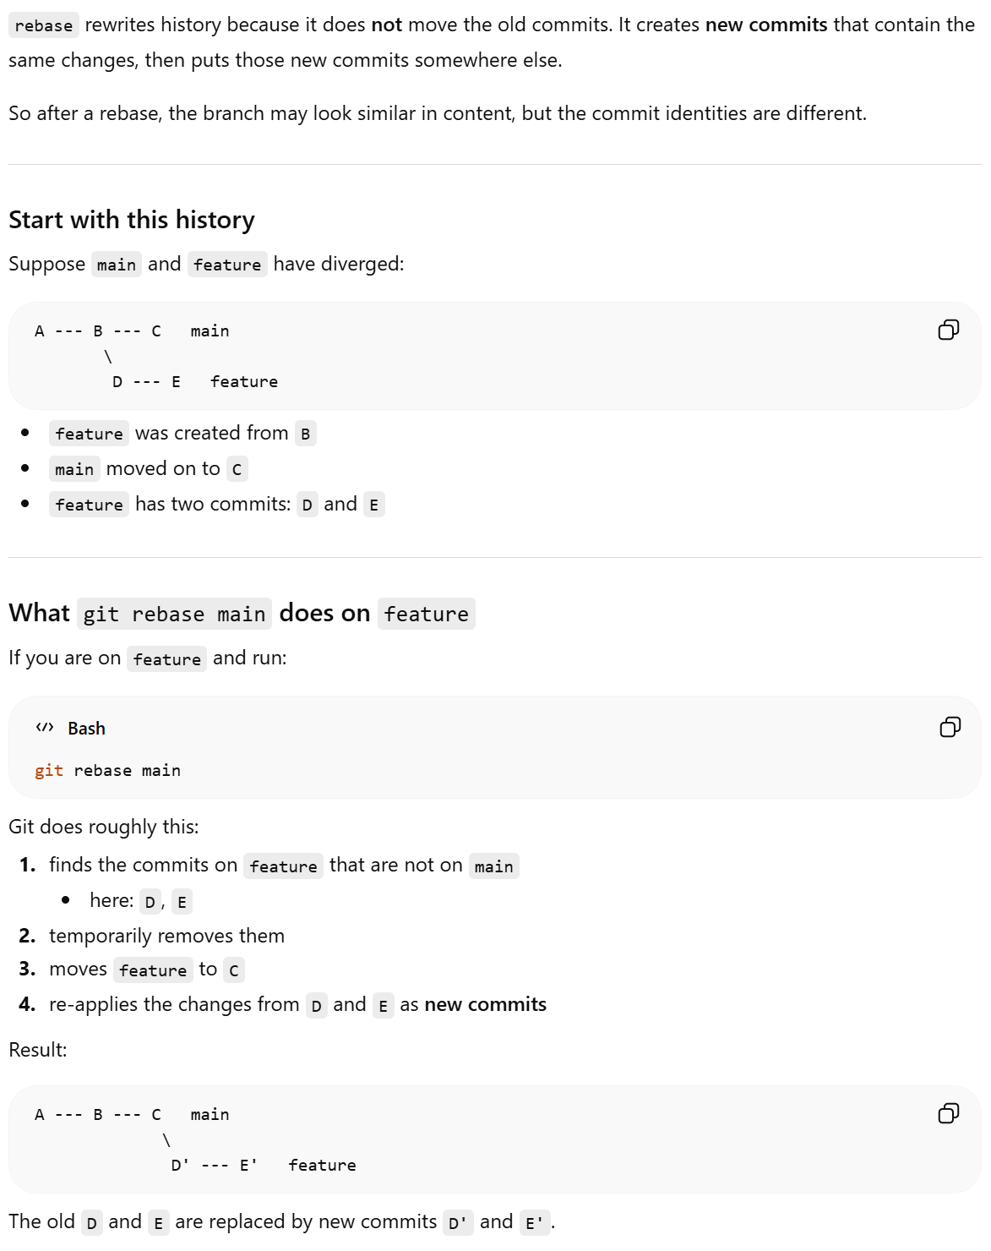
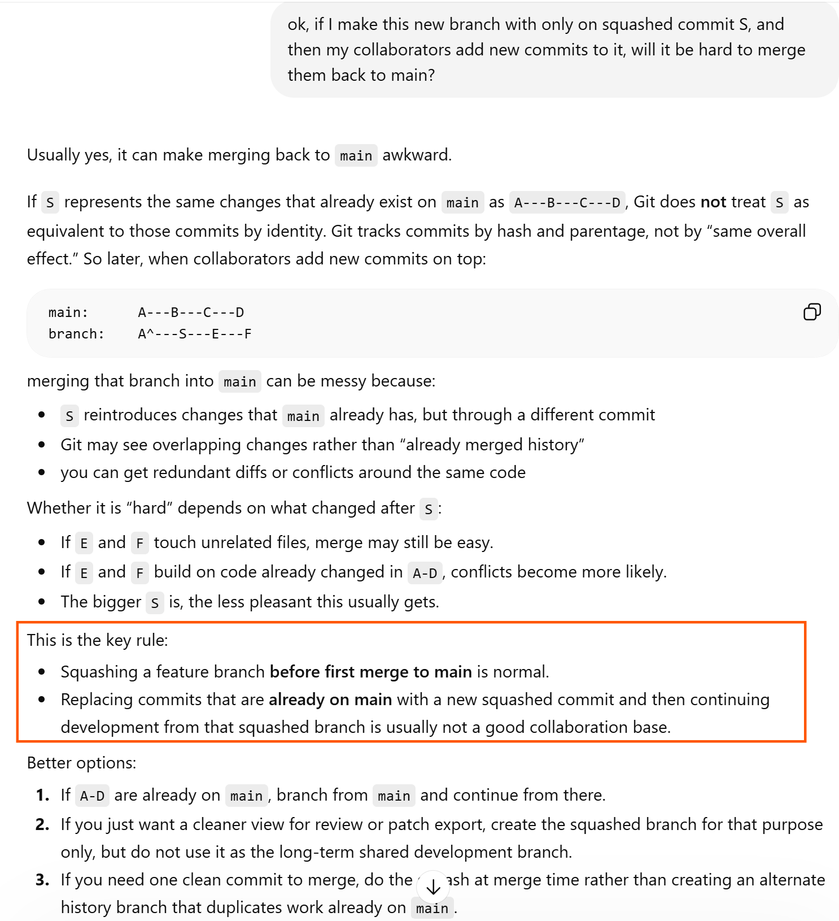
one

