Slide 1
3차 - 단어 정렬 프로그램
자료구조(11)
~2020-06-13
2017156034
전상민
Notes:
How Huffman Trees Work – Computerphile
Huffman_coding - Wikipedia

Slide 2
과제 지시사항
■ 정렬 알고리즘 3종을 선택적으로 사용하는 프로그램 구현
▪ 동작 절차 및 기능
① 영문 단어와 빈도수 집계 기능
② 사용자의 입력 받는 기능
③ 영어 단어의 오름차순으로 영어 단어와 빈도수를 함께 출력 기능 → 출력 1.
④ 빈도수의 오름차순으로 빈도수와 영어 단어 함께 출력 기능 → 출력 2.
⑤ 제시된 영어 단어를 찾아 해당 단어와 빈도수를 함께 출력 기능 → 출력 3.
▪ 구현된 프로그램은 사용자가 지정한 정렬방법에 따라 정렬 수행할 것
• 정렬 알고리즘은 “빠른” > “중간” > “느린” 방법들 중에서 각각 1종 씩 선택하고,
• 선택한 정렬 알고리즘들을 3가지 출력 기능에 1대1로 매핑 후 구현

Slide 3
과제 지시사항 요약
./WordCount -1
: 단어 정렬
./WordCount -2
: 빈도수 정렬
./WordCount -3 Beautiful
: 단어 탐색
#include <stdio.h>
#include <stdlib.h>
#include <string.h>
//#define _CRT_SECURE_NO_WARNINGS
//#define _CRT_NONSTDC_NO_DEPRECATE
#define MAX_WORDLEN 30
#define INIT_COUNT 10000

Slide 4
입력 조건부
// command argument
명령어 에러 검출 조건
정상적인 조건:
Argv[1] == -1
Argv[1] == -2
Argv[1] == -3;argv[2] == “string”
// open file
파일 입력 에러 검출 조건
int main(int argc, char* argv[])
{
printf("===WordCount.c===\n");
// command argument
if ((argc == 2 && strcmp(argv[1], "-3"))
|| (argc == 3 && !strcmp(argv[1], "-3")))
//printf("The argument supplied is %s\n\n",argv[1]);
else if ((argc > 2 && strcmp(argv[1], "-3"))
|| (argc > 3) && !strcmp(argv[1], "-3")) {
printf("Too many arguments supplied.\n");
exit(0);
}
else {
printf("One argument expected.\n");
exit(0);
}
// open file
FILE* fp = fopen("sample2_parsed.txt", "r");
if (!fp) {
printf("Cannot open ‘%s’\n", fp);
exit(1);
}

Slide 5
입력 파일 분석
// parsing word_extract
char path[100];
int i, len, index, isUnique;
struct wordcount str;
char word[50];
for (i = 0; i < INIT_COUNT; i++)
str.strc[i] = 0;
index = 0;
while (fscanf(fp, "%s\n", word) != EOF)
{
isUnique = 1;
for (i = 0; i < index && isUnique; i++)
if (strcmp(str.strw[i], word) == 0)
isUnique = 0;
if (isUnique)
{
strcpy(str.strw[index], word);
str.strc[index]++;
index++;
}
else
str.strc[i - 1]++;
}
fclose(fp);
> struct wordcount str;
> char strw[][] : 단어
> int strc[] : 빈도 수
> fscanf(fp, "%s\n", word)
struct wordcount {
char strw[INIT_COUNT][MAX_WORDLEN];
int strc[INIT_COUNT];
};
Beau
Beautiful
FUL
Game
⋮
<./word_extract –d sample1.txt>

Slide 6
입력 파일 분석
// parsing word_extract
char path[100];
int i, len, index, isUnique;
struct wordcount str;
char word[50];
for (i = 0; i < INIT_COUNT; i++)
str.strc[i] = 0;
index = 0;
while (fscanf(fp, "%s\n", word) != EOF)
{
isUnique = 1;
for (i = 0; i < index && isUnique; i++)
if (strcmp(str.strw[i], word) == 0)
isUnique = 0;
if (isUnique)
{
strcpy(str.strw[index], word);
str.strc[index]++;
index++;
}
else
str.strc[i - 1]++;
}
fclose(fp);
> if(strcmp(str.strw[i],word)==0)
isUnique = 0;
읽은 string을 각 요소와 비교해서
새로운 단어인지 검사
> if (isUnique) {
strcpy(str.strw[index],word);
str.strc[index]++;
index++;
새로운 단어이면
struct wordcount str에 추가
> else str.strc[i - 1]++;
기존에 있던 단어이면 빈도수 증가

Slide 7
str 구성
> struct wordcount str;
> char strw[][] : 단어
> int strc[] : 빈도 수
str.strw[1] == “Beau”
str.strc[1] == 2
str.strw[2] == “Beautiful”
str.strc[2] == 2
str.strw[3] == “FUL”
str.strc[3] == 1
str.strw[4] == “Game”
str.strc[4] == 1
⋮
struct wordcount {
char strw[INIT_COUNT][MAX_WORDLEN];
int strc[INIT_COUNT];
};
Beau 2
Beautiful 2
FUL 1
Game 1
⋮
<./word_extract -d sample1.txt
| sort -d | uniq -c | awk '{print $2, $1 }'>

Slide 8
case -1, case -2
> switch (atoi(argv[1]))
case -1: 삽입 정렬
“느린” 정렬 알고리즘
struct(string, int)형 정렬
case -2: 셸 정렬
“중간” 정렬 알고리즘
struct(string, int)형 정렬
switch (atoi(argv[1]))
{
case -1:
printf("---SORT 1---\n");
insertion_sort(&str, index);
for (i = 0; i < index; i++)
printf("%s %d\n", str.strw[i], str.strc[i]);
break;
case -2:
printf("---SORT 2---\n");
shell_sort(&str, index);
for (int i = 0; i < index; i++)
printf("%d - %s\n", str.strc[i],str.strw[i]);
break;

Slide 9
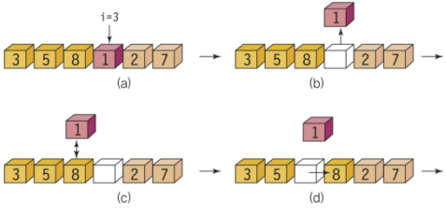
struct형 삽입 정렬
> key = str[i]
key를 기준으로
> strcmp(list->strw[j],key) == 1
// str[j]>str[i]
str[j+1]=str[j]
올바른 자리까지 뒤 요소들을 밀고
> str[j] = key
자기자리 위치
//SORT 1
void insertion_sort(struct wordcount list[], int n)
{
int i, j, key;
char keys[MAX_WORDLEN] = "";
for (i = 1; i < n; i++) {
strcpy(keys, list->strw[i]);
key = list->strc[i];
for(j=i-1; j>=0&&strcmp(list->strw[j],keys)==1; j--)
{
strcpy(list->strw[j + 1], list->strw[j]);
list->strc[j + 1] = list->strc[j];
}
strcpy(list->strw[j + 1], keys);
list->strc[j + 1] = key;
}
}

Slide 10
case -1, case -2
> switch (atoi(argv[1]))
case -1: 삽입 정렬
“느린” 정렬 알고리즘
struct(string, int)형 정렬
case -2: 셸 정렬
“중간” 정렬 알고리즘
struct(string, int)형 정렬
switch (atoi(argv[1]))
{
case -1:
printf("---SORT 1---\n");
insertion_sort(&str, index);
for (i = 0; i < index; i++)
printf("%s %d\n", str.strw[i], str.strc[i]);
break;
case -2:
printf("---SORT 2---\n");
shell_sort(&str, index);
for (int i = 0; i < index; i++)
printf("%d - %s\n", str.strc[i],str.strw[i]);
break;

Slide 11
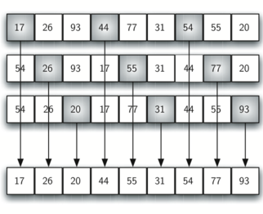
struct형 셸 정렬
> int gap;
간격을 두고
>inc_insertion_sort(list,i,n-1,gap);
나누어 삽입 정렬
삽입 정렬은 전과 동일한 원리
//SORT 2
void inc_insertion_sort(struct wordcount list[], int first, int last, int gap)
{
int i, j, key;
char keyw[MAX_WORDLEN] = "";
for (i = first + gap; i <= last; i = i + gap)
{
key = list->strc[i];
strcpy(keyw,list->strw[i]);
for (j = i - gap; j >= first && key < list->strc[j]; j = j - gap)
{
list->strc[j + gap] = list->strc[j];
strcpy(list->strw[j + gap],list->strw[j]);
}
list->strc[j + gap] = key;
strcpy(list->strw[j + gap],keyw);
}
}
void shell_sort(struct wordcount list[], int n)
{
int i, gap;
for (gap = n / 2; gap > 0; gap = gap / 2) {
if ((gap % 2) == 0) gap++;
for (i = 0; i < gap; i++)
inc_insertion_sort(list, i, n - 1, gap);
}
}

Slide 12
case -3
> switch (atoi(argv[1]))
case -3: 퀵 정렬
“빠른” 정렬 알고리즘
struct(string, int)형 정렬
> char* s = argv[2];
s: 입력 받은 단어
> if (!strcmp(str.strw[i], s))
printf("%s %d\n", …
check = 1;
찾았으면 출력하고 찾았다고 표시
> if (!check)
printf("not found.\n");
찾지 못할 경우의 조건부
case -3:
printf("---SORT 3---\n");
quick_sort(&str, 0, index);
char* s = argv[2];
int check = 0;
for (i = 0; i < index; ++i)
if (!strcmp(str.strw[i], s)) {
printf("%s %d\n", str.strw[i], str.strc[i]);
check = 1;
}
if (!check)
printf("not found.\n");
break;
}
return 0;
}

Slide 13
struct형 퀵 정렬
void quick_sort(struct wordcount list[], int left, int right)
{
if (left < right) {
int q = partition(list, left, right);
quick_sort(list, left, q - 1);
quick_sort(list, q + 1, right);
}
}
> quick_sort
구간으로 나눈후 각 구간마다 quick_sort 실행

Slide 14
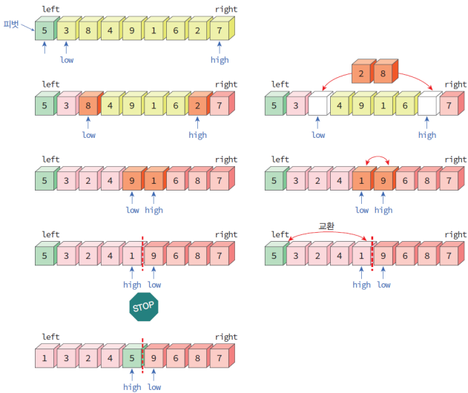
struct형 퀵 정렬
//SORT 3
int partition(struct wordcount list[], int left, int right) {
int temp;
char tempw[MAX_WORDLEN] = "";
int low, high;
char pivotw[MAX_WORDLEN] = "";
low = left;
high = right + 1;
strcpy(pivotw, list->strw[left]);
do {
do low++;
while (strcmp(list->strw[low], pivotw) == -1);
do high--;
while (strcmp(list->strw[high], pivotw) == 1);
if (low < high) {
strcpy(tempw, list->strw[low]);
strcpy(list->strw[low], list->strw[high]);
strcpy(list->strw[high], tempw);
temp = list->strc[low];
list->strc[low] = list->strc[high];
list->strc[high] = temp;
}
} while (low < high);
strcpy(tempw, list->strw[left]);
strcpy(list->strw[left], list->strw[high]);
strcpy(list->strw[high], tempw);
temp = list->strc[left];
list->strc[left] = list->strc[high];
list->strc[high] = temp;
return high;
}
> Partition
pivot = str[left]
가장 왼쪽 요소를 pivot으로 정하고
if (low < high)
swap(str[low],str[high])
진행하며 low와 high를 맞바꾸고
swap(str[left],str[high])
마지막으로 피벗을 가운데에 위치

Slide 15
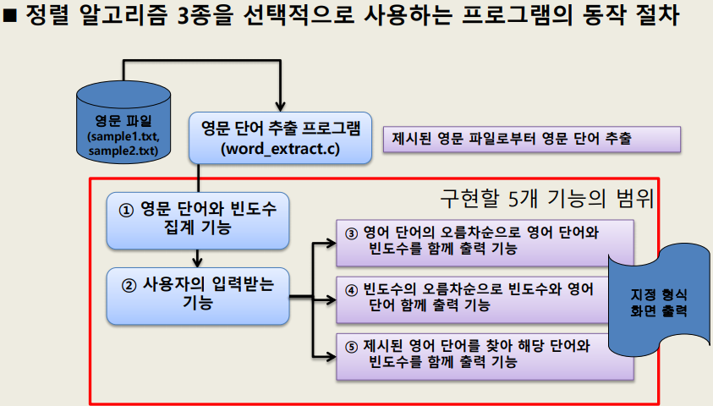
프로그램 구현 결과
`Beautiful Soup! Who cares for fish,
Game, or any other dish?
Who would not give all else for two
Pennyworth only of beautiful Soup?
Pennyworth only of beautiful Soup?
Beau--ootiful Soo--oop!
Beau--ootiful Soo--oop!
Soo--oop of the e--e--evening,
Beautiful, beauti--FUL SOUP!’
<sample1.txt>
Beautiful
Soup
Who
Cares
For
Fish
Game
or
⋮
<./word_extract –d sample.txt>
str.strw[1] == “Beau”
str.strc[1] == 2
str.strw[2] == “Beautiful”
str.strc[2] == 2
str.strw[3] == “FUL”
str.strc[3] == 1
str.strw[4] == “Game”
str.strc[4] == 1
⋮
<struct wordcount str>

Slide 16
프로그램 구현 결과

Slide 17
프로그램 구현 결과
===WordCount.c===
---SORT 1---
Beau 2
Beautiful 2
FUL 1
Game 1
Pennyworth 2
SOUP 1
Soo 3
Soup 3
Who 2
all 1
any 1
beauti 1
beautiful 2
cares 1
dish 1
e 2
else 1
evening 1
fish 1
for 2
give 1
not 1
of 3
only 2
oop 3
ootiful 2
or 1
other 1
the 1
two 1
would 1
<./WordCount -1>
===WordCount.c===
---SORT 1---
& 1
A 93
ABOUT 2
ADVENTURES 1
AFTER 1
ALABAMA 1
AS 1
AT 2
AUTHOR 1
About 7
Academy 1
Acrobatics 1
Act 2
Adored 1
Advantages 1
Adventures 1
⋮
you 797
young 29
younger 3
your 79
yourn 3
yours 1
yourself 12
yourselves 2
youth 1
youthful 1
zeal 1
zebras 1
zenith 1
zephyr 1
<./WordCount -1>
`Beautiful Soup! Who cares for fish,
Game, or any other dish?
Who would not give all else for two
Pennyworth only of beautiful Soup?
Pennyworth only of beautiful Soup?
Beau--ootiful Soo--oop!
Beau--ootiful Soo--oop!
Soo--oop of the e--e--evening,
Beautiful, beauti--FUL SOUP!’
<sample1.txt>
THE ADVENTURES OF TOM SAWYER
By Mark Twain(Samuel Langhorne Clemens)
CONTENTSCHAPTER I. Y-o-u-u Tom-Aunt Polly Decides Upon her Duty--Tom Practices Music--The Challenge--A Private Entrance
CHAPTER II. Strong Temptations--Strategic Movements--The Innocents Beguiled
CHAPTER III. Tom as a General--Triumph and Reward--DismalFelicity--Commission and Omission
CHAPTER IV. Mental Acrobatics--Attending Sunday--School--TheSuperintendent--Showing off--Tom Lionized
CHAPTER V. A Useful Minister--In Church--The Climax
⋮
<sample2.txt>

Slide 18
프로그램 구현 결과

Slide 19
프로그램 구현 결과
===WordCount.c===
---SORT 2---
1 - else
1 - two
1 - other
1 - cares
1 - would
1 - fish
1 - Game
1 - or
1 - any
1 - not
1 - dish
1 - the
1 - SOUP
1 - give
1 - all
1 - beauti
1 - FUL
1 - evening
2 - Who
2 - Beautiful
2 - Pennyworth
2 - for
2 - e
2 - ootiful
2 - beautiful
2 - only
2 - Beau
3 - Soup
3 - oop
3 - of
3 - Soo
<./WordCount -2>
===WordCount.c===
---SORT 2---
1 - veins
1 - ADVENTURES
1 - OF
1 - happily
1 - SAWYER
1 - expectantly
1 - Mark
1 - Twain
1 - Samuel
1 - Langhorne
1 - Clemens
1 - CONTENTS
1 - disclosing
1 - tilted
1 - chirped
1 - attending
⋮
797 - you
806 - Tom
863 - s
915 - in
926 - he
962 - that
1018 - I
1131 - it
1163 - was
1454 - of
1723 - to
1804 - a
2985 - and
3363 - the
<./WordCount -2>
`Beautiful Soup! Who cares for fish,
Game, or any other dish?
Who would not give all else for two
Pennyworth only of beautiful Soup?
Pennyworth only of beautiful Soup?
Beau--ootiful Soo--oop!
Beau--ootiful Soo--oop!
Soo--oop of the e--e--evening,
Beautiful, beauti--FUL SOUP!’
<sample1.txt>
THE ADVENTURES OF TOM SAWYER
By Mark Twain(Samuel Langhorne Clemens)
CONTENTSCHAPTER I. Y-o-u-u Tom-Aunt Polly Decides Upon her Duty--Tom Practices Music--The Challenge--A Private Entrance
CHAPTER II. Strong Temptations--Strategic Movements--The Innocents Beguiled
CHAPTER III. Tom as a General--Triumph and Reward--DismalFelicity--Commission and Omission
CHAPTER IV. Mental Acrobatics--Attending Sunday--School--TheSuperintendent--Showing off--Tom Lionized
CHAPTER V. A Useful Minister--In Church--The Climax
⋮
<sample2.txt>

Slide 20
프로그램 구현 결과

Slide 21
프로그램 구현 결과
`Beautiful Soup! Who cares for fish,
Game, or any other dish?
Who would not give all else for two
Pennyworth only of beautiful Soup?
Pennyworth only of beautiful Soup?
Beau--ootiful Soo--oop!
Beau--ootiful Soo--oop!
Soo--oop of the e--e--evening,
Beautiful, beauti--FUL SOUP!’
<sample1.txt>
THE ADVENTURES OF TOM SAWYER
By Mark Twain(Samuel Langhorne Clemens)
CONTENTSCHAPTER I. Y-o-u-u Tom-Aunt Polly Decides Upon her Duty--Tom Practices Music--The Challenge--A Private Entrance
CHAPTER II. Strong Temptations--Strategic Movements--The Innocents Beguiled
CHAPTER III. Tom as a General--Triumph and Reward--DismalFelicity--Commission and Omission
CHAPTER IV. Mental Acrobatics--Attending Sunday--School--TheSuperintendent--Showing off--Tom Lionized
CHAPTER V. A Useful Minister--In Church--The Climax
⋮
<sample2.txt>
===WordCount.c===
---SORT 3---
of 3
<./WordCount -3>
===WordCount.c===
---SORT 3---
of 1454
<./WordCount -3>

Slide 22

시연 / Q&A

