Slide 1




$$x$$
$$y$$
$$a$$
$$b$$
Notes:
ex2

Slide 2
end
start

Slide 3


$$2$$
$$4$$
Notes:
ex4b

Slide 4
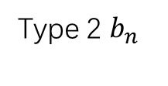
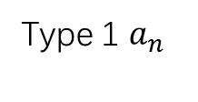
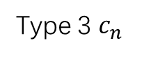
Type 1 $a_{n}$
Type 2 $b_{n}$
Type 3 $c_{n}$

Slide 5
Notes:
ex9

Slide 6
30 | 39 | 48 | 1 | 10 | 19 | 28
38 | 47 | 7 | 9 | 18 | 27 | 29
46 | 6 | 8 | 17 | 26 | 35 | 37
5 | 14 | 16 | 25 | 34 | 36 | 45
13 | 15 | 24 | 33 | 42 | 44 | 4
21 | 23 | 32 | 41 | 43 | 3 | 12
22 | 31 | 40 | 49 | 2 | 11 | 20
Notes:
ex11

Slide 7
47 | 58 | 69 | 80 | 1 | 12 | 23 | 34 | 45
57 | 68 | 79 | 9 | 11 | 22 | 33 | 44 | 46
67 | 78 | 8 | 10 | 21 | 32 | 43 | 54 | 56
77 | 7 | 18 | 20 | 31 | 42 | 53 | 55 | 66
6 | 17 | 19 | 30 | 41 | 52 | 63 | 65 | 76
16 | 27 | 29 | 40 | 51 | 62 | 64 | 75 | 5
26 | 28 | 39 | 50 | 61 | 72 | 74 | 4 | 15
36 | 38 | 49 | 60 | 71 | 73 | 3 | 14 | 25
37 | 48 | 59 | 70 | 81 | 2 | 13 | 24 | 35
Notes:
ex12

Slide 8


$$k$$
$$k−1$$
Only one
A
C
Swap
Swap
D
B
Notes:
ex13

Slide 9
Notes:
ex19

Slide 10










$$x_{1}$$
$$x_{2}$$
$$x_{3}$$
$$x_{4}$$
$$x_{5}$$
$$y_{1}$$
$$y_{2}$$
$$y_{3}$$
$$y_{4}$$
$$y_{5}$$
Notes:
EX25

Slide 11
Notes:
ex26

Slide 12

















$$C$$
$$1$$
$$5$$
$$1$$
$$4$$
$$2$$
$$D$$
$$1$$
$$F$$
$$2$$
$$A$$
$$B$$
$$1$$
$$3$$
$$3$$
$$2$$
$$E$$
Notes:
ex27

Slide 13
1 | 1 | 1 | 1 | 1 | 1 | 1 | 1
0 | 0 | 0 | 0 | 0 | 0 | 0 | 0
1 | 1 | 1 | 1 | 1 | 1 | 1 | 1
0 | 0 | 0 | 0 | 0 | 0 | 0 | 0
1 | 1 | 1 | 1 | 1 | 1 | 1 | 1
0 | 0 | 0 | 0 | 0 | 0 | 0 | 0
1 | 1 | 1 | 1 | 1 | 1 | 1 | 1
0 | 0 | 0 | 0 | 0 | 0 | 0 | 0
Notes:
ex39

Slide 14
one left
Notes:
42

Slide 15
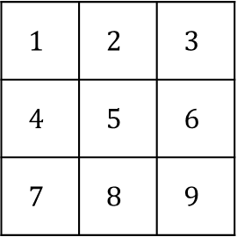

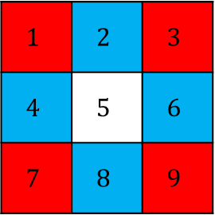

$$1$$ | $$2$$ | $$3$$
$$4$$ | $$5$$ | $$6$$
$$7$$ | $$8$$ | $$9$$
$$1$$ | $$2$$ | $$3$$
$$4$$ | $$5$$ | $$6$$
$$7$$ | $$8$$ | $$9$$
$$10$$
$$10$$
Notes:
20

Slide 16


























$$a$$
$$l$$
$$b$$
$$a$$
$$k$$
$$m$$
$$c$$
$$f$$
$$b$$
$$r$$
$$n$$
$$g$$
$$j$$
$$s$$
$$d$$
$$e$$
$$c$$
$$q$$
$$o$$
$$d$$
$$i$$
$$p$$
$$e$$
$$h$$
$$f$$
$$g$$

Slide 17




$$×11$$
$$×7$$
$$×8$$
$$×4$$
Notes:
ex44

