Slide 1









2$k+2$
$$⋯$$
$$2k+1$$
$$2k$$
$$2n$$
$$⋯$$
$$1$$
$$2$$
$$3$$
Notes:
EX1

Slide 2



































$$b$$
$$c$$
$$b$$
$$c$$
$$b$$
$$c$$
$$(ab)$$
$$(ab)$$
$$(cd)$$
$$(cd)$$
$$(\left(ab\right)c)$$
$$(b(cd))$$
$$a$$
$$d$$
$$a$$
$$d$$
$$a$$
$$d$$
$$((\left(ab\right)c)d)$$
$$(\left(ab\right)(cd))$$
$$(a\left(b\left(cd\right)\right))$$
$$b$$
$$c$$
$$b$$
$$c$$
$$(bc)$$
$$(bc)$$
$$(\left(bc\right)d)$$
$$(a(bc))$$
$$a$$
$$d$$
$$a$$
$$d$$
$$(a\left(\left(bc\right)d\right))$$
$$(\left(a\left(bc\right)\right)d)$$
Notes:
EX3

Slide 3

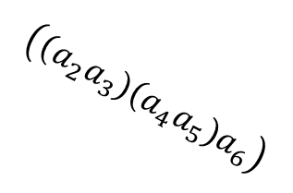






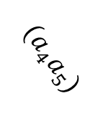

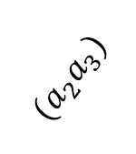
$$a_{3}$$
$$a_{4}$$
$${(a}_{2}a_{3})$$
$${(a}_{4}a_{5})$$
$$a_{5}$$
$$a_{2}$$
$$({(a}_{2}a_{3})(a_{4}a_{5}))$$
$$a_{1}$$
$$\left(\left(a_{2}a_{3}\right)\left(a_{4}a_{5}\right)a_{6}\right)$$
$$a_{6}$$
$$\left(a_{1}(\left(a_{2}a_{3}\right)\left(a_{4}a_{5}\right)a_{6})\right)$$
Notes:
EX4

