Slide 1

Cyclistic
Google Data Analytics Capstone
Fulvio
Case Study

Slide 2
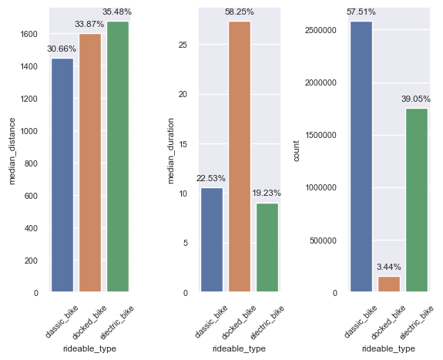
Type of Bike and Usage
People cycle further using electric bikes.
- The duration for rides on classic and electric bikes are the same, however docked_bikes rides last longer.
- The number of rides for docked bikes is small.

Slide 3
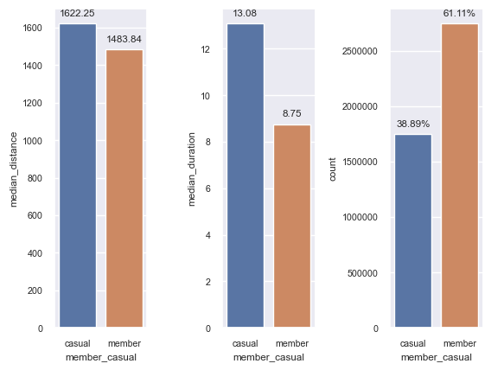
Type of User and Usage
Casual members spend more time cycling, and also tend to cycle a bit longer.
- Casual members account for almost 39% of rides, while the remaining 61% are done by members.

Slide 4
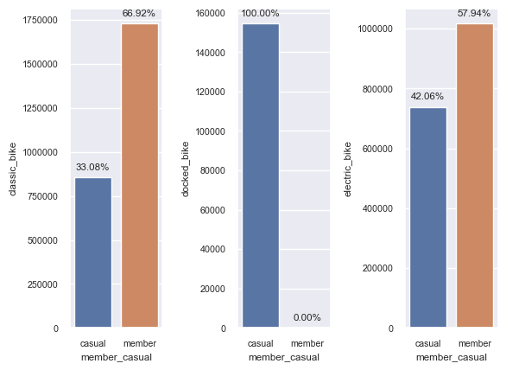
Type of User and Bike Type
Members use mostly classic and electric bikes.
Docked bikes are only used by casual users.

Slide 5
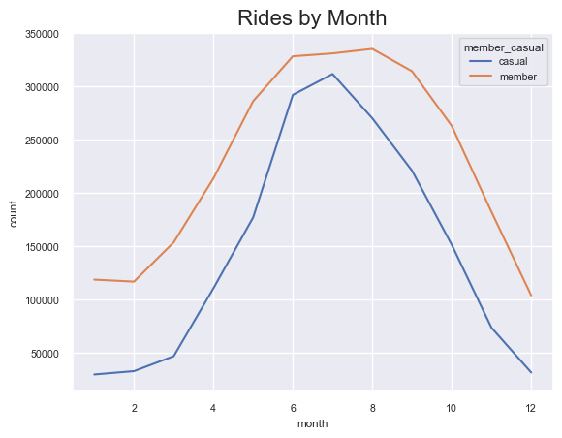
Cyclistic
Both type of members have the same pattern of usage throughout the year.
Rides are higher in the second and third quarters.

Slide 6
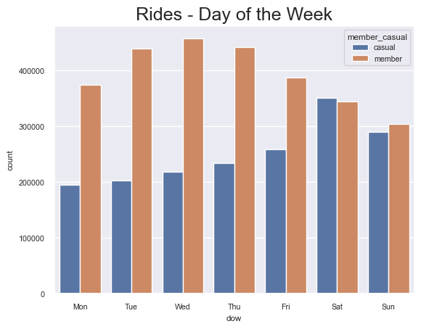
Cyclistic
Casual members usage peaks on weekend, even surprassing members.
Members usage is higher during the week

Slide 7
Cyclistic
Casual members usage peaks on weekend, even surprassing members.
Members usage is higher during the week

Slide 8
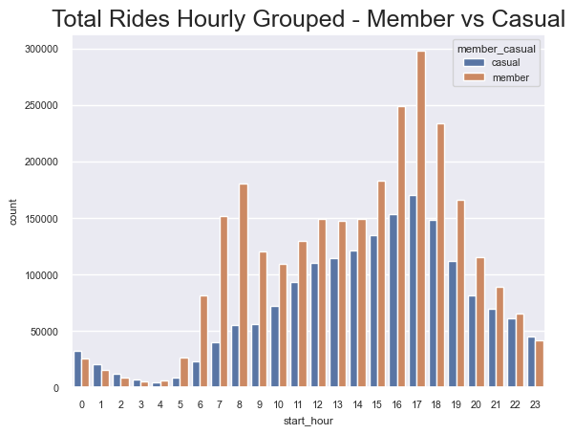
Cyclistic
- Casual Riders cycle more in the afternoon.
- Members cycle in the morning and in the afternoon.

Slide 9

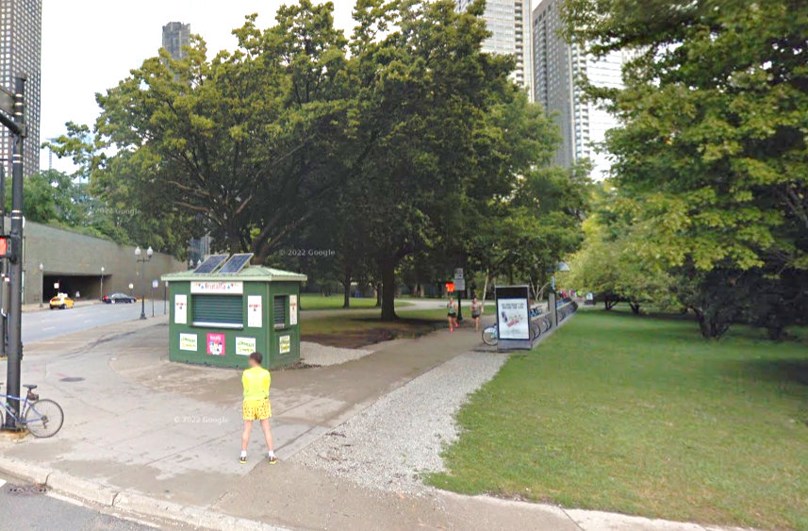
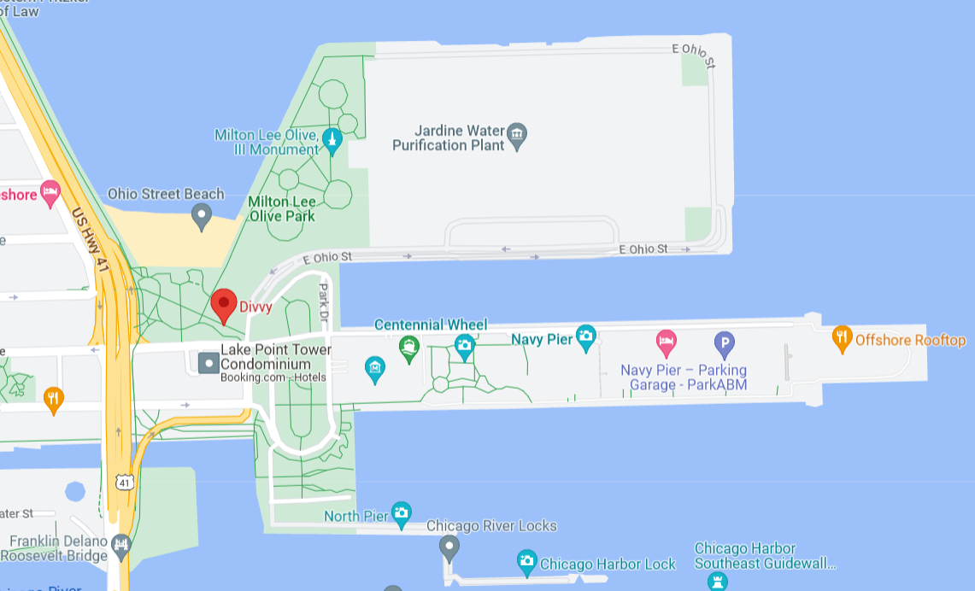
Cyclistic
Streeter Dr & Grand Ave
- Station where most trips start or end.

Slide 10
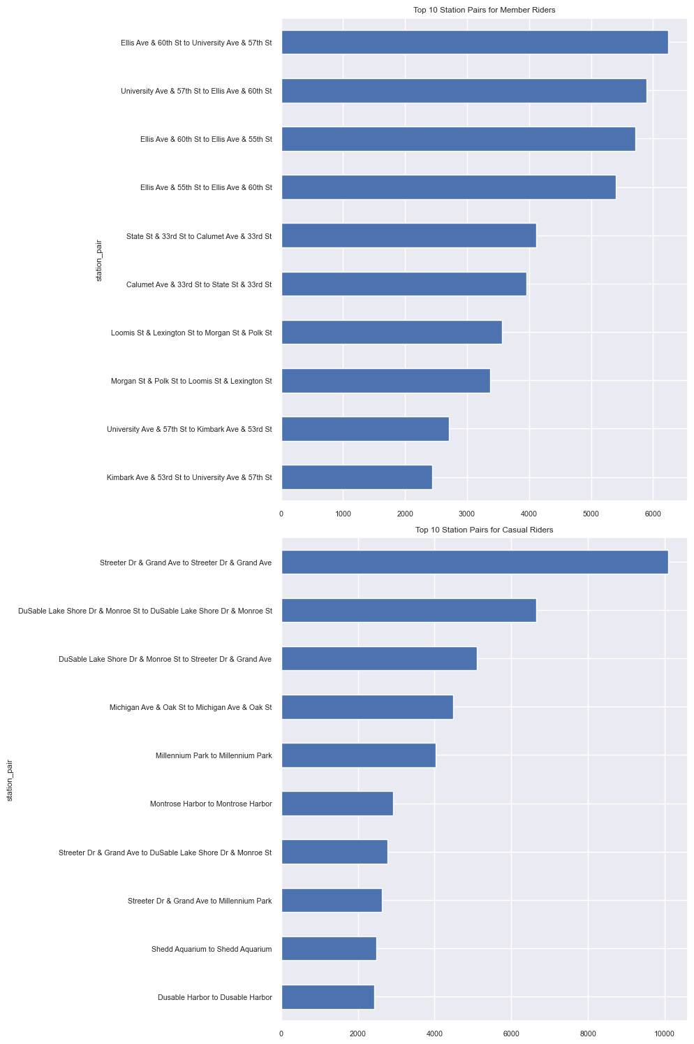
Cyclistic
Most common routes are different for casual riders and members.
This suggests that members and casual riders might be using the bike sharing service for different purposes (e.g., commuting vs. leisure).

Slide 11
Cyclistic
The data suggests that there are some differences in how and when member and casual riders use the bike sharing service. For instance, members seem to use the service consistently across the week, potentially for commuting, while casual riders use the service more on weekends, suggesting more leisure-oriented usage.

Slide 12
Cyclistic
Some strategies that could potentially help convert casual riders to members:
Targeted Marketing Campaigns:
We observed that casual riders use the service more on weekends, while member usage is more evenly spread throughout the week. Casual riders may be using the service for leisure or tourism. Campaigns could highlight the benefits of membership for these activities. Eg. a campaign could show how a membership can enhance weekend leisure rides or sightseeing activities.
Partnerships with Tourist Attractions:
As casual riders may be tourists, partnerships could be formed with local tourist attractions or travel agencies to offer special membership packages or discounts.
Improve and Highlight Service at Popular Locations:
The data showed some stations are more popular among casual riders. Improving service at these stations (e.g., ensuring bike availability, maintenance) and highlighting the advantages of membership for usage at these stations could attract more casual riders to become members.

