Slide 1

Modeling the relationship between alcohol policy and harms in Ontario
Presenter
Sze Hang (Hana) Fu
Supervisor
Dr. Lennon Li and Dr. Brendan Smith
Site
Public Health Ontario

Slide 2
Background
Alcohol is one of the leading risk factors for death and disease globally and in Canada.
Diseases that are attributable to alcohol include liver cirrhosis, cardiovascular diseases, injuries, and cancers
Studies found that low socioeconomic (SES) groups are impacted by alcohol consumption disproportionately
Population-level interventions can reduce and prevent alcohol harms

Slide 3
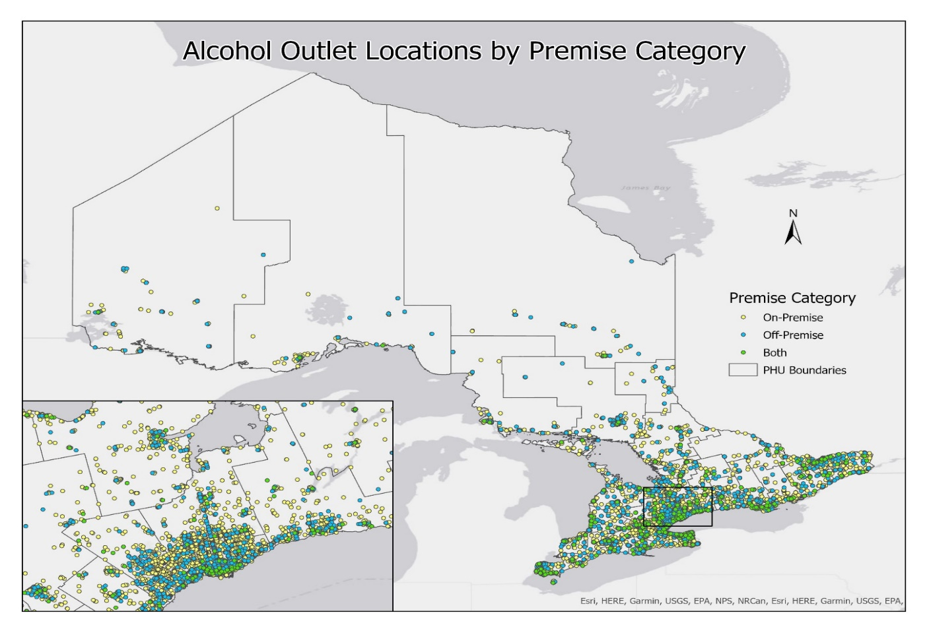
Background
Alcohol Availability
Restricting the physical availability of alcohol
However, few studies have estimated the impacts of changes in alcohol availability on alcohol use and harms by age, sex and SES level
Alcohol pricing
Regulating prices through taxation or minimum unit prices
Reduced consumption, spending, and mortality to a greater extent in consumers from low income groups

Slide 4
Background
Microsimulation models
Inform health policies in relation to complex health and health system problems
Allows policymakers to examine the results, consequences, and benefits of a policy in advance of implementation
Implemented the areas of cancer treatment, obesity, and chronic disease
Employed by Canadian agencies including Statistics Canada and Health Canada to project future incidence and prevalence of risk factors and diseases

Slide 5
Research Questions
To what extent will population-level alcohol interventions (via alcohol availability and pricing) impact future alcohol-attributable hospitalizations and mortality in Ontario?
What are the degrees of impact of alcohol interventions for the population subgroup by age, sex and SES level?
Research Hypothesis
Microsimulation models show that the impact of alcohol policy will differ by age, sex and SES in Ontario

Slide 6
Methods
Discrete-event microsimulation model
1. Model initialization
Ontario respondents from the Canadian Community Health Survey (CCHS) 2005/6 data
Scale up to generate representative 2006 Ontario population using CCHS survey weights
Provides a wide set of individual characteristics including age, sex, SES level
Starting the model in 2006 allows for 10 years of follow up for model calibration and validation
2. Health state transitioning
Individual’s possible health state at a time cycle: healthy, hospitalization, mortality
Transition of health state in the next time cycle through transitioning probability
Policy- and stratum-specific (age/sex/SES)
Informed from risk ratios obtained from the literature, or
Estimates from a Cox PH regression model based on the CCHS data

Slide 7
Methods
Transition probabilities are stratum-specific (age/sex/SES) based on individual characteristics
p = 0.02
p = 0.05
Healthy
Hospitali-zation
P = 0.6
Mortality
P = 0.97
P = 0.35
Monte Carlo (MC) simulation methods to describe the stochastic transition process of individuals through the model
Sampling from a categorical distribution
P = 0.01

Slide 8
Methods
3. Individual trajectories
Keeping track of each individual’s simulated trajectory through the model
4. Model validation/calibration
Model conditions will be adjusted based on an iterative process until simulation estimates closely match the empirical data estimates
Using CCHS 2017/18 and Census of Population data
5. Population-level summary
Aggregating all the state and transition values over the model’s cycles
Estimate the total number of outcomes
Other notes: to account for the stochastic nature of the model, each model scenario will be performed multiple times, with the median, 95% credible interval reported.
My responsibilities:
Developing the base microsimulaton model
Deriving risk estimates of alcohol use on hospitalization that is SES specific

Slide 9
Thank you! Questions?

