Slide 1

Modeling the relationship between alcohol consumption and harms in Ontario
Presenter
Sze Hang (Hana) Fu
Supervisor
Dr. Lennon Li and Dr. Brendan Smith
Site
Public Health Ontario
Present date
April 19, 2022

Slide 2
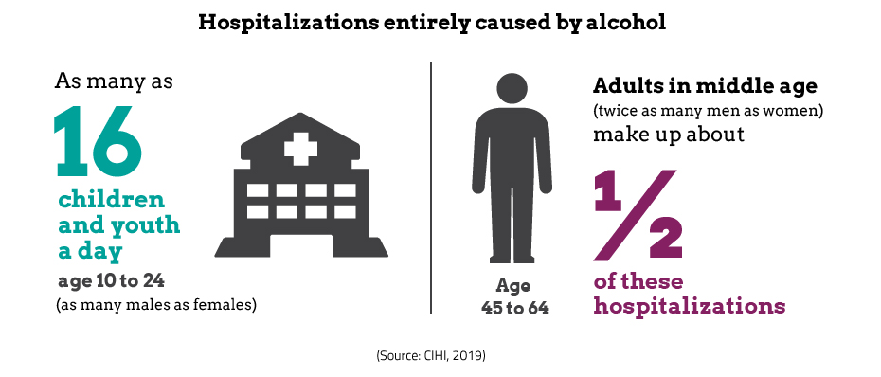
Background
Alcohol is a leading risk factor for death and disease globally and in Canada.
Burden of disease in Canada (2000-16)
Men experience more alcohol attributable deaths than women
Young women experienced a dramatic increase in harms
Greatest burden among those in the middle age
Starting in 2015, Ontario had deregulated the sale of alcohol through increasing availability and decreasing taxation
Notes:
Alcohol drinking is a leading risk factor for death and disease globally and in Canada
The burden of disease of alcohol drinking is experience among all ages. However, it differs by age and sex. For example, males experience more attributable deaths than women, however, there is an dramatic increase in burden of disease in young women. In terms of age, the burden is greatest among those ages 54 and above.
The observed trends in Canada also applies to the Ontario population.
Alcohol consumption is affected by two external factors: availability of alcohol and alcohol taxation. Given the harms of alcohol drinking, it is important to understand how the changes in these external factors can affect alcohol use and harms in the Ontario population, by age, sex, and SES.
Reference:
1 Spithoff S. Addressing rising alcohol-related harms in Canada. CMAJ. 2019 Jul 22;191(29):E802-3.
2 Franklin A, Chrystoja BR, Manthey J, Rehm J, Shield K. The Alcohol-Attributable Burden of Disease in Canada from 2000 to 2016. Canadian Journal of Addiction. 2020 Dec 1;11(4):6-12.
Figure link: https://yourhealthsystem.cihi.ca/hsp/inbrief?lang=en#!/indicators/061/hospitalizations-entirely-caused-by-alcohol/;mapC1;mapLevel2;/

Slide 3
Background
Microsimulation model
Individual-level
Structured around a set of mutually exclusive health states
Each individual can only be in one health state at any time cycle
Apply incidence/mortality risk to model the progress of disease
Probability of incidence being stochastic
Used in chronic disease epidemiology
For example, impact of alcohol policies
Notes:
- We can use statistical modelling to understand the relationship between external risk factors and alcohol harms. One approach is to use microsimulation models.
- Microsimulation models are individual-level based. The model is structured with a set of mutuality exclusive health states.
- Each individual can only be in one health state at any given cycle
To model how individuals can transition from one health state to another, we apply incidence/mortality risk specific to each individual
These probabilities of transition to another health state is stochastic, meaning two individuals with the same mortality risk can have slightly different probabilities of transition due to randomness.
Microsimulation model has been utilized in chronic disease epidemiology including research that examine the impact of alcohol policies.
References:
Tanuseputro P, Arnason T, Hennessy D, Smith B, Bennett C, Kopec J, Pinto AD, Perez R, Tuna M, Manuel D. Simulation modeling to enhance population health intervention research for chronic disease prevention. Canadian Journal of Public Health. 2019 Feb;110(1):52-7.

Slide 4
Research Question
Objective: Set up basic structure for the alcohol policy microsimulation model to understand alcohol harms for the population in Ontario from 2013-2043
Predict alcohol-related mortality without change in policy effect
Consider differences in age and sex
Focus on the Ontario population
Notes:
The goal of this practicum project is to set up a basic microsimulation structure for modeling the effects of alcohol harms
Here, using this structure, I predict the alcohol-related mortality by age and sex groups, without the effect of change in alcohol policy
We specifically focus on the population in Ontario.

Slide 5
Methods
Alcohol policy microsimulation model
Two-state model
Healthy → Death
30 year time cycles
Incorporate both alcoholic and non-alcoholic transition probabilities
Monte Carlo process
Same transition probabilities for each age- and sex-group
Stochastic variation in progression to death
Notes:
We use a two-stage microsimulation model.
An individual can either be in a healthy state or death state. Obviously, it is not reversible, that an individual who have died cannot become healthy again.
The stochastic nature is via Monte Carlo process, where individuals belonging to same age- and sex-group have the same transition probabilities, but they differ in progression to death due to randomness, as explained next.

Slide 6
Methods
Healthy
Alcoholic trans prob
Monte Carlo sim.
u₁> p₁ OR
u₂> p₂
No
Set M_{i0}= initial health state for individual i
for i to n_{i} do
for t=0 to 30 do
p₁ = probs(M_{it}) (alcoholic transition probability for individual i at time t)
p₂ = probs(M_{it}) (non-alcoholic transition probability for individual i at time t)
u₁ = uniform(0,1) (for the alcoholic path)
u₂ = uniform(0,1) (for the non-alcoholic path)
If u₁> p₁ or u₂> p₂, individual i dies, else stays in healthy state
q_{1it} = u₁> p₁ (T/F)
q_{2it} = u₂ > p₂ (T/F)
end
end
Non-alcoholic trans prob
Monte Carlo sim.
Yes
Death
}
keep track of cause of death
Notes:
Here, we have big M represents the health state, with subscript i represent an individual, and subscript 0 represent the initial time cycle.
We loop through the i individual, and loop through the 30 time cycles
For each individual at each time cycle, we obtain both the alcoholic and non-alcoholic the transition probabilities, represented by p_1 and p_2
Then, we generate two uniform numbers within the range of 0 to 1, one for the alcoholic path and one for the non-alcoholic path. These are represented by u_1 and u_2.
Given p_1, p_2, u_1, u_2, if the individual has u_1> p_2 OR u_2 > p_2, then the person dies, otherwise the person stays in the healthy state and proceed to the next time cycle.
The q_{1t} and q_{2t} allows us to keep track of the cause of death if a person dies.
Reference:
Krijkamp EM, Alarid-Escudero F, Enns EA, Jalal HJ, Hunink MM, Pechlivanoglou P. Microsimulation modeling for health decision sciences using R: a tutorial. Medical Decision Making. 2018 Apr;38(3):400-22. https://www.ncbi.nlm.nih.gov/pmc/articles/PMC6349385/

Slide 7
Methods
Age group | Sex | Ontario population (sample weighted) | Transition probabilities
Age group | Sex | Total population | Alcoholic death rates (per 100K) | Non-alcoholic death rates (per 100K)
16-24 | Female | 818,220 | 10.6 | 43.5
16-24 | Male | 861,105 | 2.1 | 26.3
25-34 | Female | 903,256 | 16.6 | 58.1
25-34 | Male | 867,389 | 4.4 | 36
35-54 | Female | 1,959,818 | 41.4 | 192.5
35-54 | Male | 1,895,180 | 20.4 | 148.2
55+ | Female | 1,997,749 | 72.1 | 2,741.10
55+ | Male | 1,794,484 | 28.9 | 3,083.50
Population:
Baseline population from Canadian Community Health Survey (CCHS) 2013/14
Age- and sex-specific
Account for survey weights
Transition probabilities (mortality risk):
Sheffield Alcohol Policy Model (UK)
Age- and sex-specific
Microsimulation is performed in R
Notes:
For the baseline population, we use those from the CCHS 2013-14.
We obtain the Ontario population by age- and sex-group after account for survey weights, which is shown in the table on the right.
For the transition probabilities, or mortality risk, we used those from the Sheffield Alcohol Policy Model from UK, since the Canadian-specific transition probabilities for alcohol-mortality are not widely available.
The Sheffield model provides both alcoholic and non-alcoholic death rates. We incorporate both in the microsimulation model.
Reference:
Brennan A, Meier P, Purshouse R, Rafia R, Meng Y, Hill‐Macmanus D, Angus C, Holmes J. The Sheffield alcohol policy model–a mathematical description. Health economics. 2015 Oct;24(10):1368-88. https://onlinelibrary.wiley.com/doi/full/10.1002/hec.3105

Slide 8
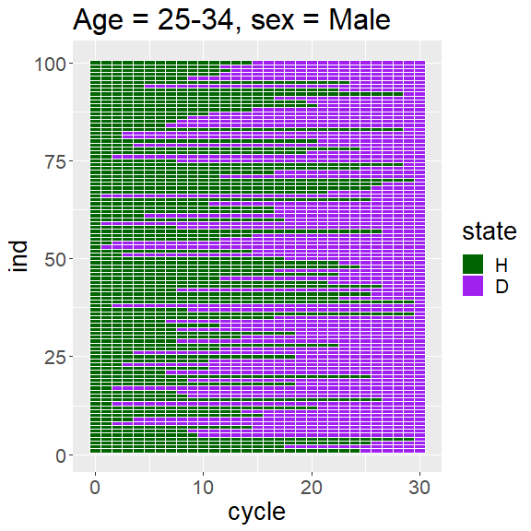
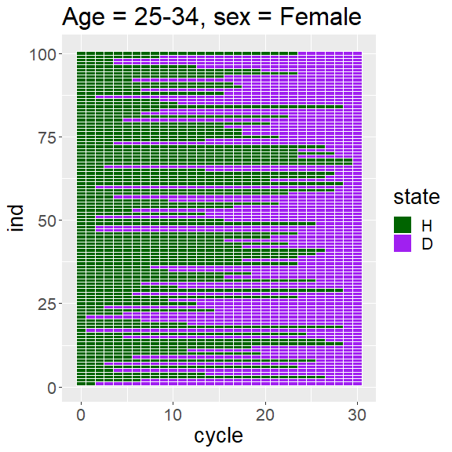
Results
Individual level results
Ages 25-34 of CCHS 2013/14 baseline population
Notes:
Here we show the results for selected individuals in the 25-34 age group, who have died within the 30 time cycle periods.
X-axis represent time cycle y-axis for different individuals. Green represent healthy state and purple are death state.
Even though we applied the same transition probabilities to the individuals, due to randomness introduced by Monte Carlo process, not all of them died at the same time as observed in these graphs.
It may not be so obviously from these graphs, but higher proportion of male individuals die earlier than female individuals.

Slide 9
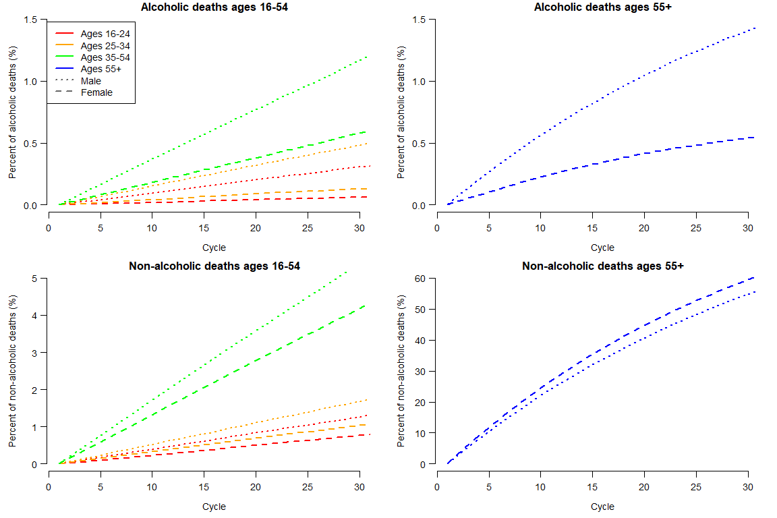
Results
Over 30 time cycles by age- and sex-group
Notes:
Here I present the results in term of percent of deaths over time due to alcoholic or non-alcoholic causes by age- and sex-groups.
Note that the y-axis range differ for alcoholic and non-alcoholic deaths.
As time progress, higher percentage of people die from either alcoholic or non-alcoholic causes.
A much smaller percentage of people died of alcoholic causes, and higher percentage died among males and older age groups.
These results are reflective of the transition probabilities used in the microsimulation models.

Slide 10
Next steps
Model alcohol policy effect (alcohol availability and taxation)
Consider uncertainty in the estimates (multiple microsimulations)
Three-state model
Healthy state ↔ sick state → Death state
Derive Canadian-specific transition probabilities for alcohol morbidity and mortality
Account for the amount of alcohol, and cumulative consumption
Lagged effects of alcohol consumption
Consider dynamics in demography
Introduce “new” individuals to the population (birth and immigrations)
Notes:
Three-stage model
Health state ↔ sick state → Death state
Derive Canadian-specific transition probabilities for alcohol morbidity and mortality
Account for the amount of alcohol, and cumulative consumption
Lagged effects of alcohol consumption
Consider dynamics in demography
Aging of the population
An individual aged 35+ become 45+ after ten years
Updating transition probabilities
Introduce “new” individuals to the population

Slide 11
Acknowledgement
Lennon Li (PhD)
Brendan Smith (PhD)
Erin Hobin (PhD)
Christine Warren (MPH)
Alessandra Andreacchi (MPH)
Hana Fu (MSA)

Slide 12
Thank you! Questions?

