Slide 1
The acts of the mind, wherein it exerts its power over simple ideas, are chiefly these three:
Combining several simple ideas into one compound one, and thus all complex ideas are made.
The second is bringing two ideas, whether simple or complex, together, and setting them by one another so as to take a view of them at once, without uniting them into one, by which it gets all its ideas of relations.
The third is separating them from all other ideas that accompany them in their real existence: this is called abstraction, and thus all its general ideas are made.
John Locke, An Essay Concerning Human Understanding (1690)
https://mitpress.mit.edu/sicp/full-text/book/book-Z-H-9.html#%_chap_1

Slide 2
KISS
Keep It Simple, Stupid!

Slide 3
Simplicity is prerequisite for reliability
Edsger W. Dijkstra
https://en.wikiquote.org/wiki/Edsger_W._Dijkstra

Slide 4
Complexity | Simplicity
State, Objects | Values
Methods | Functions, Namespaces
Vars | Managed refs
Inheritance, switch, matching | Polymorphism a la carte
Syntax | Data
Imperative loops, fold | Set functions
Actors | Queues
ORM | Declarative data manipulation
Conditionals | Rules
Inconsistency | Consistency
Simplicity Made Easy
Choose simple constructs over complexity-generating constructs.
It's the aritifacts, not the authoring.
Create abstractions with simplicity as a basic.
Simplify the problem space before you start.
Simplicity often means making more things, not fewer.
Reap the benifits!
Rich Hickey
https://github.com/matthiasn/talk-transcripts/blob/master/Hickey_Rich/SimpleMadeEasy.md

Slide 5
Software design pattern
In software engineering, a design pattern is a general reusable solution to a commonly occurring problem within a given context in software design. A design pattern is not a finished design that can be transformed directly into source or machine code. It is a description or template for how to solve a problem that can be used in many different situations. Patterns are formalized best practices that the programmer can use to solve common problems when designing an application or system.
https://en.wikipedia.org/wiki/Software_design_pattern

Slide 6
Dependency injection
In software engineering, dependency injection is a software design pattern that implements inversion of control for resolving dependencies. A dependency is an object that can be used (a service). An injection is the passing of a dependency to a dependent object (a client) that would use it. The service is made part of the client's state. Passing the service to the client, rather than allowing a client to build or find the service, is the fundamental requirement of the pattern.
https://en.wikipedia.org/wiki/Dependency_injection

Slide 7
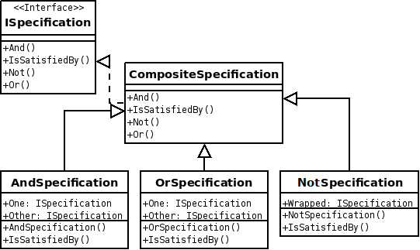
Specification pattern
In computer programming, the specification pattern is a particular software design pattern, whereby business rules can be recombined by chaining the business rules together using boolean logic. The pattern is frequently used in the context of domain-driven design.
https://en.wikipedia.org/wiki/Specification_pattern

Slide 8
Lock
In computer science, a lock or mutex (from mutual exclusion) is a synchronization mechanism for enforcing limits on access to a resource in an environment where there are many threads of execution. A lock is designed to enforce a mutual exclusion concurrency control policy.
https://en.wikipedia.org/wiki/Lock_(computer_science)

Slide 9

Model–view–controller
Model–view–controller (MVC) is a software architectural pattern mostly (but not exclusively) for implementing user interfaces on computers. It divides a given software application into three interconnected parts, so as to separate internal representations of information from the ways that information is presented to or accepted from the user.
https://en.wikipedia.org/wiki/Model-view-controller

Slide 10
Generic programming
In the simplest definition, generic programming is a style of computer programming in which algorithms are written in terms of types to-be-specified-later that are then instantiated when needed for specific types provided as parameters. This approach, pioneered by ML in 1973, permits writing common functions or types that differ only in the set of types on which they operate when used, thus reducing duplication. Such software entities are known as generics in Ada, Delphi, Eiffel, Java, C#, F#, Objective-C, Swift, and Visual Basic .NET; parametric polymorphism in ML, Scala, Haskell (the Haskell community also uses the term "generic" for a related but somewhat different concept) and Julia; templates in C++ and D; and parameterized types in the influential 1994 book Design Patterns. The authors of Design Patterns note that this technique, especially when combined with delegation, is very powerful but that "[dynamic], highly parameterized software is harder to understand than more static software."
https://en.wikipedia.org/wiki/Generic_programming

Slide 11
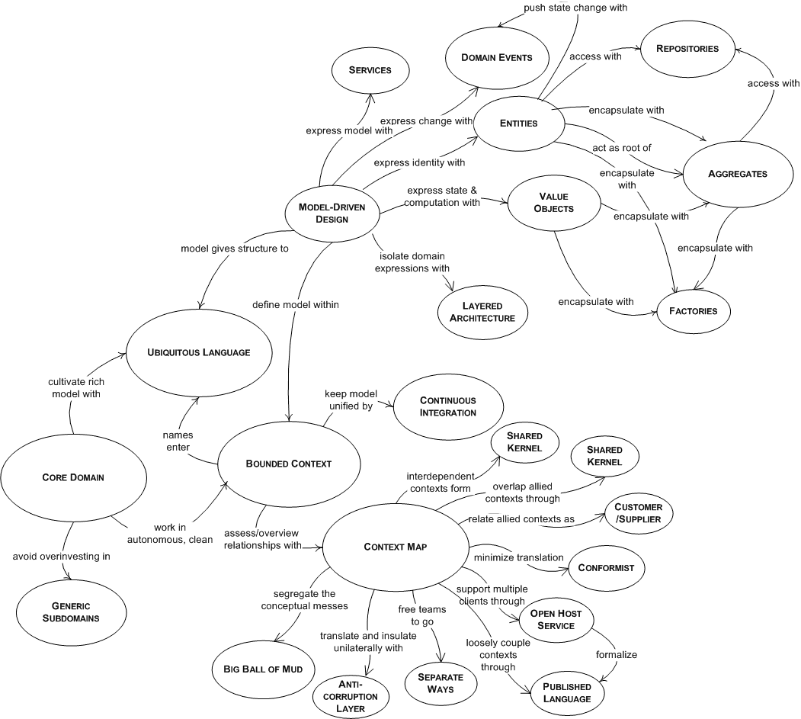
Domain Driven Design

Slide 12
