Slide 1
Abstract & Pattern

Slide 2
The acts of the mind, wherein it exerts its power over simple ideas, are chiefly these three:
Combining several simple ideas into one compound one, and thus all complex ideas are made.
The second is bringing two ideas, whether simple or complex, together, and setting them by one another so as to take a view of them at once, without uniting them into one, by which it gets all its ideas of relations.
The third is separating them from all other ideas that accompany them in their real existence: this is called abstraction, and thus all its general ideas are made.
John Locke, An Essay Concerning Human Understanding (1690)
https://mitpress.mit.edu/sicp/full-text/book/book-Z-H-9.html#%_chap_1

Slide 3
KISS
Keep It Simple, Stupid!
Simplicity is prerequisite for reliability
Edsger W. Dijkstra
https://en.wikiquote.org/wiki/Edsger_W._Dijkstra
Notes:
3 balls, problems to solutions

Slide 4
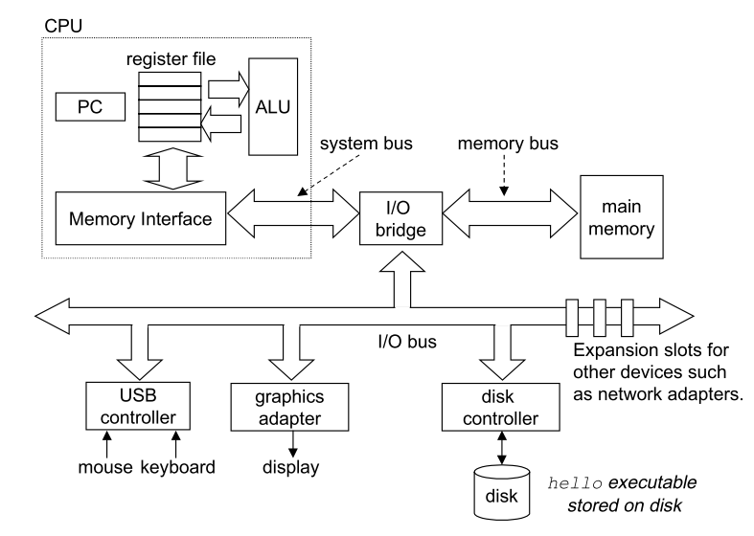
http://csapp.cs.cmu.edu/

Slide 5
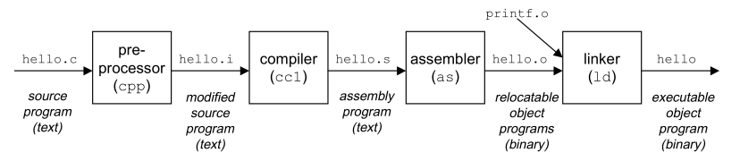
#include <stdio.h>
int main()
{
printf("hello, world\n");
}

Slide 6
Problem Definition
Detailed Design
Corrective Maintenance
Requirements Development
Coding and Debugging
Integration
Construction Planning
Integration Testing
Software Architecture
Unit Testing
System testing
http://cc2e.com/

Slide 7
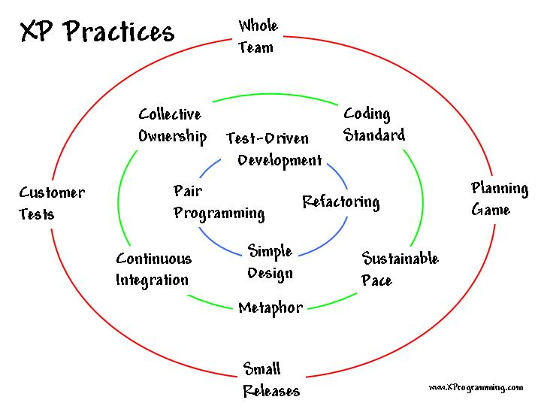
Manifesto for Agile Software Development
Individuals and interactions over processes and tools
Working software over comprehensive documentation
Customer collaboration over contract negotiation
Responding to change over following a plan

Slide 8
Complexity | Simplicity
State, Objects | Values
Methods | Functions, Namespaces
Vars | Managed refs
Inheritance, switch, matching | Polymorphism a la carte
Syntax | Data
Imperative loops, fold | Set functions
Actors | Queues
ORM | Declarative data manipulation
Conditionals | Rules
Inconsistency | Consistency
Simplicity Made Easy
Choose simple constructs over complexity-generating constructs.
Create abstractions with simplicity as a basic.
Simplify the problem space before you start.
Simplicity often means making more things, not fewer.
Reap the benifits!
Rich Hickey
https://github.com/matthiasn/talk-transcripts/blob/master/Hickey_Rich/SimpleMadeEasy.md
Notes:
Pointer, object, type, function, general type, macro, meta, interface, rec,

Slide 9
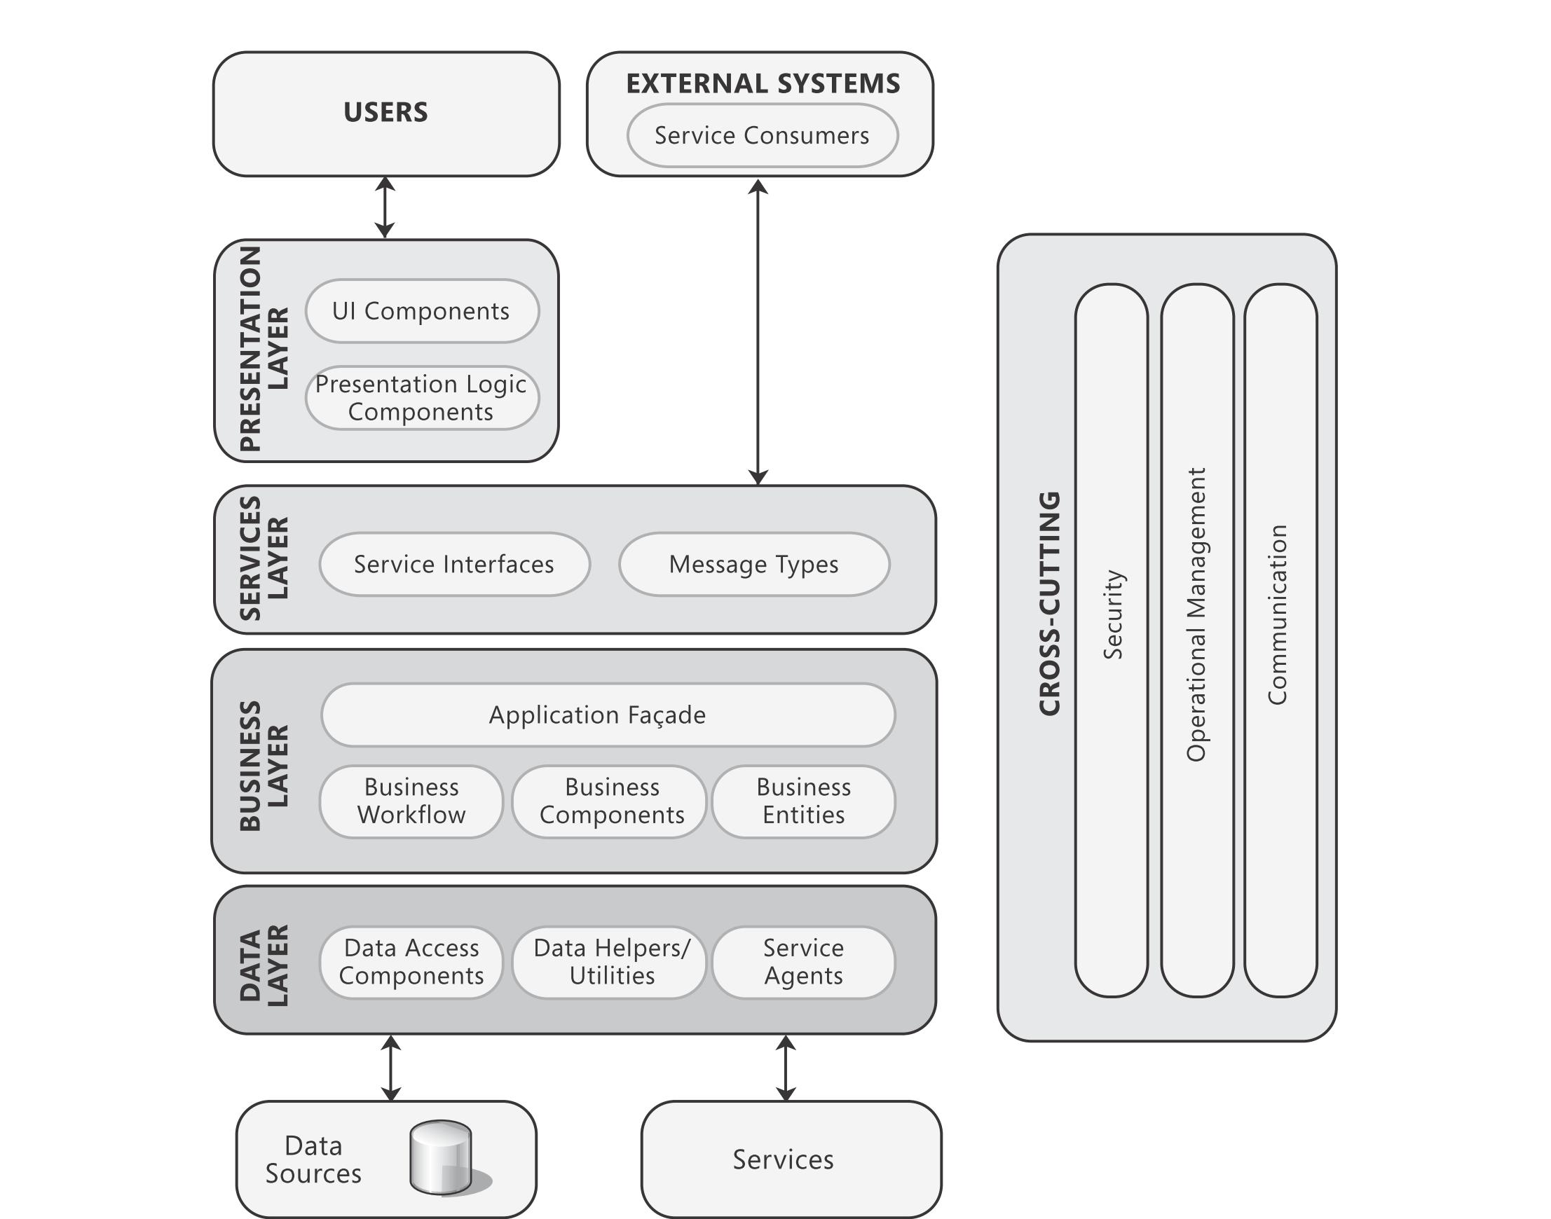
Traditional Application Architecture
https://msdn.microsoft.com/en-us/library/ff650706.aspx

Slide 10
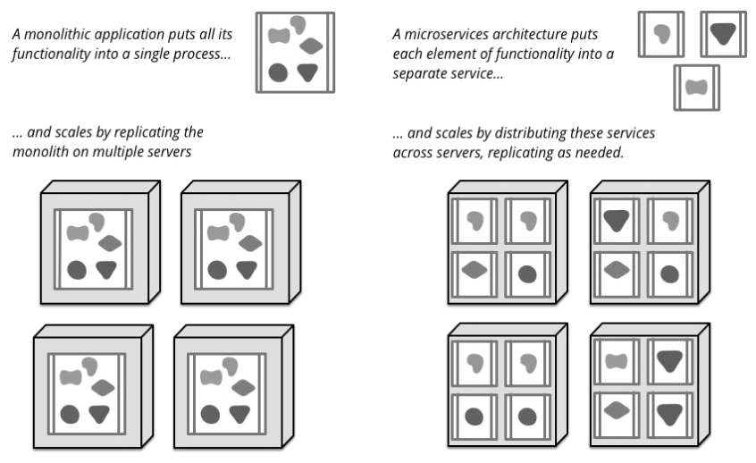
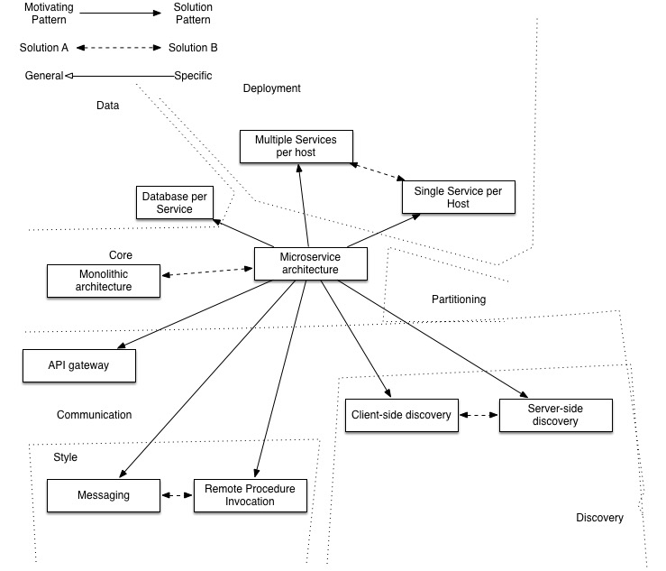
http://martinfowler.com/articles/microservices.html
http://microservices.io/patterns/microservices.html
Notes:
Microservices
Chassis: Externalized configuration, Logging, Health checks, Metrics

Slide 11
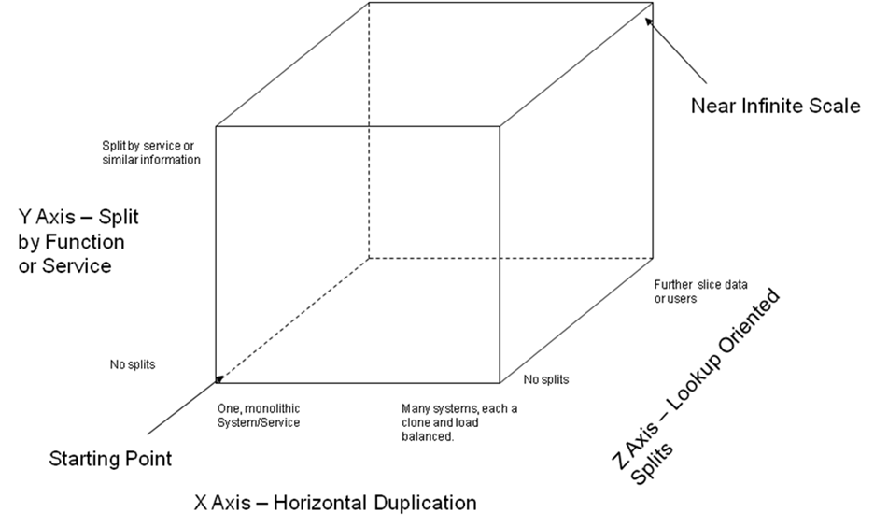
Scale Cube
http://akfpartners.com/techblog/2008/05/08/splitting-applications-or-services-for-scale/

Slide 12
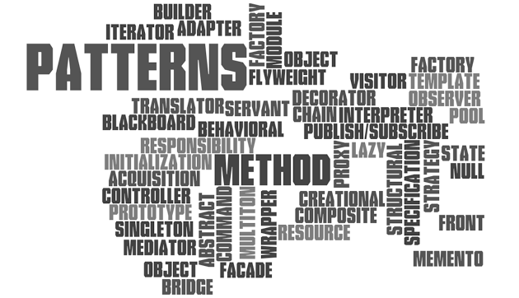
Software design pattern
In software engineering, a design pattern is a general reusable solution to a commonly occurring problem within a given context in software design. A design pattern is not a finished design that can be transformed directly into source or machine code. It is a description or template for how to solve a problem that can be used in many different situations. Patterns are formalized best practices that the programmer can use to solve common problems when designing an application or system.
https://en.wikipedia.org/wiki/Software_design_pattern

Slide 13
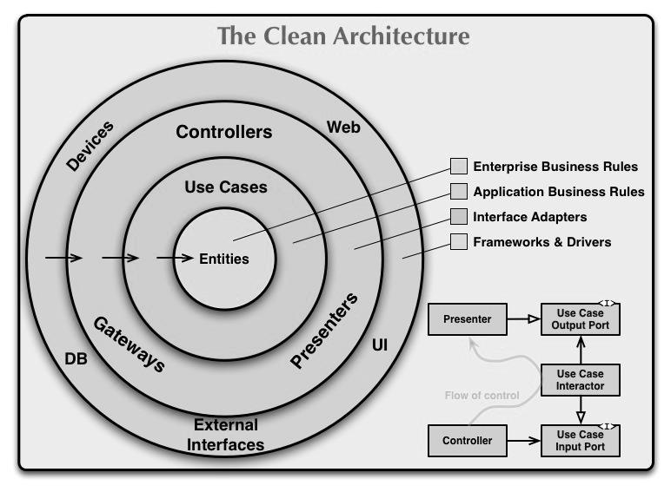
Separation of concerns
In computer science, separation of concerns (SoC) is a design principle for separating a computer program into distinct sections, such that each section addresses a separate concern. A concern is a set of information that affects the code of a computer program. A concern can be as general as the details of the hardware the code is being optimized for, or as specific as the name of a class to instantiate. A program that embodies SoC well is called a modular program. Modularity, and hence separation of concerns, is achieved by encapsulating information inside a section of code that has a well-defined interface. Encapsulation is a means of information hiding. Layered designs in information systems are another embodiment of separation of concerns.
https://en.wikipedia.org/wiki/Separation_of_concerns#SoC_via_partial_classes_in_C.23
Notes:
Horizontal Separation, (Presentation Layer, Business Layer, Resource Access Layer)
Vertical Separation, Aspect Separation
Data Concerns, Behavior Concerns, Extending Concerns, Delegating Concerns, Inverting Concerns,

Slide 14
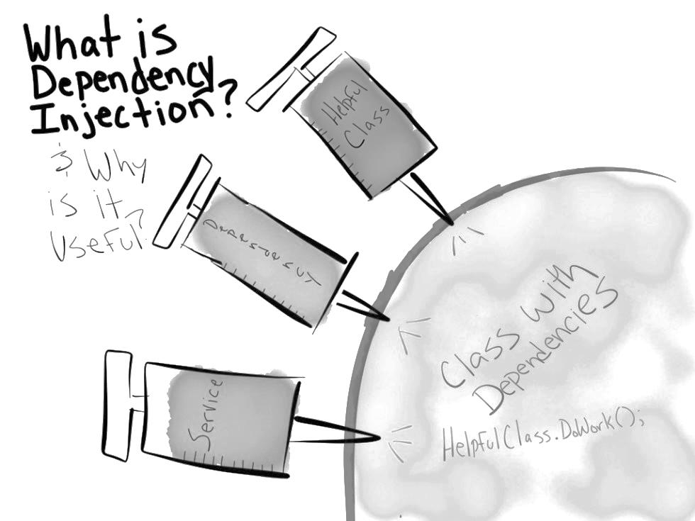
Dependency injection
In software engineering, dependency injection is a software design pattern that implements inversion of control for resolving dependencies. A dependency is an object that can be used (a service). An injection is the passing of a dependency to a dependent object (a client) that would use it. The service is made part of the client's state. Passing the service to the client, rather than allowing a client to build or find the service, is the fundamental requirement of the pattern.
https://en.wikipedia.org/wiki/Dependency_injection

Slide 15
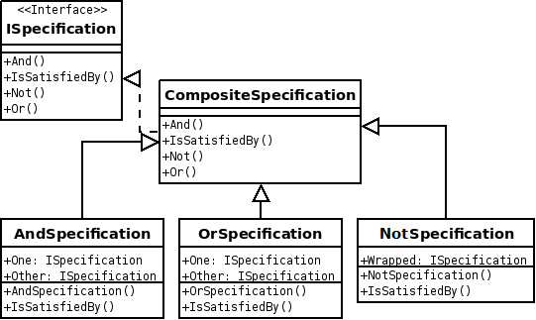
Specification pattern
In computer programming, the specification pattern is a particular software design pattern, whereby business rules can be recombined by chaining the business rules together using boolean logic. The pattern is frequently used in the context of domain-driven design.
https://en.wikipedia.org/wiki/Specification_pattern

Slide 16
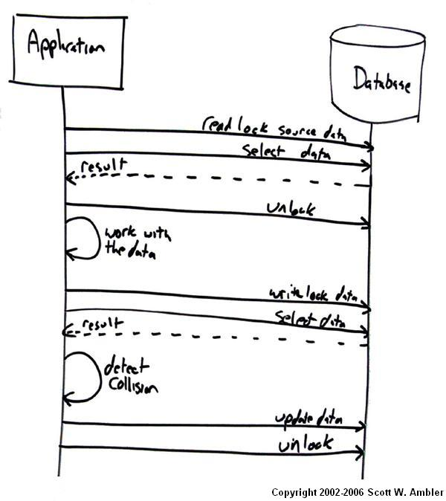
Lock
In computer science, a lock or mutex (from mutual exclusion) is a synchronization mechanism for enforcing limits on access to a resource in an environment where there are many threads of execution. A lock is designed to enforce a mutual exclusion concurrency control policy.
https://en.wikipedia.org/wiki/Lock_(computer_science)
Notes:
数牌，投标

Slide 17

Model–view–controller
Model–view–controller (MVC) is a software architectural pattern mostly (but not exclusively) for implementing user interfaces on computers. It divides a given software application into three interconnected parts, so as to separate internal representations of information from the ways that information is presented to or accepted from the user.
https://en.wikipedia.org/wiki/Model-view-controller

Slide 18
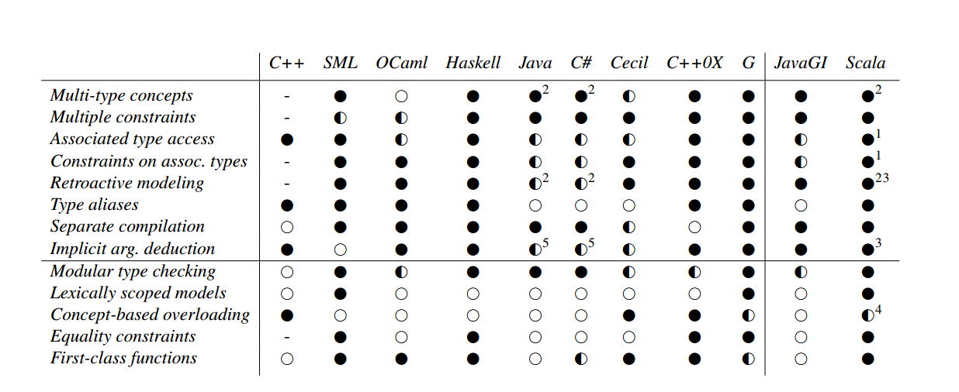
http://citeseerx.ist.psu.edu/viewdoc/download?doi=10.1.1.176.5300&rep=rep1&type=pdf
Generic programming
In the simplest definition, generic programming is a style of computer programming in which algorithms are written in terms of types to-be-specified-later that are then instantiated when needed for specific types provided as parameters. This approach, pioneered by ML in 1973, permits writing common functions or types that differ only in the set of types on which they operate when used, thus reducing duplication.
https://en.wikipedia.org/wiki/Generic_programming
Notes:
参数化类型

Slide 19
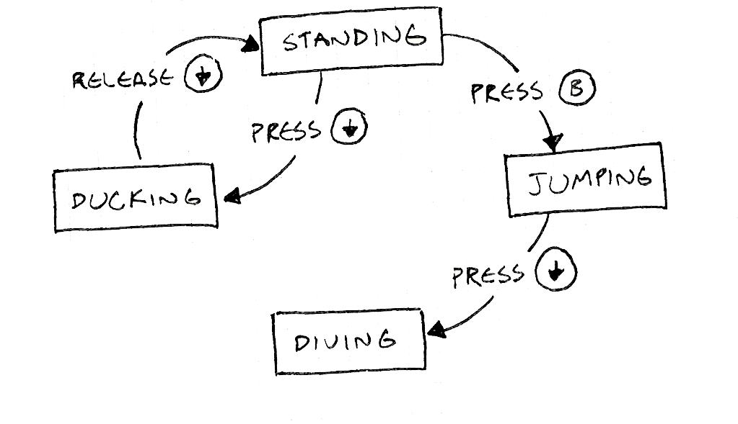
Finite-state machine
A finite-state machine (FSM) or finite-state automaton, or simply a state machine, is a mathematical model of computation used to design both computer programs and sequential logic circuits. It is conceived as an abstract machine that can be in one of a finite number of states. The machine is in only one state at a time; the state it is in at any given time is called the current state. It can change from one state to another when initiated by a triggering event or condition; this is called a transition. A particular FSM is defined by a list of its states, and the triggering condition for each transition.
https://en.wikipedia.org/wiki/Finite-state_machine

Slide 20
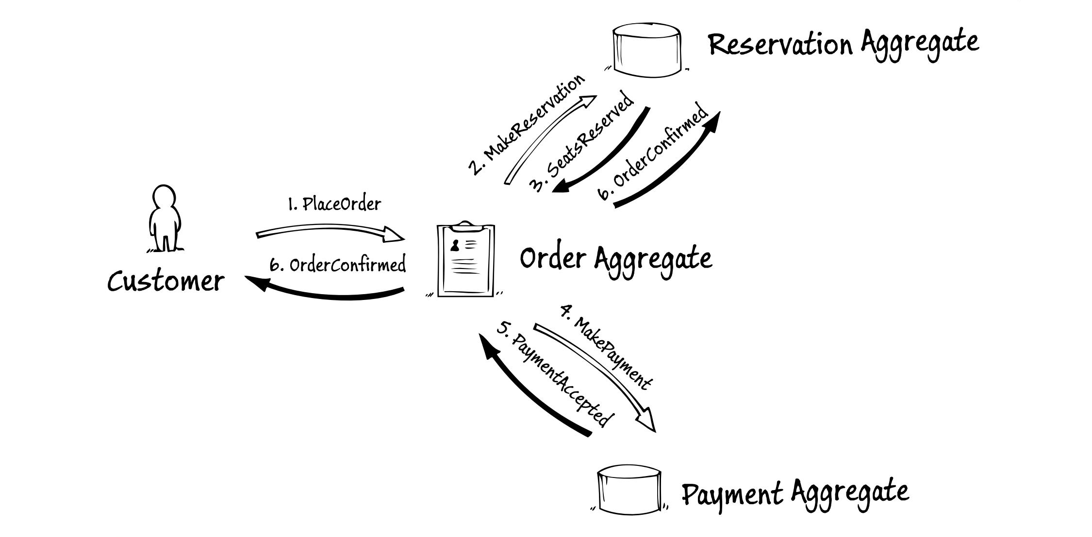
Event
In computing, an event is an action or occurrence recognised by software that may be handled by the software. Computer events can be generated or triggered by the system, by the user or in other ways. Typically, events are handled synchronously with the program flow, that is, the software may have one or more dedicated places where events are handled, frequently an event loop. A source of events includes the user, who may interact with the software by way of, for example, keystrokes on the keyboard. Another source is a hardware device such as a timer. Software can also trigger its own set of events into the event loop, e.g. to communicate the completion of a task. Software that changes its behavior in response to events is said to be event-driven, often with the goal of being interactive.
https://en.wikipedia.org/wiki/Event_(computing)
https://msdn.microsoft.com/en-us/library/jj554200.aspx

Slide 21
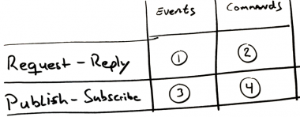
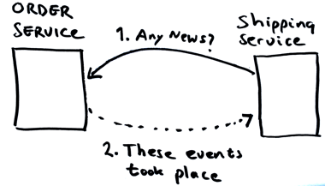
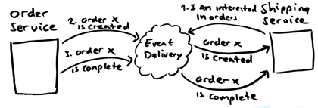
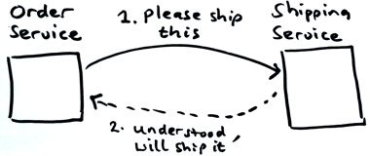
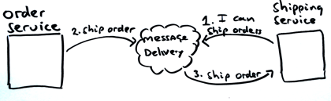
Coupling Versus Autonomy
https://www.voxxed.com/blog/2015/04/coupling-versus-autonomy-in-microservices/

Slide 22
Closure
In programming languages, closures (also lexical closures or function closures) are a technique for implementing lexically scoped name binding in languages with first-class functions. Operationally, a closure is a record storing a function together with an environment: a mapping associating each free variable of the function (variables that are used locally, but defined in an enclosing scope) with the value or storage location to which the name was bound when the closure was created. A closure—unlike a plain function—allows the function to access those captured variables through the closure's reference to them, even when the function is invoked outside their scope.
https://en.wikipedia.org/wiki/Closure_(computer_programming)
Notes:
对象是数据中以方法的形式包含了过程，闭包是在过程中以环境的形式包含了数据

Slide 23
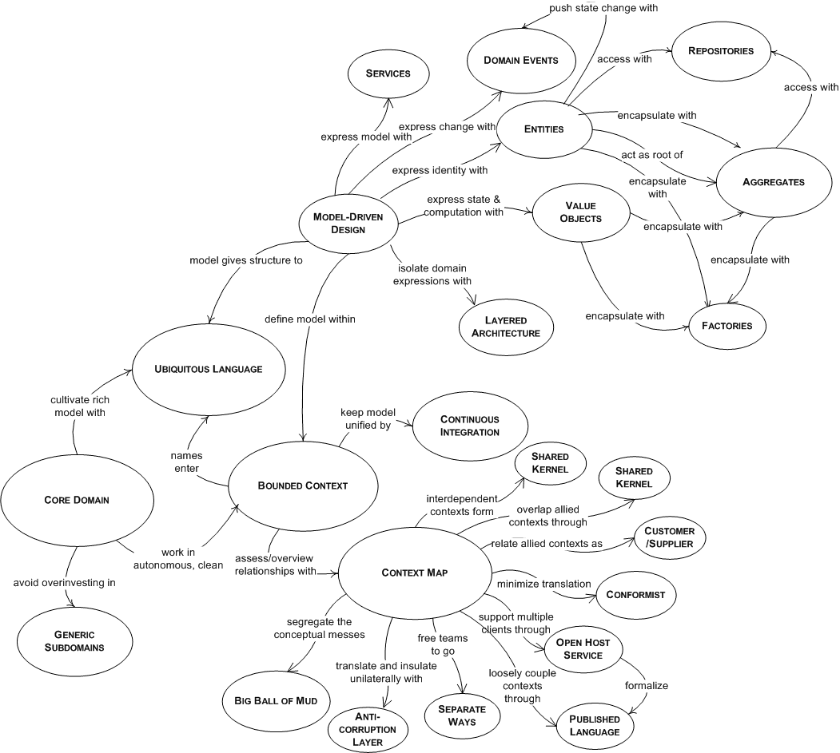
Domain Driven Design
http://dddcommunity.org/book/evans_2003/

Slide 24
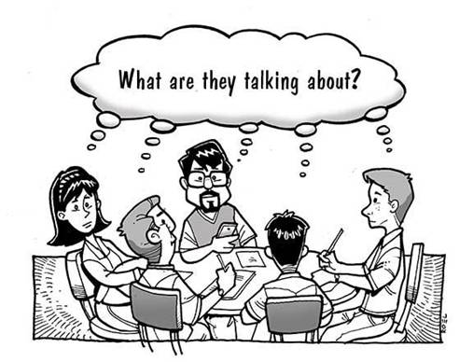
Ubiquitous Language
Programmers should speak the language of domain experts to avoid miscommunication, delays, and errors. To avoid mental translation between domain language and code, design your software to use the language of the domain. Reflect in code how users of the software think and speak about their work. One powerful approach is to create a domain model.
The ubiquitous language is a living language. Domain experts influence design and code and the issues discovered while coding influence domain experts. When you discover discrepancies, it's an opportunity for conversation and joint discovery. Then update your design to reflect the results.
http://www.jamesshore.com/Agile-Book/ubiquitous_language.html

Slide 25
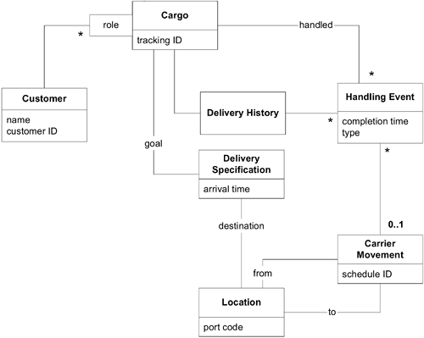
Domain model
In software engineering a domain model is a conceptual model of the domain that incorporates both behavior and data.
https://en.wikipedia.org/wiki/Domain_model
Domain
A domain is a field of study that defines a set of common requirements, terminology, and functionality for any software program constructed to solve a problem in the area of computer programming, known as domain engineering.
https://en.wikipedia.org/wiki/Domain_(software_engineering)

Slide 26
https://en.wikipedia.org/wiki/Alan_Cooper
Notes:
愿望，能力，可行性

Slide 27

Domain-specific language
A domain-specific language (DSL) is a computer language specialized to a particular application domain. This is in contrast to a general-purpose language (GPL), which is broadly applicable across domains, and lacks specialized features for a particular domain.
https://en.wikipedia.org/wiki/Domain-specific_language
Notes:
Html, css, jade, Expression, make file, spring xml,

Slide 28

Metaprogramming
Metaprogramming is the writing of computer programs with the ability to treat programs as their data. It means that a program could be designed to read, generate, analyse or transform other programs, and even modify itself while running. In some cases, this allows programmers to minimize the number of lines of code to express a solution (hence reducing development time), or it gives programs greater flexibility to efficiently handle new situations without recompilation.
https://en.wikipedia.org/wiki/Metaprogramming

Slide 29
“Talk is cheap. Show me the code.”

