Slide 1
Integer Division

Slide 2
Purpose
Verify that the result of the division is correct using a multiply-and-shift operation, representing the divisor with
q+ 1 + floor(log2(b))
bits instead of sizeof(type(a)) bits, where
sizeof(type(a)) ≤ q ≤ nBits(a)
And nBits(x) computes the minimum number of bits needed to represent x

Slide 3
Multiply-and-shift
You can see the division as
a/d = (a/2^{n})*(2^{n}/d)= (a*m)>> shift_factor
n ≤ shift_factor
If you want a more precise result (i.e. more digits) you must increase n

Slide 4
The GCC implementation
n = 32 bits
shift_factor = n + post_shift
0 ≤ post_shift ≤ nBits(d)
Apply pre_shift in the case d is a multiple of 2 before m is computed.
a/(2^{pre_shift}d) = (a>>pre_shift)/d = a’/d
Some pathological cases (such as d=7, 14 and others) requires n+1 bits to obtain a correct result. GCC solves this issue considering the x<=n least significant bits of m (ml), setting a flag (mh) to 1 and applying a sort of rounding.

Slide 5
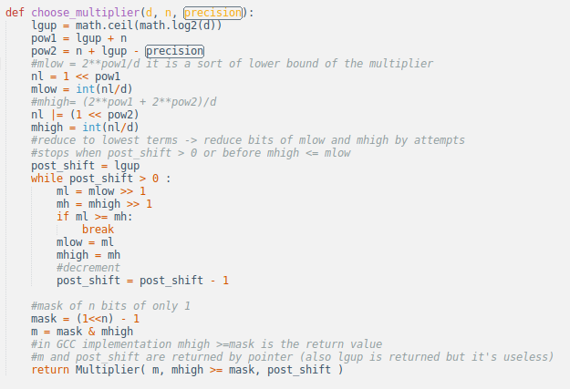
How to choose m

Slide 6
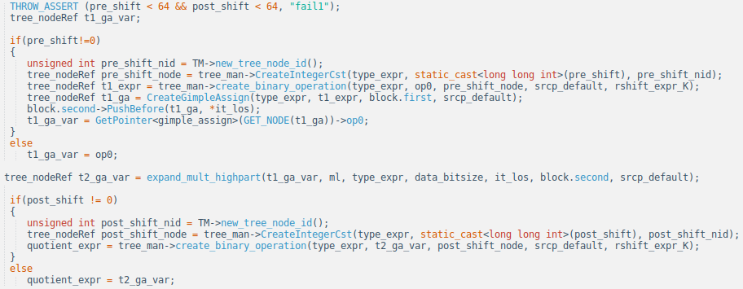
The simple case (mh=0)

Slide 7
The simple case in a better point of view
t1 = a >> pre_shift
t2 = (t1 * ml) >> n
result = t2 >> post_shift

Slide 8
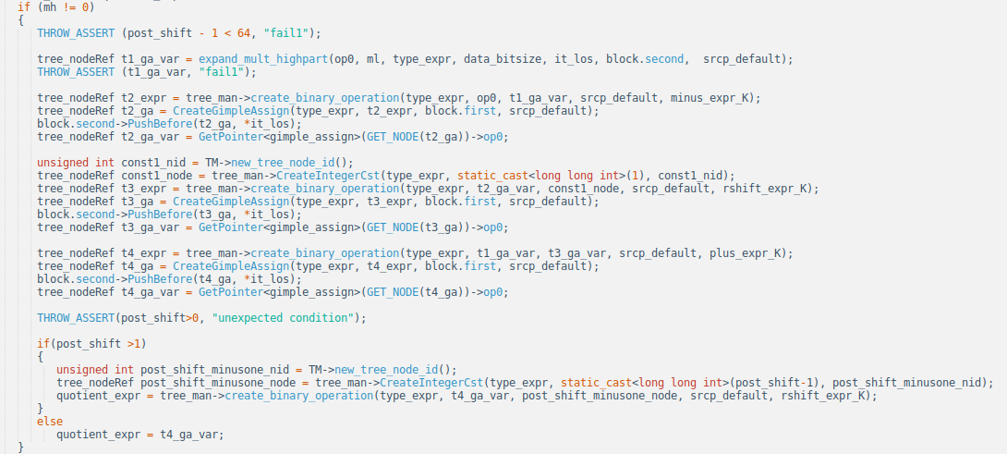
When we employ n+1 bits (mh=1)

Slide 9
n+1 bits case (mh=1)
t1 = (a*ml) >> n
t2 = a - t1
t3 = t2 >> 1
t4 = t1 + t3
result = t4 >> (post_shift - 1)
In this case post_shift >= 1

Slide 10
The improvement
Make
n = q + 1 + floor(log2(b))
In this way it is possible to represent m with few bits respect to the previous implementation. We apply this technique beacuse we’re considering integer division (we don’t care about the decimal part).

Slide 11
What we want and what we have
a is a variable, so we cannot always know nBits(a) at compile time (this is the reason why we use q and not nBits(a) in the formula ). To solve this issue sizeof(m) is computed as
min( sizeof(type(a)), minBits )
Where minBits = q + 1 + floor(log2(b)). In this way we ensure that we use the minimum number of bits as much as we can.

Slide 12
Case 1: 15/3
Case 1: we can’t know nBits(15) at compile time, so we consider n=32
m=2863311531₁₀
10101010101010101010101010101011₂
Its size is 32 bits, so mh=0, m=ml
post_shift = 1
We’re in the simple case

Slide 13
Case 1: Result Computation
pre_shift=0 because 3 is not a multiple of 2.
t1 = a >> pre_shift = 15 >> 0 = 15
t2 = (t1 * ml) >> n = (15*2863311531)>>32 = 10
result = t2 >> post_shift = 10 >> 1 = 5
Compute 15*2863311531 can be painful is the width of the operators is limited.

Slide 14
Case 2: 45/7
Case 2: we know that nBits(45)=6 bits. This can be done under certain conditions at compile time.
n = 6 + 1 + nBits(7) = 6 + 1 + 3 = 10
ml=147₁₀=10010011₂ (8 bits are required)
mh =1, post_shift = 3

Slide 15
Case 2: Result computation
t1 = (a*ml) >> n = (45 * 147) >> 10 = 6
t2 = a - t1 = 45 - 6 = 39
t3 = t2 >> 1 = 39 >> 1 = 19
t4 = t1 + t3 = 6 + 19 = 25
result = t4 >> (post_shift – 1) =
25 >> 2 = 6

