Slide 1
Multiplication by rational constants

Slide 2
Algorithm description
Input: a small periodic constant a/b, a variable X and the precision w₀ of the result
Output: the result of the multiplication of the variable X for the constant a/b
How: using shift-and-add tree the multiplication can be done optimally

Slide 3
Periodic representation
Transform a/b into a tuple of values:
<e, h, p, s>
Where
e is the scaling factor exponent, or shift (a/b = x/y*2e)
h the header, the integer part of the variable (a/b = h + c/d where c/d < 1)
p the periodic pattern (1/3 = 0.(3)∞ where p = 3)
s the period size (in bits) of p

Slide 4
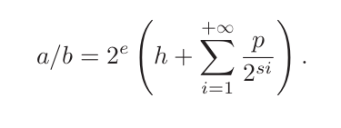
Periodic representation
Using <e, h, p, s>, we can obtain a/b in this way:
Note that a/b = 2e * (h + c/d)
NB: simplify fraction before generating the tuple

Slide 5
Example
70/100 has to be first simplified.
70/100 → 7/10
Then the tuple must be computed
<e = -1, h = 0, p = 6, s = 4>
7/10 = 2⁻¹*(7/5) = 2⁻¹*(0,(0110₂)∞)
Note that 0110₂ = 6₁₀ = p

Slide 6

Building the shift-and-add tree
To properly compute the multiplication, we have to consider w₀ bits of the constant
Then, we can compute approximations π_{i} of c/d (seen in the previous slide)
First we compute

Slide 7
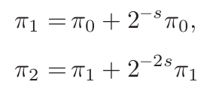

Building the shift-and-add tree
Then we compute better approximations
And in general

Slide 8

Building the shift-and-add tree
The computation of π_{i} can stop when
2^{i} * s < w₀ ⩽ 2^{i+1} * s
In this case we can compute j where 0 ⩽ j ⩽ i and being the smallest integer such that (2^{i} + 2^{j}) * s ⩾ w₀ – w_{h} (w_{h} being the size of the header h)
In this way, we can use an already computed approximation that is π_{j} to compute the last approximation

Slide 9
Building the shift-and-add tree
If h = 0, f is the final result.
Otherwise, we have to add h * x to f.
r = h * x + f

Slide 10
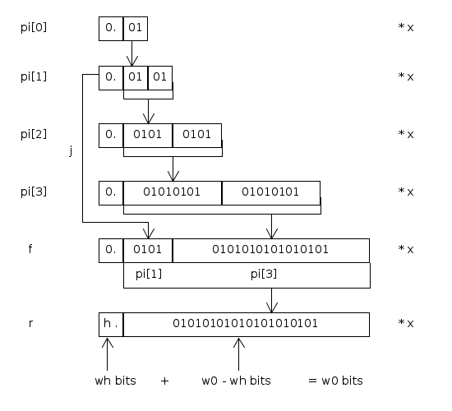
Example: x * 1/3 with w₀ = 20

