Slide 1
Steps
Multiplication detection: find mults that satisfy contraints (i.e. small rational constants x variables) in the IR
Computation: compute the equivalent code that employs the algorithm described in the paper
Replacement: substitute the code in the IR
Verification during development

Slide 2
Testing
Compare the performance of the “standard” implementation with respect to the shift-and-add implementation
If the shift-and-add algorithm works properly, the multiplication for small constants should be faster using that algorithm

Slide 3
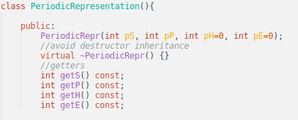
Implementation
PeriodicRepresentation (a class or a struct). Contains the tuple <e,h,p,s>

Slide 4
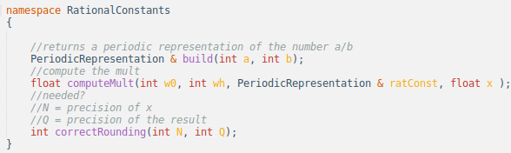
Implementation
Namespace RationalConstants

