Slide 1
Integration
Testing Plan

Slide 2
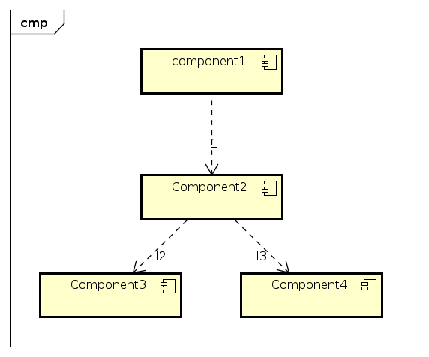
A Small Example

Slide 3
Strategy
Bottom-up
We assume that GoogleMapsService works properly

Slide 4
The system

Slide 5
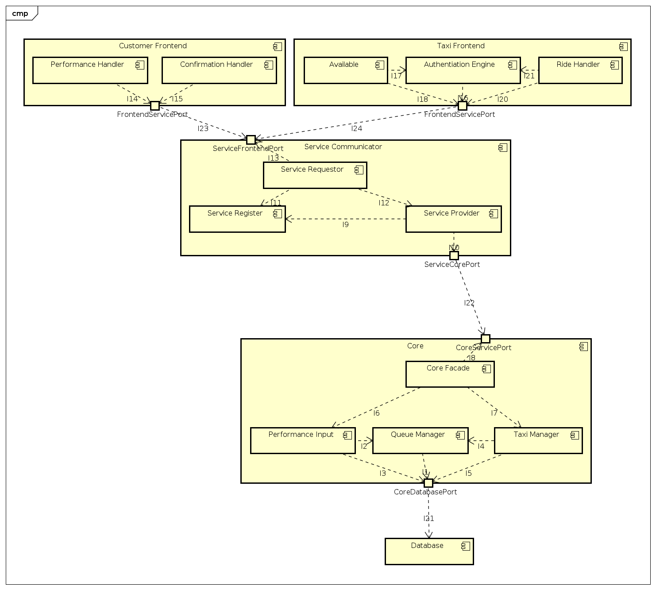

Slide 6
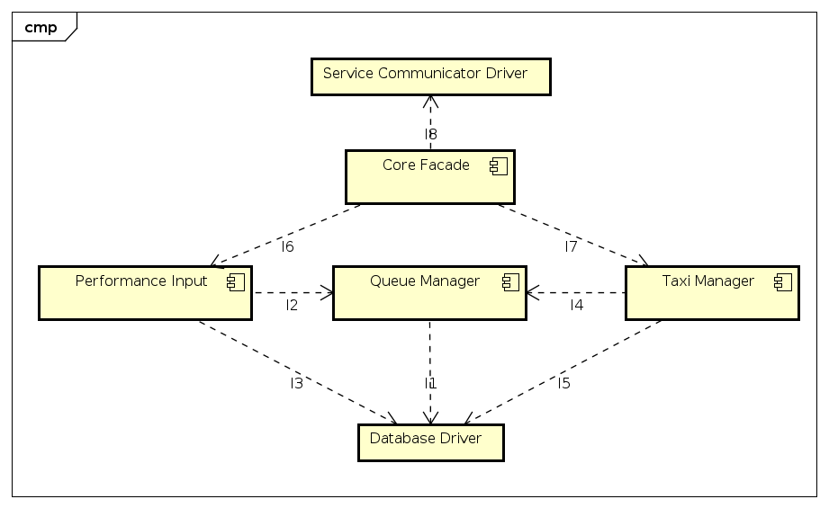
TP1 - Core

Slide 7
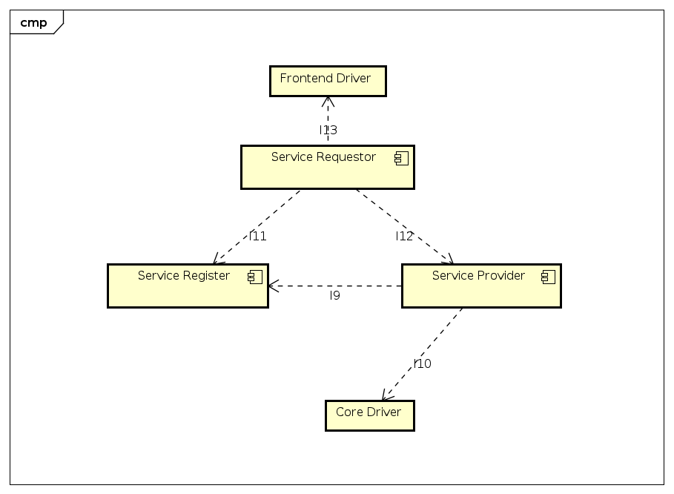
TP2 - Service Communicator

Slide 8
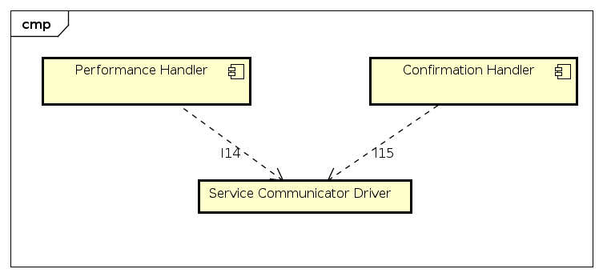
TP3 - Customer Frontend

Slide 9
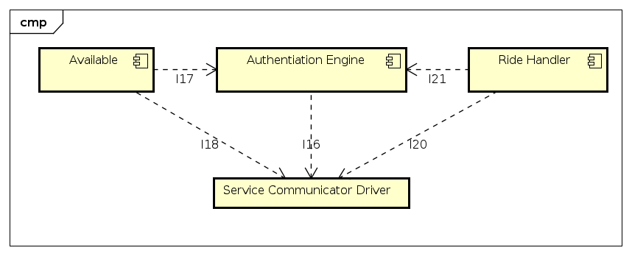
TP4 - Taxi Frontend

Slide 10
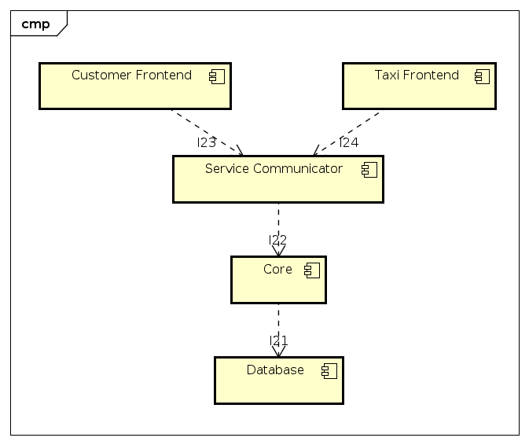
TP5 - Final Integration

Slide 11
Strategy
Test in parallel TP1, TP2, TP3, TP4 using stubs
Test TP5

Slide 12
Stubs
Frontend driver: it simulates ServiceFrontendPort from the Service Communicator point of view.
Service Core driver: it simulates CoreServicePort from the Core point of view.
Service Frontend driver: it simulates FrontendServicePort from the Frontend point of view.
Core driver: it simulates ServiceCorePort from the Core point of view.
Database driver: it simulates CoreDatabasePort from the Core point of view.

