Slide 1
Design Document

Slide 2
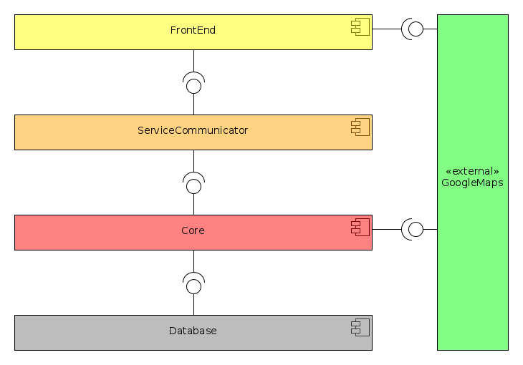
Architecture

Slide 3
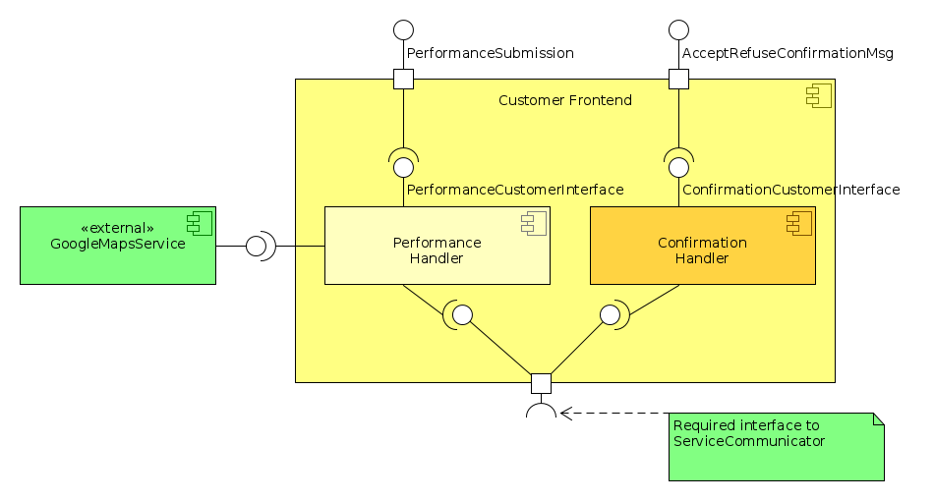
Customer Frontend

Slide 4
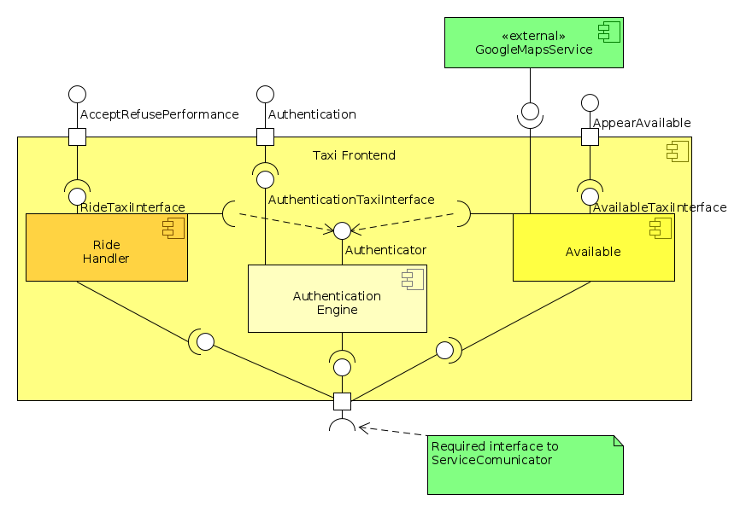
Taxi Frontend

Slide 5
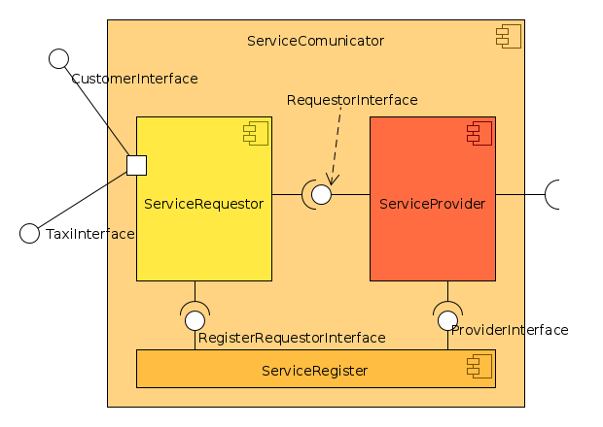
Service Communicator

Slide 6
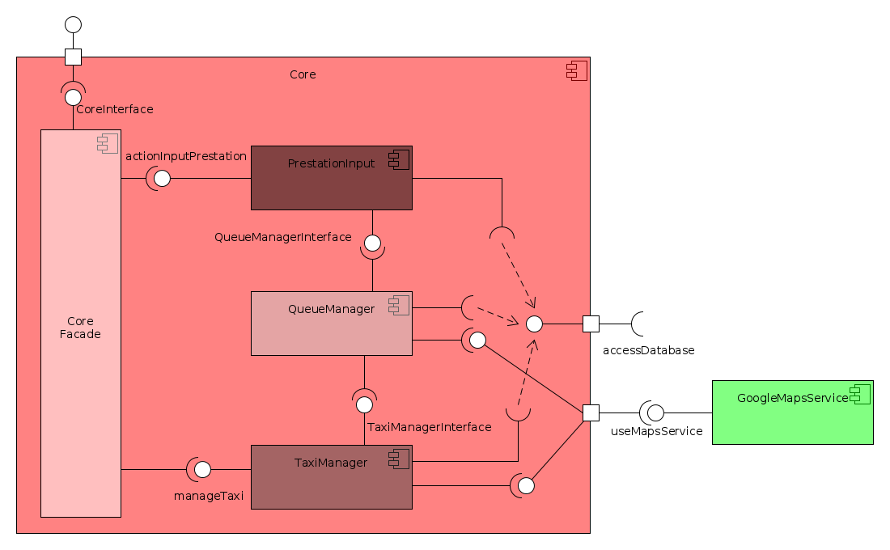
Core

Slide 7
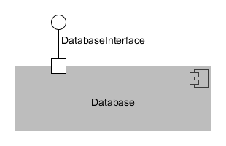
Database - Tables
TAXIDRIVER( ID, Name, Surname, BirthDate, Address, LicenseID, TaxiPlate, CurrentZone )
ZONE( ZoneID, Width, Height )
PERFORMANCE( TaxiDriverID, Date, StartingTime, FinishTime, StartingZone, FinishZone )

Slide 8
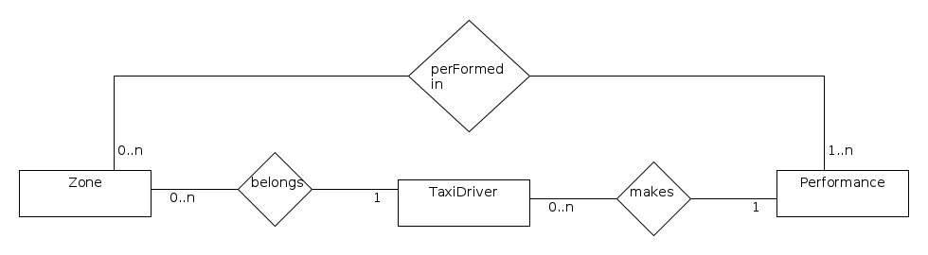
Database – ER diagram

Slide 9
Deployment

Slide 10
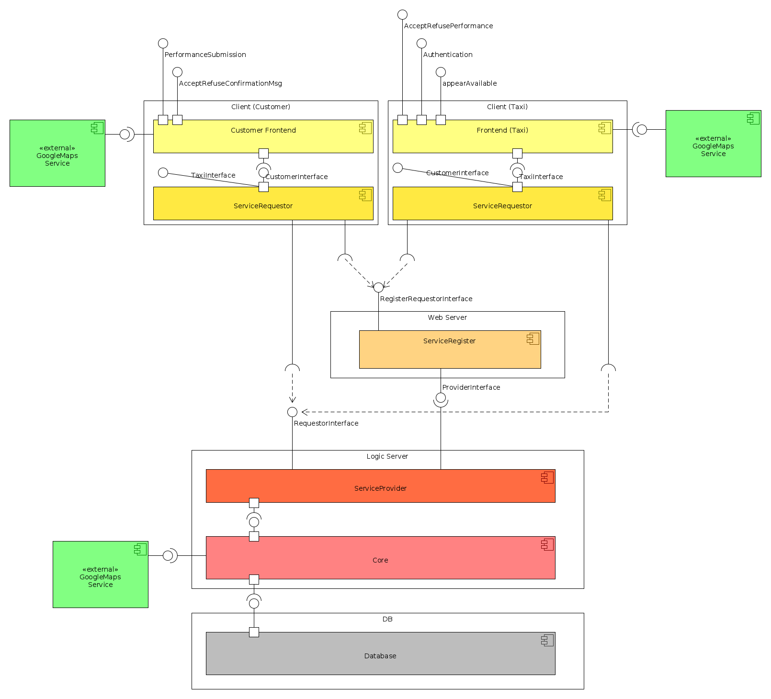

Slide 11
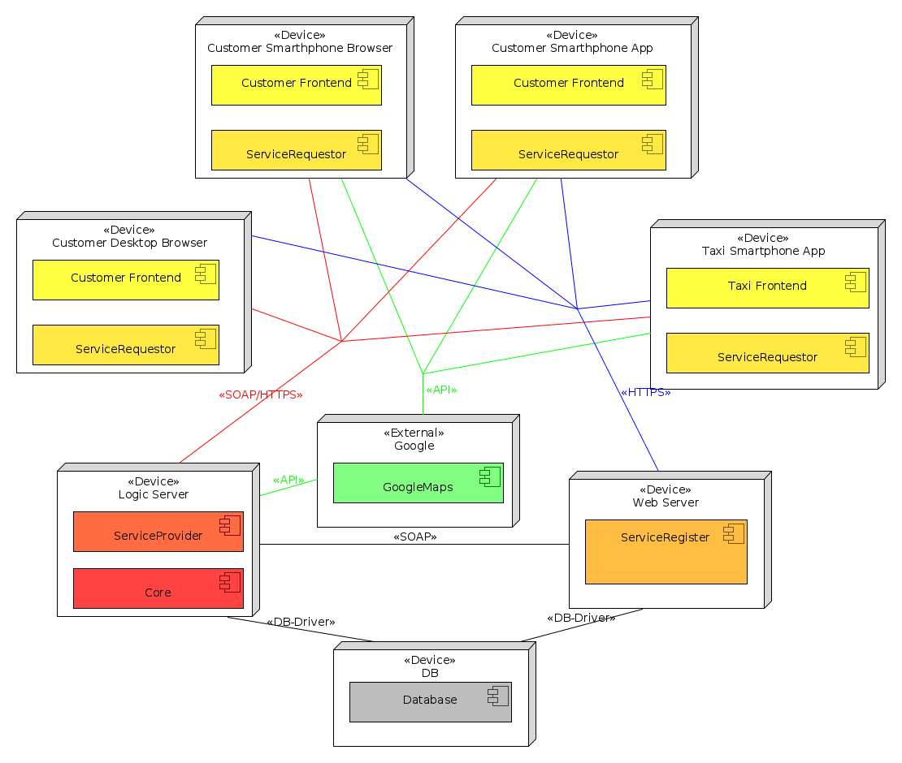
Deployment – How do devices communicate?

Slide 12
Deployment – More physical

Slide 13
Runtime

Slide 14
Request for a performance

Slide 15
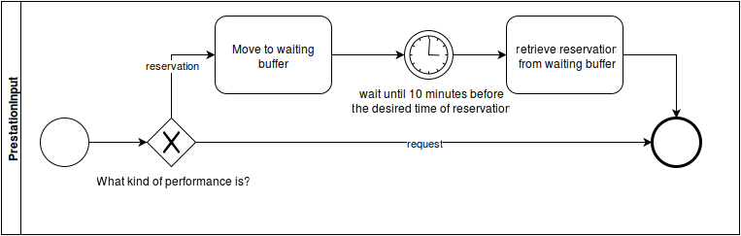
Core Performance Handling

Slide 16
Queue Algorithm

Slide 17
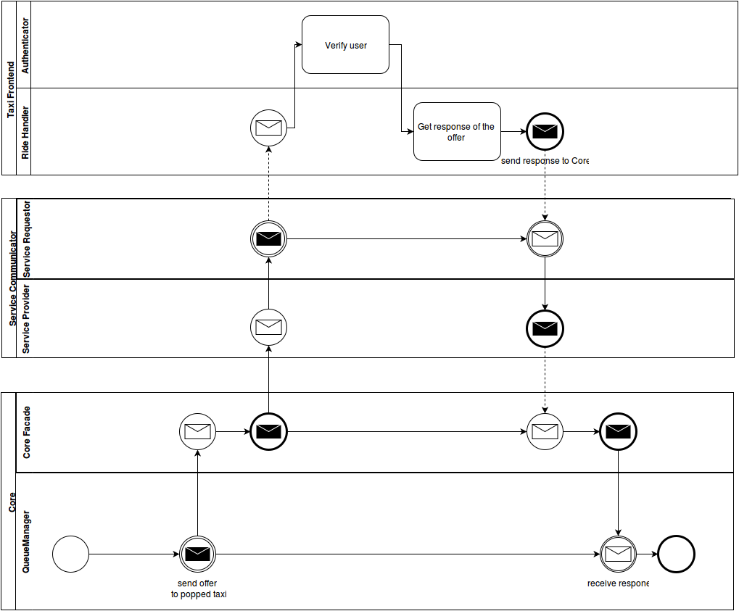
Contact Selected Taxi

Slide 18
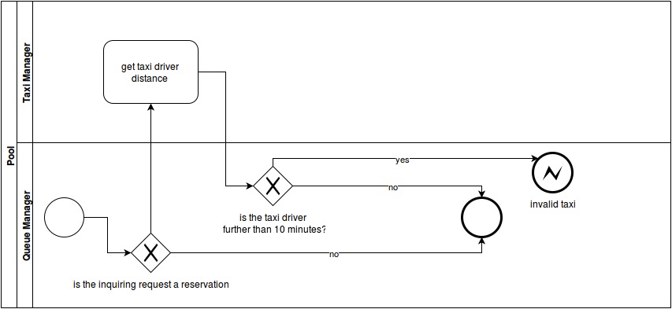
Check if taxi is valid for a performance

Slide 19
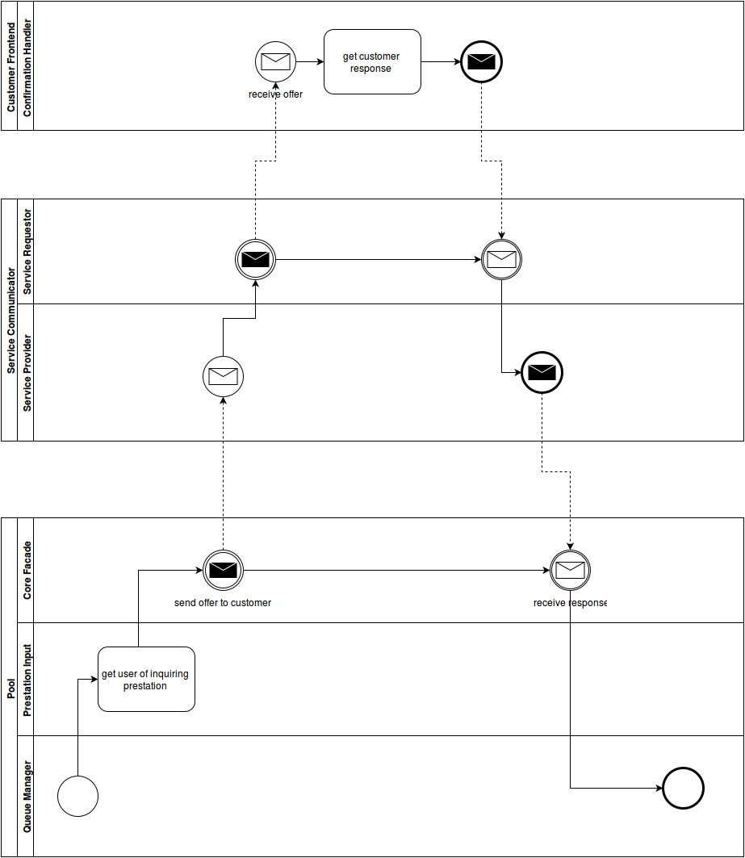
Send Taxi out of the zone offer

Slide 20
Taxi driver authentication

Slide 21
Taxi available operation (change status)

Slide 22
Change Taxi Zone

Slide 23
Close Ride

Slide 24
Service List Retrievement

Slide 25
Start Ride

Slide 26
Component
Interfaces

Slide 27
CustomerInterface
void(AbstractPerformance pre): sending the passed performance to Core using ServiceCommunicator
void notify(Message msg): notify something to Customer Frontend using the passed msg.
void notifyDecision(DecoratedAbstractPerformance pre, CustomerResponse resp): notify Core about his decision on pre with resp. this method is used for accepting or refusing a performance when a taxi is contacted out of the zone of the customer. DecoratedAbstracPerformance contains infos about the inquiring performance plus infos about taxi (id of taxi, ETA).

Slide 28
TaxiInterface
void sendTaxiResponse(Taxi taxi,Abstractperformance pre, TaxiResponse resp): notify Core about his decision on pre with resp.
void login(Taxi taxi,string id, string hashPsw): log in the taxi driver into the system using the passed id and the hash of the password inserted by the driver.
void setAvailable(Taxi taxi, bool available): set the status of the inquiring taxi available or not as imposed as passed available variable imposes.
void notify(Message msg): notify something to Taxi Frontend using the passed msg

Slide 29
Component Interfaces
RegisterRequestorInterface
ServiceRegistry retrieveServiceRegistry(User user): retrieve a ServiceRegistry. the object returned will depend on the type of user that makes the request. A customer’s service registry will be different than a taxi driver’s one becuase they can access to different services.
ProviderInterface
void updateServiceRegistry(GlobalServiceRegistry newRegistry): replace the current serviceRegistry instance the the new passed one.

Slide 30
CoreInterface
void changeTaxiStatus(Taxi taxi, bool available): ask Core to change the status of the inquiring taxi as available variable imposes.
void login(Taxi taxi,string id, string hashPsw): validate login in the Core of the passed taxi with the passed id and hashPsw.
void notifyUser(User user, Message msg): notify a generic user with msg.
void contactTaxi(Taxi taxi, AbstractPerformance pre): contact taxi asking him if he wants to accept pre and wait for his response.
void forwardPerformanceToCore(AbstractPerformance pre): send pre to Core with the purpose of handling it.

Slide 31
Selected Architectural Styles
Client-Server
Layers
Service-Oriented
Messages: Point-to-Point

Slide 32
Requirements Traceability (1)
Allow customers to make a reservation → Request for a performance (Runtime, handle a reservation)
Allow customers to make a request → Request for a performance (Runtime, handle a request)
Allow customers to use the system via the web-app version → Deployment view, web-app is available
Allow customers to use the system via the smartphone app version → Deployment view, smartphone-app is available

Slide 33
Requirement Traceability (2)
Guarantee a fair management of taxi queues for each taxi zone → Queue Algorithm
Allow taxi drivers to use a mobile application to access to the system → Taxi drivers use smartphone -app
Allow taxi drivers to accept/refuse a request → Use Taxi Frontend component
The service must be extendible → SOA Architecture + Layers

