Slide 1
Project Plan

Slide 2
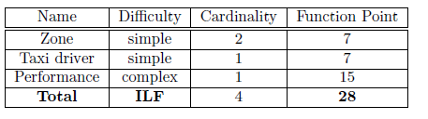

Function Points
Internal Logic File
External Interface File

Slide 3
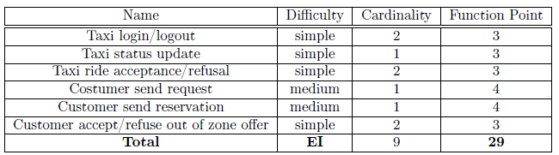
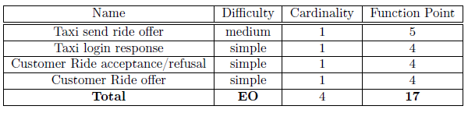
Function Points
External Input
External Output

Slide 4
Function Points
External Inquiries
The system is simple, so inquiries do not exist.
EIN = 0
Unadjusted Function Points
UFP = ILF + EIF + EI + EO + EIN = 28 + 10 + 29 + 17 + 0 = 84

Slide 5
Cocomo
Source lines of code
We suppose that the software will be written using a high level language like J2EE.
SLOC = 46 * UFP = 46 * 84 = 3864 SLOC = 3,864 KSLOC
Effort
The estimated effort depends on nominal cost drivers and scale drivers. Thus, the EAF factor will be 1 and The E factor will be equal to 1.0997.
effort = 2,94 * EAF * KSLOCE = 2,94 * 1 * 3,864^{1,0997} ≈ 13 people/month

Slide 6
Cocomo
Duration
duration = 3,67 * effort^{E} = 3,67 * 13^{0,3179} = 8,29 months
Number of people
Npeople = effort / duration = 13 / 8,29 = 1,57 people ≈ 2 people

Slide 7
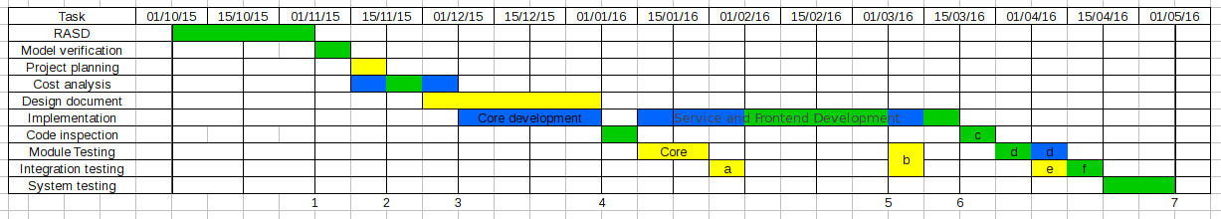
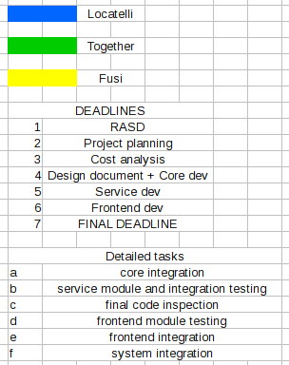
Project Schedule

Slide 8
Resource Allocation
The tasks are divided in the way that every member of the team has assigned the same amount of work.
Matteo M. Fusi: responsible of requirement analysis, model verification, project planning, design document and module & integration testing
Matteo Locatelli: responsible of cost analysis, implementation & development, code inspection and system testing.
Important tasks of the development such as the requirement analysis and the final system testing are executed by the entire team. Code inspection must also be executed together because different points of view are important.

Slide 9
Possible Risks
A change in the organization of the taxi service during the developing process, like the introduction or the deletion of a zone of the city. This issue can be resolved guaranteeing a flexible application that can be easily modified during the development process.
A change in the requirements after the RASD documente has been completed. This can cause a delay in the developing process, because the RASD must be modified, along with other documents or the code if the coding phase has already begun.
An inaccurate cost estimation, caused by the statistical nature of the FP and Cocomo II, that can’t provide an exact value of the costs that the application requires. This means that the actual costs could be smaller (this doesn’t represent a problem) or bigger, meaning that additional money has to be invested in the application development.
Problems with the testing and/or integration phase, this means that if one of these two steps show some error in the code, it has to be corrected and then tested and integrated againg, causing a delay in the development time.

Slide 10
Possible Risks
The maxmimum estimated delay in the process is 2 months; in the case of a delay another viable option is to release the application on the scheduled day without the reservation functionalities, that can be added later by means of an update.

