Slide 1
Requirement Analysis
Specication Document

Slide 2
Goals
Allow customers to make a reservation.
Allow customers to make a request.
Allow customers to use the system via the web-app version.
Allow customers to use the system via the smartphone app version.
Guarantee a fair management of taxi queues for each taxi zone.
Allow taxi drivers to use a mobile application to access to the system.
Allow taxi drivers to accept a request.
Allow taxi drivers to refuse a request.
The service must be extendible.

Slide 3
Domain Properties
The City is divided in taxi zones.
Zones are 2 km² wide.
The position of a taxi is known by receiving GPS coordinates from the smartphone that the taxi driver owns.
A taxi is associated to a zone if its location is inside the zone's boundaries.
Costumers don't lie about a request made, which means they are present at the location submitted when the taxi arrives.
Costumers use real information for making requests.

Slide 4
Assumptions
Taxi drivers are inserted in the system from the beginning. They don't need to make any kind of registration to the service. Credentials needed for log into the app are provided by sending an e-mail to them.
A taxi driver can only drive the taxi associated to him/her.
Every taxi driver should have installed the mytaxi application on their smartphone in order to detect the vehicle position and, so, assign him to a zone of the city.
We assume that taxi drivers will accept or refuse a request in an admissible time such as 1 minute.
We assume that the location where the service will be installed and set upis near the city in which it will be exploited.
A taxi can arrive at the origin of a reservation with a tolerance of 5 minutes, this mean 5 minutes before or after the scheduled time.
Every path contained in a single zone can be covered in at most 10 minutes.

Slide 5
Functional Requirements
To allow customers to make a request.
  A customer can make a request specifying his/her name and the origin of the ride.
    If the customer is using the smartphone app, he can also specify the origin of the ride using the GPS.
  When the request is accepted by a taxi driver a conrm message will sent to the customer.
    If an available taxi is found, the customer is notied with the code of the taxi and the estimated waiting time.
    If the available taxi is in a different zone from the one in which the customer is, when the passenger receives the confirmation he can decide to accept or refuse the ride.
To allow customers to make a reservation.
  A customer can make a reservation specifying the name, the origin and the destination of the ride and the hour he wants to make it.
  If the customer is using the smartphone app, he can also specify the origin of the ride using the GPS.
  The system will confirm the reservation to the customer.
  The system will automatically make a request 10 minutes before the time chosen by the customer.

Slide 6
Functional Requirements
To allow customers to use the system via web-app version.
  A customer can use the web-app version of the system which will allow him to access to every functionality of the system.
A customer can use the smartphone app version of the system which will allow him to access to every functionality of the system.
A customer can use the smartphone app version of the system which will allow him to access to every functionality of the system.
  When a taxi enters a zone, if it's available, it's added to the queue of that zone.
  When a taxi exits a zone, it is removed from the queue of that zone.
  If a taxi driver refuses a request from a customer, the taxi is moved to the last place of the queue.
  If there isn't any available taxi in the customer's zone or all the taxis in it refuse his request, the request will be forwarded to taxis in other zones.

Slide 7
Functional Requirements
Allow taxi drivers to use a mobile application to access to the system.
  Taxi drivers are given a code and a password, thanks to them they can log into the system.
  Using the app, taxi drivers can choose to appear available to make a ride.
  Taxi drivers can also decide to appear unavailable.
Allow taxi drivers to accept a request.
  Taxi drivers can accept a request from a customer.
Allow taxi drivers to refuse a request.
  Taxi drivers can refuse a request from a customer.
The service must be extendible.
  To guarantee programmatic interfaces to enable the development of additional services.

Slide 8
Non Functional Requirements
Same UX: The UX should be the same in every system in which the application is available. For example, the user interface should be the same in IOS and Android apps. A similar UX should be reproduced on the web-app if used by a desktop computer.
Acceptable performance: The system must maintain a reasonable time to manage information. Which means, the time of processing a request made by a customer (the time elapsed from the submission to the forwarding of the requesto to a taxi driver) should resolve in no more than 30 seconds. The same amount of time must not pass between the acceptance or rejection of the request and the arrival of the confirmation message to the customer.
Freeware: The application must be free to improve its spread.

Slide 9
Constraints
Internet connection is required for accessing the service.
The reservation must be made at least 2 hours before the time of the ride.
If a taxi is called for an out of the zone reservation he must be far at most 10 minutes from the starting point of the ride. In this way the taxi can arrive in time at the meeting point.
If the customer is using the system with the web-app version, the origin of the ride must be inserted manually because desktop PCs usually don't have a GPS system.
The GPS of the smartphone used by taxi drivers must be always turned on, in this way the system always is informed about the position of the taxis.

Slide 10
Other Constraints
Functional constraints
  All the rides must be stored by the system.
  A taxi cannot make multiple rides at the same time. So, the taxi driver cannot accept other requests while he/she's performing a ride.
Legal Constraints
  Taxis and taxi drivers are subjected to the actual law in the country where mytaxi is installed and used.
  Privacy of users is guaranteed by the law in the country where mytaxi is installed and used.
Software Constraints
  Software design of mytaxi will be affected by the language choosen for the application development.

Slide 11
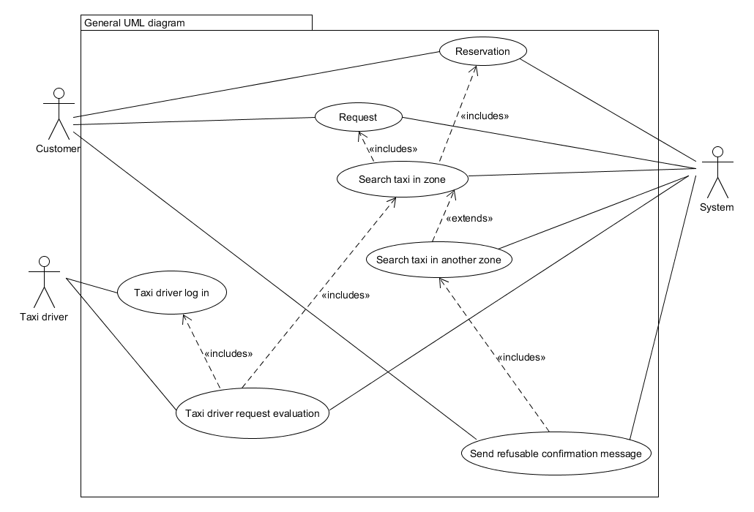
Use Cases

Slide 12
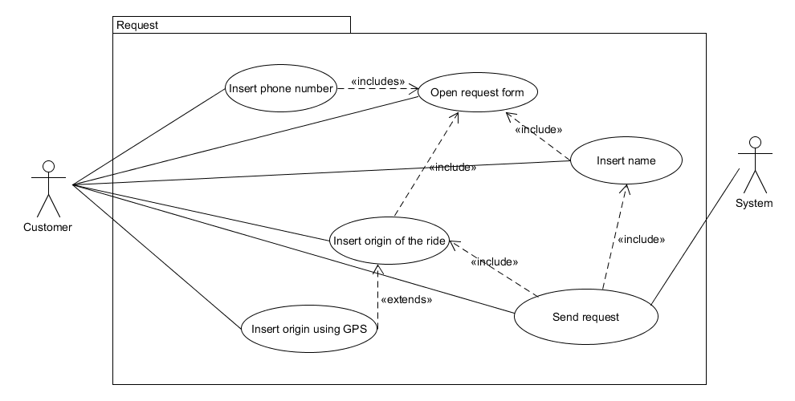
Use Cases

Slide 13
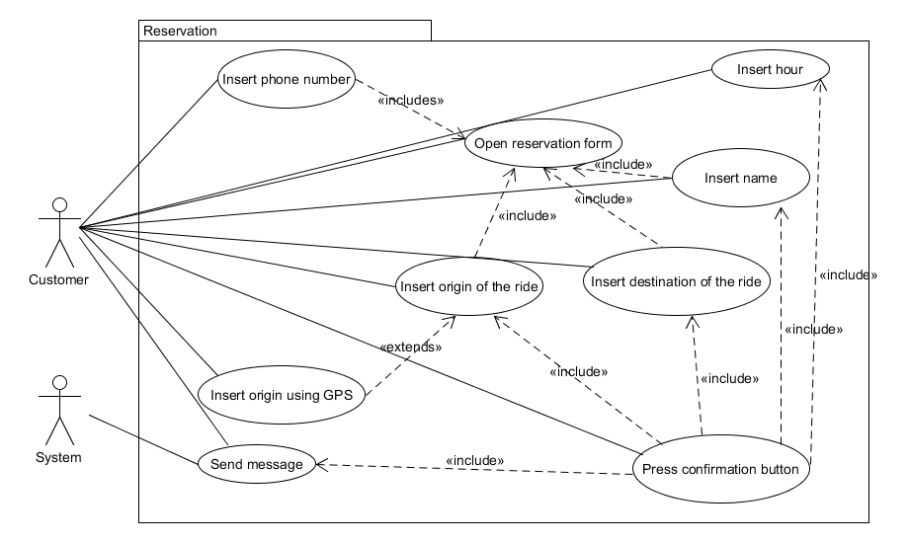
Use Cases

Slide 14
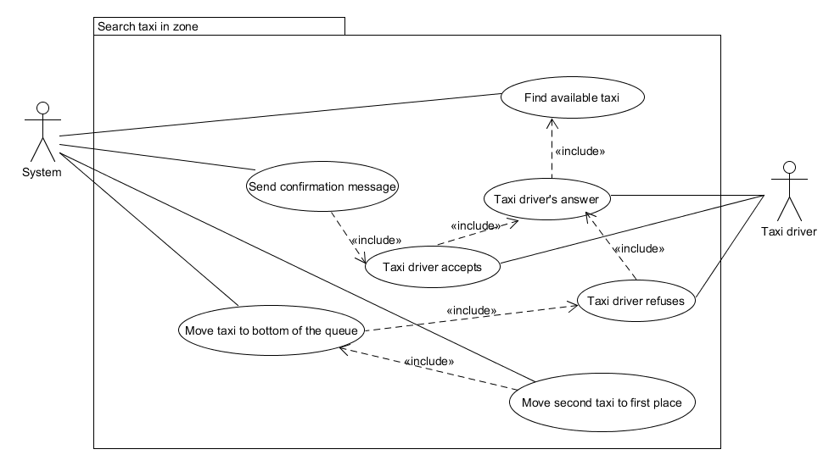
Use Cases

Slide 15
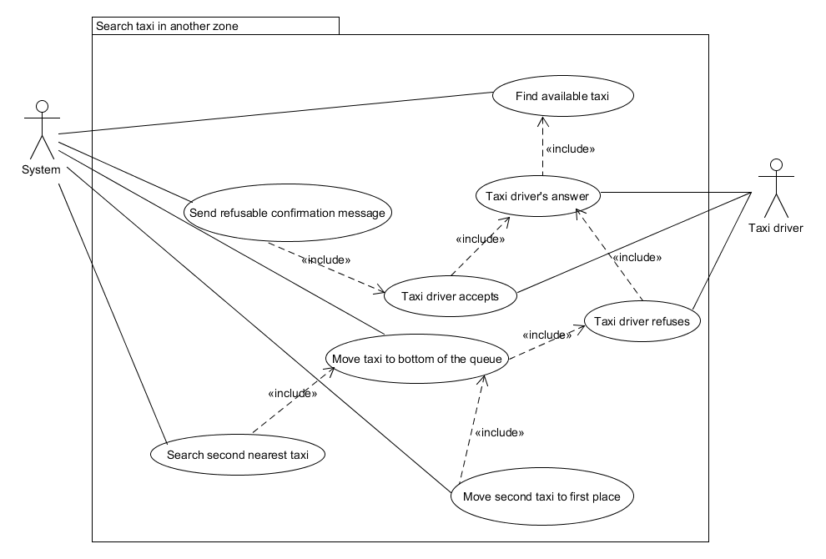
Use Cases

Slide 16
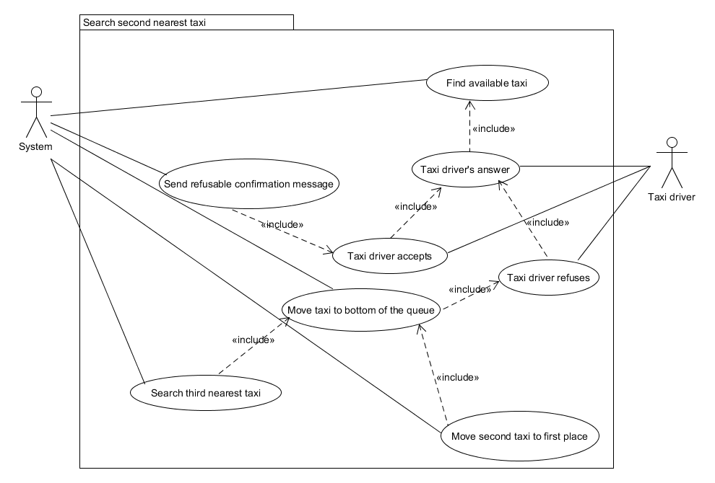
Use Cases

Slide 17
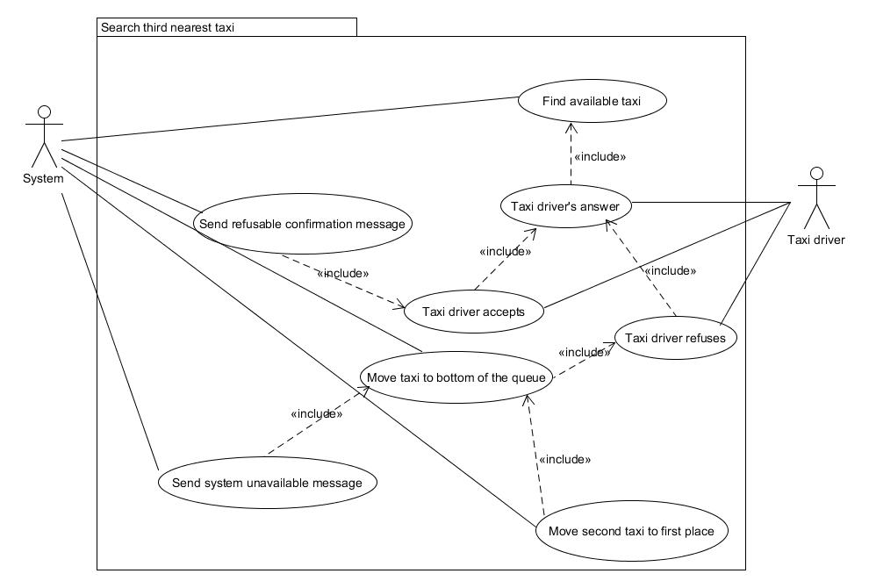
Use Cases

Slide 18
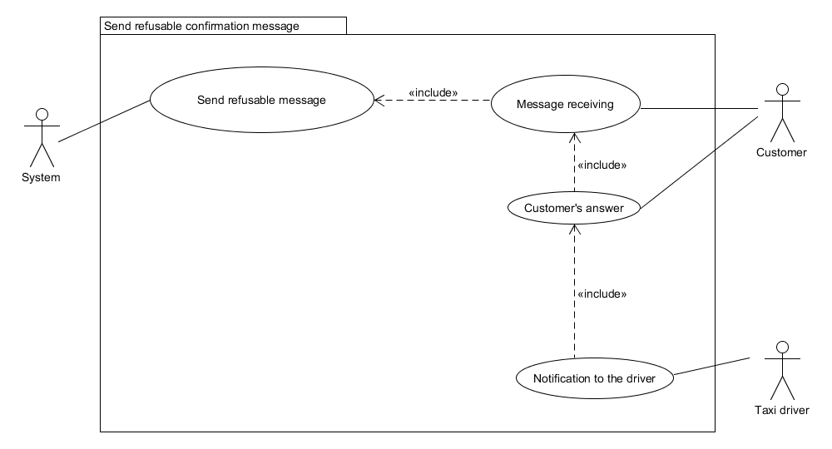
Use Cases

Slide 19
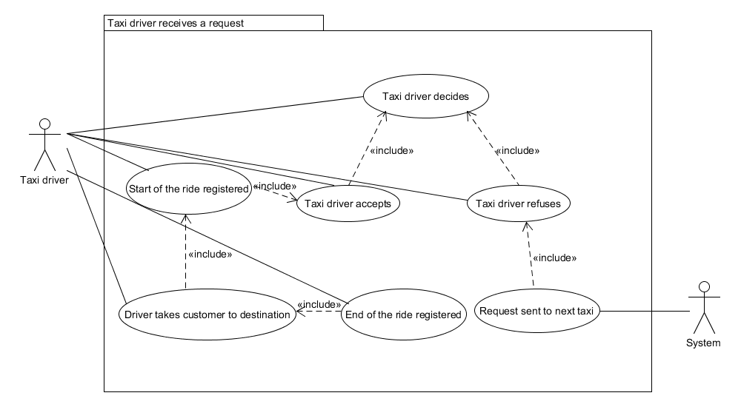
Use Cases

Slide 20
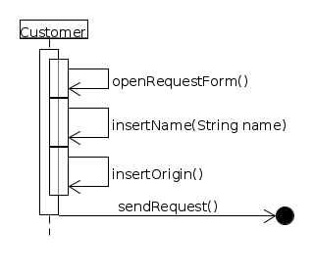
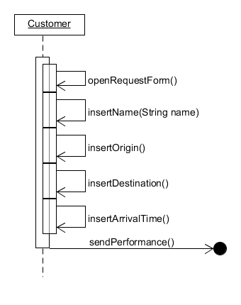
Customer Sequence Diagrams

Slide 21
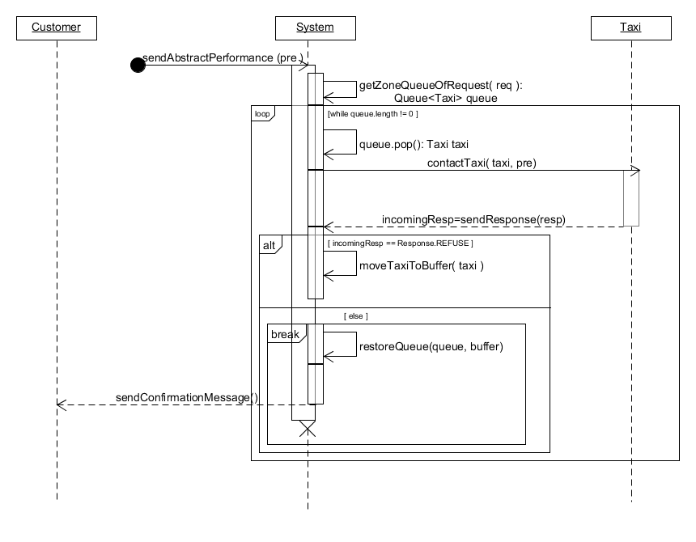
System Sequence Diagrams

Slide 22
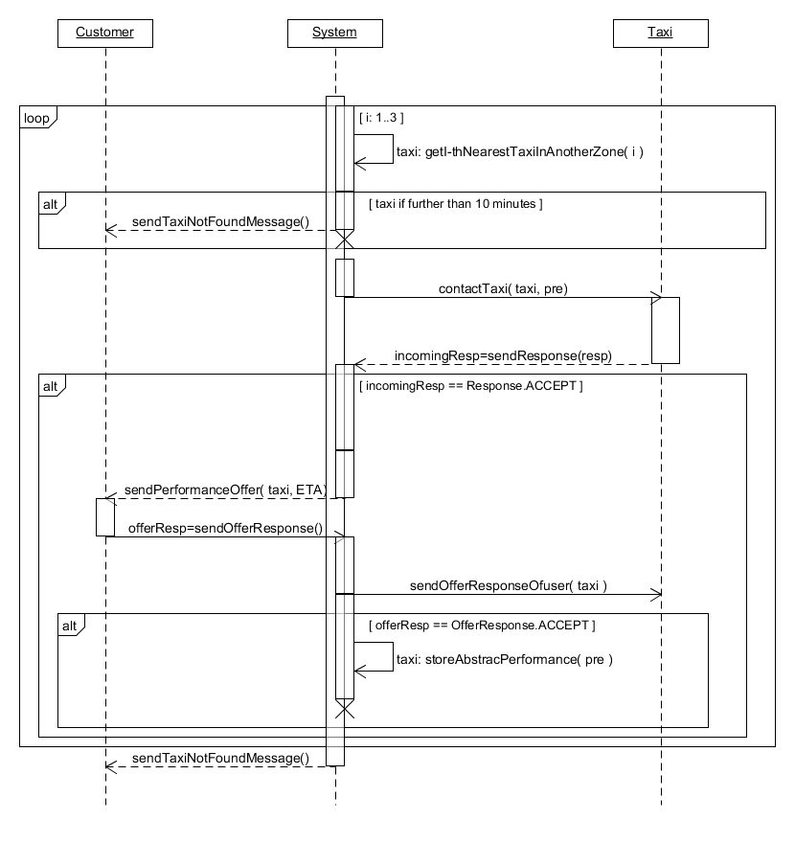
System Sequence Diagrams

Slide 23
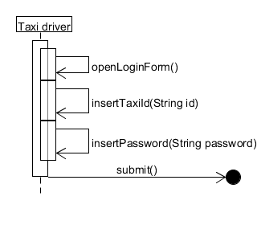
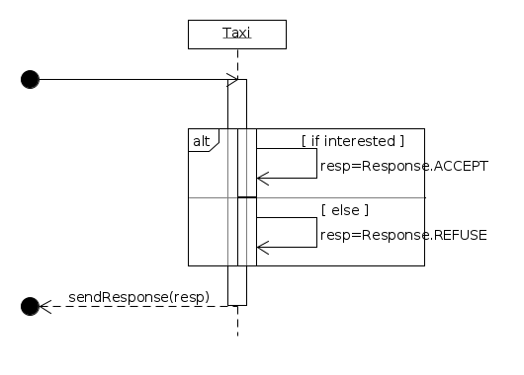
Taxi Driver Sequence Diagrams

Slide 24
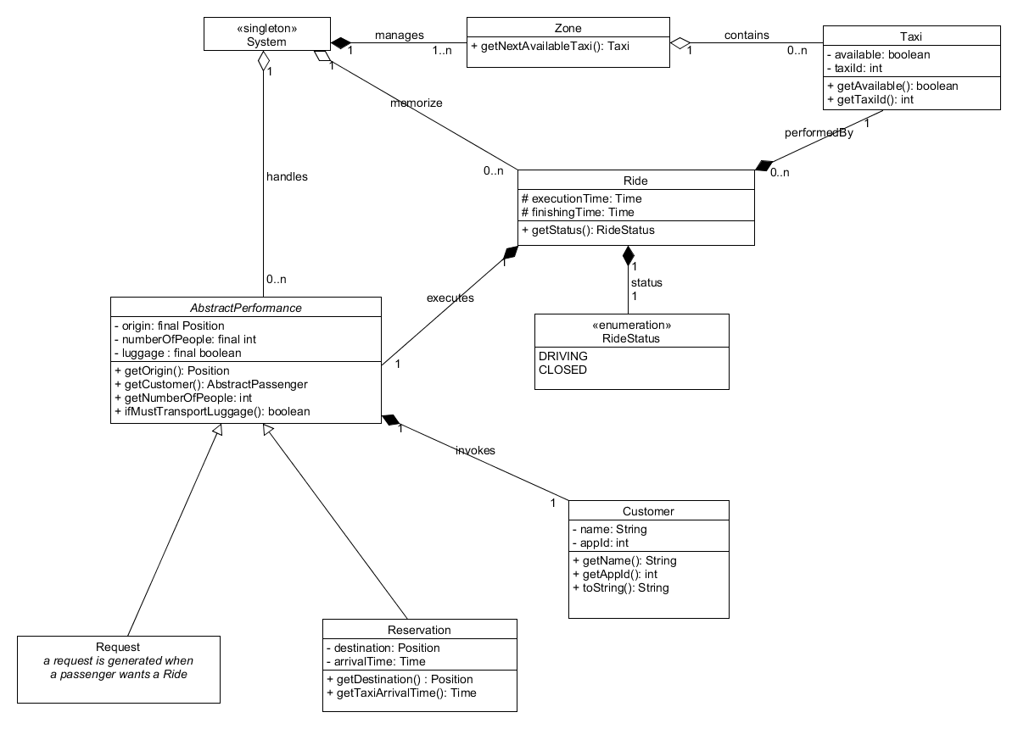
Class Diagram

Slide 25
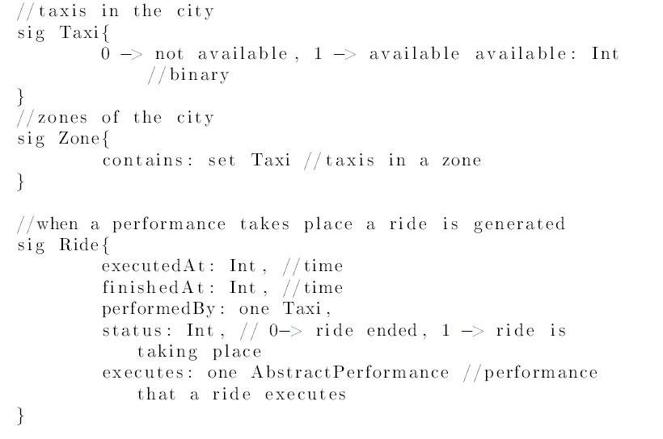
Alloy Signatures

Slide 26
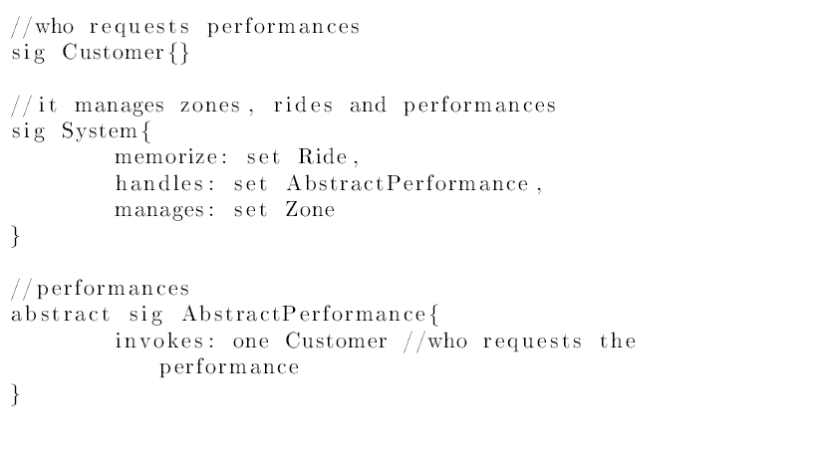
Alloy Signatures

Slide 27
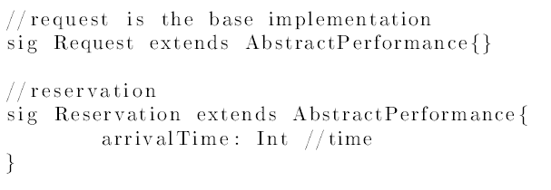
Alloy Signatures

Slide 28
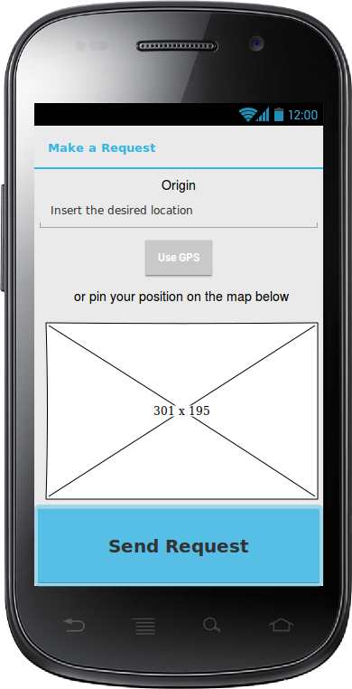
Request Mockup

Slide 29
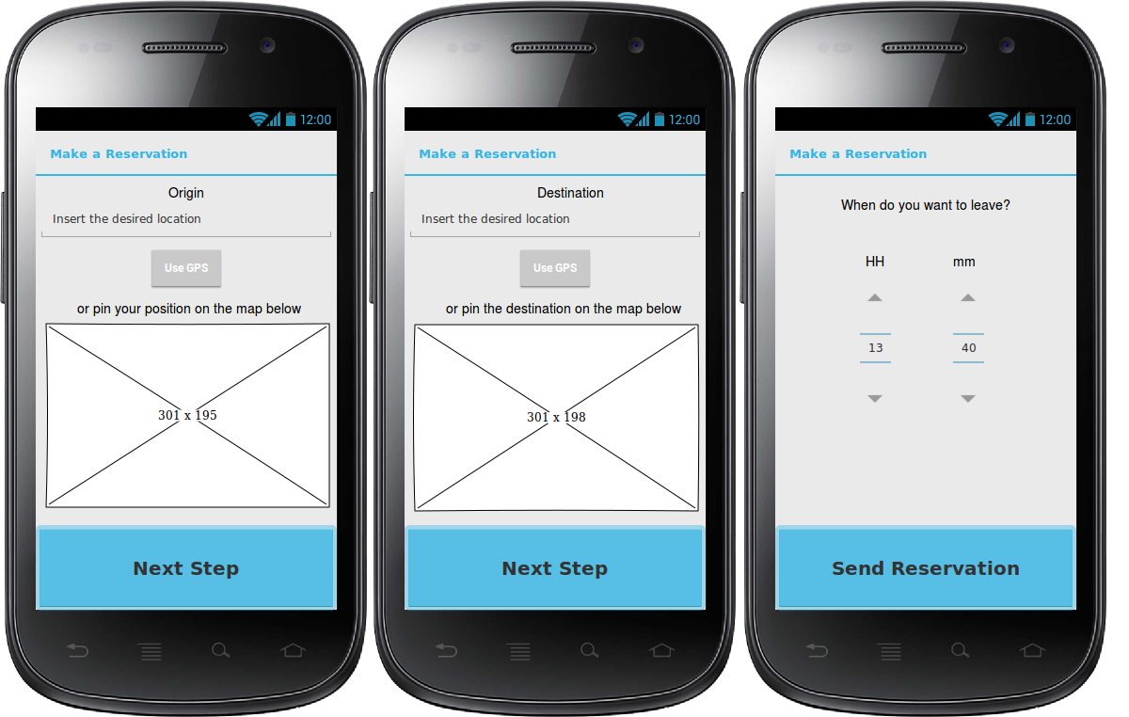
Reservation Mockups

Slide 30
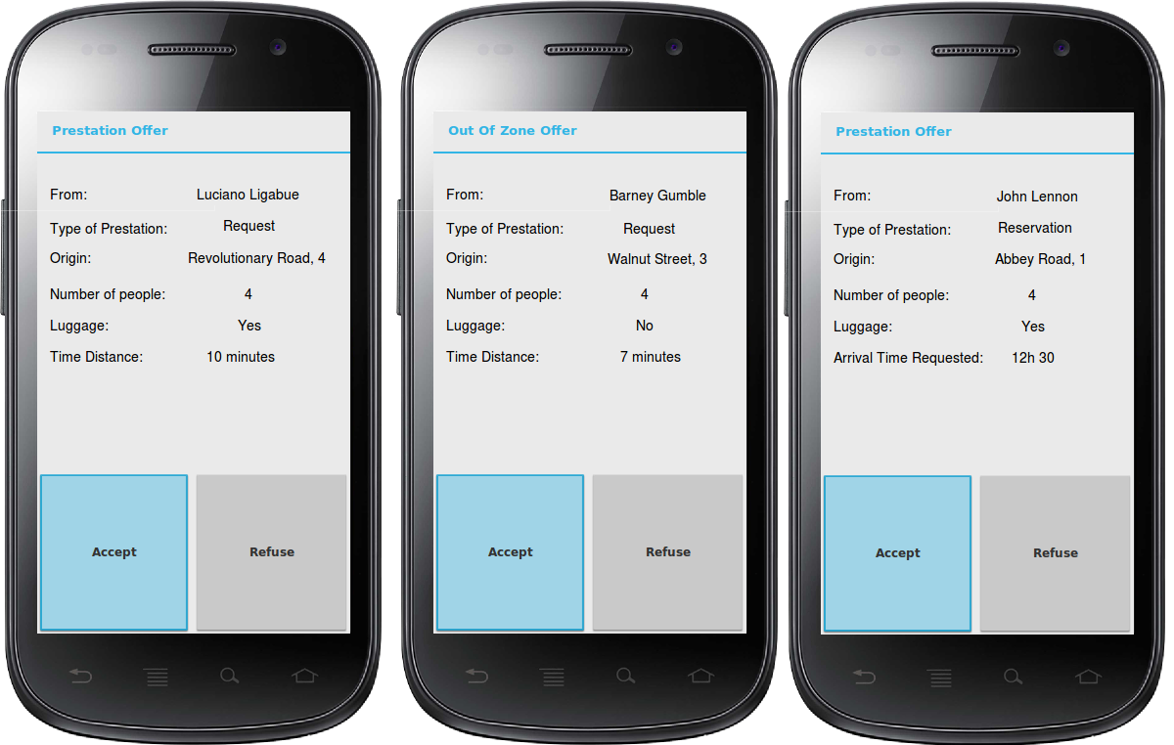
Taxi Requests Mockups

