Slide 1
Accelerating large graph algorithms
(From CUDA to OpenMP)
Matteo M. Fusi

Slide 2
Abstract
Study the paper “Accelerating large graph algorithms on the GPU using CUDA” by Pawan Harish and P. J. Narayanan analyzing algorithms and presented results to obtain an efficient and equivalent solution using OpenMP.
The authors of the article wanted to demonstrate the potential of GPUs (also cheap GPUs) for parallel algorithm implementation.
We adapt their work to an OpenMP implementation.

Slide 3
The graph and its implementation
G(V,E) where V are the vertices and E are the edges. If the weight of the edges must be taken into account the structure W of size E is considered.
Vertices are packed in an array V_ar of size |V|. Every Vertex has a pointer to its adjacency list.
Adjacency lists are packed in a large size array E_ar if size |E|.
Each vertex points to the starting position of its own adjacency list in E_ar

Slide 4
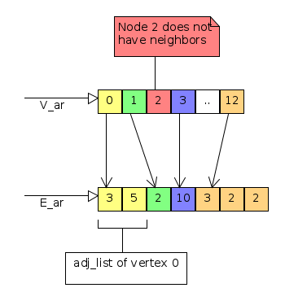

Slide 5
BFS – Breadth-First Search
Visit the graph by levels. Once a level is visited it is not visited again.
Support arrays (all of size |V|):
F is an array of boolean values.F[a]=true if the vertex a is in the frontier set at the moment, otherwise it is false.
V is an array of boolean values. V[a]=true if the node a had been visited, otherwise it is false.
C is an array of integer values. C[a] stores the minimal number of edges of each vertex from the source vertex S to a.
We exploit parallelism when we update F, V and C

Slide 6
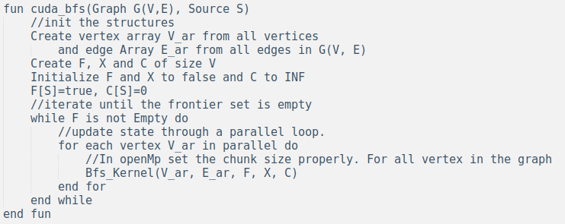
BFS – Main

Slide 7
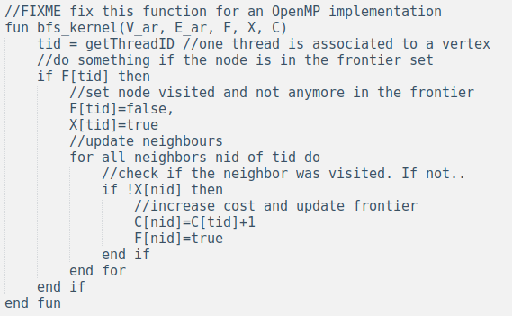
BFS - kernel

Slide 8
SSSP – Single-Source Shortes Path
Support structures:
M is a boolean mask of size |V|
C is the cost array from S of size |V|
U is an alternate array of size |V|. It is a sort of buffer that contains the updated cost calculated in sssp_kernel_1 function.

Slide 9
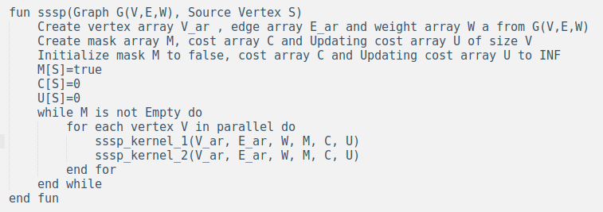
SSSP - Main

Slide 10
SSSP - Logic
In each iteration each vertex checks if it is in the mask M:
If yes, it fetches its current cost from the cost array C and its neighbor’s weights from the weight array W. Update neighbor’s if this is >= than the cost of current vertex plus the edge weight to that neighbor. But update the cost in U (not in C)
After that, a second kernel compares cost C with updating cost U. It updates the cost C only if C[a]> U[a] and makes its own entry in the mask M[a]. The second stage of kernel execution is required as there is no synchronization between the CUDA multiprocessors (OpenMP can simplify this). Updating the cost at the time of modification itself can result in read after write inconsistencies.

Slide 11
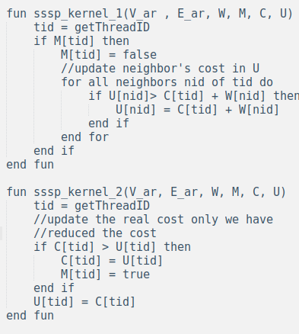
SSSP – Kernels

Slide 12
APSP_FW – All Pairs Shortest Path Floyd-Warshall
It is possible to test this algorithm with at most a thousand of vertices because the algorithm requires at O(V²) space.
An adjacency matrix is used to implement the graph.
It is implemented using V² threads running the classic CREW PRAM algorithm of the Floyd-Warshall.
It also possible to implement it with O(V) threads that run an O(V) algorithm, but authors found this solution slower “because of the sequential access of entire vertex array by each thread”.

Slide 13
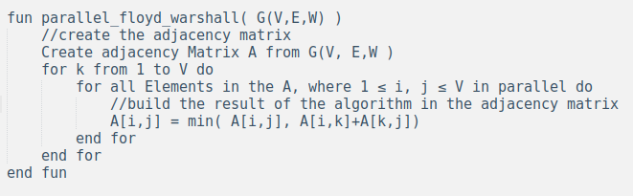
ASPS_FW - Algorithm

Slide 14
APSP_SSSP – APSP using SSSP
This is faster than the Floyd-Warshal algorithm because this one requires a single O(V) operation looping over O(V²) threads which creates extra overhead for context switching the threads on the SIMD processors.
Authors parallelize SSSP algorithm. We could parallelize the Source selection and invoke the sequential SSSP algorithm.

Slide 15
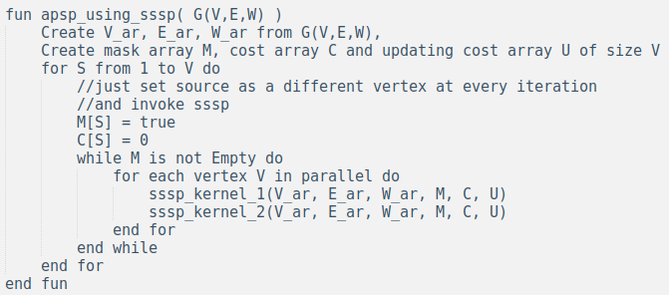
APSP_SSSP - Algorithm

Slide 16
OpenMP Algorithms

Slide 17

Notes
INF = MAX_INT (from limits.h)
Employed a BoolArray struct to pack boolean arrays and, so, save space
UNS_TRUE = 1U
UNS_FALSE = 0U

Slide 18
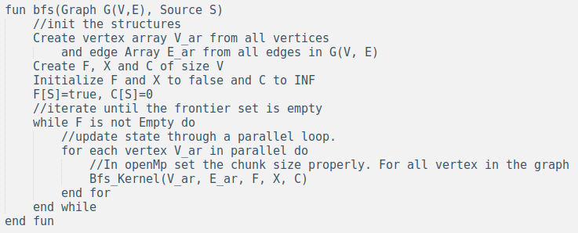
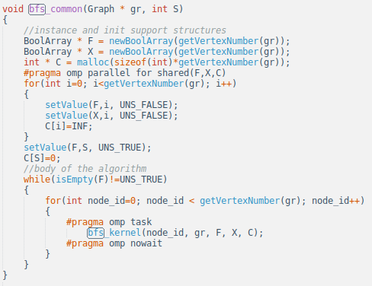
BFS

Slide 19
BFS
It is essentially equal to the algorithm described in the paper, but tasks are used.
bfs_kernel it is the same function described in the paper

Slide 20
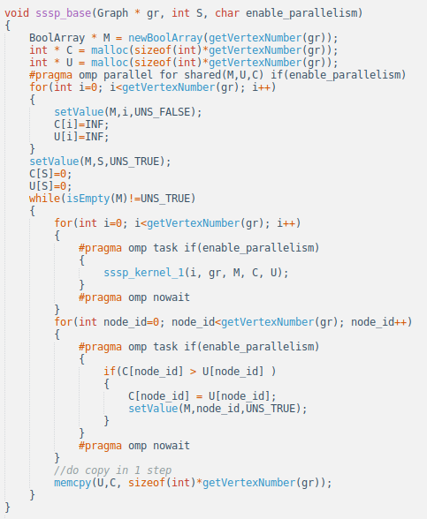
SSSP

Slide 21
SSSP
Call sssp_base with enable_parallelism=1
sssp_kernel_1 is equal to the pseudocode
sssp_kernel_2 is substituted by the last for + memcpy operation (is it really better?)
enable_parallelism set parallelism on (it will be used in apsp_sssp)

Slide 22
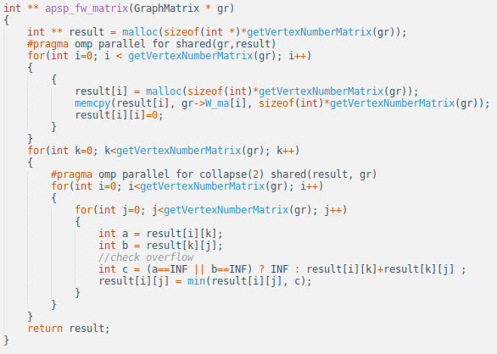
APSP_FW

Slide 23
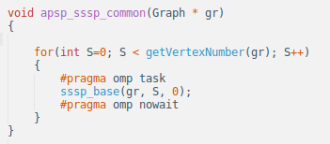
APSP_SSSP
Just call sequential sssp (enable_parallelism=0)
It seems to be faster

Slide 24
Results Collection

Slide 25
How to get execution time
Use sys/time.h:
struct timeval tick,tock, result
gettimeofday(&tick)
Execute algorithm
gettimeofday(&tock)
timersub(&tock,&tic, &result)

Slide 26
Available data
Real graphs are present on uniroma website (see references)
Other references about test graphs are not described in the paper. Randgraph tool (present on uniroma website) will be used.

Slide 27
Experimental Results of the Paper
PC with 2 GB RAM, Intel Core 2 Duo
E6400 2.3GHz processor running Windows XP with one Nvidia GeForce 8800GTX.
The graphics card has 768 MB RAM on board.
For the CPU implementation, a PC with 3 GB RAM and an AMD Athlon 64 3200+ running 64 bit version of Fedora Core 4
Applications were written in CUDA version 0.8.1 and C++ using Visual Studio 2005.
Nvidia Graphics driver version 97.73 was used for CUDA compatibility.
CPU applications were written in C++ using standard template library.

Slide 28
Experimental Results of the Paper
BFS for a 400 million vertex, 2 billion edges graph takes less than 5 seconds on a CRAY MTA-2, the 40 processor supercomputer, which costs 5–6 orders more than a CUDA hardware. They also implemented BFS on CPU, using C++ and found BFS on GPU to be 20–50 times faster than its CPU counterpart.
SSSP timings are comparable to that of BFS for random graphs due to the randomness associated in these graphs. Since the degree per vertex is 6–7 and the weights vary from 1–10 in magnitude it is highly unlikely to have a less weighted edge coming back from a far away level. They compared the results with the SSSP CPU implementation and they found that the algorithm is 70 times faster than its CPU counterpart on an average.

Slide 29
Experimental Results – Scale Free Graphs
In such graphs a few vertices are of high degree while the rest are of low degree (Test done with the maximum degree of any vertex to be 1000 and average degree pervertex to be 6. A small fraction, 0.1%, of the total number of vertices were given high degrees).
BFS and SSSP are slower for scale free graphs as compared to random graphs. Because of the large degree at some vertices, the loop inside the kernel increases, which results in more lookups to the device memory slowing down the kernel execution time. (Loops of non-uniform lengths are inefficient on a SIMD architecture).

Slide 30
Experimental Results - APSP
A graph with 100K vertices, 6 degree per vertex, it takes around 22 minutes to compute sequential APSP. Authors found an average improvement of a factor of 3 for the Floyd Warshall CUDA algorithm and a factor of 17 for the all pair shortest path using SSSP CUDA implementation. As shown by the results APSP using SSSP is faster than Floyd Warshall’s APSP algorithm on the GPU. (It is also more scalable)

Slide 31
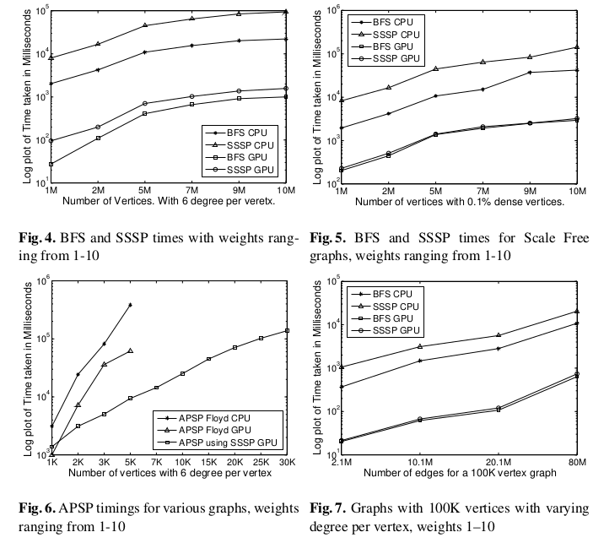
Experimental Results

Slide 32
Conclusions
It is possible to readapt algorithms from CUDA to OpenMP (improving them if possible)
Performance differences between the paper implementation and the future OpenMP implementation will be evaluated (we can find out if a Laptop for the consumer’s market can do better than paper’s GPU).

Slide 33
References
Nineth DIMACS implementation challenge (useful for datasets):
http://www.dis.uniroma1.it/challenge9/download.shtml
Accelerating large graph algorithms on the GPU using CUDA: https://cvit.iiit.ac.in/images/ConferencePapers/2007/Pawan07accelerating.pdf

