Slide 1
FLAP: Fusion Library of Analysis Programs
FLAP
A program suite for processing large multidimensional datasets
Sandor Zoletnik
Wigner Research Center for Physics
Budapest, Hungary

Slide 2
FLAP features in nutshell
Python 3.7 + numpy + matplotlib
All data are in flap.DataObject:
N dimensional (complex) data + error + coordinates + other data
Stored in variable or memory storage area
Save/load to file
Processing: filter, slicing, APSD, CPSD, CCF, conditional averaging, ...
flap.DataObject → processing → flap.DataObject
Optimized numpy processing routines operate along 1 (or multiple) dimensions
→ processing of many signals in one call
Data input modules: core FLAP and data access methods are separate
Options configurable for processing methods, data source
Plots for 1D, 2D, 3D data objects, slices of objects
Available on GitHub: https://github.com/fusion-flap

Slide 3
flap.DataObject
All data (experimental, calculated, modeling) are stored in DataObjects
d = flap.DataObject(data=..., error=...)
Data fields:
data: n-dimensional numpy array: integer, float, complex, ...
data_shape: Data array shape (used if no data is present)
error: Optional error values: symmetric (1 array) asymmetric (list of two arrays)
data title: String (e.g. ‘ABES-13’)
data unit: flap.Unit class
name: String (e.g. ‘Signal’)
unit: String (e.g. ‘Volt’)
coordinates: List of flap.Coordinate() objects
Arbitrary number of coordinate values can be assigned to data points:
exp_id: Some kind of experiment ID (shot number, project no..)
data_source: String (e.g. ‘W7X_ABES’)
info: Any other information (Depending on data_source)
history: at present empty for future application

Slide 4
Coordinates
Coordinates assign some data to all data points in the data array.
Arbitrary number of coordinatates can be added to DataObject
What is the difference between data and coordinate?
Coordinates are assumed to have some structure:
Varies only along some dimension(s)
May change systematically e.g Time: equidistant → description is very simple
Some examples to coordinates:
Sample: sample number (integer) 0...N
Time: Time point of measurement (float) Start, sampletime, N
Channel name: Name of the measurement channel (string)
Frequency: Frequency in power spectrum
Device R: Major R coordinate of device
Flux R: Effective radius
Coordinates have value and range (error).
Some coordinates are generated during data read, others can be added later.

Slide 5
Coordinate description
c = flap.Coordinate(name=None,....)
name: the name (string)
unit: flap.Unit class
name: string (e.g. ‘Device x’)
unit: string (e.g. ‘cm’)
mode: flap.CoordinateMode()
mode.equidistant: boolean
True: coordinate changes equidistantly → description: start, step
False: coordinate values are given in values
mode.range_symmetric: Boolean
True: symmetric range [-value_ranges, + value_ranges]
False: asymmetric range [-value_ranges[0], + value_ranges[1]]
start, step: description for equidistant coordinates
values: the coordinate values for non-equidistant case
value_ranges: the range (error)
for equidistant case: list of 1 or 2 elements (symmetric, asymmetric)
for non-equidistant case: list of to arrays with same shape as values

Slide 6
Adding new coordinates (calibration)
Data source modules may also register an add_coordinate() method in their register call. This enables e.g. doing spatial calibration:
The above call adds major radius coordinate to the ‘ABES’ data object in FLAP storage.
It is calculated using the ‘Channel’ coordinate and exp_id.
This way each module can define a method which calculates e.g. flux coordinates.

Slide 7
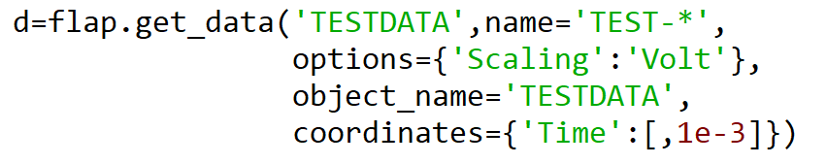
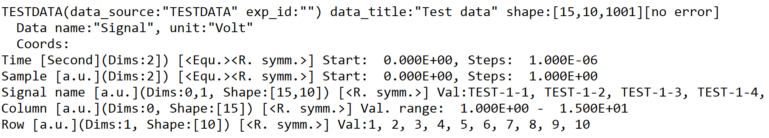
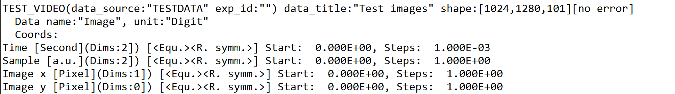
Example data objects
Flap storage contents can be listed with flap.list_data_objects()
Test data: 10x15 matrix of signals (e.g. GPI):
Test video: Sequence of 1024x1280 pixel images:

Slide 8
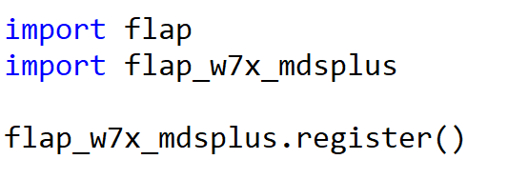
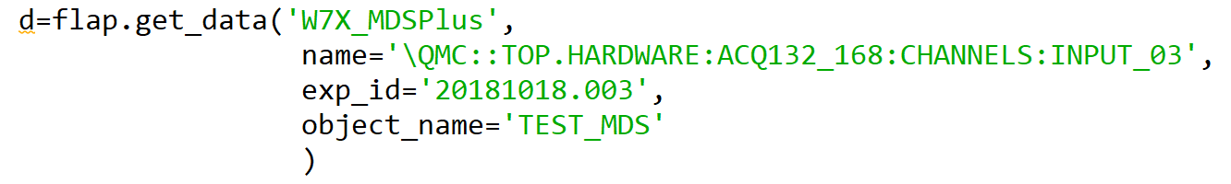

Data source modules
Data are read into DataObjects through data source modules.
After importing module data source should be registered in FLAP:
After registering FLAP can read data from the module using:
data source name, data name, exp_id
In the above example variable d will be a flap.DataObject and a copy will be stored
under name TEST_MDS in FLAP data storage (memory).
All processing works on variables or FLAP storage:

Slide 9
Available input modules
testdata: Generates various test signals and image sequences
w7x_abes: W7-X Alkali BES data (locally stored)
mdsplus: General MDS+ module
w7x_mdsplus: MDS+ for W7-X. Can use signal translation table, e.g:
This defines CR-B....CR-D complex reflectometry signals from pairs of MDS+ entries.
w7x_webapi: W7-X web database access (experimental)
nstx_mdsplus: NSTX MDS+ access (experimental)
w7x_camera: W7-X EDICAM and Photron camera data (locally stored)
apdcam: General APDCAM access

Slide 10
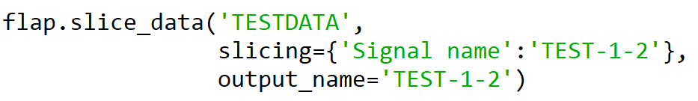
Slicing
slice_data method/function can do multiple things:
Cut out part of the data (certain elements or intervals)
Convert part of the data to a single value (Mean, Sum, Min, Max)
Cut out intervals and arrange them in a new dimension (multi-slice)
Slicing is done along coordinates.
Example 1: selecting one signal from the 10x15 matrix of signals
Selects TEST-1-2 and save to data object TEST-1-2.
Selects TEST-1-2 and save to data object TEST-1-2.
Example 2: Ploting a time slice of the TESDATA object (3D):
Example 3: Taking average of all signals in TESTDATA in a time interval:

Slide 11
Multi-slice
Two basic slice types:
Simple slice:
Selects certain elements → data dimension is kept or reduced (if 1 element is kept)
Multi slice:
Selects multiple intervals (flap.Intervals, Data Object with error/value_ranges)
→ Adds dimension: e.g. from 1D data creates 2D: (intervals, index in intervals)
from 2D data (Time, channel) creates 3D
Start Time
Rel. Time
Time
Doing ‘mean’ along Start Time → average time evolution in intervals
Doing ‘mean’ along Rel. Time → mean signal in intervals

Slide 12
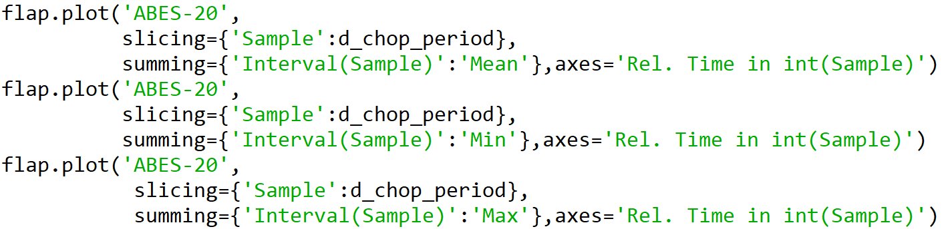
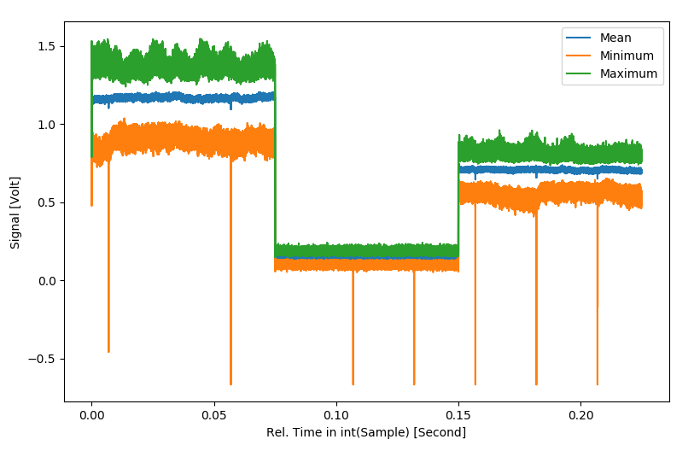
Summing through intervals
Plotting across intervals with slicing/summing one DataObject (ABES-20)

Slide 13
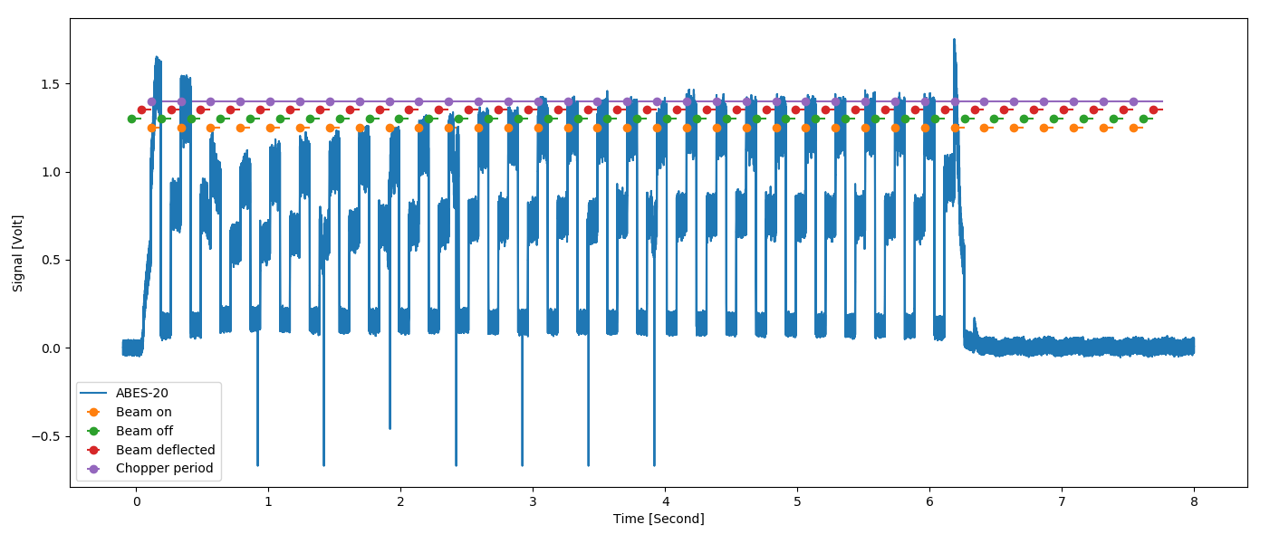
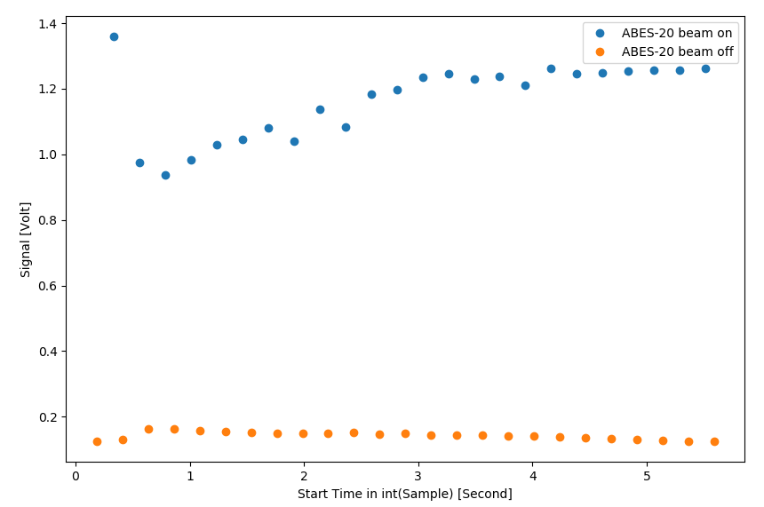
Summing in intervals
Avearing along intervals gives the time evolution of interval mean data

Slide 14
Data processing methods
All processing methods operate on data objects and produce data objects as output.
It is possible to limit processing to intervals:
filter_data: Various scipy filters can be used along one coordinate
detrend: Remove trend with polyfit.
apsd: Auto Power Spectral Density along a coordinate
(e.g. converts Time coordinate to Frequency)
cpsd: Cross Power Spectral Density between all signals in two data objects
(e.g. converts Time coordinate to Frequency)
ccf: Cross Correlation Function between all signals in two data objects
Also multi-dimensional CCF
(e.g. converts Time coordinate to Time lag)
select_intervals: Select intervals in a coordinate either by mouse click or on condition
Output is data object where intervals are described by data and error.
The output data object can be used in slice_data → conditional averaging
arithmetic: +,-,* is implemented between data objects with identical shape and scalars
broadcasting to be implemented soon

Slide 15
Plotting
flap.plot function implements higher level plots on the basis on Matplotlib:
Handles coordinates, errors, ... automatically
Can plot data vs coordinates, coordinates vs coordinates, constant vs coordinate,
one data object vs another, ....
Handles overplotting: as default prevents overplotting data with incompatible units
(can be overridden)
Plot types as present: xy, multi xy, image, contour, anim-image, anim-contour
Default plots: e.g. 3D data object plotted as anim-...
Multiple part plots. (e.g. complex signal is plot as amplitude/phase or real/imaginary)
Plot ID is returned: possible to overplot to any existing (even multi-part) plot.

Slide 16
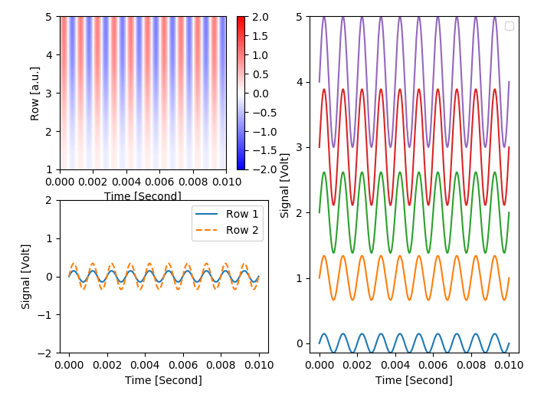
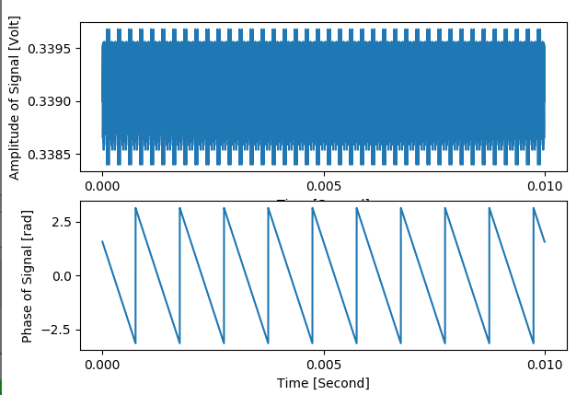
Plotting
‘image’ plot
‘multi-xy’ plot
‘xy’ plot from complex data
‘xy’ plot

Slide 17
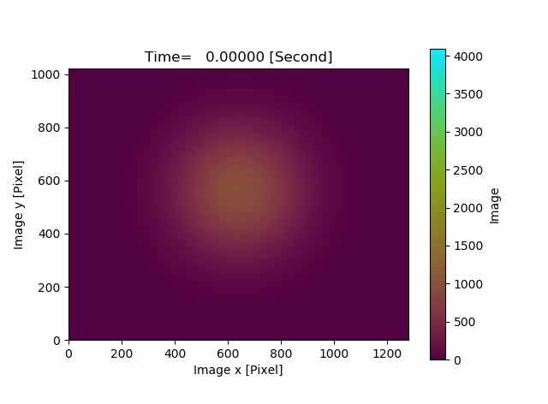
anim plots
‘anim-image’, ‘anim-contour’ are 3D plots
‘anim-image’ plot of test video data

Slide 18
Summary
FLAP package has now good functionality
Considered as beta version
Available on GitHub: https://github.com/fusion-flap
master branch is stable
development is current upgrades
flap_tests.py demonstrates possibilities on test data
Users, collaborators are welcome

