Slide 1
FLAP: Fusion Library of Analysis Programs
FLAP
User Information Meeting
UIM/2
Sandor Zoletnik
on behalf of the FLAP core programming team
A. Buzas, G. Cseh, D. Dunai, M. Lampert, M. Vécsei, S. Zoletnik
Wigner Research Center for Physics
Budapest, Hungary

Slide 2
Changes since UIM/1
User’s guide V1.0
Small change in data source module registration
Configuration possibilities, options significantly upgraded
Chopper information read, handling for W7-X
W7-X data amplitude calibration, offset subtraction
Slice_data method/function
Detrend
Auto Power Spectral Density (APSD)
Smaller changes to plot()
W7-X web API module (Vécsei M.)

Slide 3
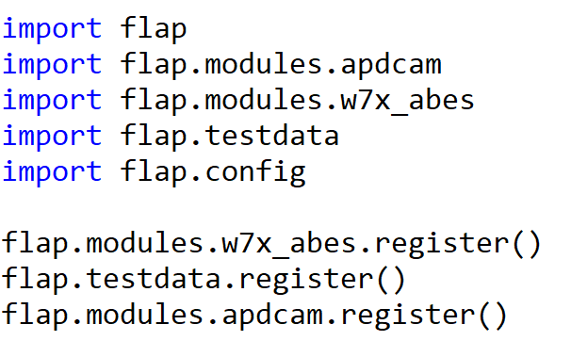
Module integration
Data source module import and registration separated.
Reason is to be able to use the functions in the module in other modules.

Slide 4
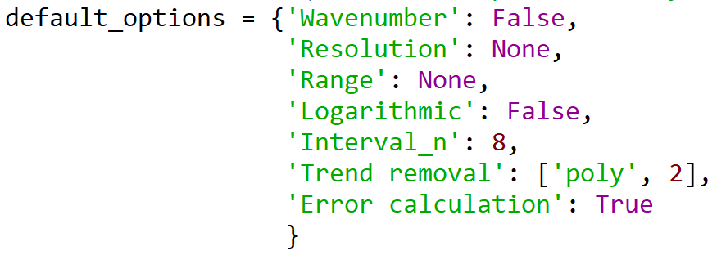
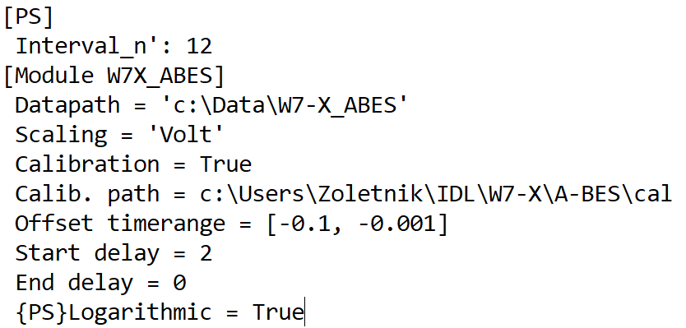
Options and configuration
FLAP processing functions have an options dictionary
Configuration is considered for setting defaults for options.
3 level defaults:
Function defaults:
Defined when function is written.
All possible options and their default values should
be listed in function
Section defaults:
A section in the configuration file may contain
options.
Module defaults:
A data source module section may contain defaults
for certain section
From config file values are converted to Python types:
True (Yes) / False (No) → bool
Numbers → numbers (including complex)
[....] → list
‘ccscx’ and anything else → string

Slide 5
Using options
Precedence:
Function defaults < Section defaults < Module defaults < input options
Options processing and defaults are implemented by single function call:
As all possible options are known at the function call they can be abbreaviated
until it matches onoly one option name:
In the configuration file full names must be used.

Slide 6
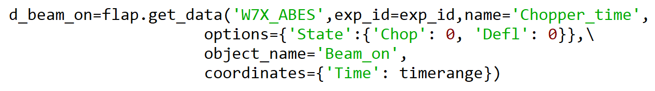
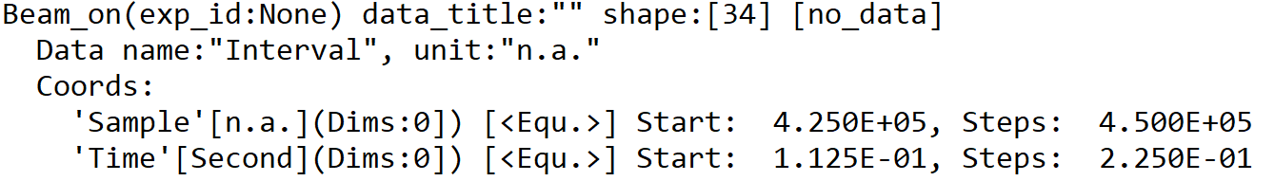
W7-X chopper
W7X_ABES data source can handle data name “Chopper_time”
Returns a DataObject with no data only Time and Sample coordinates
Options:
State: Which chopper/deflection state: {‘Chop’: 0 or 1, ‘Defl’: 0 or 1}
Phase: Which phase of the chopper period (0...)
Start delay, End delay:
start/end delay of interals (in microsec) relative to chopper state change
Resulting DataObject:

Slide 7
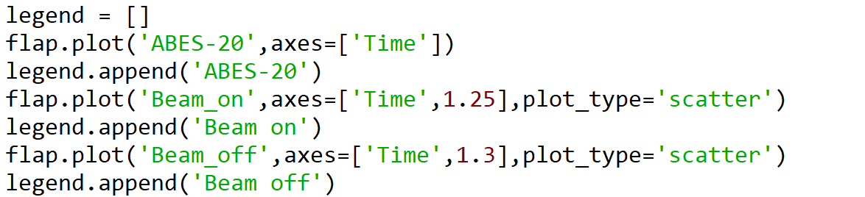
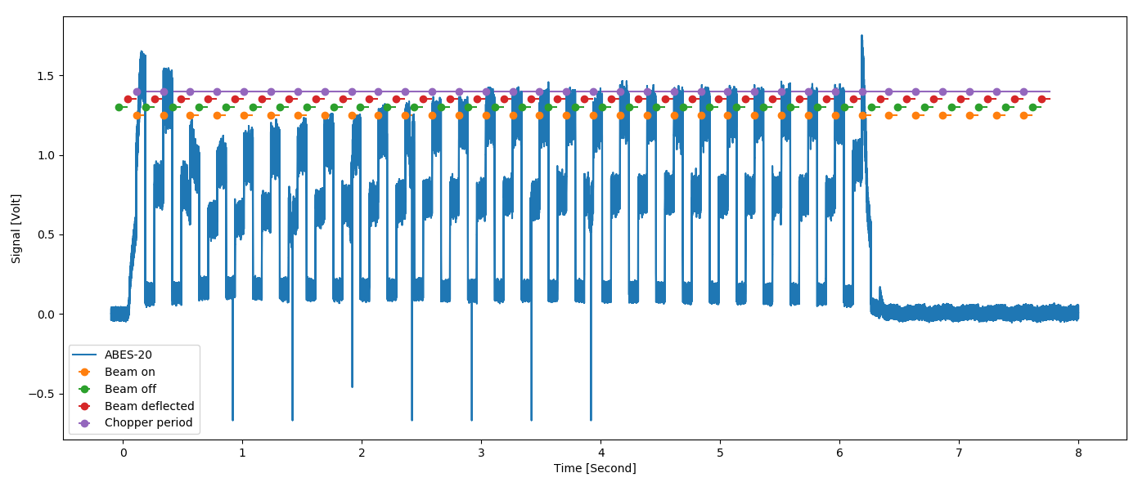
Plotting chopper data

Slide 8
Slice
slice_data method/function can do two things:
Cut out part of the data (certain elements or intervals)
Convert part of the data to a single value (Mean, Sum, Min, Max)
slice(slicing={}, summing={})
slicing: Dictionary.
Keys are coordinate names
Values: slicing description:
flap.Intervals → single or multiple intervals,regular or irregular
{‘Time’: flap.Intervals(0,1e-3, step=2e-3, number=10)}
list of values → selects certain elements
slice, range → select elements in a regular pattern. E.g. slice(0, 1, 1E-3)
flap.DataObject
If DataObject.unit.name is same as coordinate → use data values and error
If DataObject.unit.name is not the same as coordinate, but
one of the coordinates in DataObject the same as coordinate
→ use coordinate values and value ranges in DataObject
Multiple slicing operations can be listed in the dictionary.
If the coordinate changes along multiple dimensions all these dimensions are flattened.

Slide 9
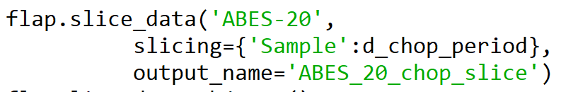
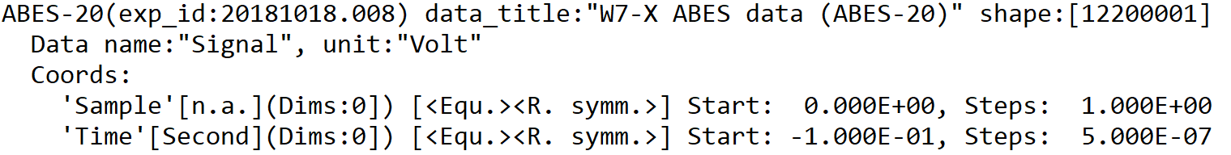
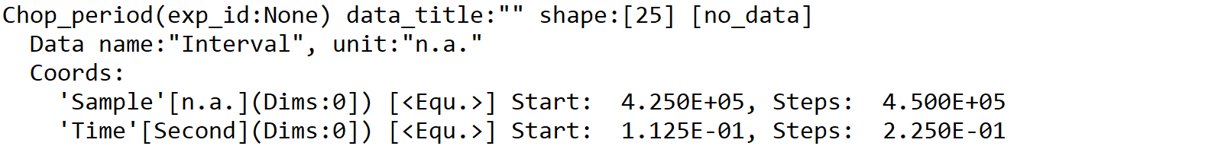
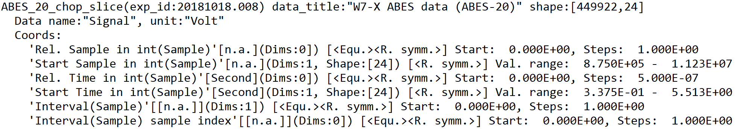
Slice
Two basic slice types:
Simple slice:
Selects certain elements → data dimension is kept or reduced (if 1 element is kept)
Multi slice:
Selects multiple intervals (flap.Intervals, Data Object with error/value_ranges)
→ Adds dimension from 1D data creates 2D: (intervals, index in intervals)

Slide 10
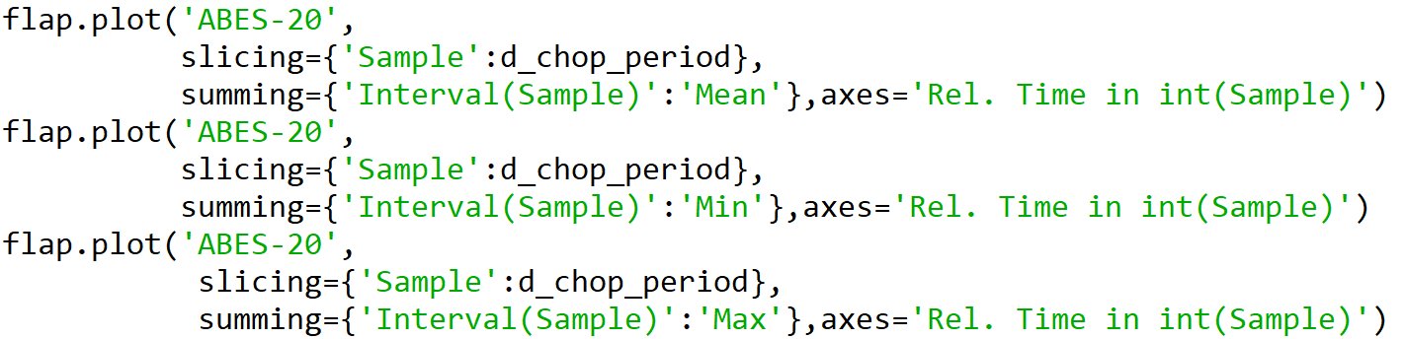
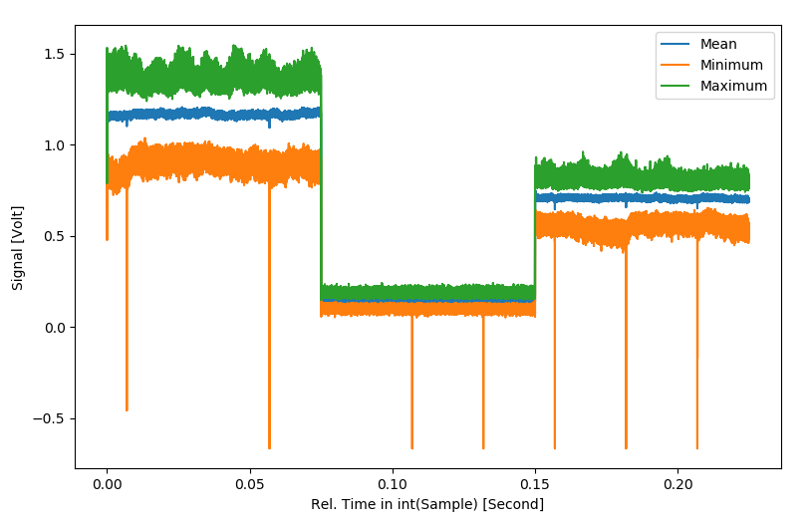
Summing
Plotting across intervals with slicing/summing one DataObject (ABES-20)

Slide 11
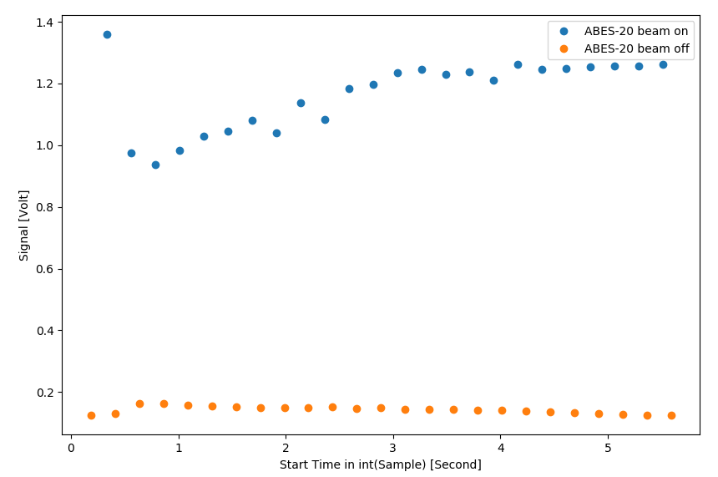
Summing
Avearing along intervals gives the time evolution of interval mean data

Slide 12
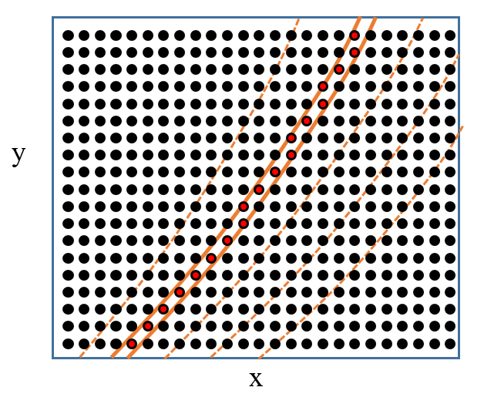
Multi slice for multiple coordinates
Multiple slice operations can be listed in one call.
If cocordinates are independent this is no problem
→ Sequential slicing
If coordinates have common data dimension slicing cannnot be done sequentially
as dimensions are flattened.
slicing for non-independent coordinates not implemented yet.
Would be useful e.g. to set up pixels along flux contours:
Curves mark constant coordinate (say Flux R)
Now red dots can be selected in slice operation
Slicing+summing sums pixel data along Flux R.
Slicing jointly along Flux R and Flux phi would
allow calculating data in pixelf following flux
contours.

Slide 13
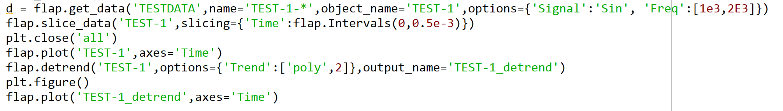
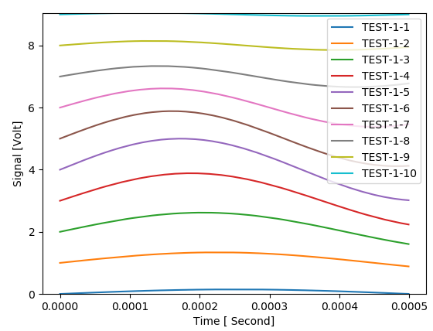
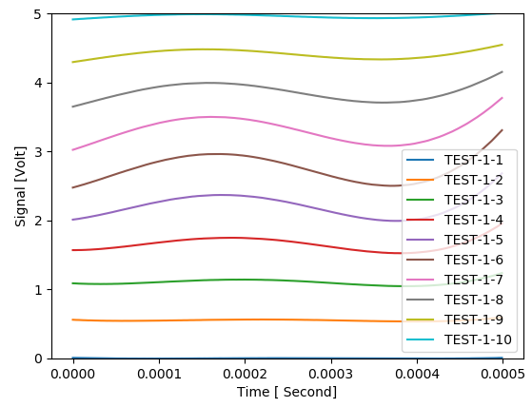
Detrend
Detrend removes slow varying component from data:
Operates only along coordinates which change in one data dimension
At present only mean and poly fit

Slide 14
APSD
Calculates Auto Power Spectral Density along one coordinate:
E.g. converts Time coordinate to Frequency
Operates on real or complex data
Returns frequency or wavenumber (2Pi*frequency)
Statistical evaluation as it is in FLIPP: divides signal to multiple intervals
Trend removal using detrend
Linear or Log frequency scale
Processing time:
1 000 000 sample: ~ 0.1s/signal
50 000 sample: ~0.01s/signal

Slide 15
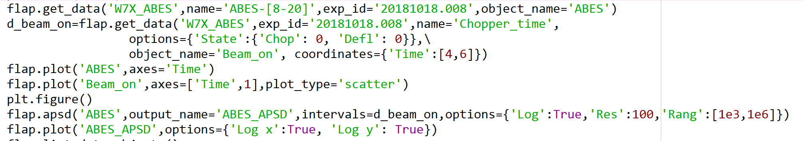
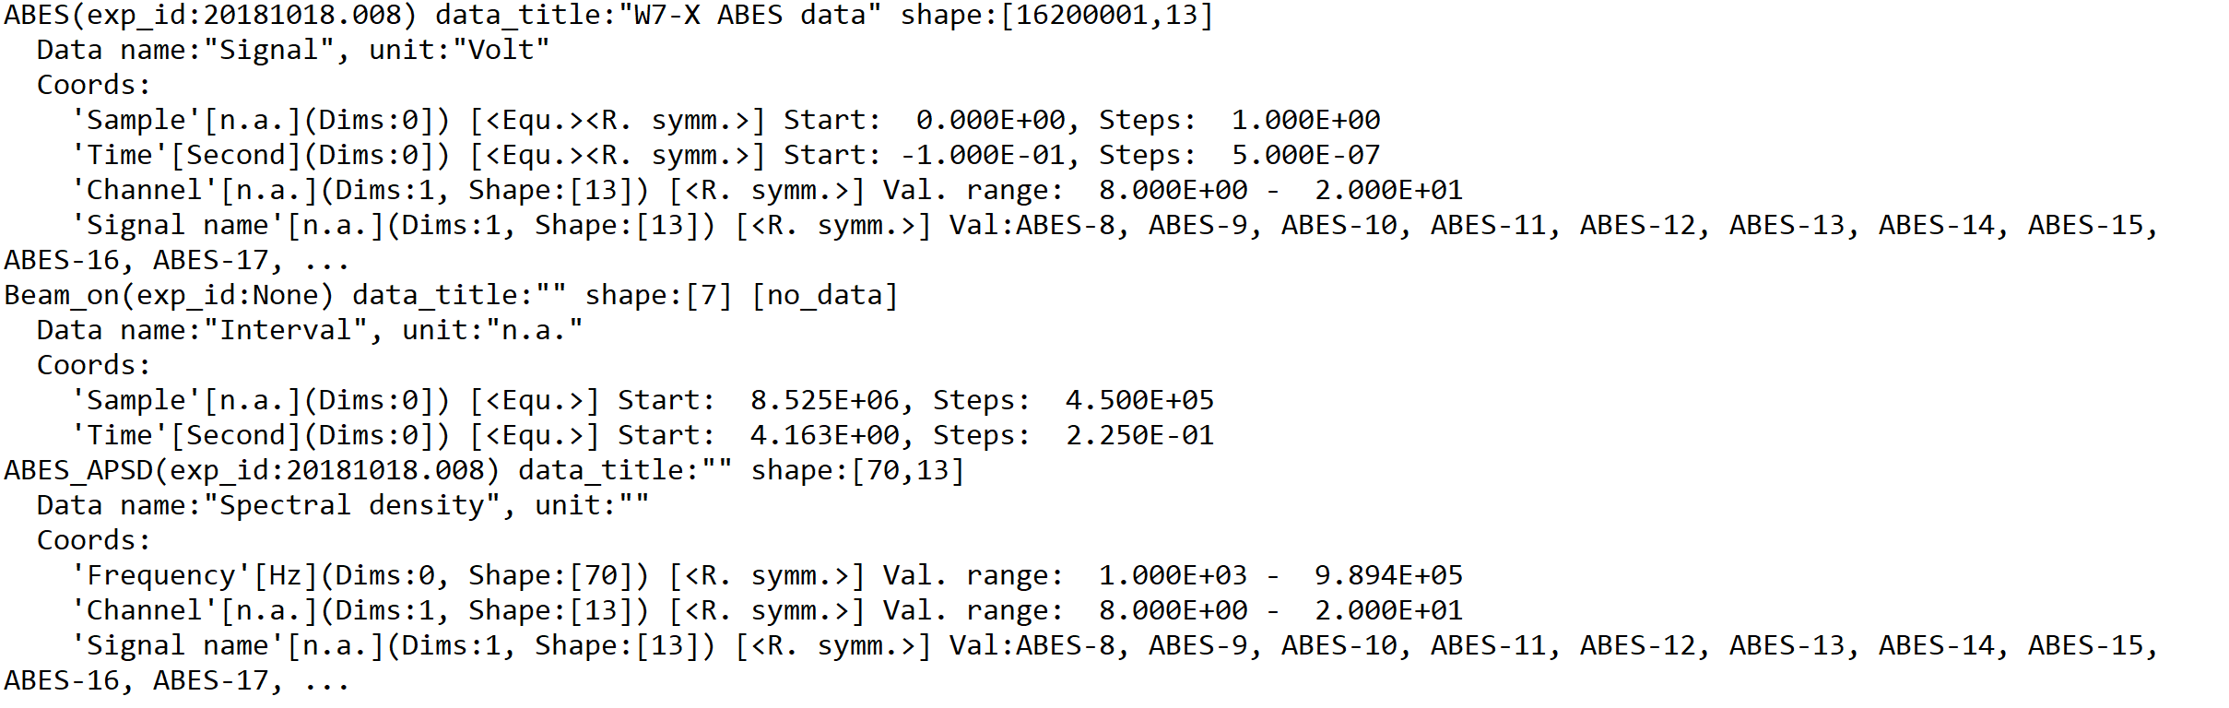
APSD
Example: processing 13 W7-X ABES signals:

Slide 16
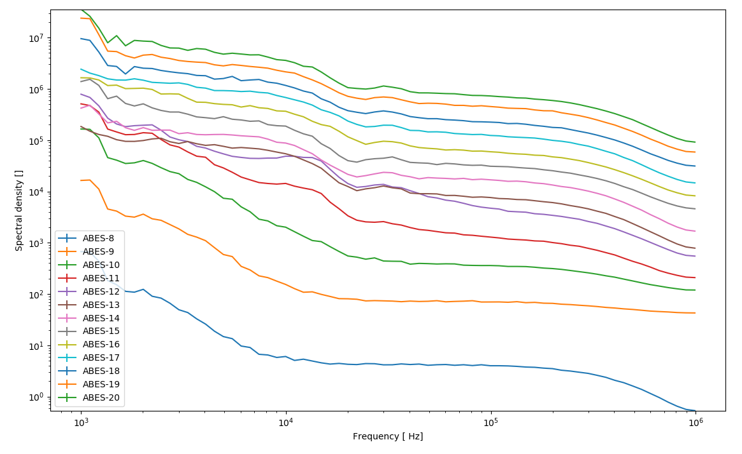
APSD
Example: processing 13 W7-X ABES signals:

Slide 17
ToDo
Issue tracking
Save/Load
Interpolation (extension of slice_data, would allow time vector interpolation)
Simple arithmetic (+-*/)
Correlation calculation (S. Zoletnik)
Select_time
W7-X ABES spatial calibration
Video data module (G. Cseh)
Upgrade plot interface: figure ID, multiple figures in page, contour, image, video...
W7-X spectrum module

