Slide 1
FLAP: Fusion Library of Analysis Programs
FLAP
Training
28 March, 2022
Sandor Zoletnik
on behalf of the FLAP core programming team
A. Buzas, G. Cseh, D. Dunai, M. Lampert, M. Vécsei, S. Zoletnik
Centre for Energy Research
Budapest, Hungary

Slide 2
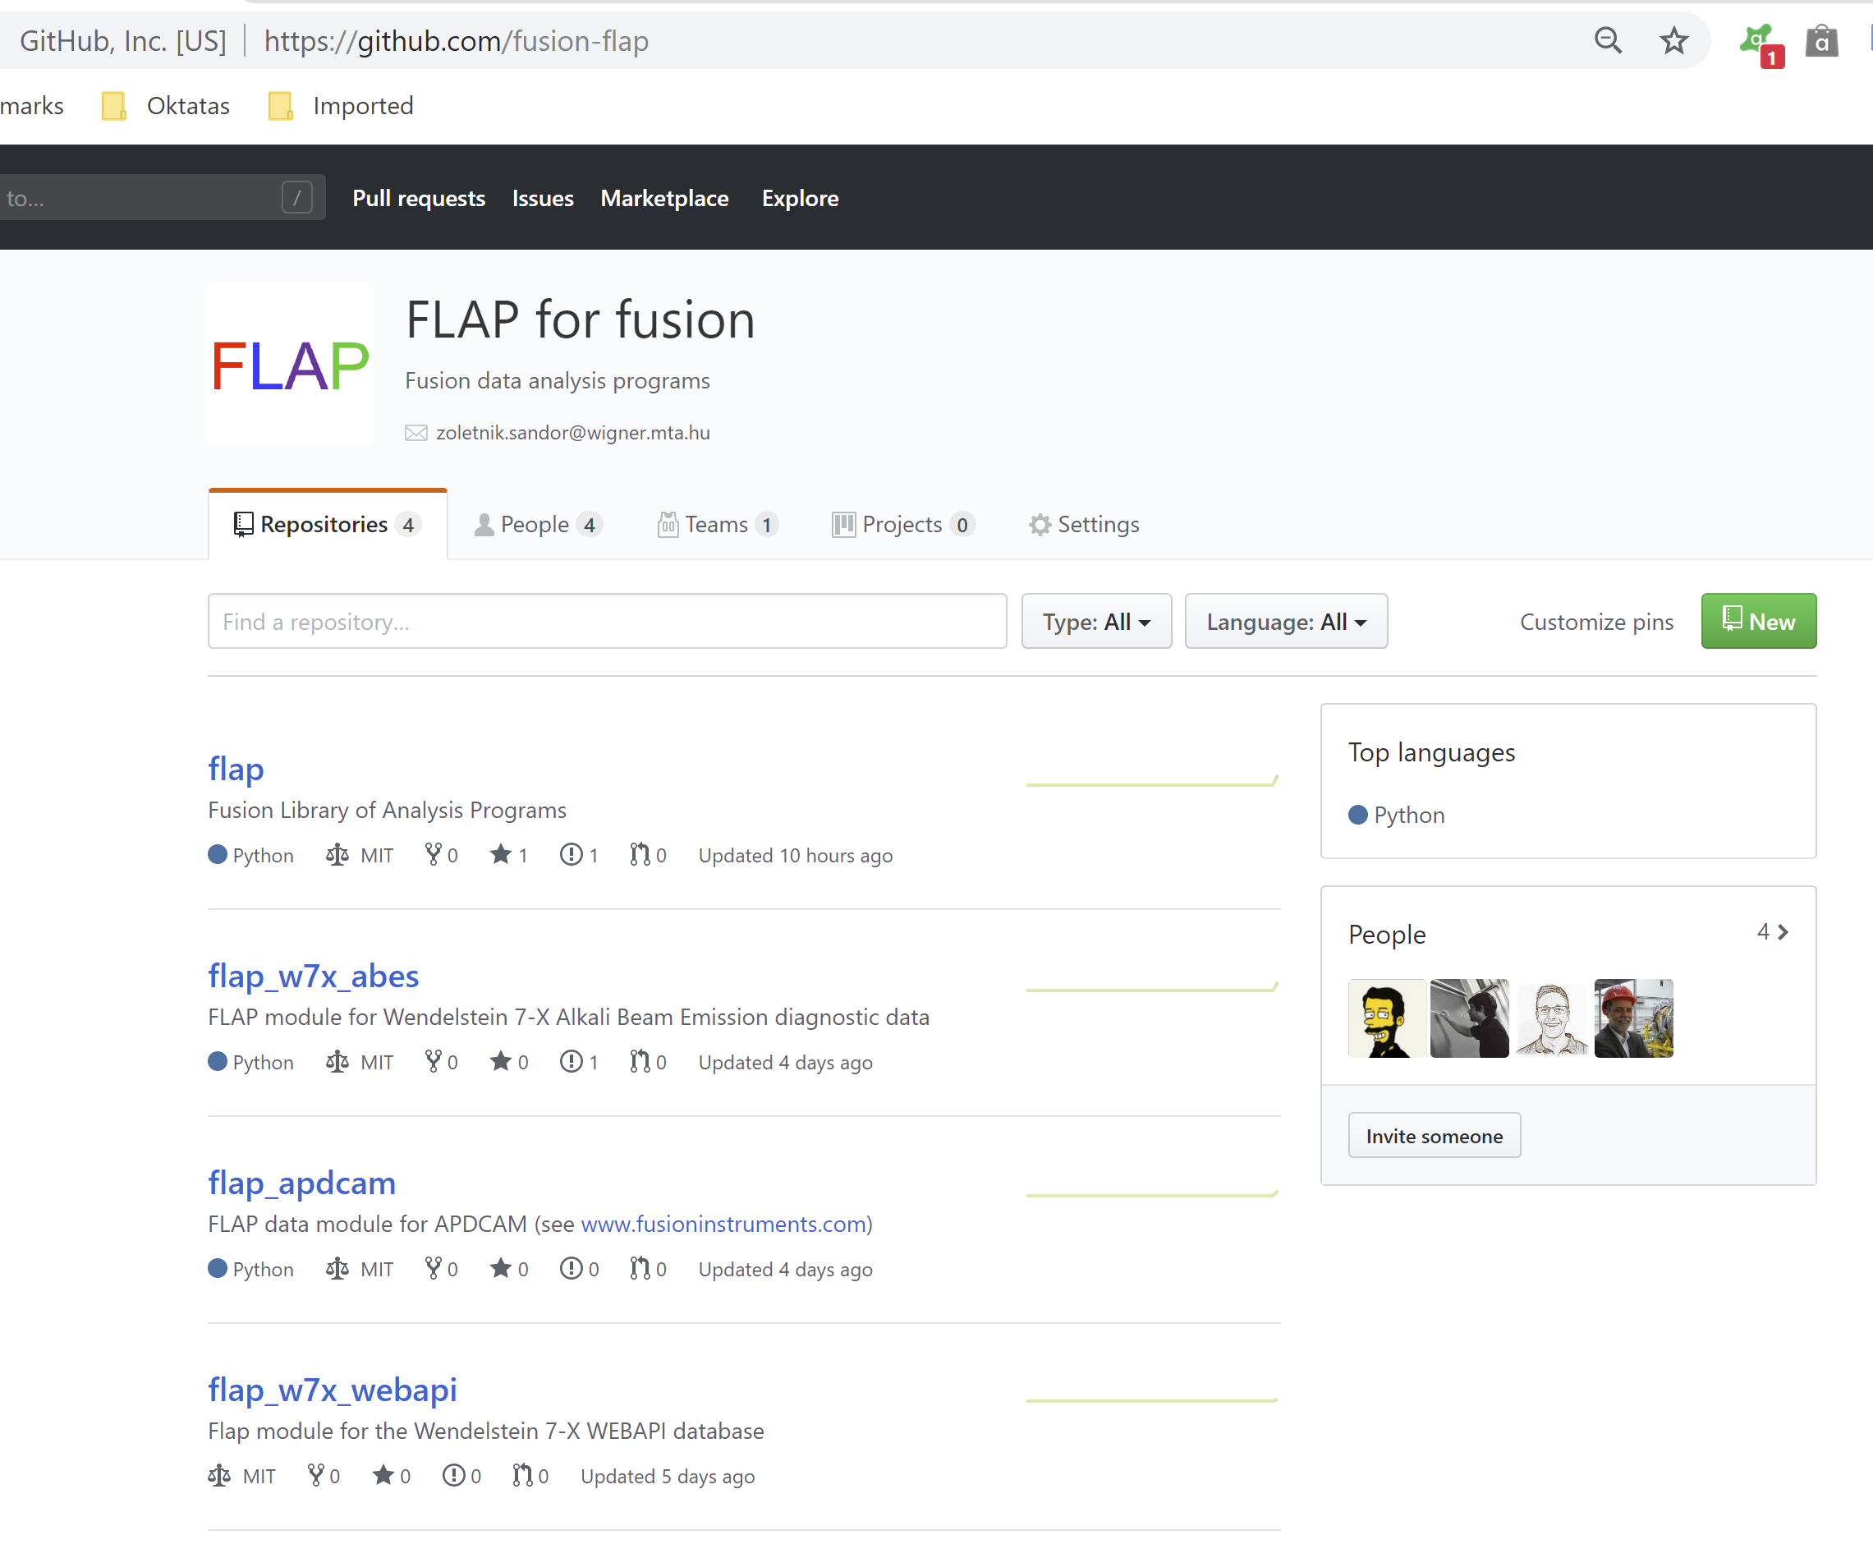
Environment, archive
Programming language is Python 3.7.x
Most important packages:
- numpy (Array processing, math)
- matplotlib (Graphics)
- scipy
...
Environment is contained in Anaconda.
Use the docs/conda_setup.yml file to set up the environment before use.
Flap is maintained in GIT archive:
beam.rmki.kfki.hu:/home/git/git/flap.git
The last working version is the MASTER

Slide 3
Python modules
Python is organized into modules.
Modules must be imported (run) before use:
import numpy as np
....
a = np.zeros(100)
Modules can be:
- A single python file somewhere on PYTHONPATH
- A directory with programs, subdirectories, ...
__init__.py file in directory is run when module is imported,
it imports all elements of the module and can do other things
Modules define classes and functions.
classes define objects with data and methods (functions)
FLAP has one core module and multiple modules for various data sources.
Data source modules are not part of the core flap package, except testdata

Slide 4
Project organisation
flap
|
+---docs
| Style guide: Styleguide.pdf
| Conda setup: conda_setup.yml
| Install guide: FLAP_install_guide.pdf
| User’s guide: FLAP_V1.11_Users_Guide_vxxx.pdf
| Presentations
+---flap
| flap core program files:
| core.py, data_object.py, coordinate.py, tools.py, config.py, ...
| test data source: testdata.py
| sample config file: flap_defaults_sample.cfg
+---tests
Test/sample programs: flap_tests.py
Configuration file for test programs: flap_tests.cfg
Modules:
flap_apdcam, flap_mdsplus, flap_mdsplus, flap_nstx, flap_mdsplus_w7x, flap_nstx, flap_w7x_abes, flap_w7x_camera,flap_w7x_webapi

Slide 5
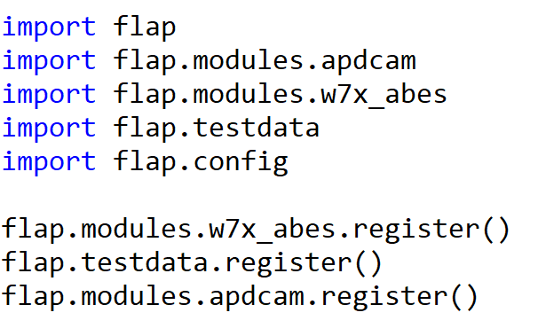
Module intergration
Data source module import and registration separated.
Reason is to be able to use the functions in the module in other modules.

Slide 6
Programming style
See style guide.
Basics:
Class names in CamelCase
data, functions are small letters and underscore:
this_is_a_function()

Slide 7
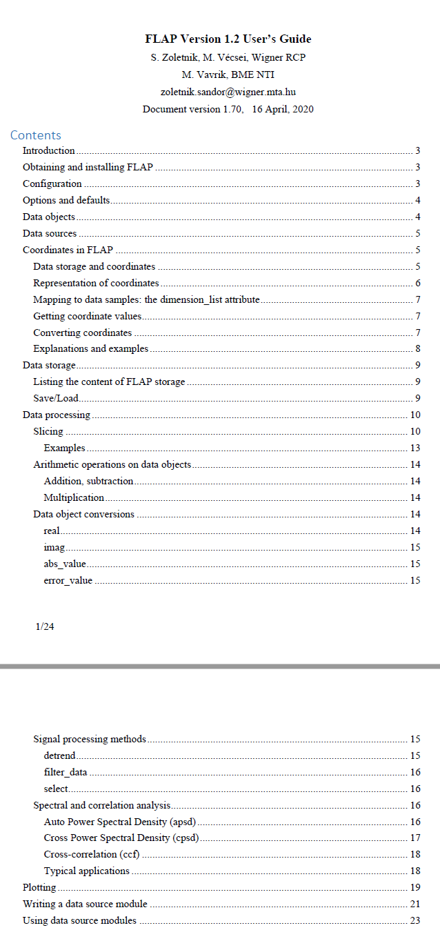
Documentation
Only few line descriptions on functions → use code and samples
Section on how to write and use a data module
An extensivev set of test/example programs: flap_tests.py
Some test functions for modules

Slide 8
DataObject
All data (experimental, calculated, modeling) are stored in DataObjects
d = flap.DataObject(data=..., error=...)
All inputs have defaults, empty object is created as d = flap.DataObject()
Data fields:
data: n-dimensional numpy array: integer, float, complex, ...
data_shape: Data array shape (used if no data is present)
error: Optional error values: symmetric (1 array) asymmetric (list of two arrays)
data title: String (e.g. ‘ABES-13’)
data unit: flap.Unit class
name: String (e.g. ‘Signal’)
unit: String (e.g. ‘Volt’)
exp_id: Some kind of experiment ID (shot number, project no..)
data_source: String (e.g. ‘W7X_ABES’)
info: Any other information (Depending on data_source)
coordinates: List of flap.Coordinate() objects
Arbitrary number of coordinate values can be assigned to data points
history: Idea is to record data origin (data read parameters) and add description
of all processing steps with standard FLAP operations (not implemented):
→should be possible to regenerate data from data object

Slide 9
Coordinates
Coordinates assign additional data to all data points.
Arbitrary number of coordinatates can be added to DataObject
What is the difference between data and coordinate?
Coordinates are assumed to have some structure:
Varies only along some dimensions
May change systematically e.g Time: equidistant → description is very simple
Some examples to coordinates:
Sample: sample number (integer) 0...N
Time: Time point of measurement (float) Start, sampletime, N
Channel name: Name of the measurement channel (string)
Frequency: Frequency in power spectrum
Device R: Major R coordinate of device
Flux R: Effective radius
Coordinates have value and range (error).
Some coordinates are generated during data read, others can be added later.

Slide 10
Coordinate description
c = flap.Coordinate(name=None,....)
name: the name (string)
unit: flap.Unit class
name: string (e.g. ‘Device x’)
unit: string (e.g. ‘cm’)
mode: flap.CoordinateMode()
mode.equidistant: boolean
True: coordinate changes equidistantly → description: start, step
False: coordinate values are given in values
mode.range_symmetric: Boolean
True: symmetric range [-value_ranges, + value_ranges]
False: asymmetric range [-value_ranges[0], + value_ranges[1]]
start, step: description for equidistant coordinates
values: the coordinate values for non-equidistant case
a) Value given for all data points
b) Different number of values as data points → interpolation to data points
(not implemented yet, you will get NotInplementedError)
value_ranges: the range (error)
for equidistant case: list of 1 or 2 elements (symmetric, asymmetric)
for non-equidistant case: list of two arrays with same shape as values

Slide 11
Relation between coordinate and data
The coordinate description is related to the data array.
flap.Coordinate has further elements:
dimension_list: list of data dimensions along which this coordinate changes
if equidistant → step has multiple elements
C = start + step₁*i₂ + step₂* i₂ ...
If coordinate is non-equidistant the shape of the values matrix might be different
from the shape of the data subspace (but number of dimensions should be identical)
shape: shape of the description in non-equidistant case
If shape is different from subspace of data → interpolation (not implemented yet)
value_index: If set the coordinate description is based on random data points
in the coordinate sample space (shape)
For details see document.

Slide 12
Simple coordinate examples
Example has 2D data matrix, shape: (n, 4)
Equidistant coordinates
Name: Time
shape: (n), dimension_list = [0]
t₁ t₂ t₃ t₄ t₅... t_{n}
t₁ t₂ t₃ t₄ t₅... t_{n}
t₁ t₂ t₃ t₄ t₅... t_{n}
t₁ t₂ t₃ t₄ t₅... t_{n}
Name: y
shape: (5), dimension_list = [1]
y₁ y₁ y₁ y₁ y₁... y₁
y₂ y₂ y₂ y₂ y₂... y₂
y₃ y₃ y₃ y₃ y₃... y₃
y₄ y₄ y₄ y₄ y₄... y₄
Non-equidistant coordinate:
Name: Device Z
shape: (n,5), dimension_list =[0,1]
Z₁₁ Z₁₂ Z₁₃ Z₁₄ Z₁₅... Z_{1n}
Z₂₁ Z₂₂ Z₂₃ Z₂₄ Z₂₅... Z_{2n}
Z₃₁ Z₃₂ Z₃₃ Z₃₄ Z₃₅... Z_{3n}
Z₄₁ Z₄₂ Z₄₃ Z₄₄ Z₄₅... Z_{4n}

Slide 13
Using Coordinate
Deatils of the coordinate description should not be interesting for the ordinary user.
flap.Coordinate.data(data_shape=None, index=None, options=None)
returns the coordinate values and ranges
data_shape: the shape of the data matrix (must be present)
index: index of various elements describing elements in data
... (Ellipsis)
scalar e.g. 2
list e.g. [1,3,4]
slice (elements with fixed step)
range (single range or elements with fixed step)
numpy array
E.g.
coord = flap.Coordinate(......)
c, cl, ch = c.data((10,1000), [0,...])
c, cl, ch = c.data((10,1000), [[1,3],range(2,100,2)])
The same can be obtained from DataObject:
E.g.
d = flap.DataObject(....)
c, cl, ch = d.coordinate(‘Time’, [0,...])

Slide 14
Coordinate and data dimensions
coordinate.data() returns the coordinates for a subarray of data.
If index is not given the coordinates of all elements are returned
Using options={‘Change only’: True}
returns only coordinates for the dimensions where it changes
E.g.
Assume data is 2D DataObject: (time,channel)
Time coordinate is equidistant, changing along dimension 0
channel is non-equidistant changing along dimension 1
data.coordinate(‘Time’,options={‘Change only’:True})
returns only the time coordinates (1D array)
data.coordinate(‘Channel’,options={‘Change only’:True})
returns only the channel coordinates (1D array)

Slide 15
FLAP storage
Stores DataObjects in global memory area
DataObject is identified by name, exp_id
Advantage is that in GUI/interactive operations data can be used by name without using data object.

Slide 16
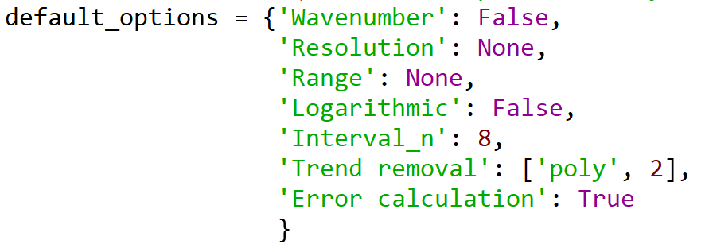
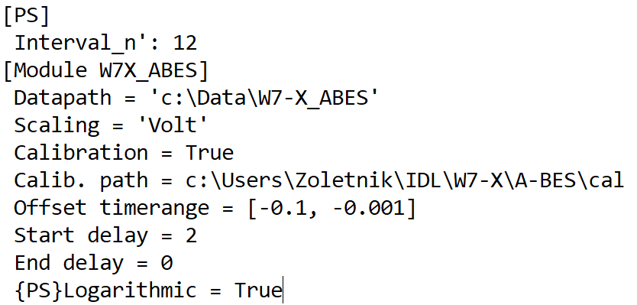
Configuration
FLAP processing functions have an options dictionary
Configuration is considered for setting defaults for options.
3 level defaults:
Function defaults:
Defined when function is written.
All possible options and their default values should
be listed in function
Section defaults:
A section in the configuration file may contain
options.
Module defaults:
A data source module section may contain defaults
for certain section
From config file values are converted to Python types:
True (Yes) / False (No) → bool
Numbers → numbers (including complex)
[....] → list
‘ccscx’ and anything else → string

Slide 17
Configuration
Precedence:
Function defaults < Section defaults < Module defaults < input options
Options processing and defaults are implemented by single function call:
As all possible options are known at the function call they can be abbreaviated
until it matches onoly one option name:
In the configuration file full names must be used.

Slide 18
Data and coordinate read
Data can be read from various data sources.
Data source is implemented by a module and registered during import.
A data source module may provide two interfaces:
“data read” interface:
Receives data names(s) to read and returns DataObject
E.g.
get_data(exp_id=‘20181018.003’, data_name=‘ABES-3’)
data_name can be string or string array with extended wildcards:
E.g. ‘ABES-*’, ‘SM[1,2]02’, [‘ABES-3, ‘ABES-7’], ‘ABES-[9-23]’
flap.select_signals() is helper function to process data_name and select from given data list.
“add coordinate” interface:
Adds new coordinate values to existing DataObject
E.g.
add_coordinate(d, coordinates=[‘Device x’, ‘Device y’, ‘Device z’,])
Adds spatial calibration to the data.

Slide 19
Data source implementation
The data source module implements the 2 functions (get_data, add_coordinate)
import flap
def testdata_get_data(exp_id=None, data_name='*', no_data=False,
options=None, coordinates=None):
.... function body
def add_coordinate(data_object, coordinates=None, exp_id=None, options=None):
....function body
The module registers these services calling a flap function:
flap.register_data_source('TESTDATA', get_data_func=testdata_get_data,
add_coord_func=add_coordinate)
(This example registers data source ‘TESTDATA’.)

Slide 20
Reading data in the user program
import flap (General FLAP definitions, initialize storage)
import flap.testdata (Imports TESTDATA source)
flap.testdata.register() (Registers the data source for FLAP)
d=flap.get_data('TESTDATA',name=[‘TEST-1-1’,’TEST-1-2’],
options={'Scaling':'Volt'},
object_name='TD',
coordinates={'Time':[0.3,0.4]})
Reads all TEST-1-1 and TEST-1-2 channels from the TESTDATA source in time range 0.3-0.4 s. Scales data to Volts and returns a DataObject. Also stores the DataObject under name TD in FLAP storage. d.data is 2D array [2, N_{time}]
d has coordinates: Sample, Time, Row, Column, Signal name
To plot the data vs time for the first channel:
plt.plot(d.coordinate(‘Time’,[0,...]), d.data[0,:]))
Under implementation: slice
To get the data for the first channel in part of the time interval:
ds = d.slice({‘Signal name’: ‘TEST-1-2’, ‘Time’: range(3.15,3.16)})
plt.plot(ds.coordinate(‘Time’,...),ds.data)
Slicing and summing in one routine:
Select range in coordinate 1 and average along coordinate 2
Select multiple intervals in coordinate 1 and average data in each interval

Slide 21
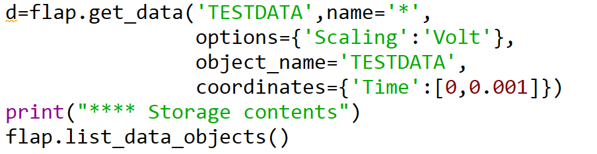
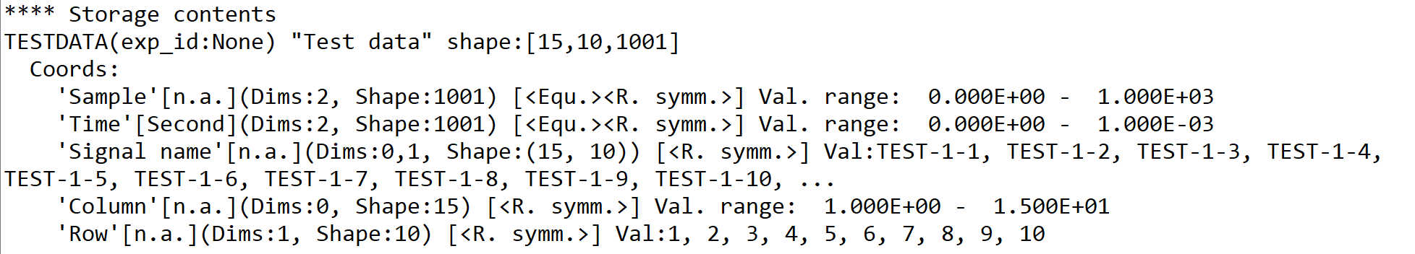
Example
TESTDATA source provides sinus signals on 15x10 spatial matrix with
1 MHz time resolution. Signal names are TEST-<column>-<row>
Reading all data:

Slide 22
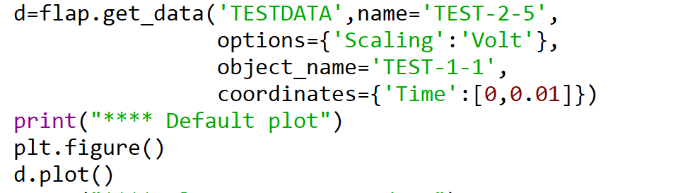

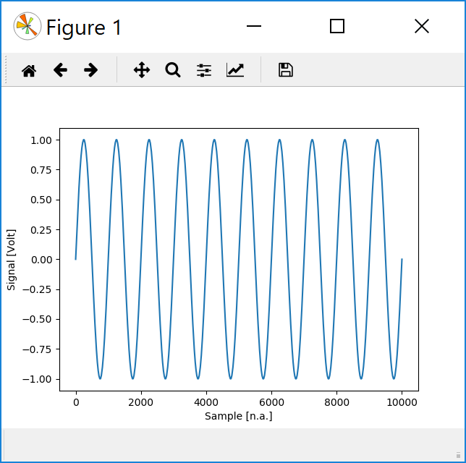
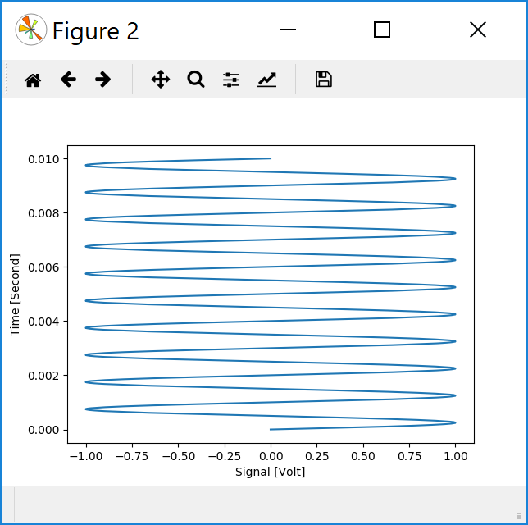
Simple 1D plotting
d.plot(axes=None, slicing=None, options=None, plot_type=None):
creates plots of the data.
plot_type has a default, depending on data dimensions:
xy, scatter, multi_xy, image, contour, anim–image, anim-contour
axes defines the plot axes: list of coordinate names or ‘Data’

Slide 23
Plotting: axes
For each plot axes can be set:
coordinate in DataObject: string
Data in DataObject: string: ‘__Data__’
Constant: any contant value
Data in another data object: DataObject
→ Enables plotting data as a function of another data (to be tested in detail)
Eamples:
axes=[‘Time’] or axes=[‘Time’,’__Data__’]
x: time coordinate, y: data (default)
axes=[‘__Data__’,3]
x: data, y: constant 3 (see e.g plotting of selected intervals)
axes=[d1,’__Data__’]
x: data of d1 DataObject y: data of own DataObject

Slide 24
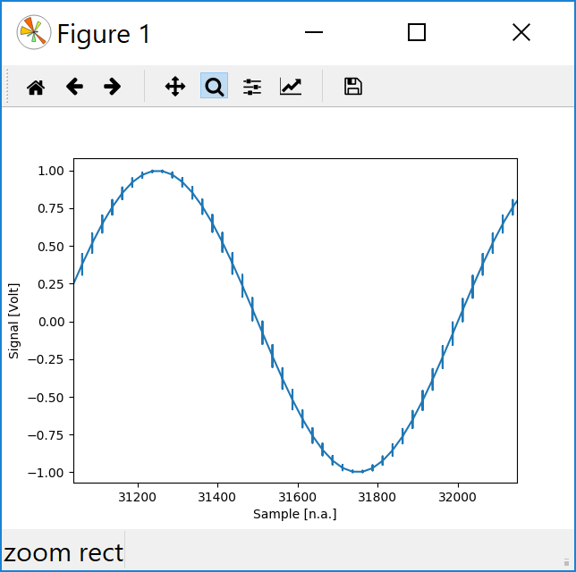
Plot acceleration
When a lot of data points are present plot takes a lot of time. By default FLAP plot uses
plot acceleration:
plots maximum 4000 points
If more points are available divides into boxes and plots mean, minimum, maximum, mean.
This is fast but still plots sharp pulses.
When magnified with matplotlib magnifier trick becomes visible:
To plot all points add:
option={‘All_points’: True}

Slide 25
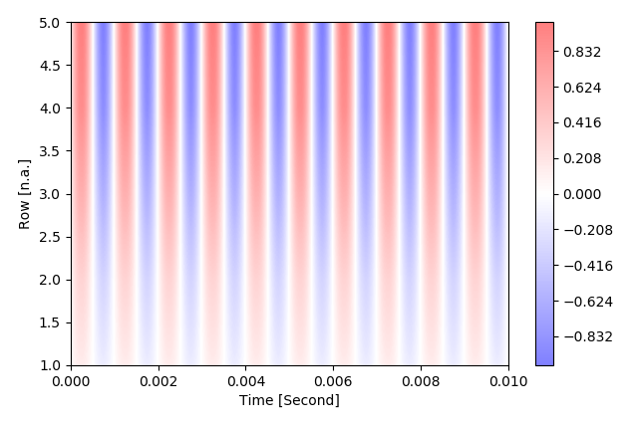
Image plot
plot: ‘image’
Image representation of 2D data in coordinate (like otv in FLIPP)
colorscale, range can be set

Slide 26
Plotting: plot ID
Plot concept:
Matplotlib subplot concept can be used to create multiple plots in figure
FLAP plot is an object with potentially multiple plots
Each FLAP plot has a PlotID
PlotID can be used to access/modify/overplot any existing plot
Plot function/method returns PlotID which stores:
Axes and location (figure.sublot) of plot
Plot options
Link to data
Advantages:
Prevents overplotting data with different coordinate/units (option Force to overplot)
Can overplot multi-plot data (e.g. complex signals)
Gives potential to refresh plot (e.g. when not all data are plot for speed, not implemented yet)
Can potentially save source of data, plotting options.
All subplots can be reached by PlotID.plt_axis_list[] → Matplotlib axes
Default plotID is always last plot
Default can be set with flap.set_plot()

Slide 27
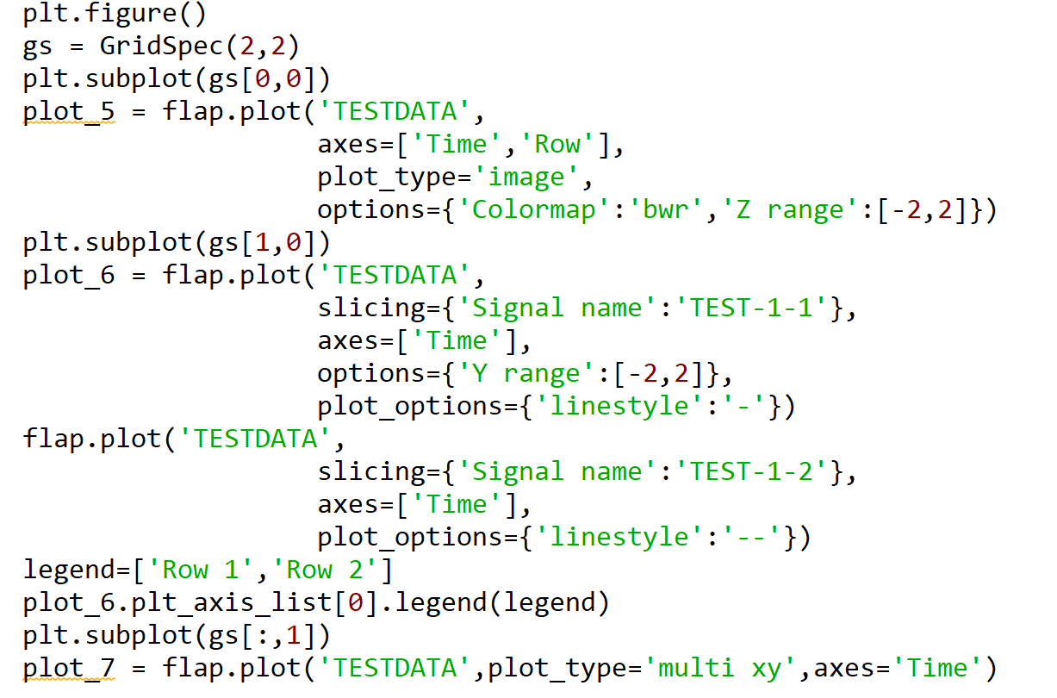
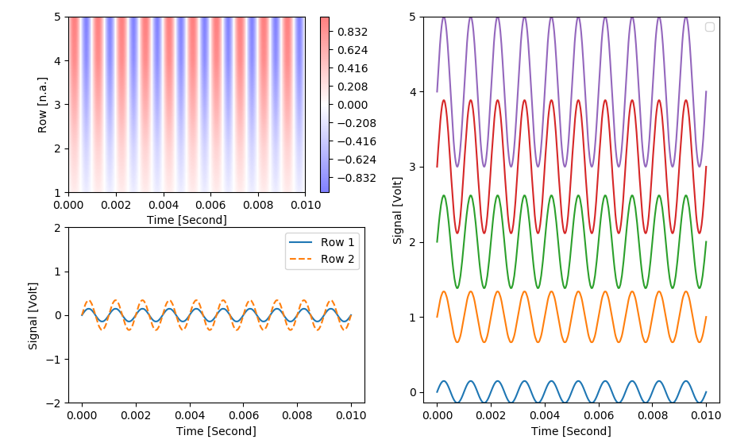
Plotting: examples from flap_tests.py

Slide 28
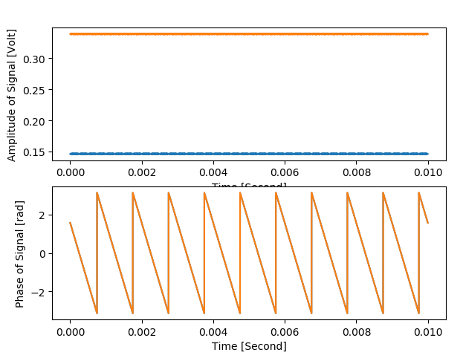
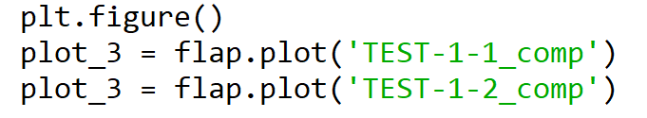
Plotting: examples from flap_tests.py
‘xy’ plot of complex signal results in two axes: real-imag or amp-phase
Automatic recognition of complex data
Horizontal axis is coupled for two axes: magnification works together

Slide 29
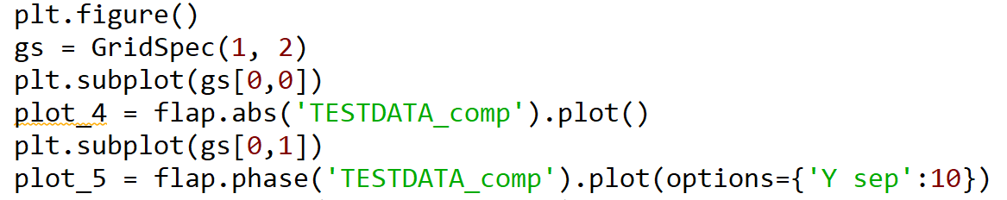
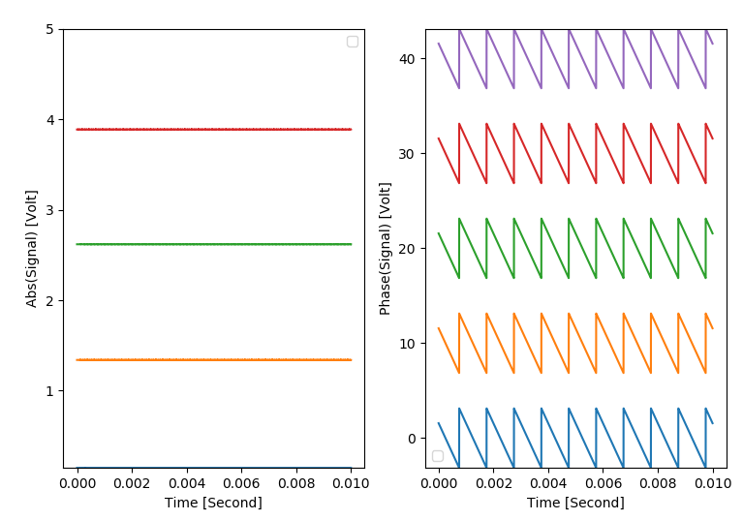
Plotting: examples from flap_tests.py
multi xy plot of complex data: amplitude and phase in one figure

